Slide 1
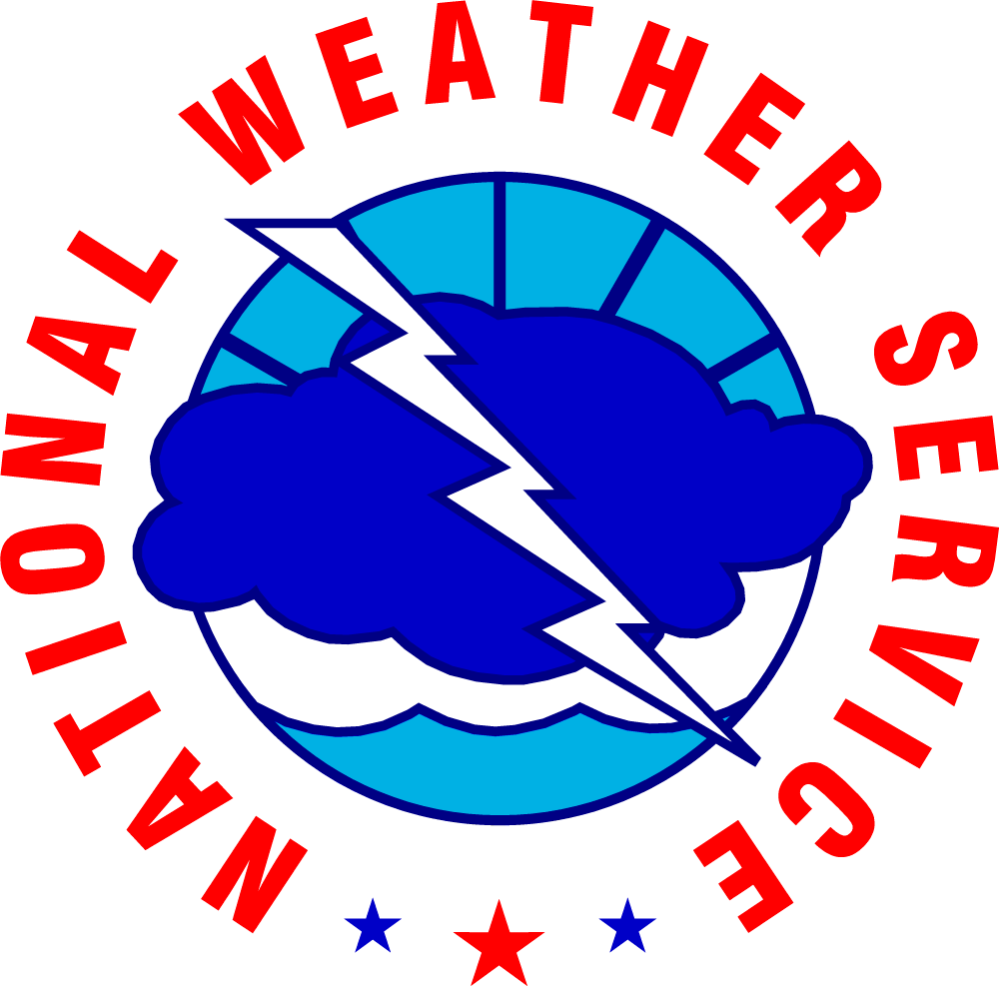
User Imagery from National Weather Service WFO Fairbanks
JPSS/GOES Satellite Proving Ground and Risk Reduction Summit
February 24-28, 2020
Melissa Kreller
Meteorologist In Charge
National Weather Service
Fairbanks Weather Forecast Office

Slide 2
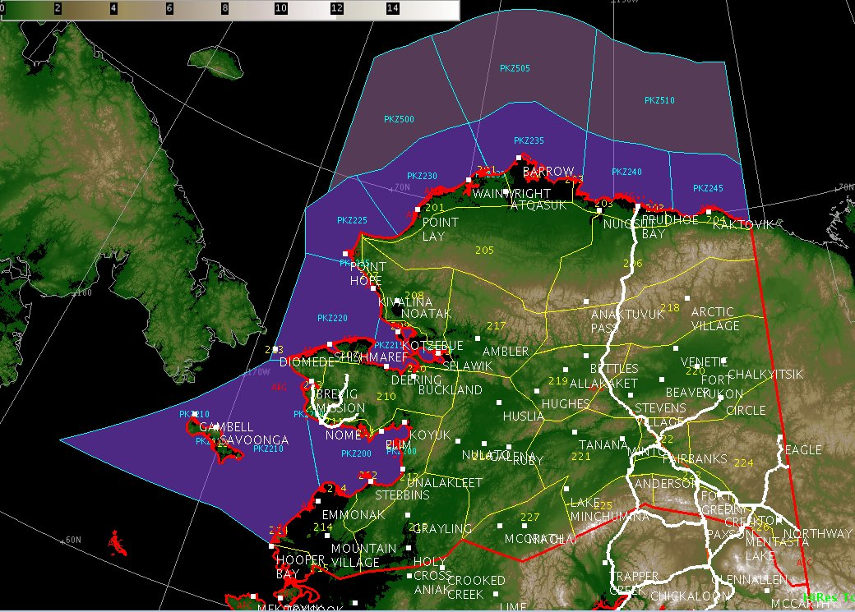
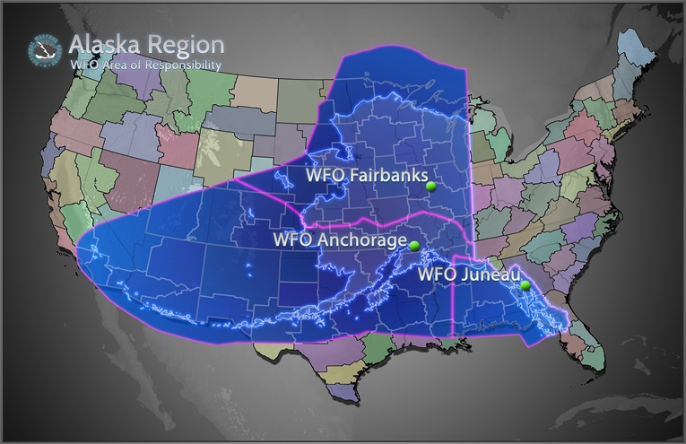
Overview
User Perspective on Various Satellite uses:
River Flooding
Fire Weather
Convective Weather
Sea Ice
Winter Weather (Temperatures, Wind)
Aviation
Volcanic Ash
Challenges
73.6N
Utqiaġvik(Barrow)
71.3N 156.8W
Kotzebue
64.8N 147.7W
Nome
Fairbanks
178.8W
McGrath
NWS Alaska Region forecast area of responsibility (AOR)
Notes:
Although there are many challenges forecasting in Alaska Region from model performance with sea ice interaction, trying to force a diurnal trend when quite honestly in the winter when we get almost 3.5 hr of daylight, communication with our native Alaskan communities., etc. However, the critical is data observation limitations. It’s all about framework and understanding this lack of information and why satellite data is so critical in Alaska, such as taking all of New York State and only having 1 observation data point or all of NE coast with zero radar.
Arctic Circle 66N

Slide 3
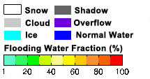
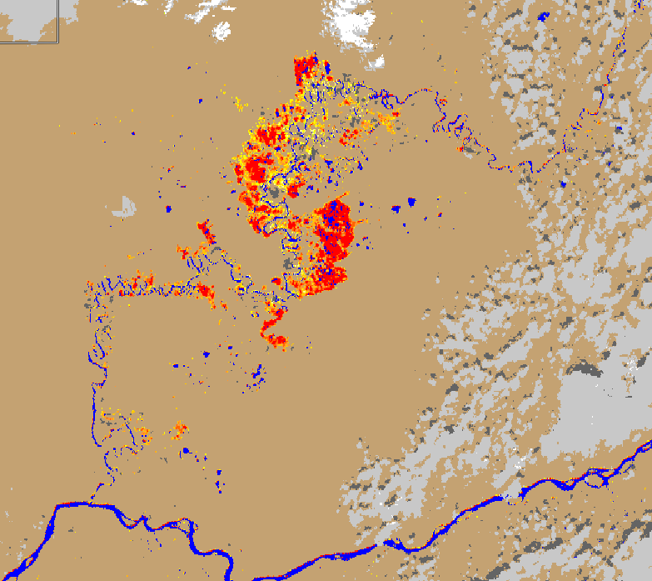
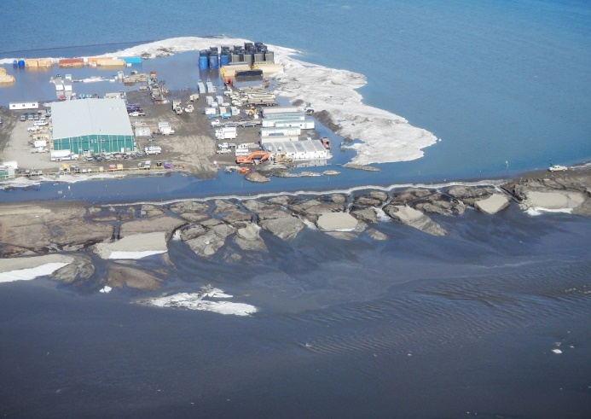
River Flooding
Decision Support Services (DSS) provided weekly April – June:
Yukon River Communities
Sag River (North Slope Borough EMs)
Koyukuk River
Sagavanirktok (Sag) River
on the Dalton Highway
Huslia
SNPP VIIRS Areal Flood Extent product on June, 2019
Koyukuk River
Koyukuk
SNPP VIIRS River Ice and Areal Flood Extent Products on April 8, 2015 at 12:15 ADT
Yukon River
Galena
Notes:
June 2019 Koyukuk River High water from snow melt continues on the Koyukuk River near Huslia.
Elevated river levels will continue this Week. Expect erosion to persist until River levels fall significantly.
River banks will remain unstable Use caution even as river levels Recede.

Slide 4
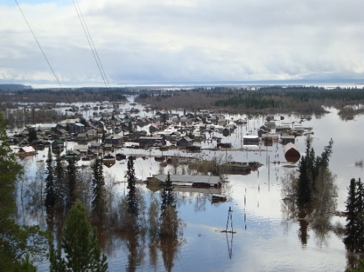
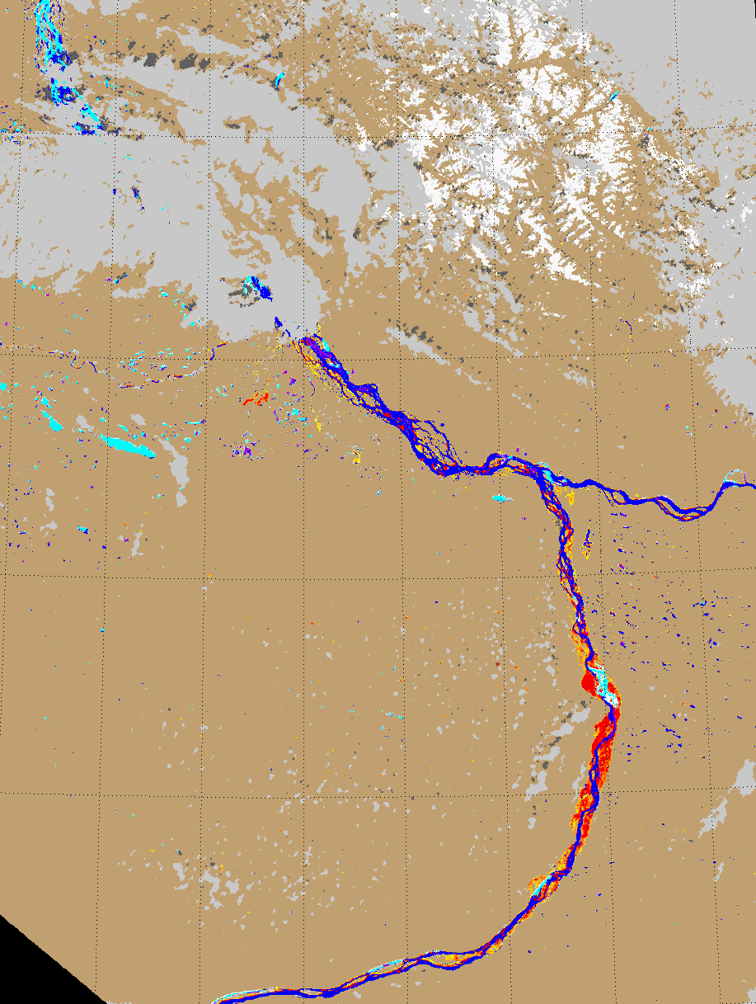
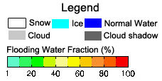
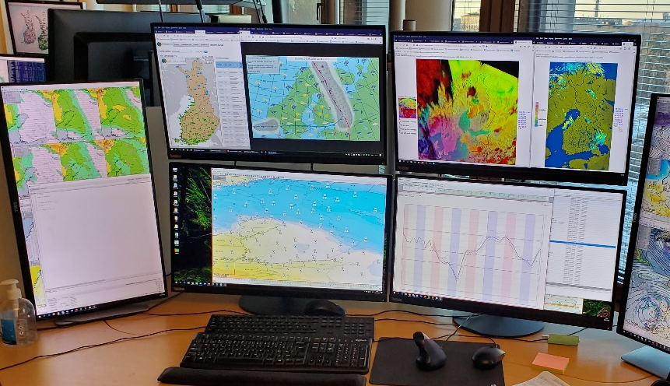
International Best Practices
Nighttime Microphysics
Yakutia, Russia
May 2013
US Department funded Peer to Peer Program – WCM participated
Ice Jam
Edeytsy
Village
Finnish Meteorological Institute (FMI) Forecaster Exchange Program
January 2020
Lead Forecaster from WFO Fairbanks visited and shared best practices with Finland (Suomi)
Yakutsk
SNPP VIIRS Areal Flood Extent Product at 0134Z on May 17, 2013
Photos courtesy Namsky District, Yakutia, Russia
Notes:
The ice and flood products can be used beyond Alaska and North America. The NWS Fairbanks is currently partaking in the US State Department funded Peer-to-Peer program on a project sharing best practices between the US and Russia on topics such as forecasting, preparedness, monitoring, mitigation, response and recovery. The communities of Galena, Alaska and Edyetsy, Russia both experienced devastating ice jam floods in May 2013. The WFO Fairbanks SH was involved with an exchange to Siberia in Nov 2015 with a team of physical and social scientists and community members. A similar Russian team will visit Alaska in March 2016. The river ice and flood product was shared with the Russian’s as a best practice being developed in the USA.
Involved in Peer-Peer and Edyetsy and Galena being compared and sharing best practices. Russia is very interested in utilized this product to help identify flooding detection and river-ice.

Slide 5
Fire Weather
GOES 17 Day Cloud Phase Distinction RGB
on June 30, 2019 at 0120z
at 0105z-0120z timelapse
Notes:
One is from this summer with the GOES17 Day Cloud Phase Distinction RGB showing a variety of things, but primarily the smoke and associated pyrocu from wildfires.

Slide 6
Fire Weather
NPP-NOAA 20 Fire Temperature RGB (3.9um, 2.25um, 1.61um) on May 1, 2019 at 2120z
GOES 17 Fire Temperature RGB (3.9um, 2.25um, 1.61um) on May 1, 2019 at 2120z

Slide 7
Fire Weather/Air Quality

Slide 8
Fire Weather/Air Quality

Slide 9
Fire Weather
Daily DSS briefing calls with Alaska Fire Service
2 IMETs deployed, 1 IMET at WFO Fairbanks
Fire Weather Spots (FWS) scheduled 4am-7am daily

Slide 10
Fire Weather
3.7 um BT, 2.3 um, 1.6 um
(Fire Temperature RGB)
4.0 um BT
(Fire Band)
0.64 um
3.7 um BT
SNPP VIRRS 4 panel imagery on June 30, 2017 at 2134z. Campbell River Wildfire next to Yukon, Canada.
Notes:
Campbell River wildfire near the border Yukon, Canada and Rat Creek wildfire northeast of Chalyitsik.

Slide 11
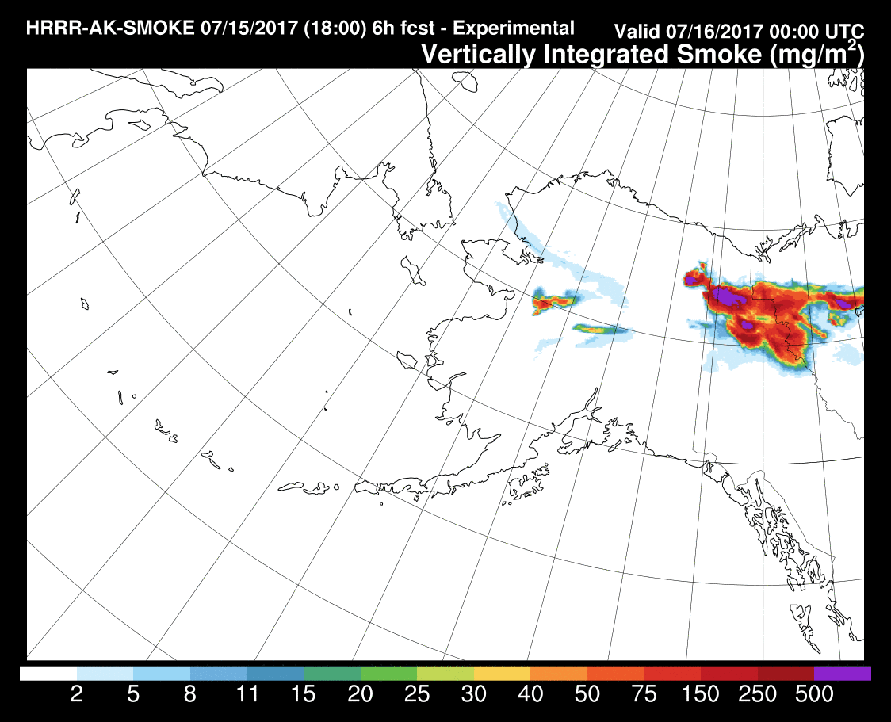
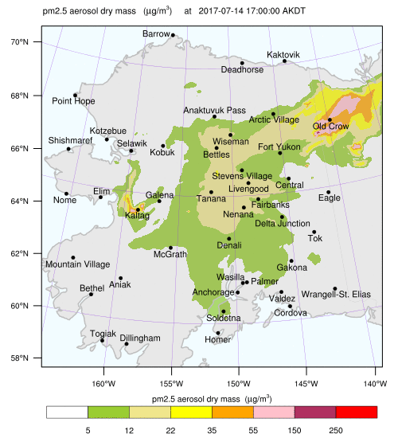
Fire Weather
SNPP VIRRS 0.64 um on June 30, 2017 at 2134z
GFE Smoke Grid Element
GFE Weather Grid Element
HRRR AK Smoke Vertical Integration June 30, 2017 F24hr
UAF AK Smoke Vertical Integration June 30, 2017 F24hr

Slide 12
Convective Weather
Thunderstorm Umiat
SNPP-NOAA 20 Natural Fire Color RGB on May 28, 2019
Notes:
These are from the VIIRS NaturalFireColor under the RGB and Multispectral Composits in the Sat menu.
Thunderstorm near Umiat, looks like a Halibut.
SDB May 28, 2019

Slide 13
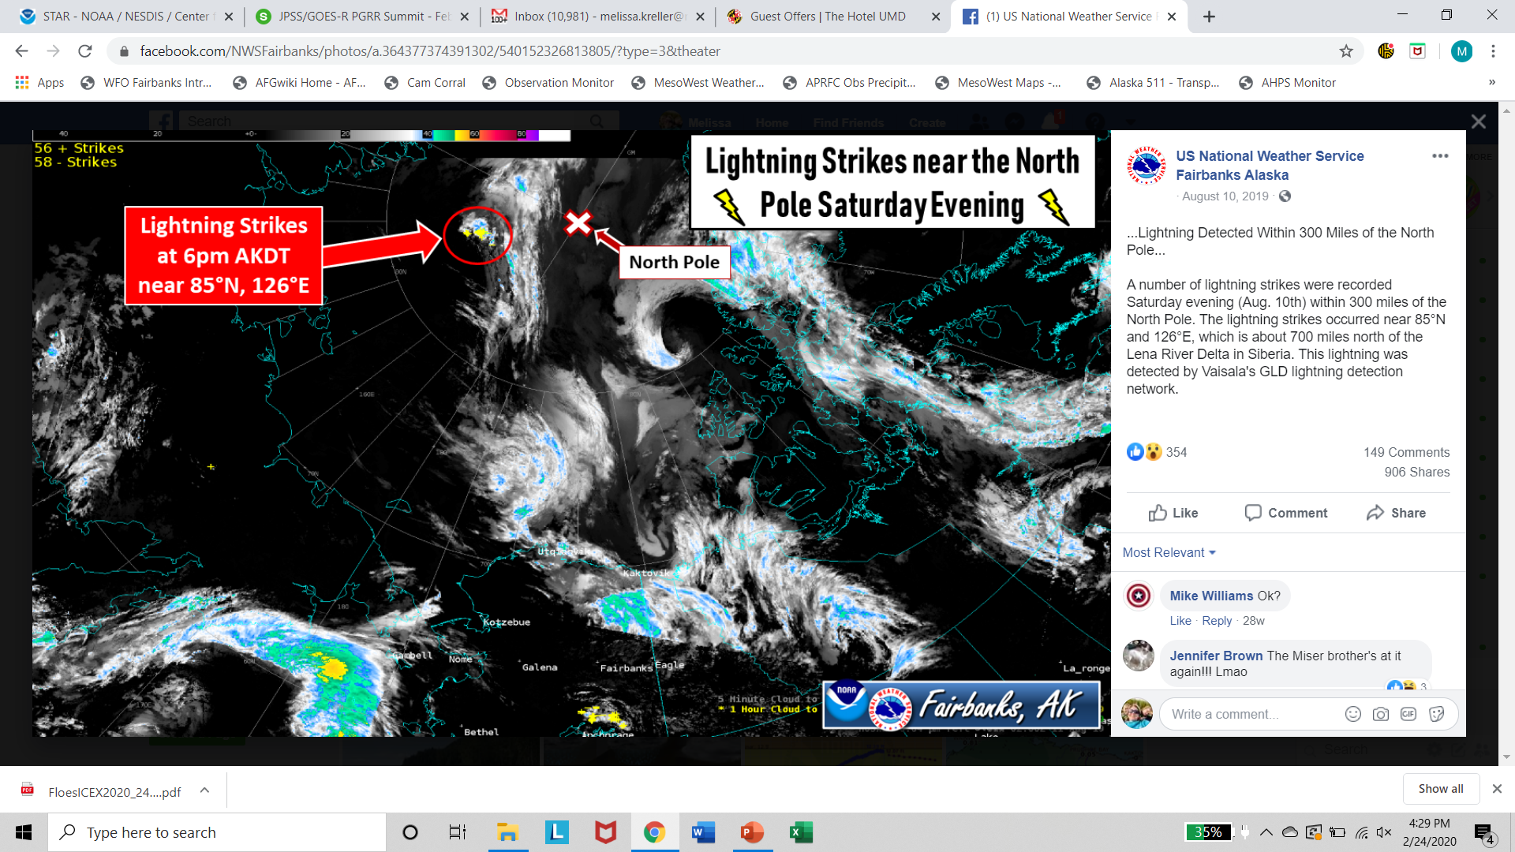
Convective Weather
Thunderstorm Umiat

Slide 14
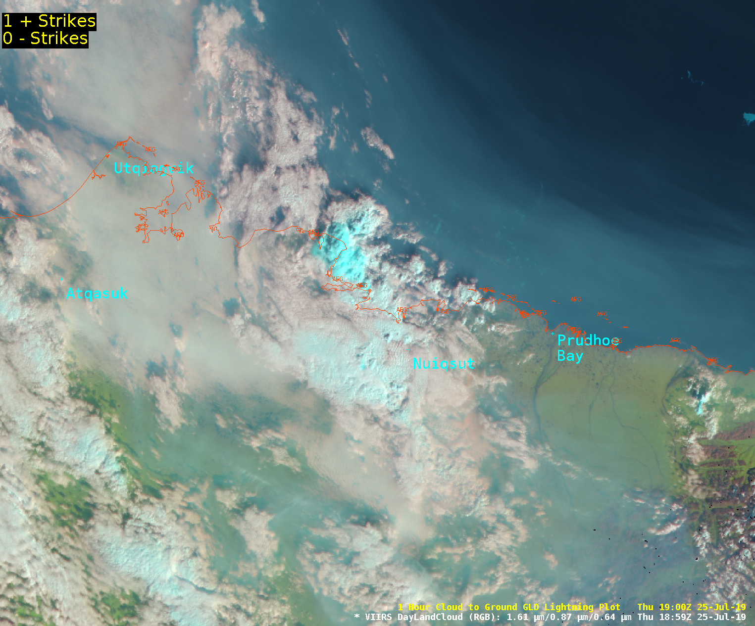
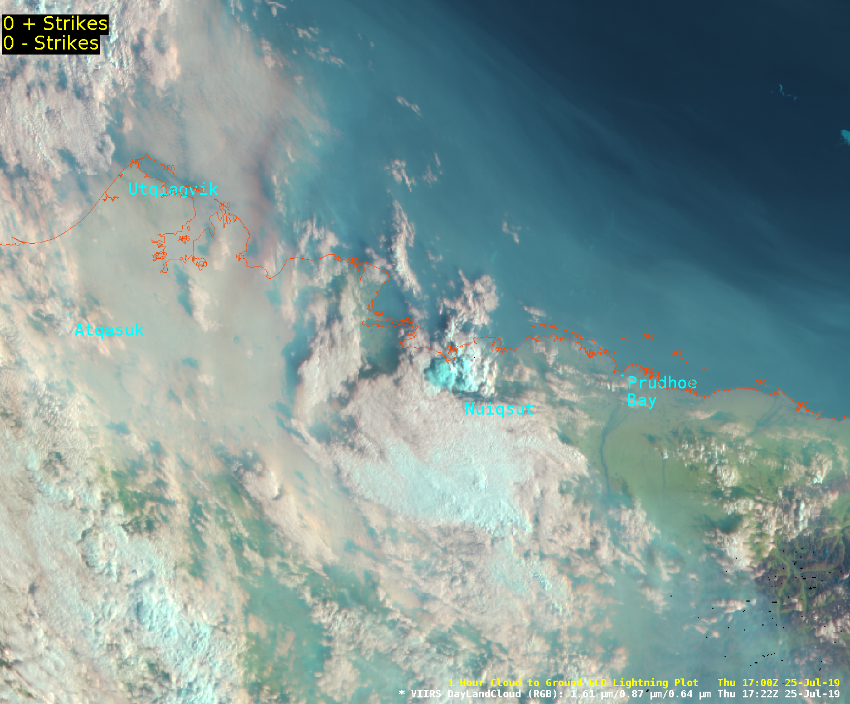
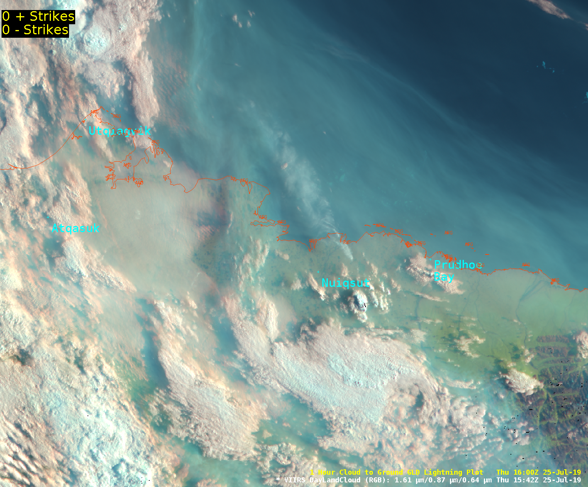
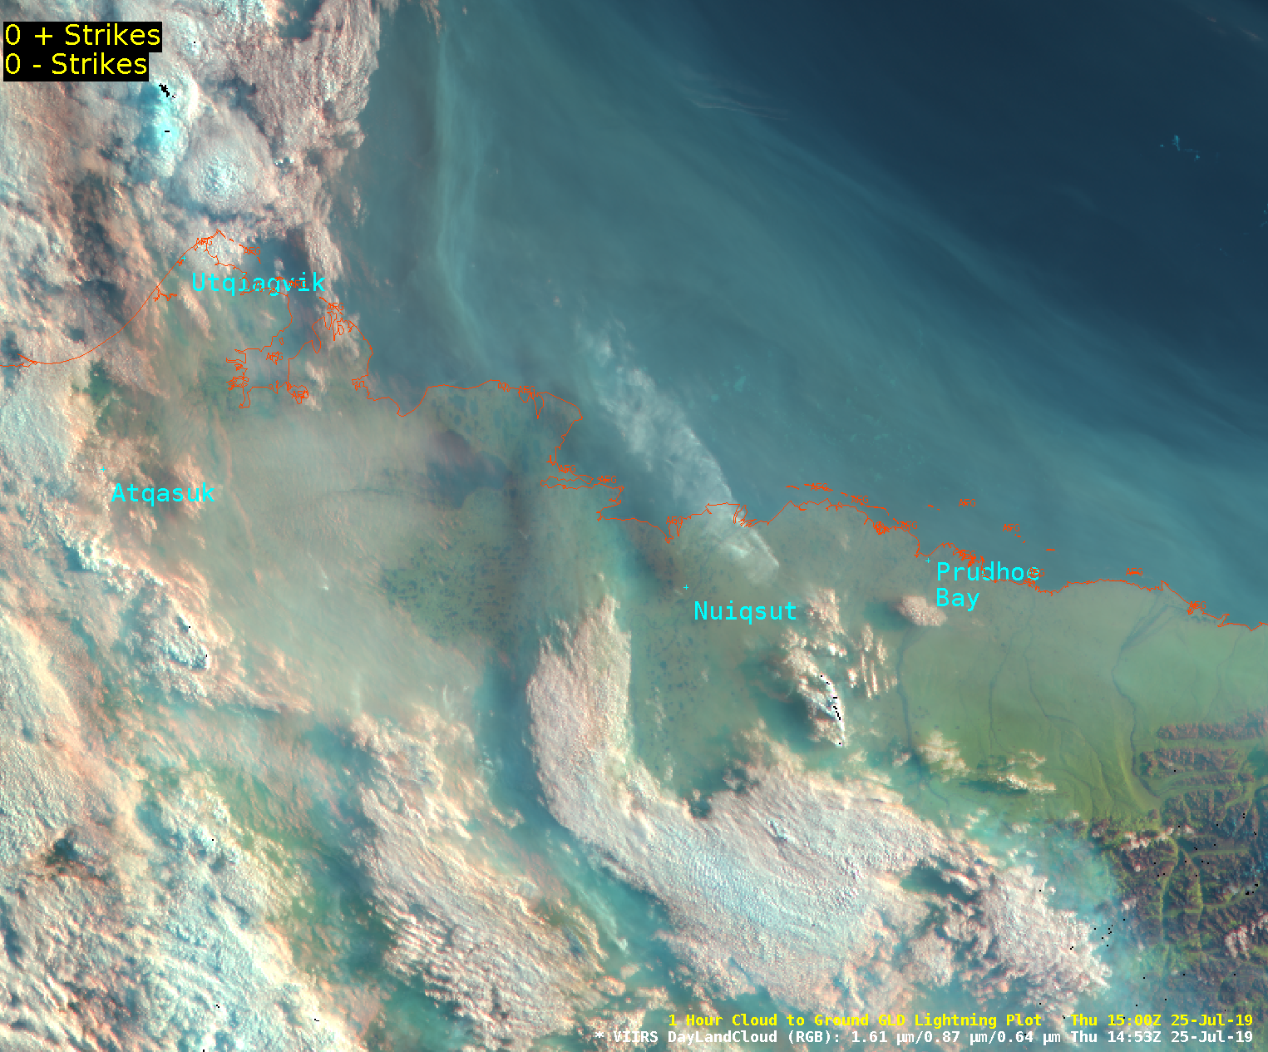
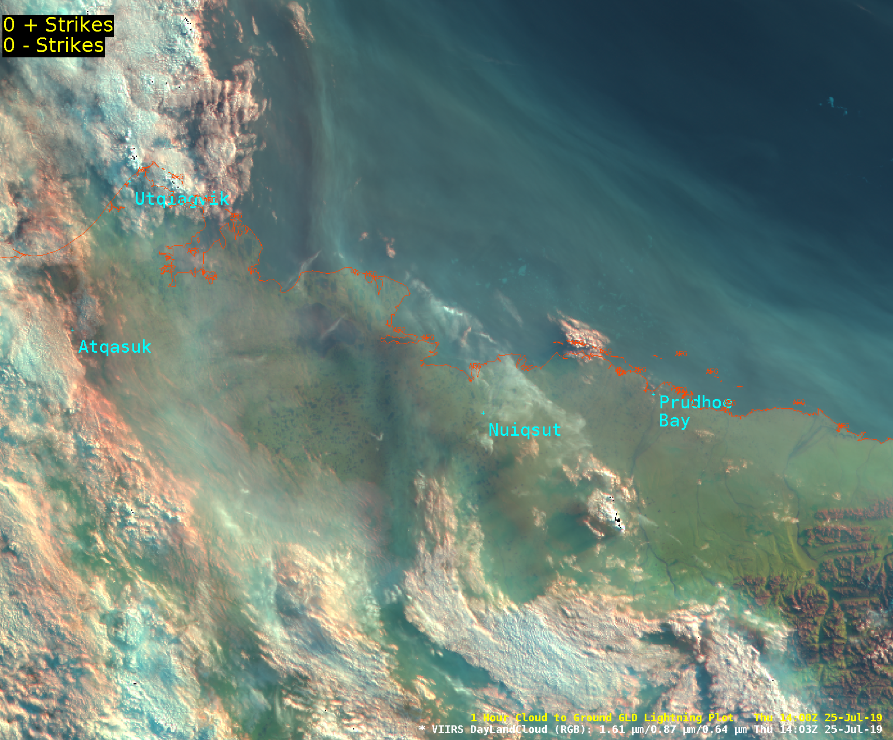
Convective Weather
S-band
Radar
Radar Coverage
SNPP-NOAA 20 DayLand Cloud RGB (1.61um, 0.87um and 0.64um)
on July 25, 2019 times 1403z-1947z

Slide 15
Winter Weather
SNPP-NOAA 20 Day Night Band September 6, 2018 at 1144z

Slide 16
Winter Weather: Snow

Slide 17
Winter: Cold Temperatures
Point Lay: -51F
Kaktovik: -35F
Deadhorse: -45F
Toolkik Station: -51F
Selawik: -52F
GOES 17 IR

Slide 18
Winter: Cold Temperatures
SNPP-NOAA 20 IR on December 27, 2019

Slide 19
Winter: Blowing Snow
SNPP-NOAA 20 IR on November 8, 2019 at 1955z
Stratus
Blowing Snow
Stratus
Notes:
The blue area is winds blowing across the area under clear skies. The green areas are stratus. This is some of the available imagery from NOAA20. November 8, 2019

Slide 20
Aurora
SNPP Day Night Band on January 22, 2019

Slide 21
Aviation: Volcanic Ash
SNPP VIIRS March 28, 2016 Pavlof Eruption at 1321Z
11um-12um
10.8 um BT
12 um BT
DNB
Notes:
n March 27, 2016, Alaska's Pavlof Volcano began erupting, sending ash over 20,000 feet into the sky.
Located on Alaska's Alaskan Peninsula, the volcano sits about 600 miles southwest of Anchorage. The U.S. Geological Survey (USGS) reports that the volcano is about 4.4 miles in diameter and has had 40 known eruptions.
Reported to be one of the most consistently active volcanoes in the Aleutian arc, Pavloflast erupted in November 2014.

Slide 22
Aviation: Volcanic Ash
SNPP VIIRS May 28, 2017 at 23321Z
Bogoslof
SNPP VIIRS January 31, 2017 at 1150Z
8.6 um BT
Bogoslof
Volcanic Ash RGB
Notes:
May 28, 2017 at 2332z: The Alaska Volcano Observatory says Bogoslof (BOH-gohs-lawf) Volcano in the Aleutian Islands erupted at 2:16 p.m. Sunday and sent a cloud of ash at least 35,000 feet (10,668 meters) high. The eruption lasted 55 minutes. The image is from eruption of Bogoslof Volcano from VIIRS longwave IR band. Monitoring by the Alaska Aviation Weather Unit, Center Weather Service Unit and Volcanic Ash Advisory Center (VAAC) partners with the Alaska Volcano Observatory.
Unalaska Island reported seeing a large white-gray mushroom cloud form over Bogoslof, with ash falling out to the west.
For the January 31, 2017 at 1150Z: The SNPP VIIRS Volanci Ash with the SO2 cloud identified as the light green coloring south of the Aleutian Islands.

Slide 23
Aviation: Low Clouds
Low Cloud
Utqiagvik
GOES 17 SO2 RGB (6.95-7.34um, 10.35-8.50um, 10.35um) on January 30, 2020 at 1750z
Notes:
New tool like to use for high arctic low cloud cover for 3-5 mile VIS and low ceiling heights

Slide 24
Aviation: Fog
Salcha and Goodpaster River Basin
Copper River Basin
SNPP-NOAA 20 [SPoRT] 24-hr Nighttime Microphysics RGB on October 31, 2019 at 1407z
Notes:
Nice clear satellite image with fog in the Salcha, Goodpaster, and Copper river basins. Status to the west can be seen and moved over the Fairbanks area around noon.
October 31, 2018 SDB

Slide 25
Sea Ice
Sea Ice cracking under strong east wind
Prudhoe Bay
Kaktovik
Canada
Alaska
Legacy IR SNPP and NOAA-20 on December 9, 2019 from 12z-20z timelapse
Notes:
Shortwave IR polar orbiting imagery showing sea ice east of Kaktovik cracking under strong east winds.

Slide 26
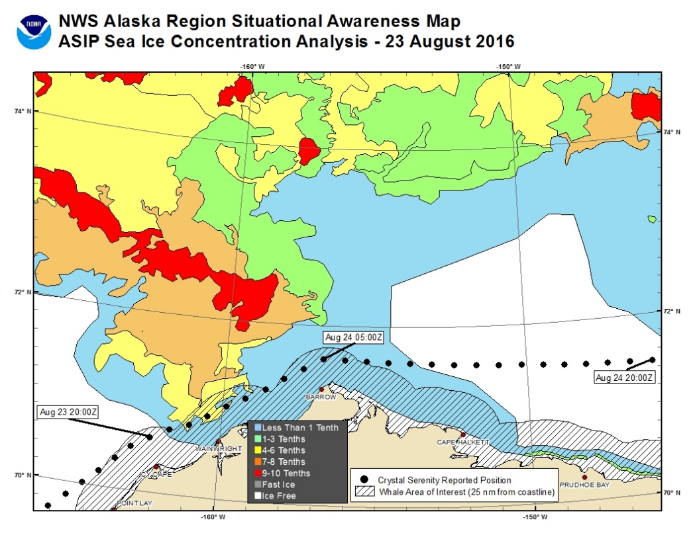
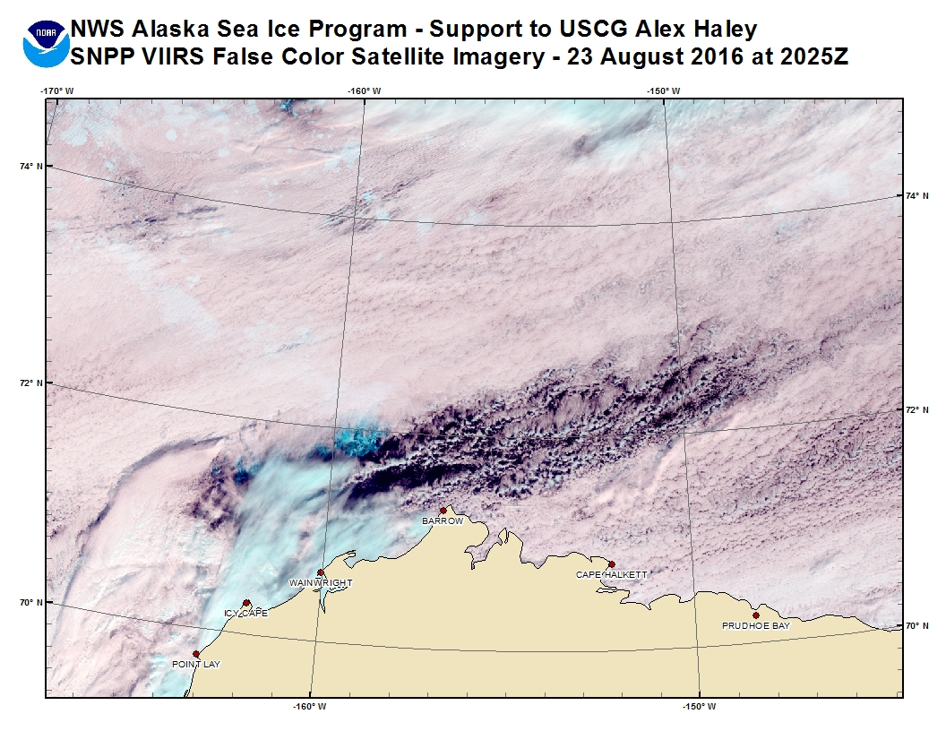
Sea Ice and Winds
Crystal Serenity
August 23, 2016
Crystal Serenity Port Web Camera
Decision Support Services for USCG for Cruise Ships:
Daily briefing reports to US Coast Guard Cutters: Alex Haley, Healy, and Stratton
Reports included NWS ASIP Sea Ice analysis, Fairbanks WFO wind/temp forecast and SNPP VIIRS satellite imagery
Notes:
August 2016 active year in providing Decision Support Services (DSS) to USCG for cruises across the Northwest Passage. Crystal Serenity and L’Austral. Earlier in season there was the French LeSoleal smaller sized cruise vessel.
With less sea ice there opens a new support for cruise ships and traffic. NWS Alaska Region provided during same time provided forecast to the Arctic Chinook Exercise involving Alaska Department Homeland Security and Emergency Management (DHSEM) and other agencies. What would occur if had to support help distress from cruise ship (moving people off ship, facilities, etc).

Slide 27
Aviation: US Navy ICEX
US Navy ICEX 2016 and 2018 Exercise: Collaborative Decision Support Services (DSS) for Aviation and Sea Ice
US Navy ICEX 2018 Exercise: WFO Fairbanks providing daily DSS briefings February 25th - March 25th, 2018
Notes:
2016: All of the satellite imagery ties into every day mission of the NWS Fairbanks and specifically into Decision Support Services (DSS). Camp Sargo ICEX 2016 -- due to unsafe conditions at the ice camp had to demobilize.
2018: WFO Fairbanks has been providing operational support for the 2018 US Navy Ice Exercise (ICEX) since Sunday Feb 25th and will continue through Mar 25th. Operations for the ice camp will be based out of Deadhorse and WFO support will be focused on the Deadhorse (PASC) TAF and any weather impacts at Deadhorse. Fleet Weather Center-Norfolk (FWC-N) will be providing aviation weather for the ice camp.

Slide 28
Aviation: US Navy ICEX 2020
AVHRR Satellite Data with Heights by NWS AR
US Navy ICEX 2020 Exercise: WFO Fairbanks (briefing TAF Deadhorse) and Alaska Aviation Weather Unit (AAWU) providing daily DSS briefings
February 20th - March 20th, 2019

Slide 29
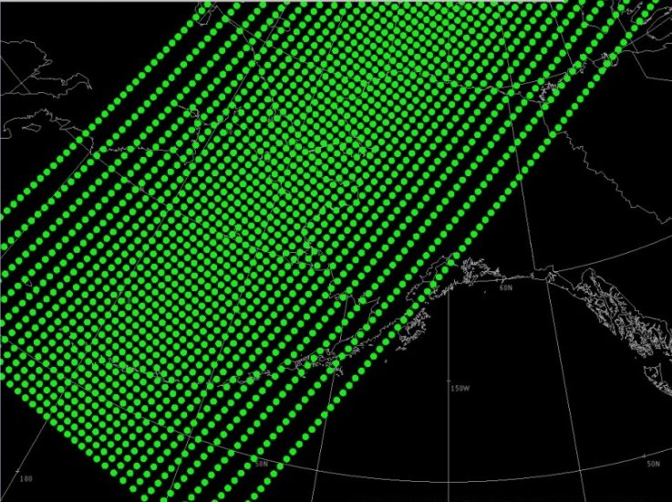
NUCAPS
2016 Student Volunteer examine NUCAPS in convective season
Up to 2hr latency
2016 Alaska Aviation Weather Unit
Aviation hazards for Cold Air Aloft events and potential freezing fuel
2017 Recreational Climbing forecast - Denali
Used as temperature comparison for model verification
NUCAPS Temperature Cross-section
NUCAPS at 1341z on June 20, 2016
250 mb
-60F
SNPP IR 10.8um and NCAPS at 1400z
on December 9, 2016
Notes:
NWS Alaska Region only receiving the SNPP – trying to get IASI
CrIS – Cross track Infrared Sounder
ATMS - Advanced Technology Microwave Sounders
2014 Preliminary:
Soundings reasonably compared with upper air locations, so very useful for data sparse regions BUT need way to identify areas where satellite based sounding were poor quality (used satellite imagery with the dots)
Changed coloration dots to highlight green good, red poor, yellow hesitant
Large forecast area and very hard to click on each individual sounding location to view information
Recently developed way to view the soundings in product cross sections
Student Volunteer Project 2016: Penn State Undergraduate June 1st- July 29th
Examine utilization for severe and fire weather:
Compare model, NUCAPS and RAOB soundings
Examine indices such as CAPE, CIN, LI for convective behavior
Examine fire weather parameters (variation Haines ), lightning activity level
Results:
Latency issues
For Severe and Fire Weather indices – really need to modify the satellite based sounding in the lower levels, which currently a lot of work for forecasters

Slide 30
Cloud cover: street Clouds
Utqiagvik (Barrow)
Chukchi Sea
SNPP-NOAA 20 [SPoRT] Nighttime Microphysics RGB on November 23, 2019 at 1656z
Notes:
SDB Nov 23, 2018 Nice cloud streets pic! nice SPoRT nighttime

Slide 31
What is this?
Alaska Range
Mountain Shadows: Denali 20, 308 ft
SNPP-NOAA 20 Natural Color RGB on November 23, 2019 at 2012z
Notes:
Sweet image of the shadows of the Alaska Range on the Nov 23, 2018 SDB VIIRS Naturalcolor today. Awesome image. Scotty measured the shadow length - 43 miles. So about 8 times the height of the peak. Cool. thanks for sharing Scotty. E

Slide 32
User Perspective
Challenges
A TON of Satellite training required. Very grateful for those visited office for training and AWIPS help guides!!!
How to manage satellite imagery (data overload). Staff can get lost on the different types or new RGBs. Need to make decisions quickly and need satellite tools integrated and easy to understand.
NEED Direct Broadcast for Alaska due latency in products.
NUCAPS hard to examine individual soundings over large area, need to utilize gridded NUCAPS data.
AWIPS Thin Client issues with satellite (deployment or COOP situations)
Potential Development Ideas
Blowing snow detection?
Land changes, such as coastal erosion? With AK large coastline, can satellite detect coastal changes after flooding events for storm damage survey (or year to year)?

Slide 33
Cloud Cover: stratus
SNPP-NOAA 20 [SPoRT] 24-hr Nighttime Microphysics RGB on January 17, 2019 at 1940z
Notes:
nice VIIRS image of cold air stratus to the east. Jan 17, 2019

Slide 35
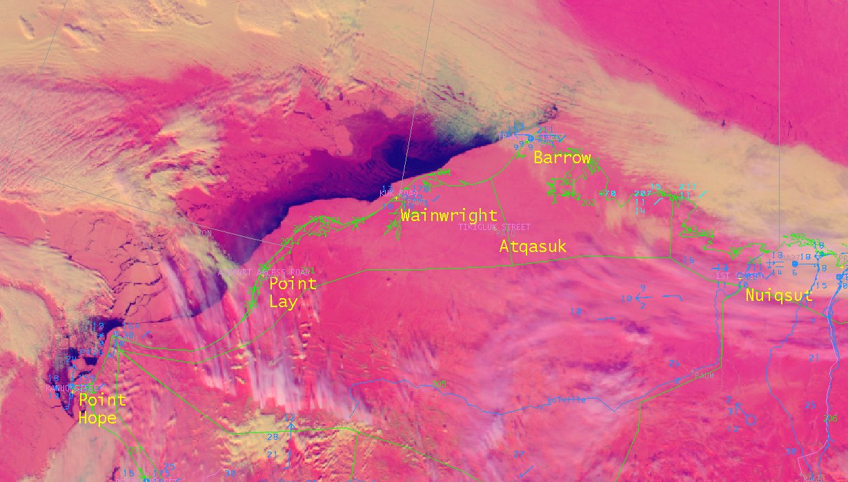
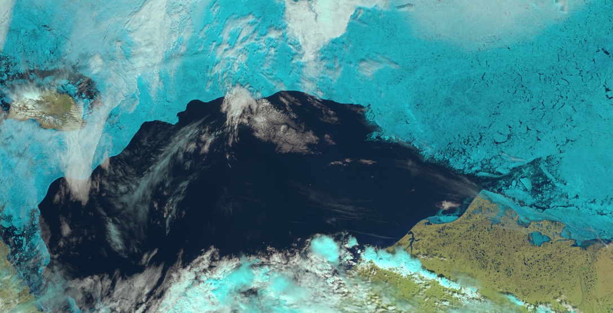
Sea Ice
SNPP VIIRS SnowCloud RGB on April 10, 2017 at 2332z
SNPP VIIRS Natural Color RGB on June 22, 2016 at 1312z
Notes:
This VIIRS falsecolor image helps ice analysts differentiate sea ice from clouds overhead. While this is a pretty clear example of what is sea ice and what is not, the falsecolor images make the sea ice visible even under higher coverage clouds. The resolution of the imagery not only helps us refine the position of the ice edge, but identify areas of varying concentration/type/thickness.
The SnowCloud RGB helps identify clouds and especially fog over the sea ice.

Slide 36
Sea Ice Movement
JPSS Constant Contrast on April 12, 2018 from 1800z – 2300z

Slide 37
Social Media

Slide 38
Social Media

Slide 39
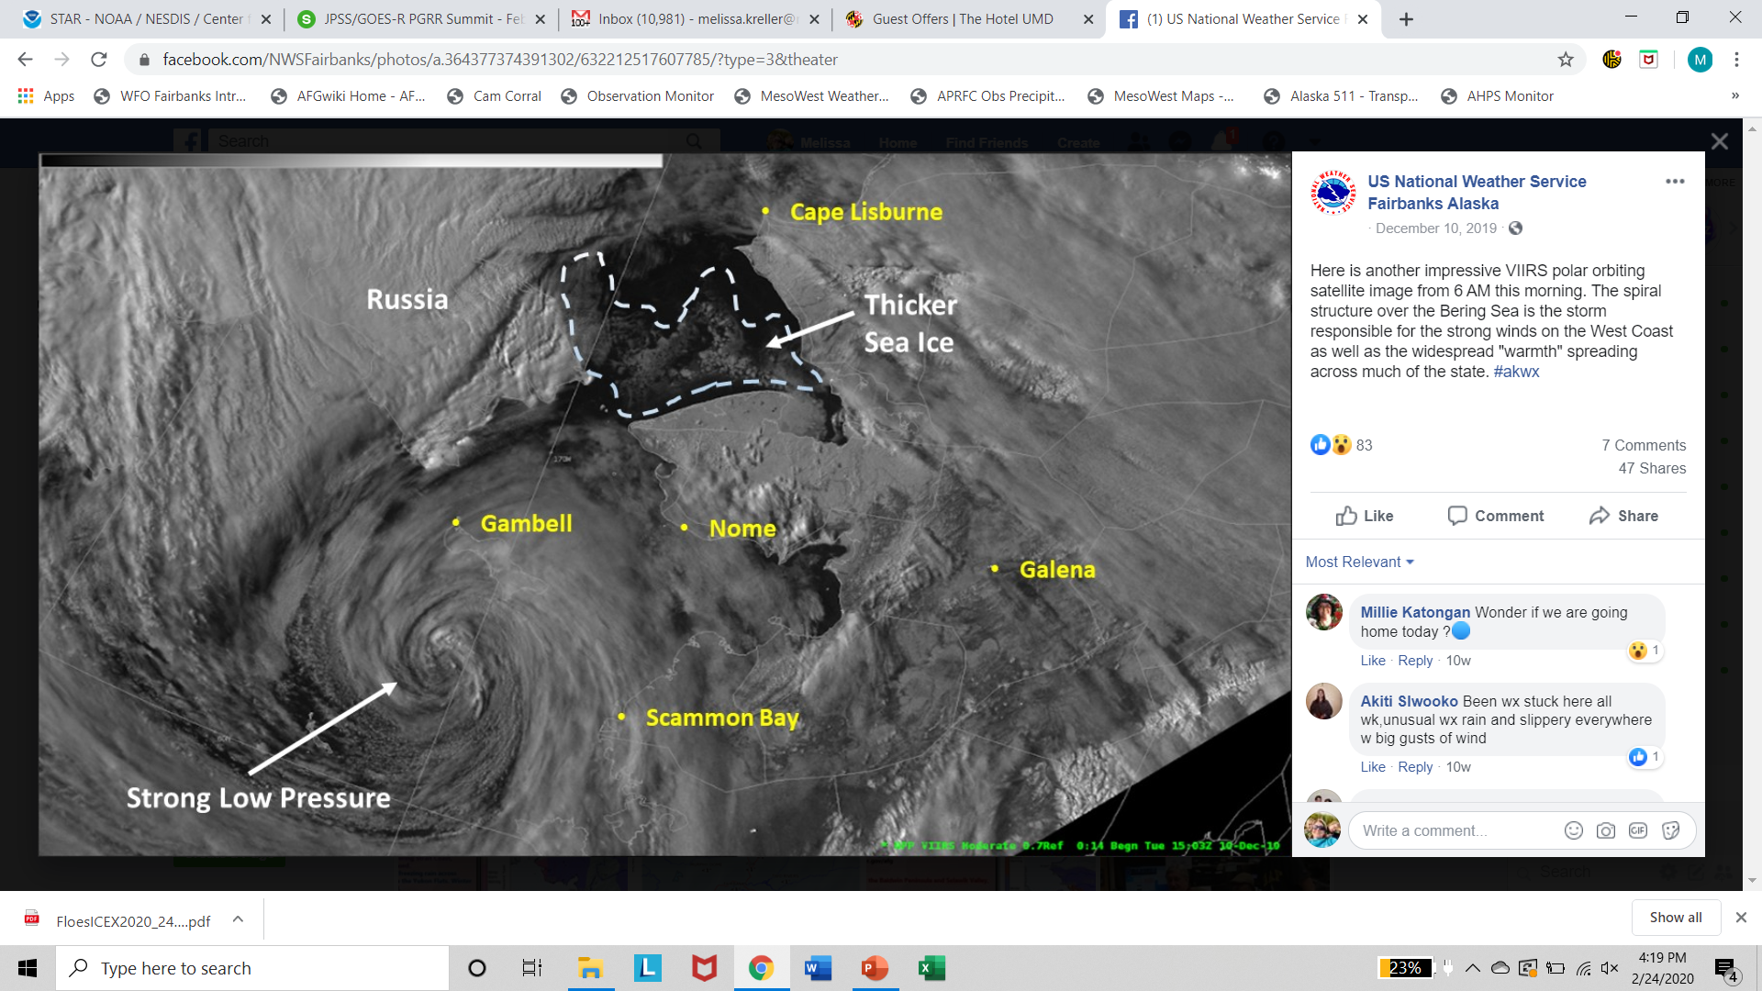
Social Media

