Slide 1
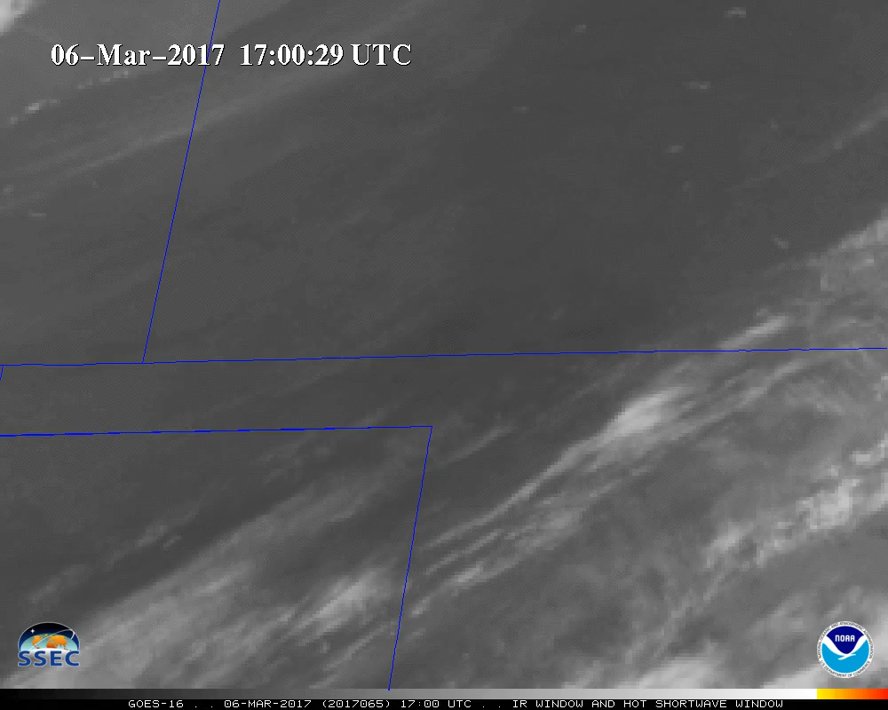

Imagery panel
Tim Schmit NOAA NESDIS STAR
Jun Li, Mat Gunshor, Jim Nelson, CIMSS
Madison, Wisconsin
Notes:
None of these images are operational.

Slide 2
GOES ABI Imagery
GOES Imagery is great and wonderful and useful, etc, etc.
  Be wary of (infrequent) artifacts
Lots of options for user workflows
  Individual imagery bands
  Band differences
  Composite imagery (RGB)
  Level 2 products
  Combination (and other information)
Rapid scan imagery isn’t just for watching rapid scan images!
  AMV’s, fires?, etc.

Slide 3
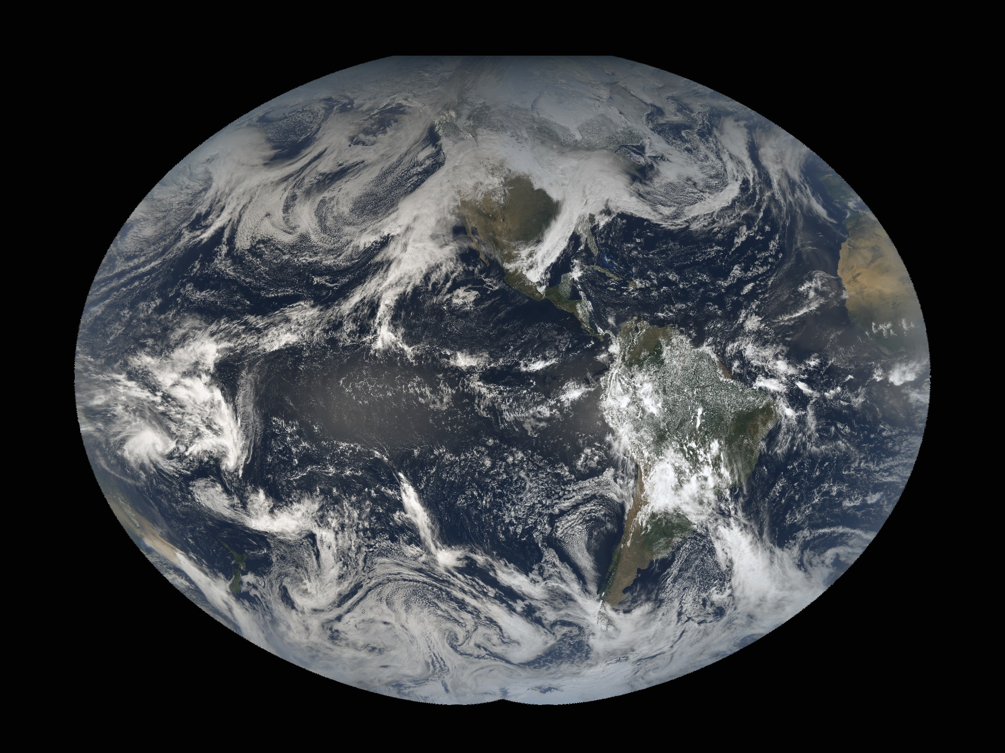
GOES-17 First Operational Day
ABI “Solar Noon”
GOES-West / GOES-East
Mollweide Projection Composite February 12, 2019
Credit Rick Kohrs, SSEC

Slide 4
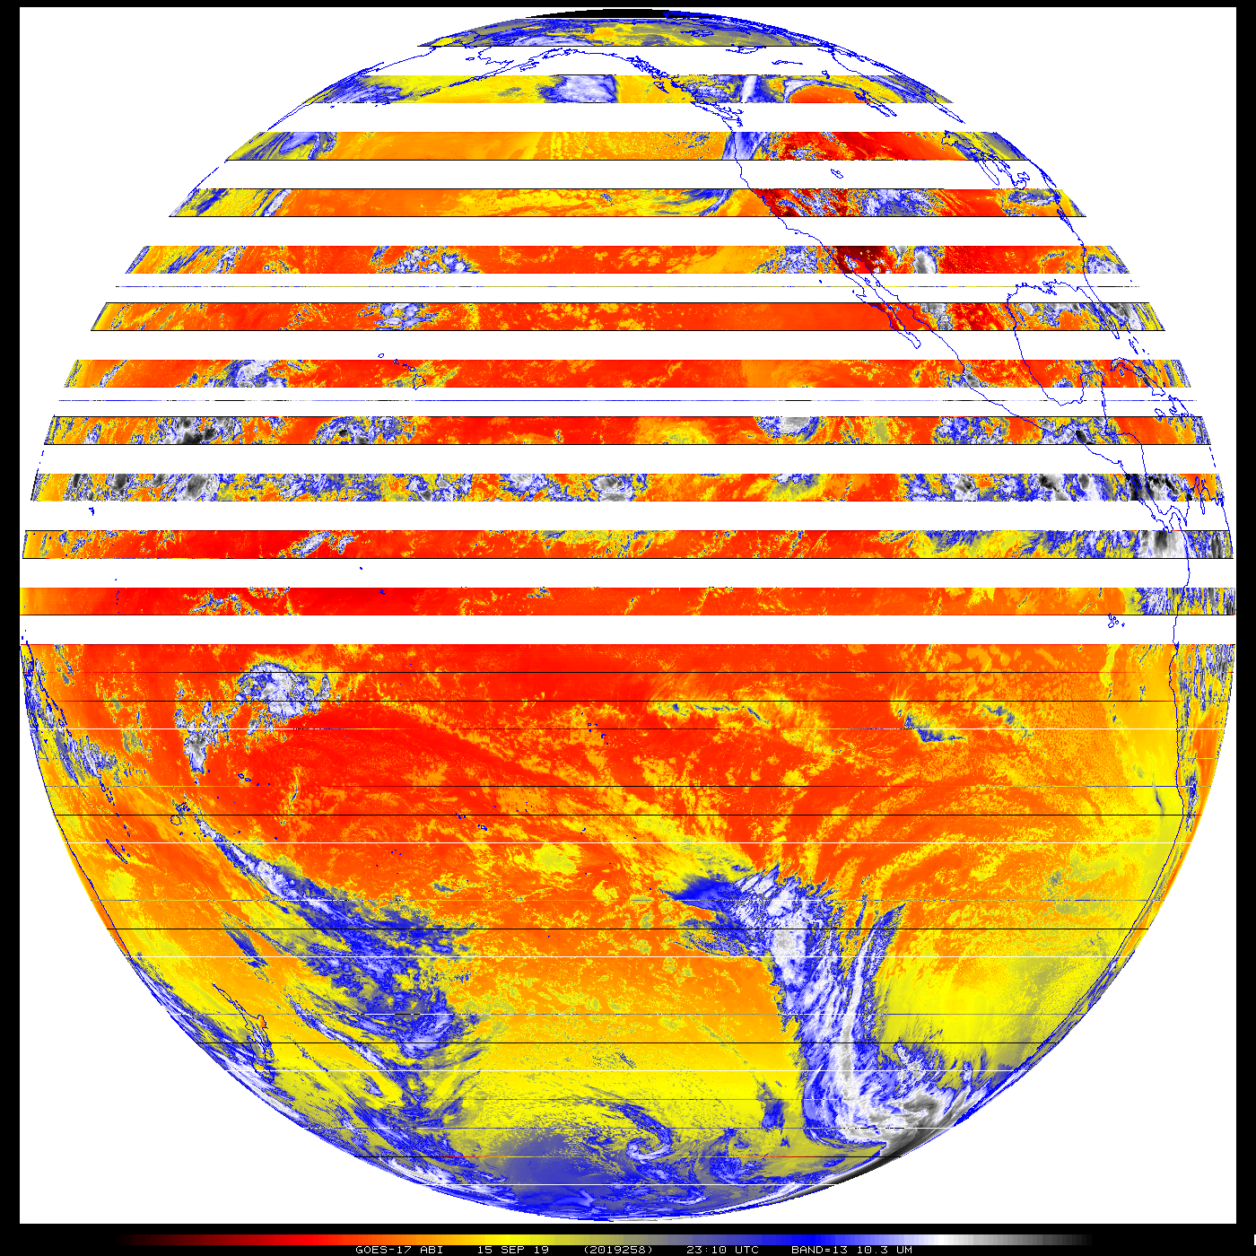
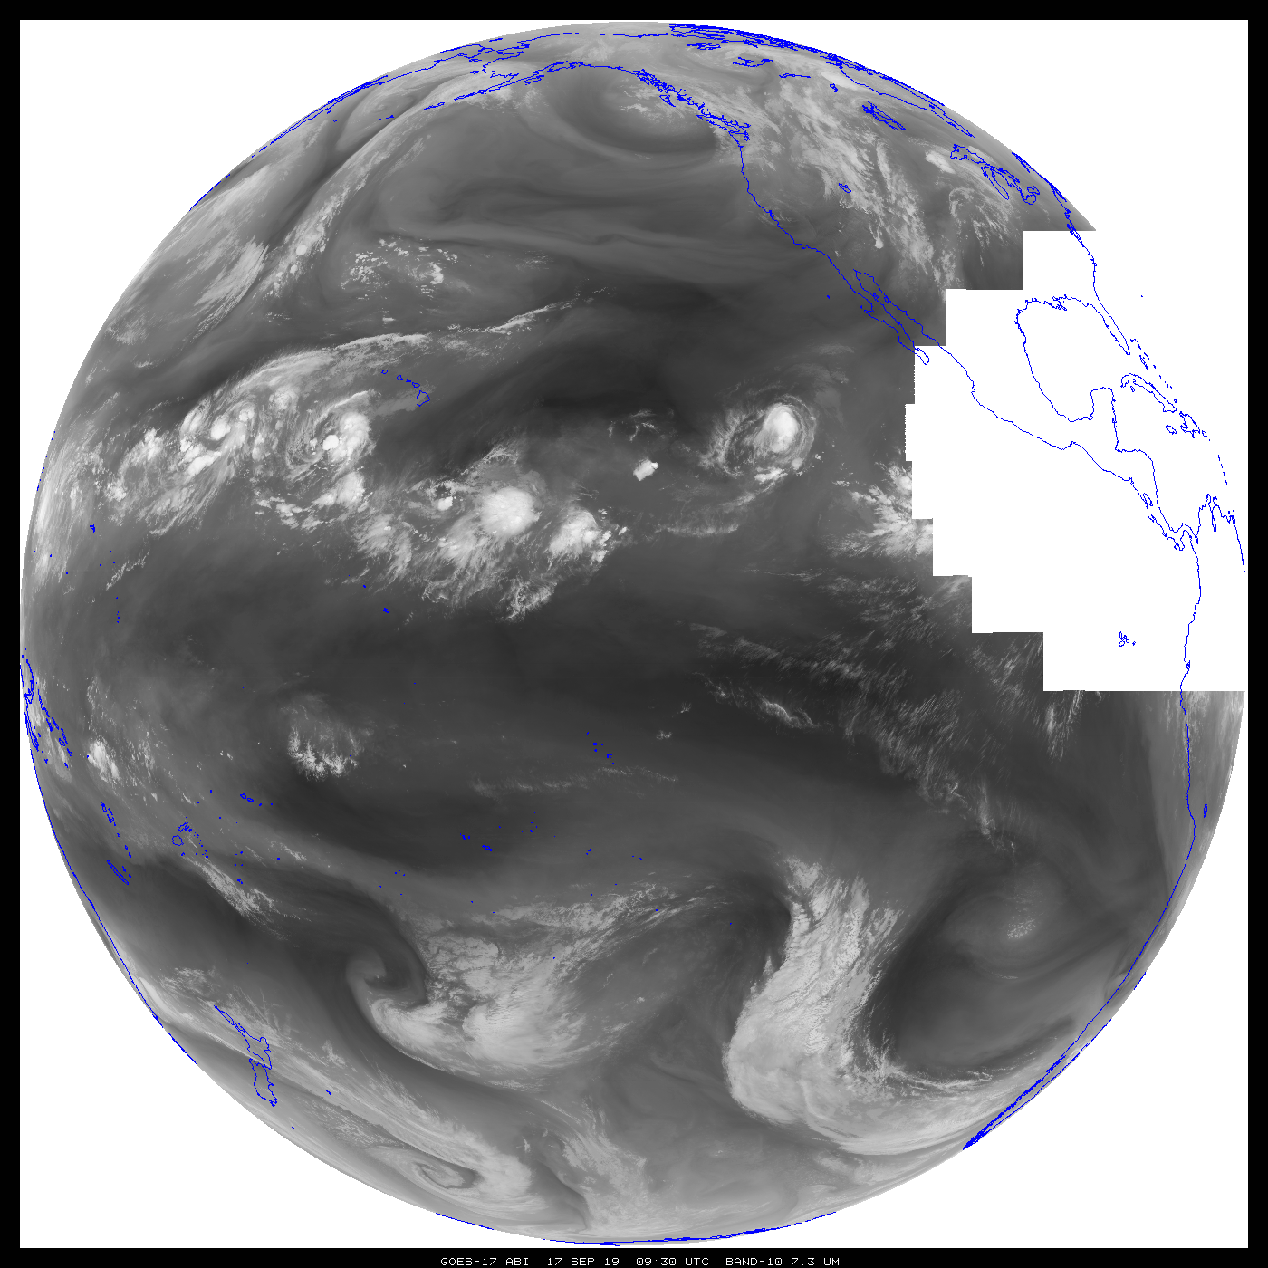
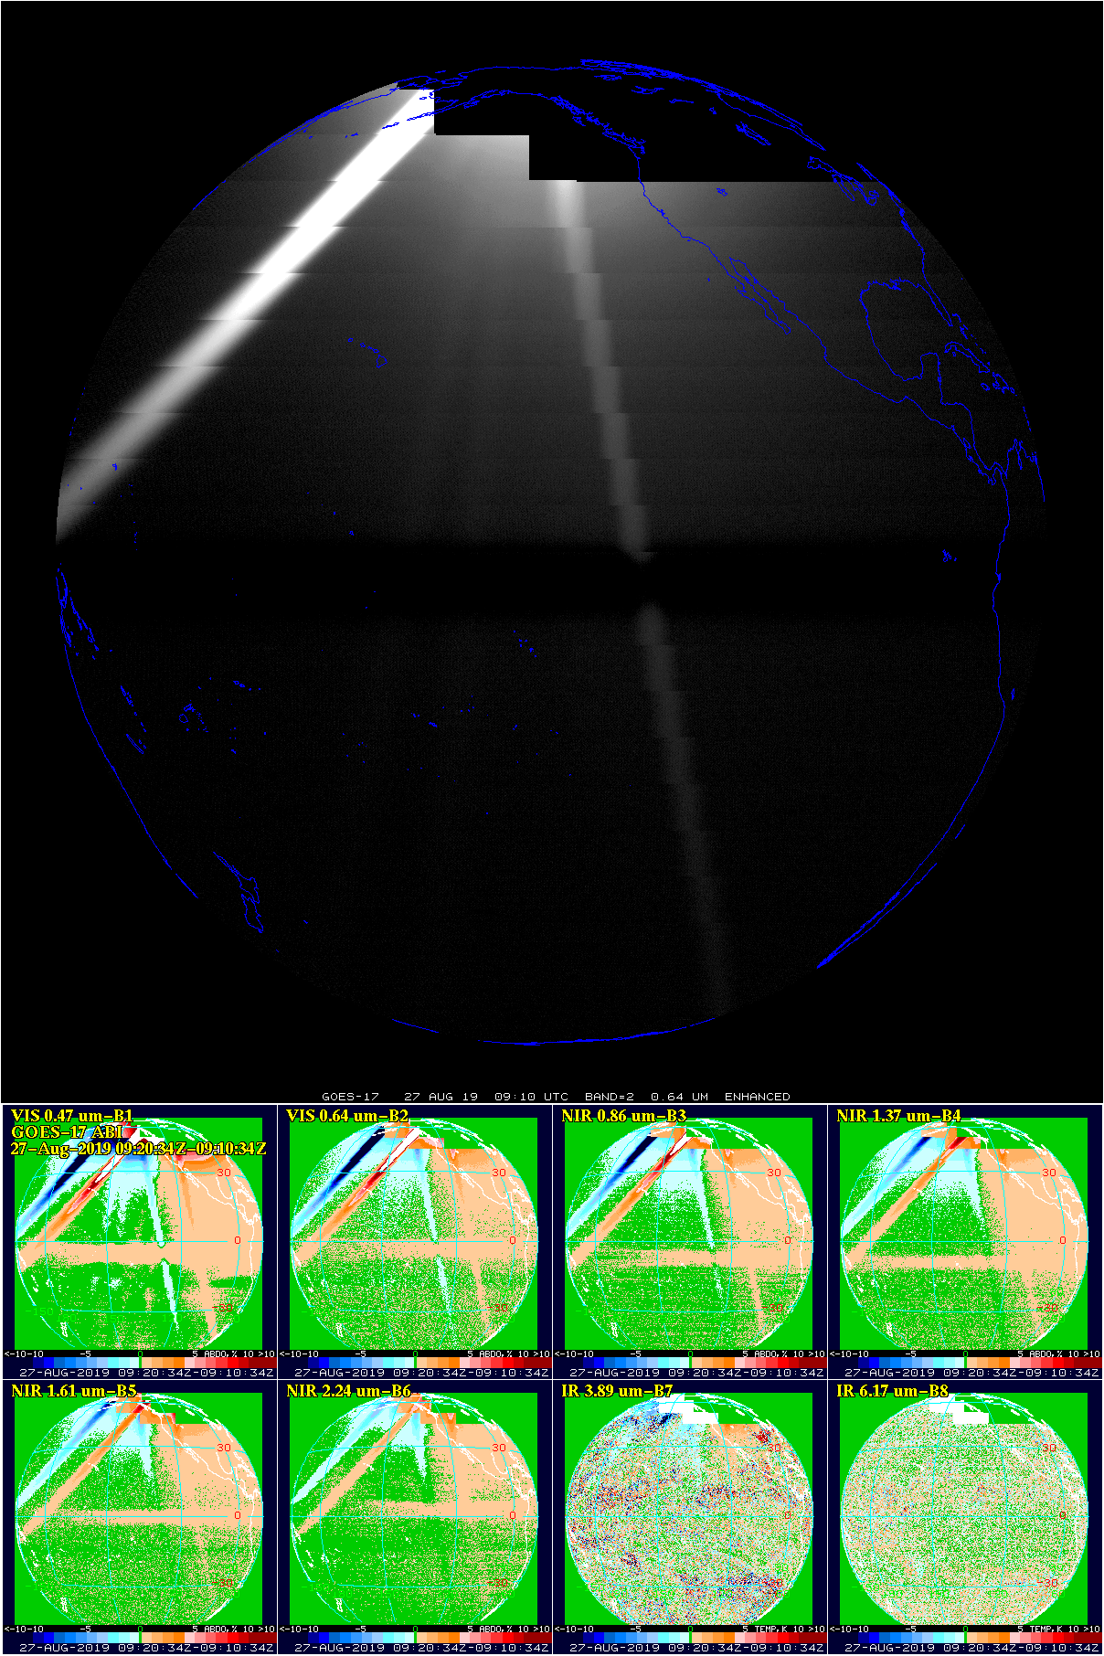
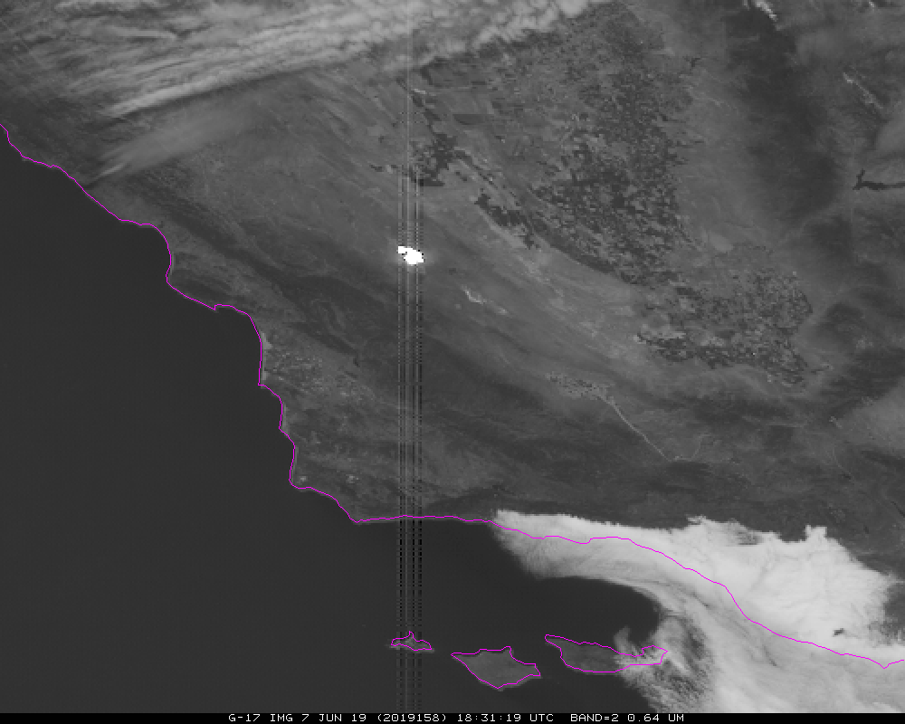
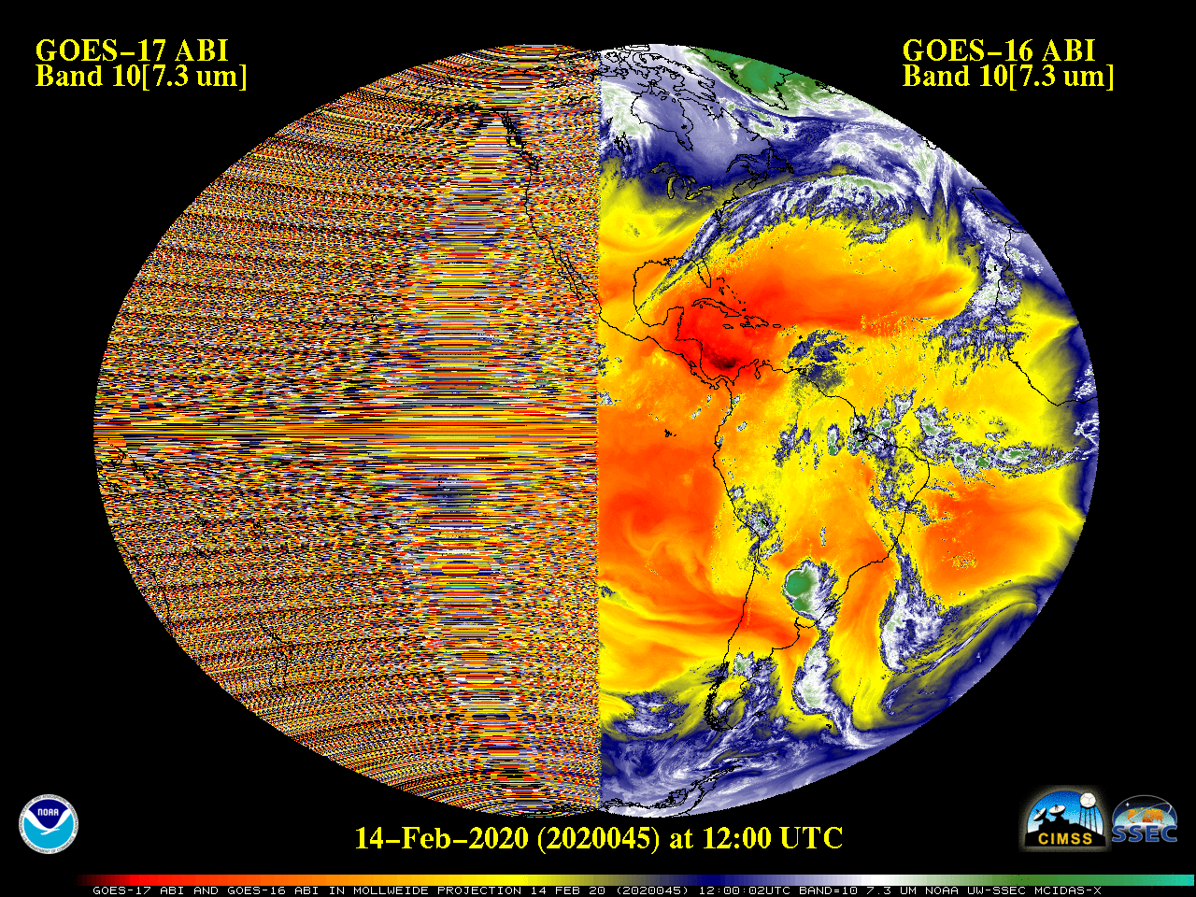
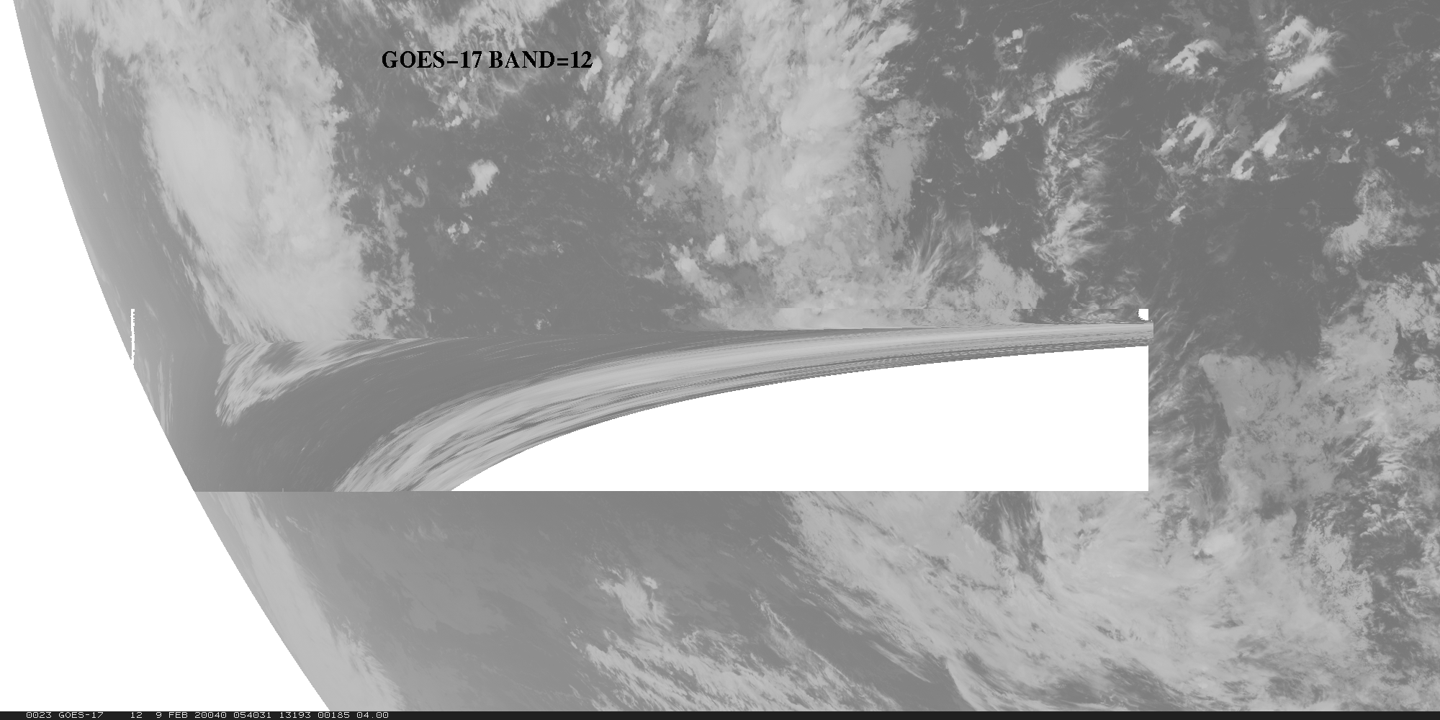
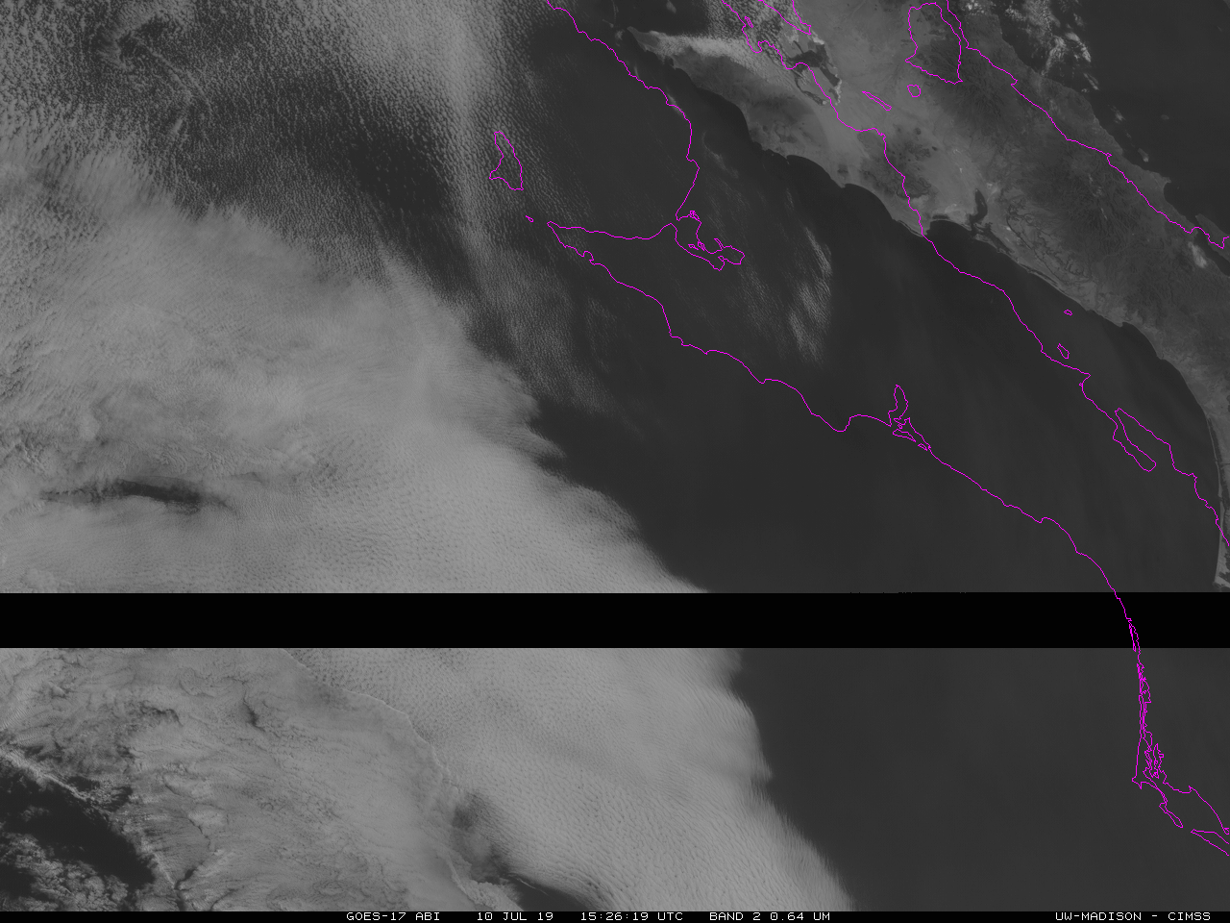
Artifacts
BOA
Lunar intrusion into space look
(G-17 only)
stray light
stray light
(4 micrometer)
“ringing”
LHP
(G-17 only)
“caterpillar”
“shark fin”
HBT Flush

Slide 5
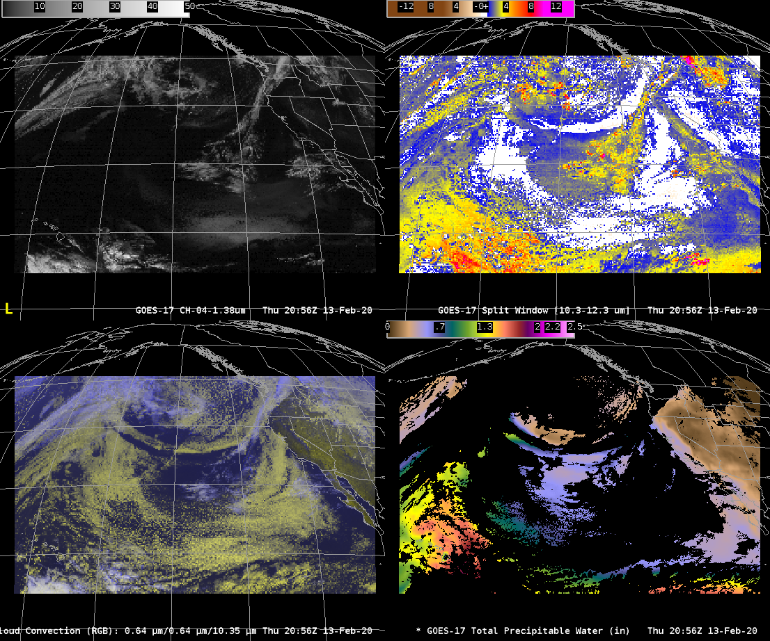
GOES-17 ABI

Slide 6
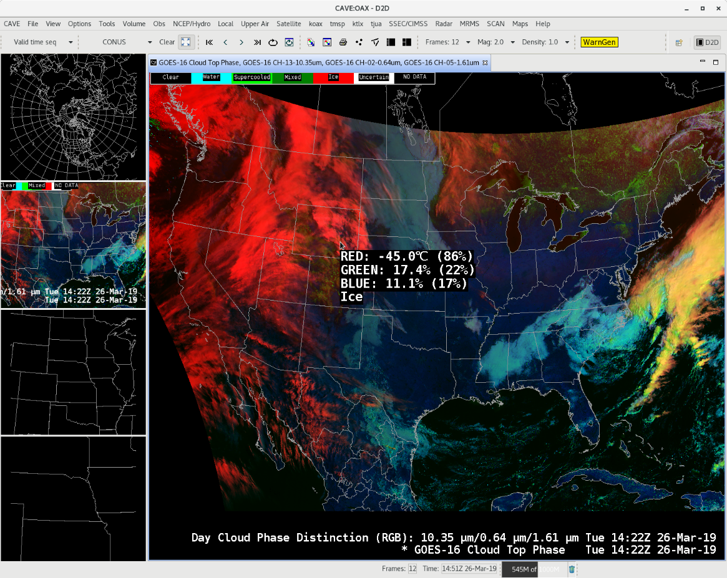
AWIPS example of showing an RGB, but adding the cursor read-out from a Derived Product
Day Cloud Phase Distinction RGB
  With derived Cloud Top Phase read-out

Slide 7
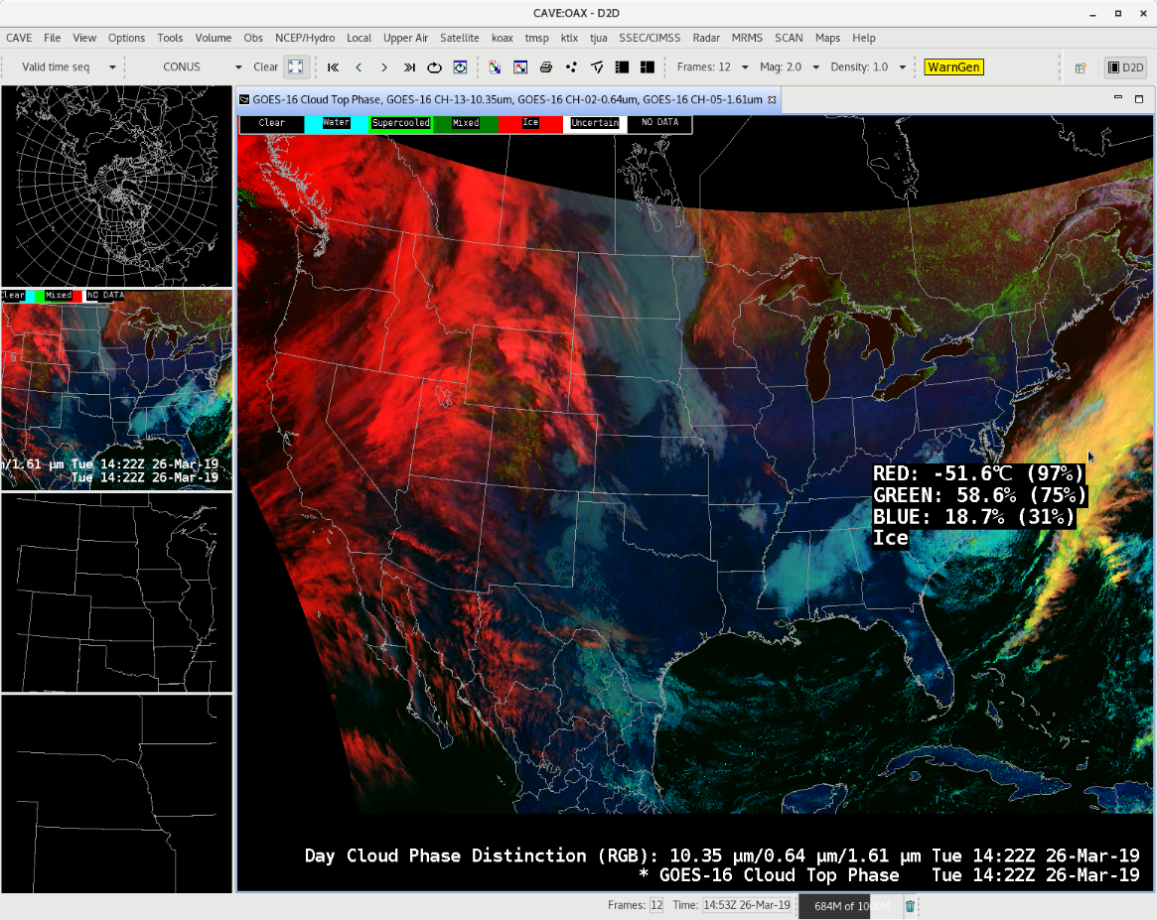
Different RGB colors, both ice clouds
(due to different solar lightning)

Slide 8
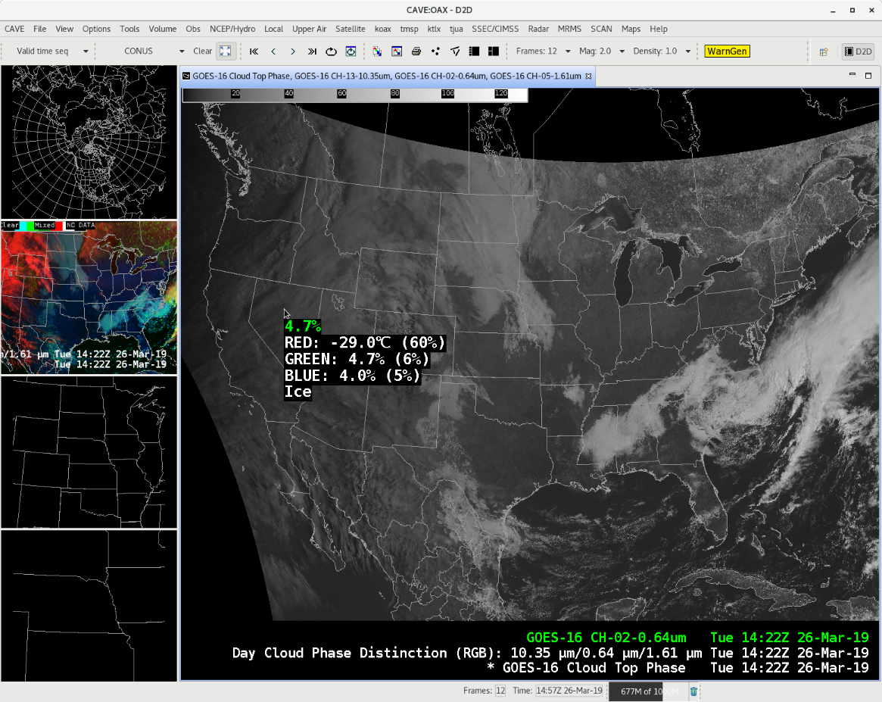

Slide 9
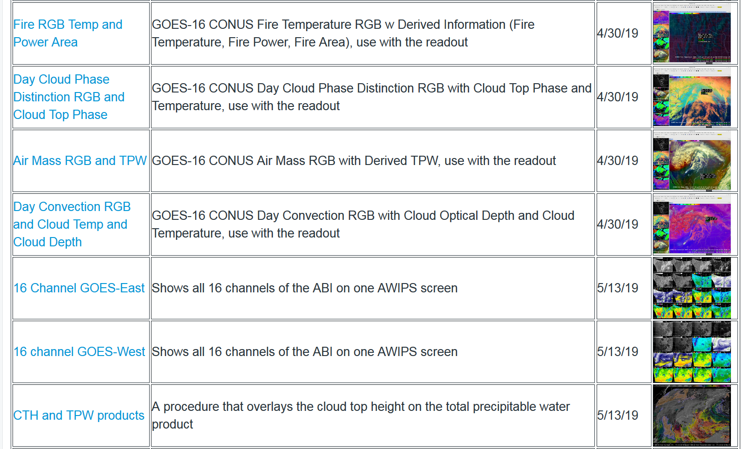
GOES Procedures in the STOR
https://vlab.ncep.noaa.gov/group/stor/goes
https://vlab.ncep.noaa.gov/web/

Slide 10
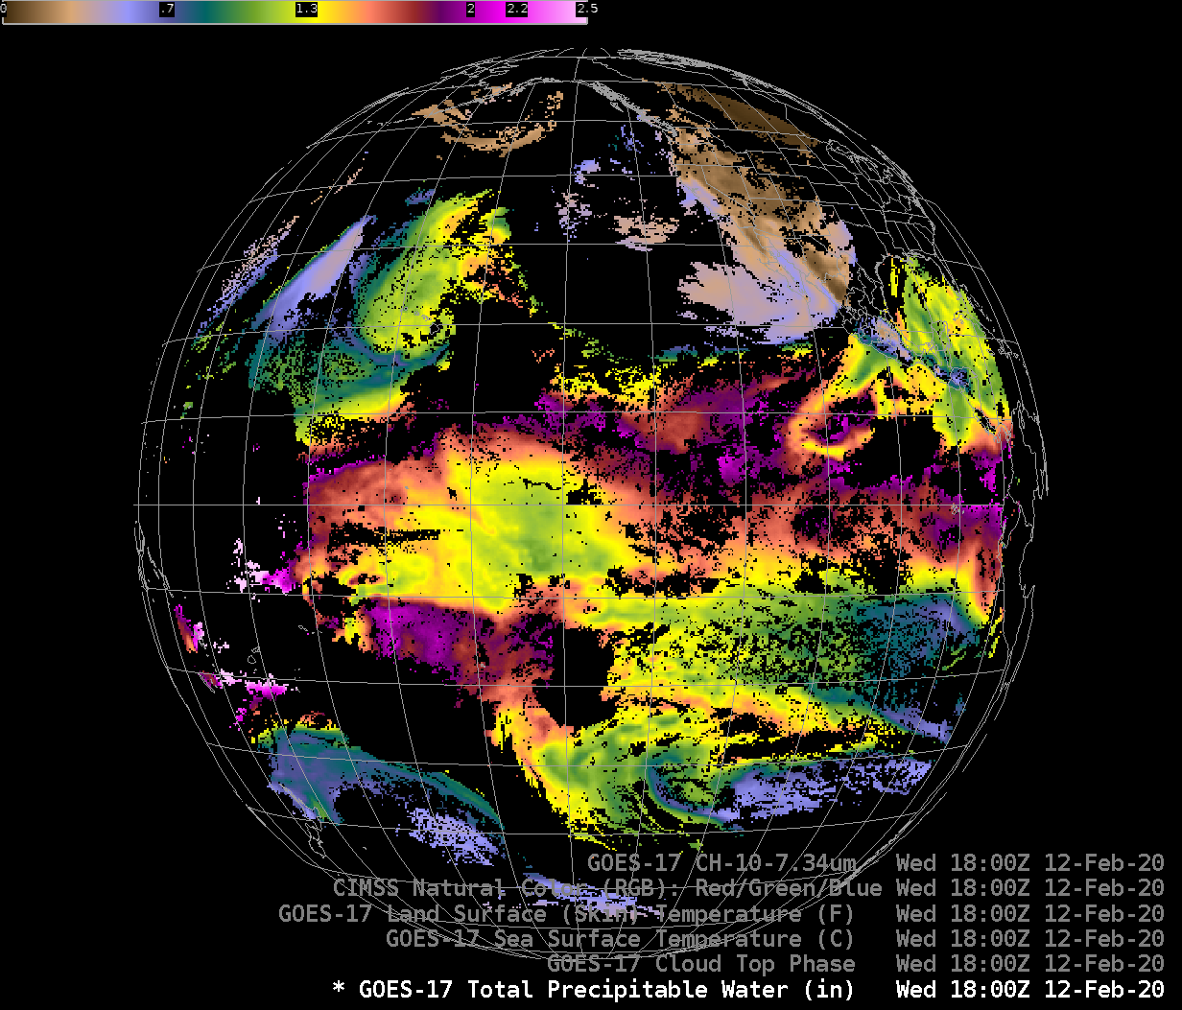
GOES-17 TPW

Slide 11
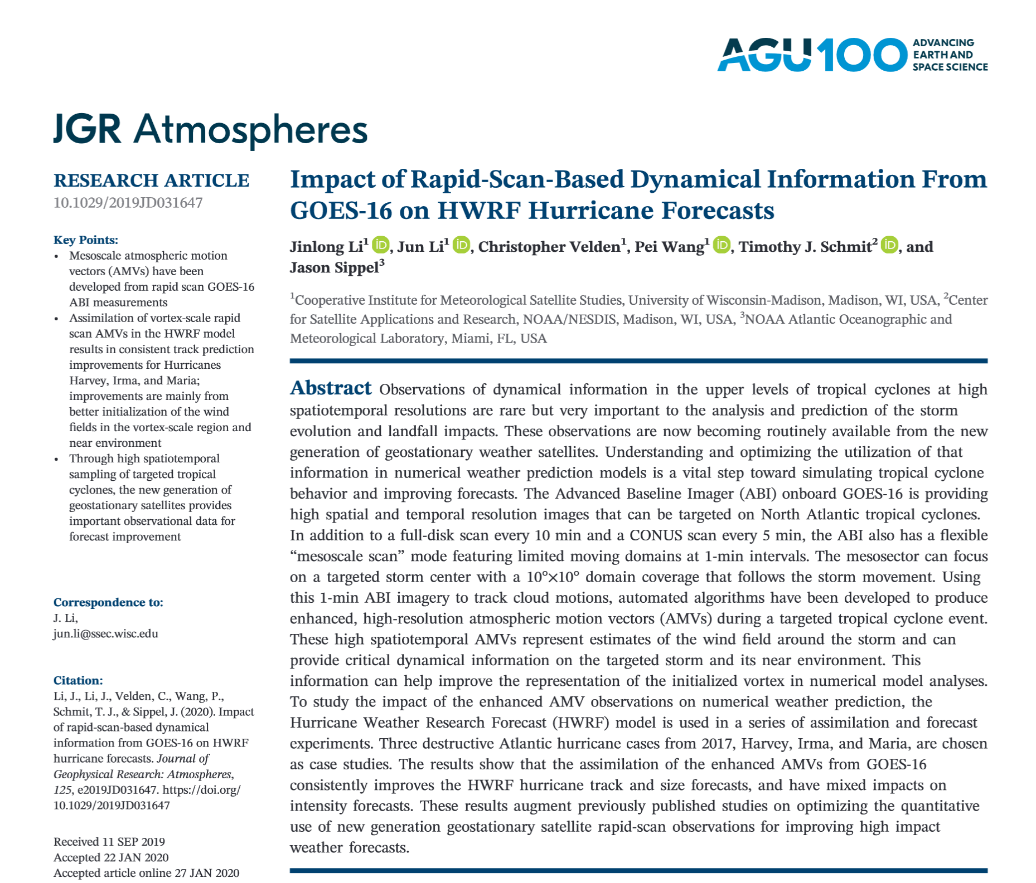

Slide 12
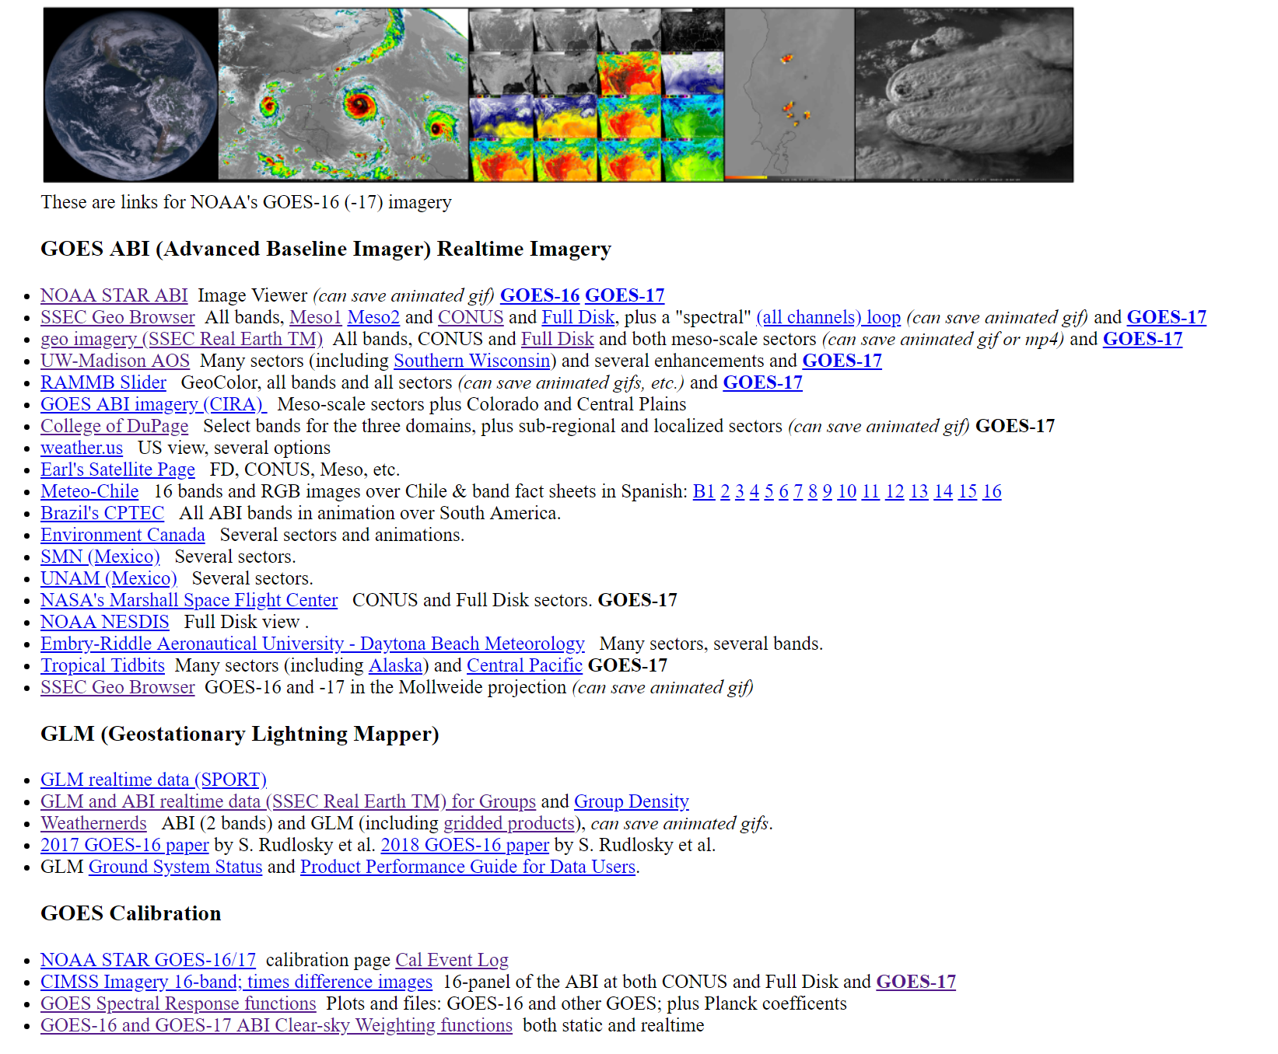
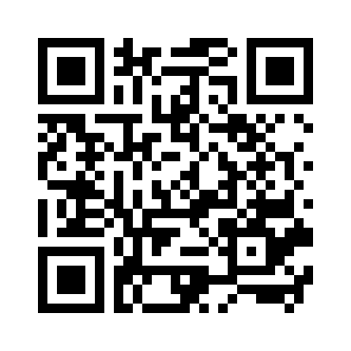
GOES-R Series web sites
Imagery
GLM
Calibration
GOES-16/17 ABI Data
(Free) Software (+ webapps)
(Free) Phone apps
ABI Training and Info
Education (2020 Virtual Science Fair)
Level 2 -- Derived Products, etc.
Space Weather
http://cimss.ssec.wisc.edu/goes/goesdata.html
Notes:
animation

Slide 13
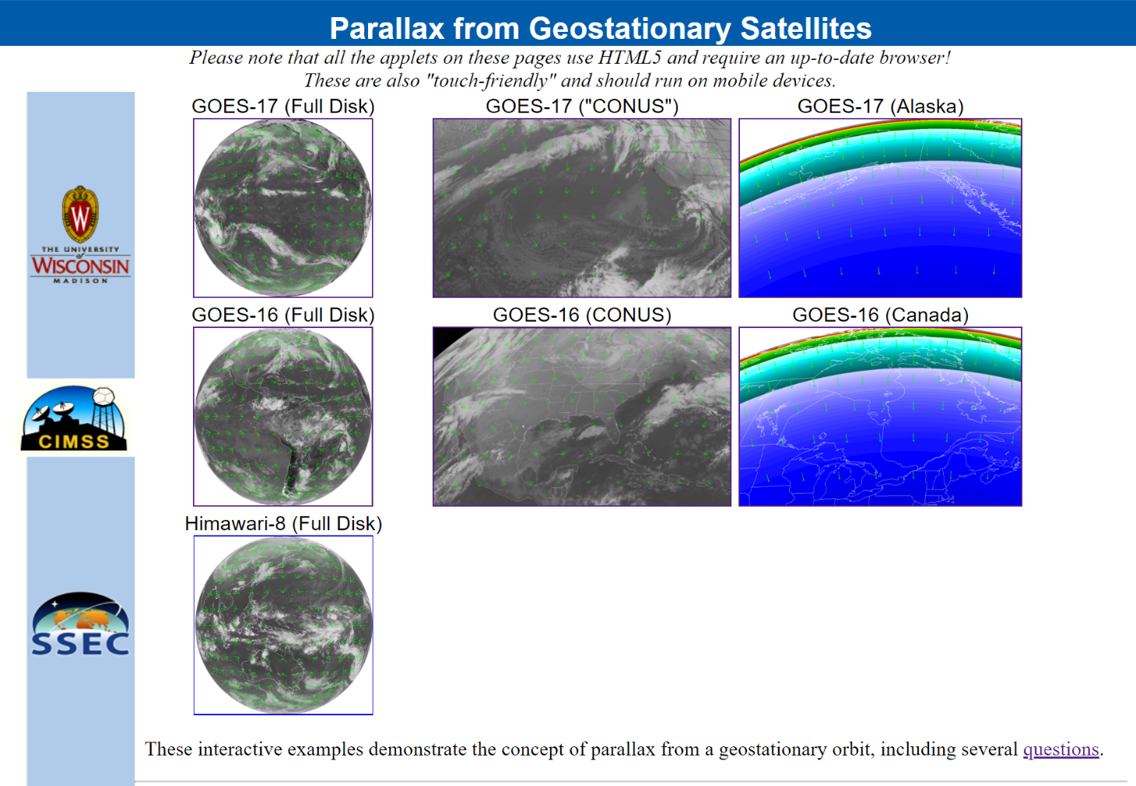
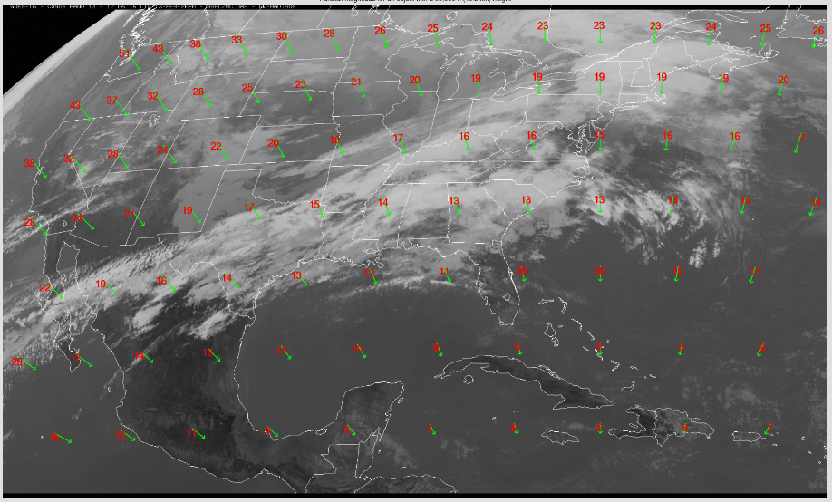
Parallax
Interactive webapp for the concept of parallax from geostationary satellites:
http://cimss.ssec.wisc.edu/goes/webapps/parallax/overview.html

Slide 14
GOES-R Series web sites
Imagery
GLM
Calibration
GOES-16/17 ABI Data
(Free) Software (+ webapps)
(Free) Phone apps
ABI Training and Info
Education (2020 Virtual Science Fair)
Level 2 -- Derived Products, etc.
Space Weather
http://cimss.ssec.wisc.edu/goes/goesdata.html
Notes:
animation

