Slide 1
Alaska Sea Ice Program Operations
JPSS/GOES-R PG RR Summit
Michael Lawson 2/27/20

Slide 2
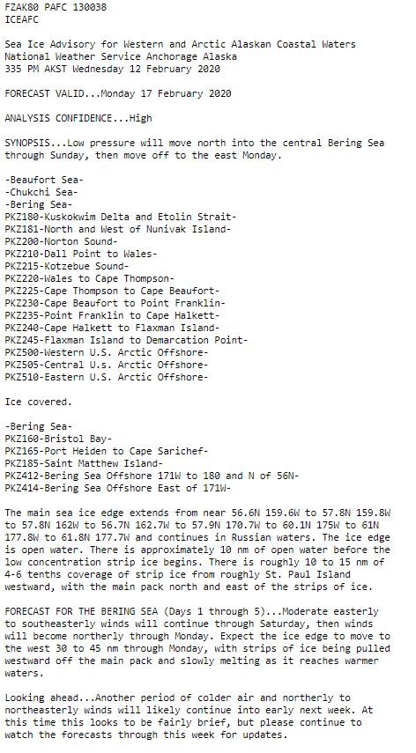
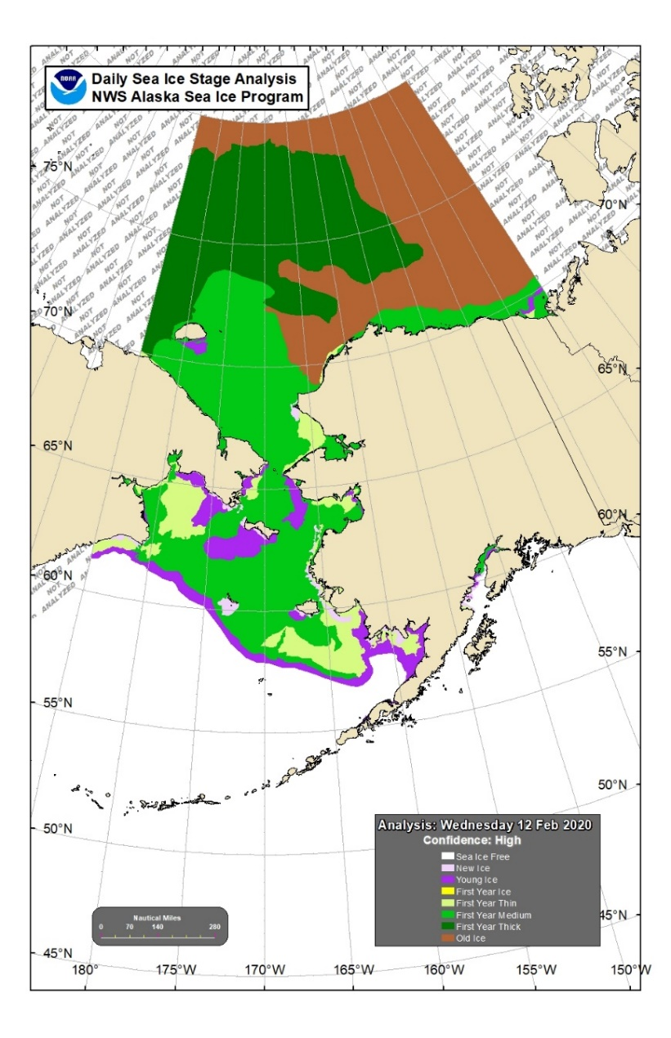
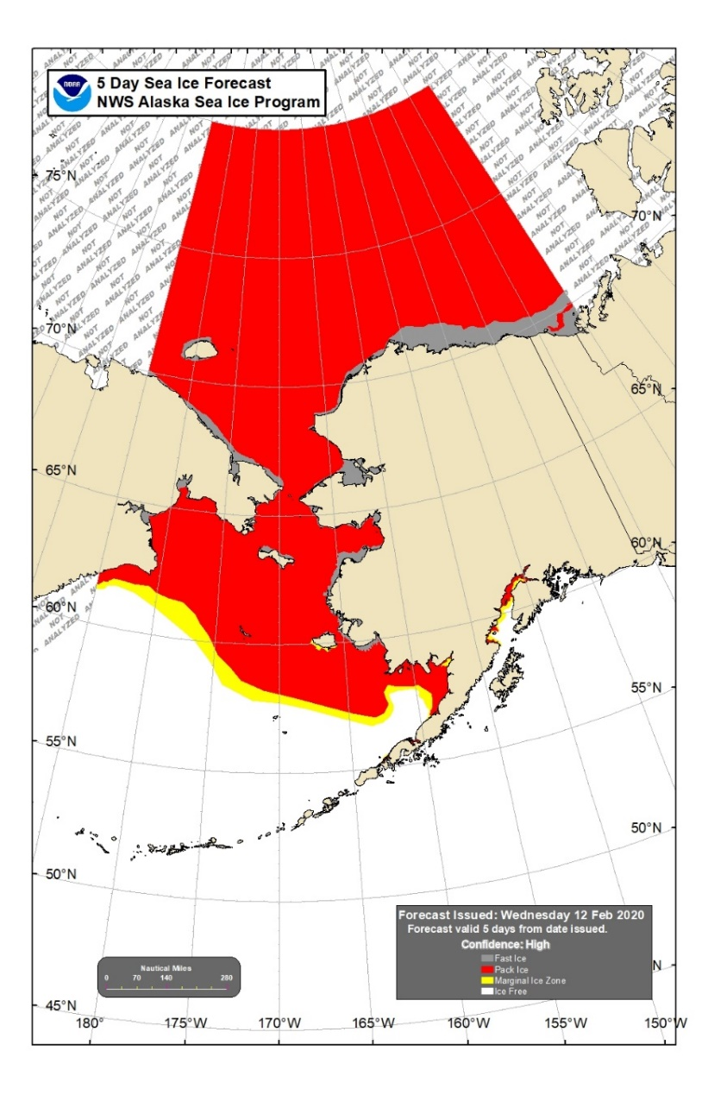
End Products
Notes:
These are the maps that get produced at the end of our day of analysis/forecasting. The two on the left get produced 7 days/week while the forecast map on the right gets produced Mon/Wed/Fri
Concentration Analysis break out in tenths how much ice is in a given area.
Stage Analysis takes those concentrations and highlights the oldest/thickest ice in a given shape, even if it is only 1/10 of a particular shape.

Slide 3
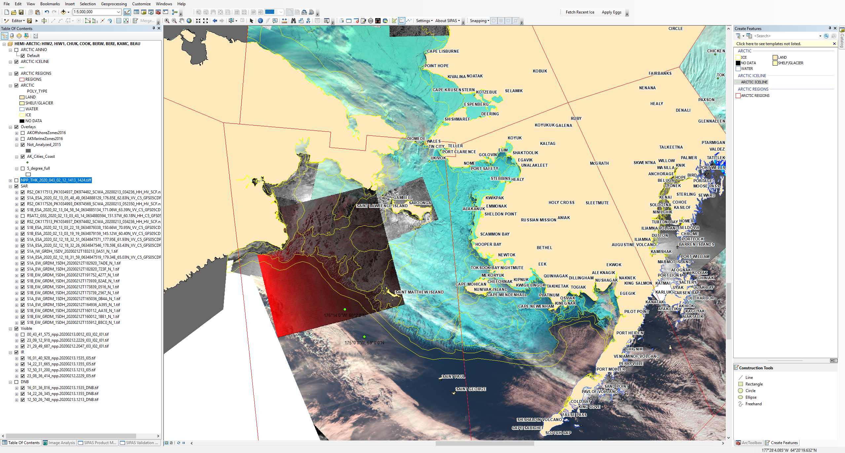
Format/What we use
Notes:
SIPAS is an application within ArcMap

Slide 4
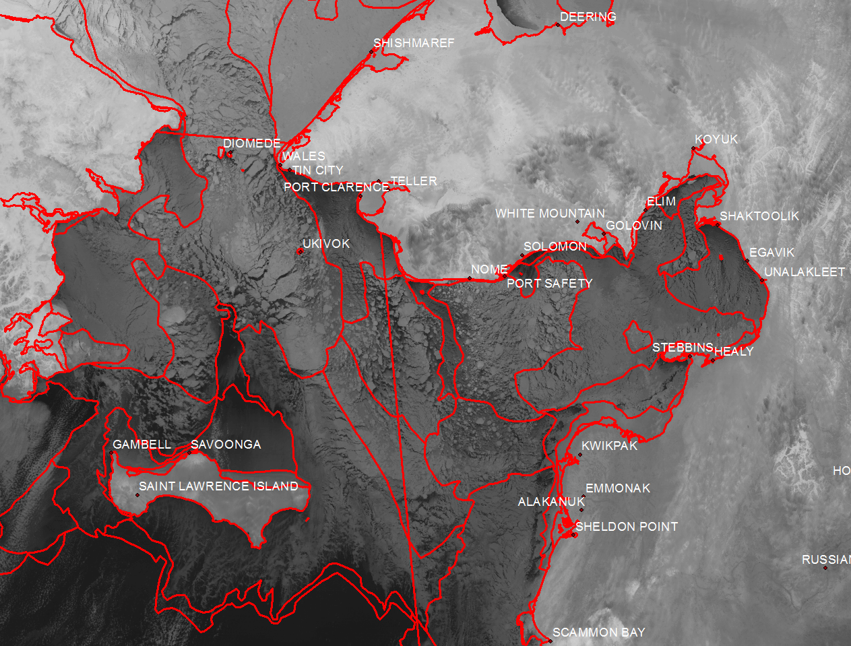
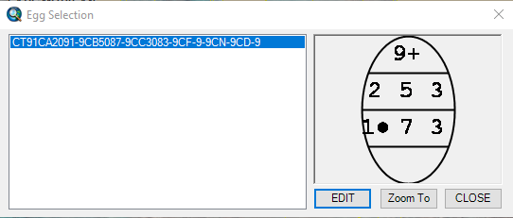
Starting Image------> End Goal

Slide 5
What is important to us?
Ice edge (position of marginal ice zone/pack ice zone)
Shorefast ice (Public safety: subsistence hunting/travel)
Identification of old ice (Summertime navigational waters)

Slide 6
Fishing fleet DSS

Slide 7
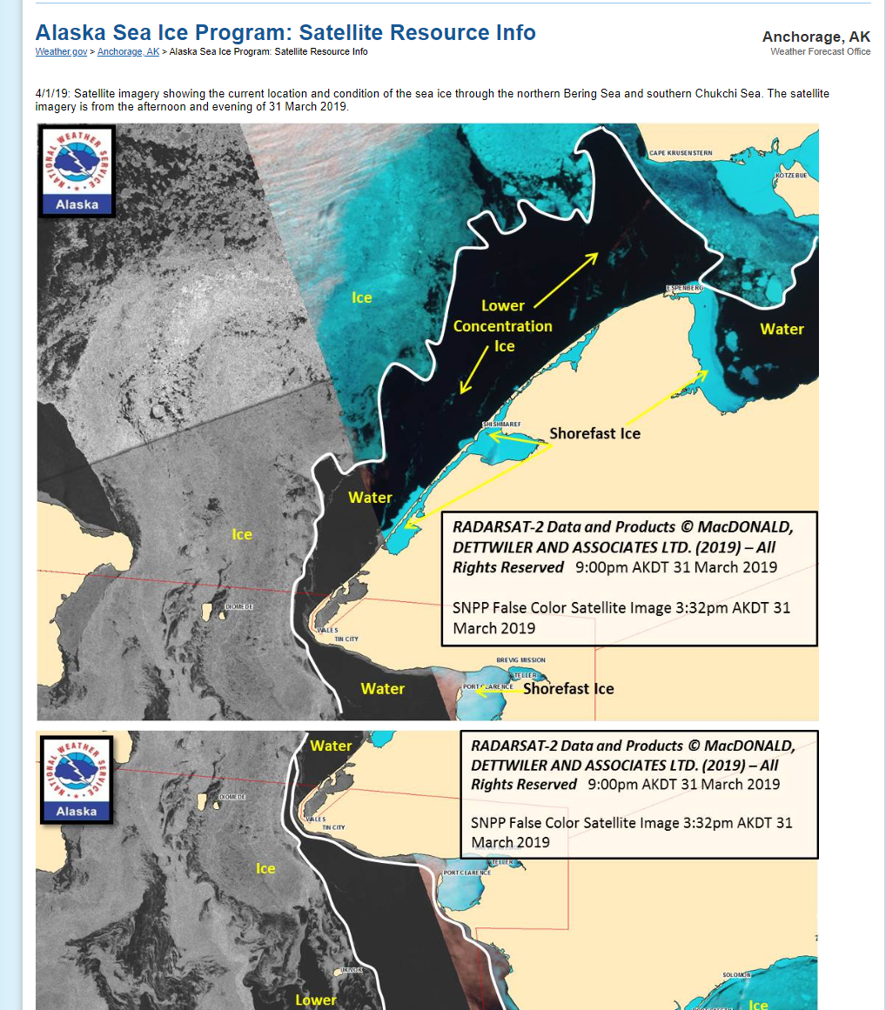
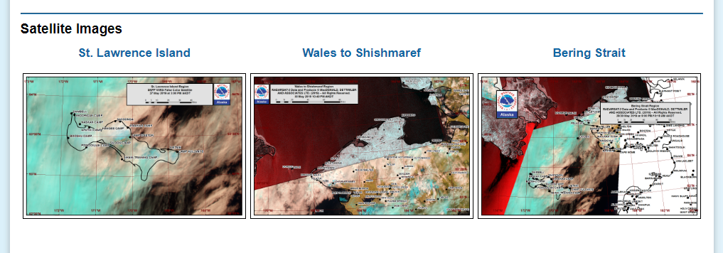
Additional resources
Sea Ice for Walrus Outlook:
Notes:
Potential for a JPSS collaboration project? Satellite overlaid with ice edge info?

