Slide 1
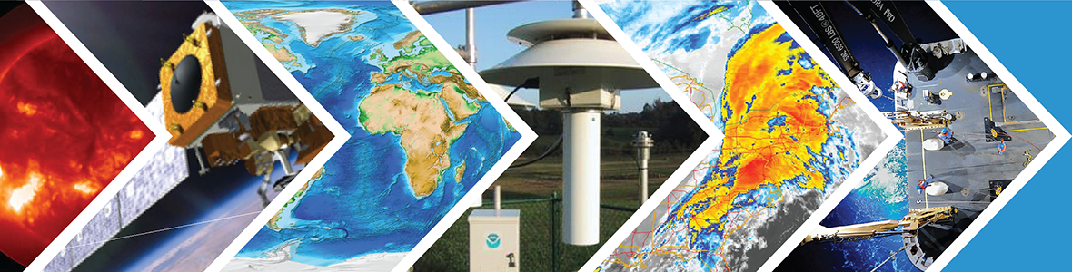

Decision Support at Regional Scales:
Connecting Products and Technologies to User
Needs in a NOAA Services Framework
Ellen Mecray, NOAA Regional Climate Services Director- Eastern Region
NOAA/NESDIS/NCEI Regional Climate Services
NOAA Satellite and Information Service | National Centers for Environmental Information

Slide 2

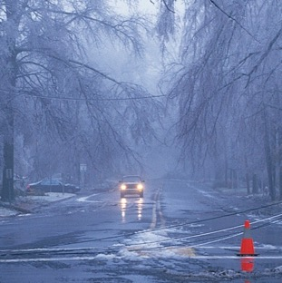
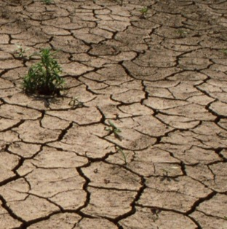
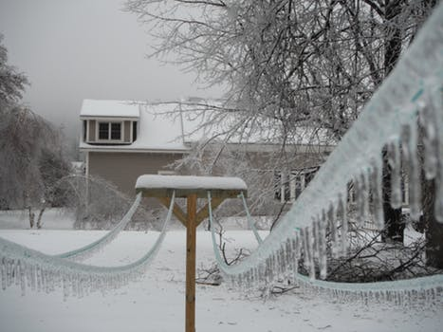

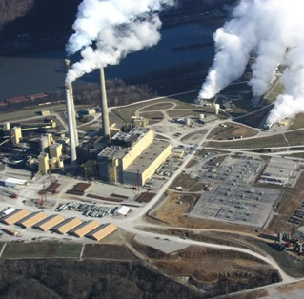

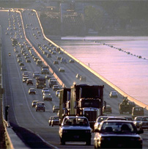

Rising Demand for Information with Regional Perspectives
NOAA’s Societal Challenge Areas
COASTS
Community Resilience
CLIMATE
Extremes
WATER
Drought and Flooding
S2S
Icing, wind, heat
Application of NOAA’s Information by Sector
Agriculture
Energy
Health
Transportation
Sustainability of Marine
Ecosystems

Slide 3
R2S- Lingo on the role of services
Information for decision-makers
User-driven, use-oriented, use-inspired, problem-focused
Partnerships, collaboration, can’t do it alone
Environmental Intelligence
THE USER
Co-production of knowledge
Actionable Science
DSS

Slide 4
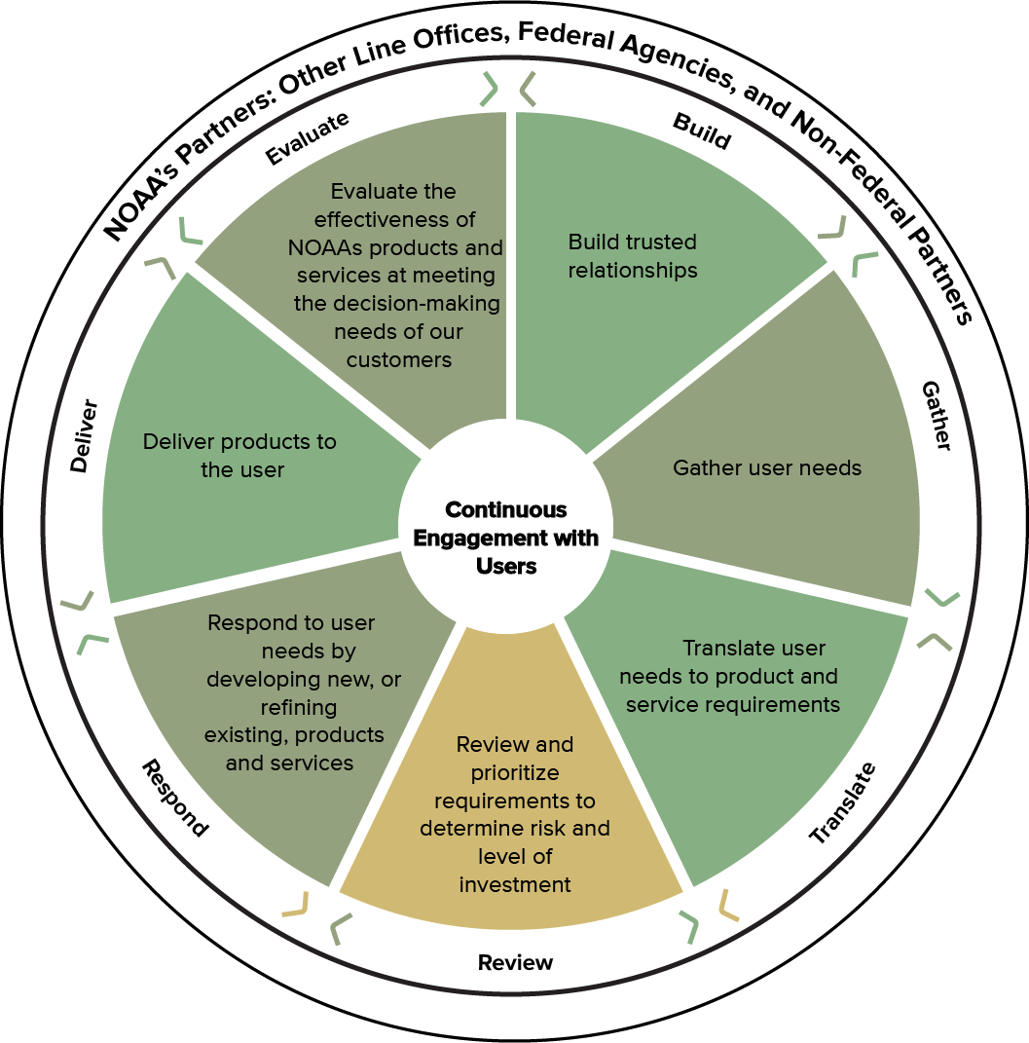
Service Delivery Framework
Vision: U.S. residents understand and use the breadth of NOAA’s information for their decisions
Mission: NOAA will build a network of trusted agents who engage internally and with partners to inform NOAA’s product and service development to be useful, usable, and used.
Assembled by a team across NOAA line offices, all services entities
User-focused, interconnected model
Two-way, ongoing communication
Notes:
(Top) Visual representation of service delivery model highlighting user-focused, iterative, interconnected process. Dotted lines represent porous two-way communication.

Slide 5

Connecting Science, Services and People:
NOAA’s Services Enterprise
State and Local Engagement, Education & Service Delivery
Relevant state-level presence from other agencies (e.g., National Science Foundation, Dept. of Education, Health & Human Services, Dept. of Energy, Dept of Interior, Dept of Agriculture)
Dept. of Agriculture Extension
State Climatologists
Federal Protect Area Programs
USGCRP Climate Literacy Partners, etc.
Weather Forecast Offices
Sea Grant Education & Extension
Marine Sanctuaries, Monuments
& Estuarine Reserves
River Forecast Centers
Data Centers
Regional Services Partnerships
USER ENGAGEMENT
Development, Delivery & Evaluation of Products & Tools
Understanding and Translating User Needs
Informing Program Requirements
NOAA Regional Offices and Programs
Regional offices (NWS and NMFS)
Regional Climate Services (NCEI)
NOS/OCM regional offices
River Forecast Centers
Regional Collaboration Teams
Data Centers
Relevant Regional Offices from other agencies (e.g., Environmental Protection Agency, Dept. of Agriculture, Dept. of Interior, Health and Human Services,
Dept. of Transportation, Dept of Energy, etc.)
Government
Private Sector
Academia
NGO’s
National and Regional Science
Regional Integrated Science & Assessments
NOAA Labs (OAR & NMFS)
Sea Grant
Cooperative Institutes
Applied Research Centers
Data Centers
Climate Prediction Center
Other science/research agencies (e.g., National Aeronautics and Space Administration, Dept. of Interior, Dept. of Agriculture, National Science Foundation & other USGCRP agencies)
Etc…
Notes:
No discussion of climate services is complete without addressing the regional component. NOAA has a long standing history of regional climate science and service, as well as extensive service delivery capacity.
Not on this slide, but important to mention, is that NOAA also has a history of supporting the use of our science, information and services in the private sector. For example, there is a robust private sector based around NOAA’s weather services. We recognize that in order to make climate information accessible to the nation, the private sector will play a critical role in providing services and delivering information. To fully realize the opportunities for private sector growth in delivery of climate services, NOAA will leverage existing DOC capacity to support U.S. business nationally and internationally. DOC’s Commerce Connect efforts will be a valuable tool to ensure the private sector and the American public can fully utilize NOAA’s investments in climate science and service.
NOAA is also in the process of developing a climate MOU between DOC and DOI, and establishing our interagency regional operations is an important purpose of this MOU.
Part of the Secretary’s announcement included the creation of 6 new Regional Climate Service Director positions. Announcements are posted on USAJOBs as of today.
The primary functions will include:
Responsibility for providing leadership in the development of an integrated NOAA program of climate services on a regional scale that responds to the needs of stakeholders and draws upon agency-wide assets and capabilities.
Management of the development and execution of a Regional Climate Services Strategic Plan that combines the unique assets and special capabilities of NOAA programs working with regional partners in other Federal agencies, state, local and tribal governments, universities, the private sector and NGOs.

Slide 6
Services by Sector
Energy
Agriculture
WATER
Health
COASTS
CLIMATE
Sustainability of Marine
Ecosystems
Transportation

Slide 7
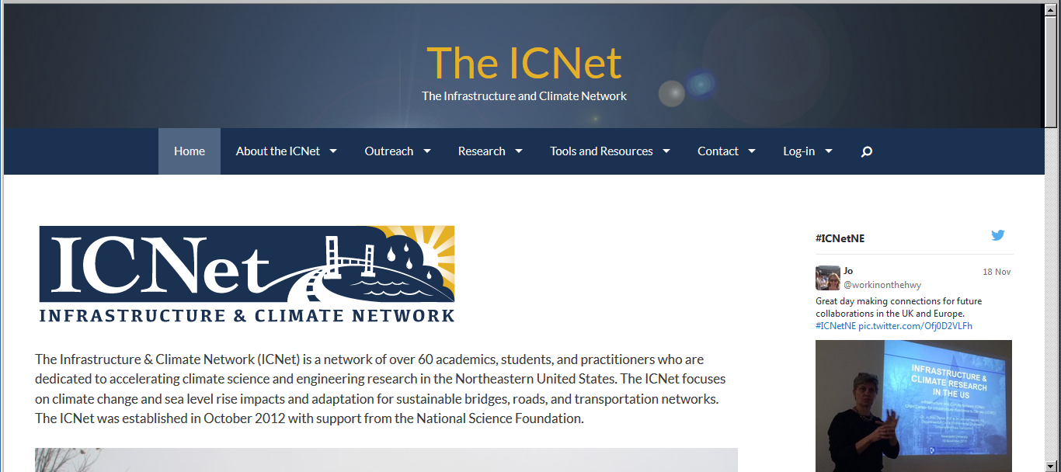
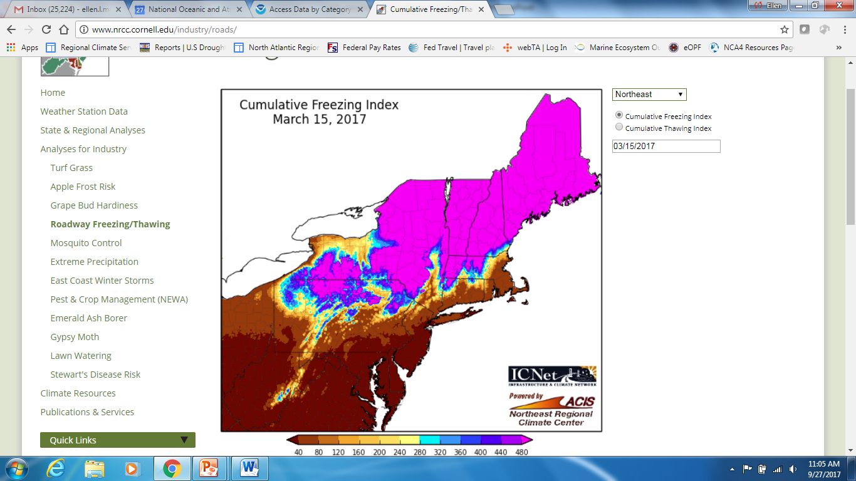
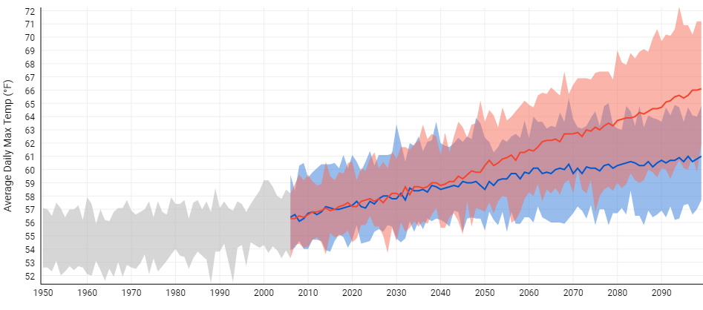
Transportation
Climate Variables
  Precipitation frequency (design storms)
  Temperature projections (road salt, potholes)
  Accounting for extremes
  Seasonal road posting
  Research on wind and other variables
Infrastructure and Climate Network: http://theicnet.org/
Average Annual Daily Max Temperature
Augusta, ME
Central NH, Flooding 2010
Notes:
----------
Image: Modeled sea surface temperatures simulated by NOAA GFDL CM2.4 climate model.
Source: NOAA GFDL Climate Change, Variability & Prediction Group (http://www.gfdl.noaa.gov/ccvp)
Related content:
http://www.gfdl.noaa.gov/e-media-produced-by-gfdl-ccvp#oceancurr
Common themes across New England and Maine:
Increasing annual precipitation
Increasing frequency of heavy rains
Warming annual temperatures
Earlier “ice out” and peak spring flows
Shift in precipitation frequency
For smaller (<800 sq. mi) basins in southern and western Maine
Trend toward increased flood magnitude and/or frequency
Most pronounced where significant land use change and/or urbanization has occurred

Slide 8
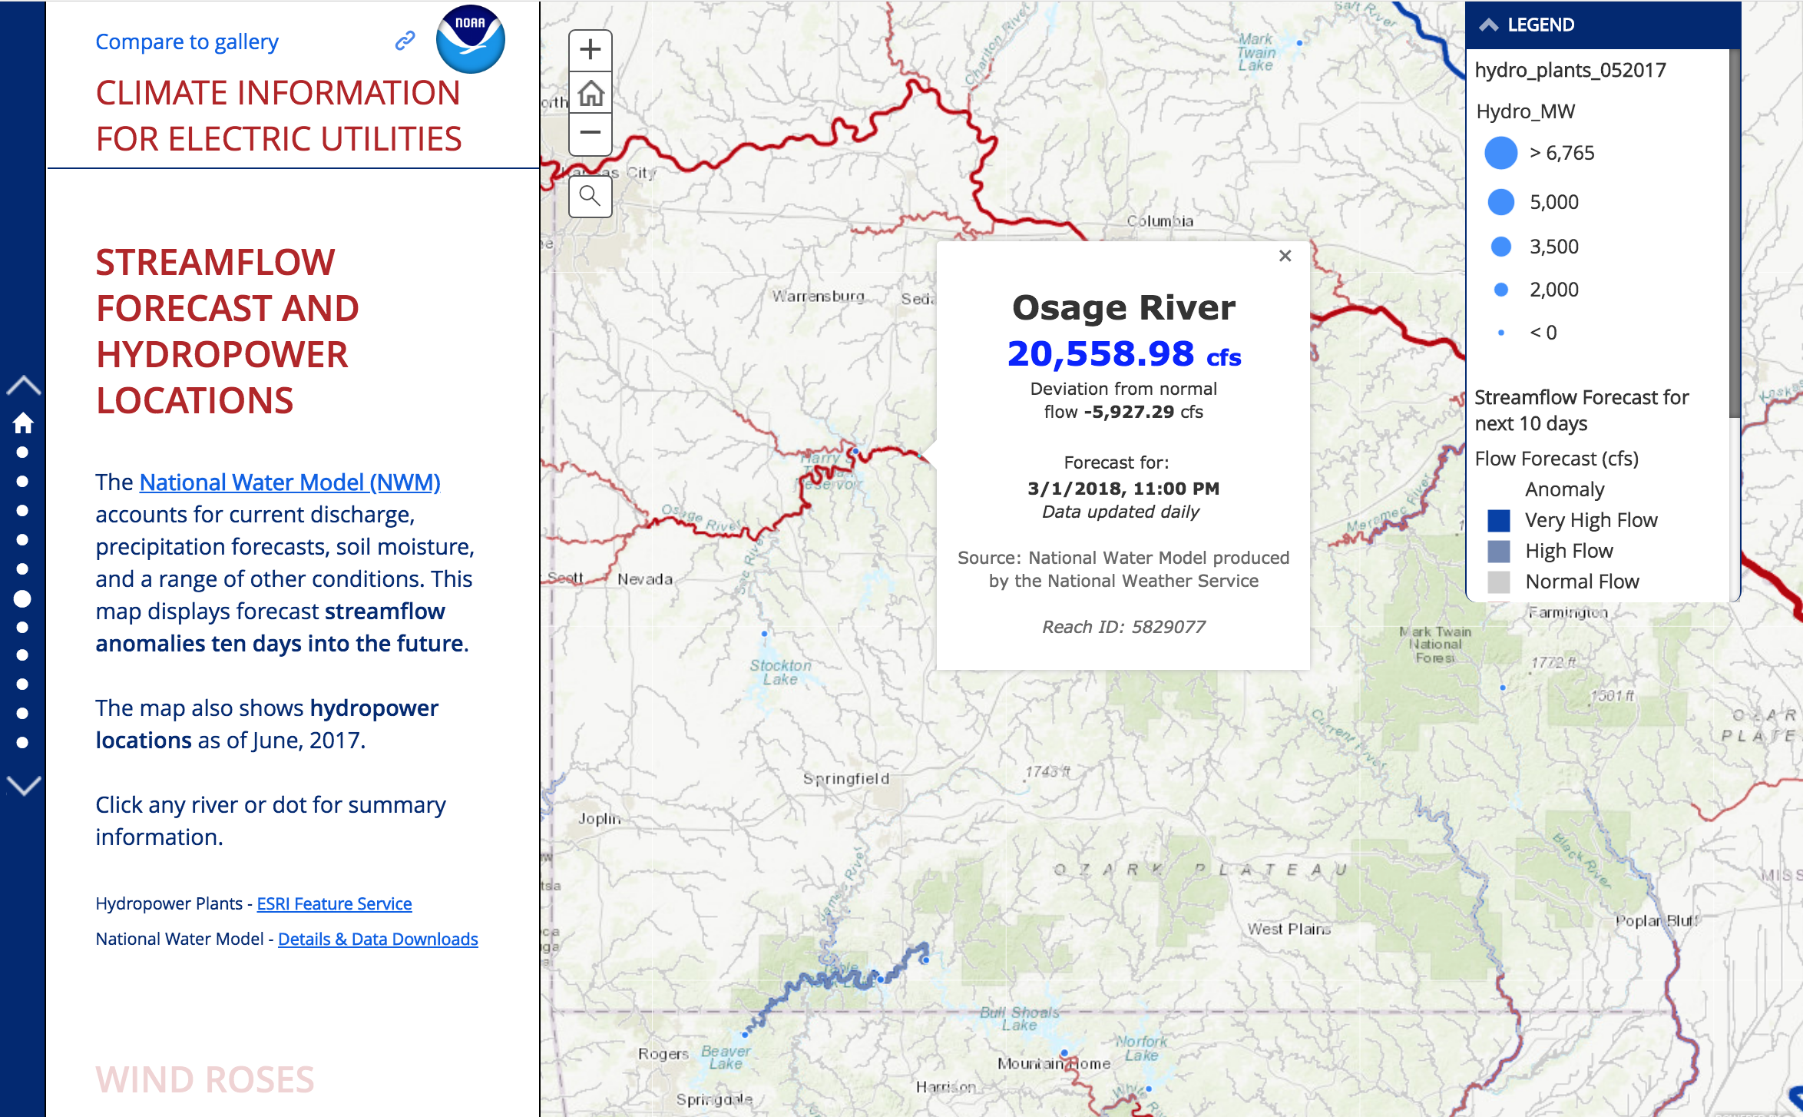

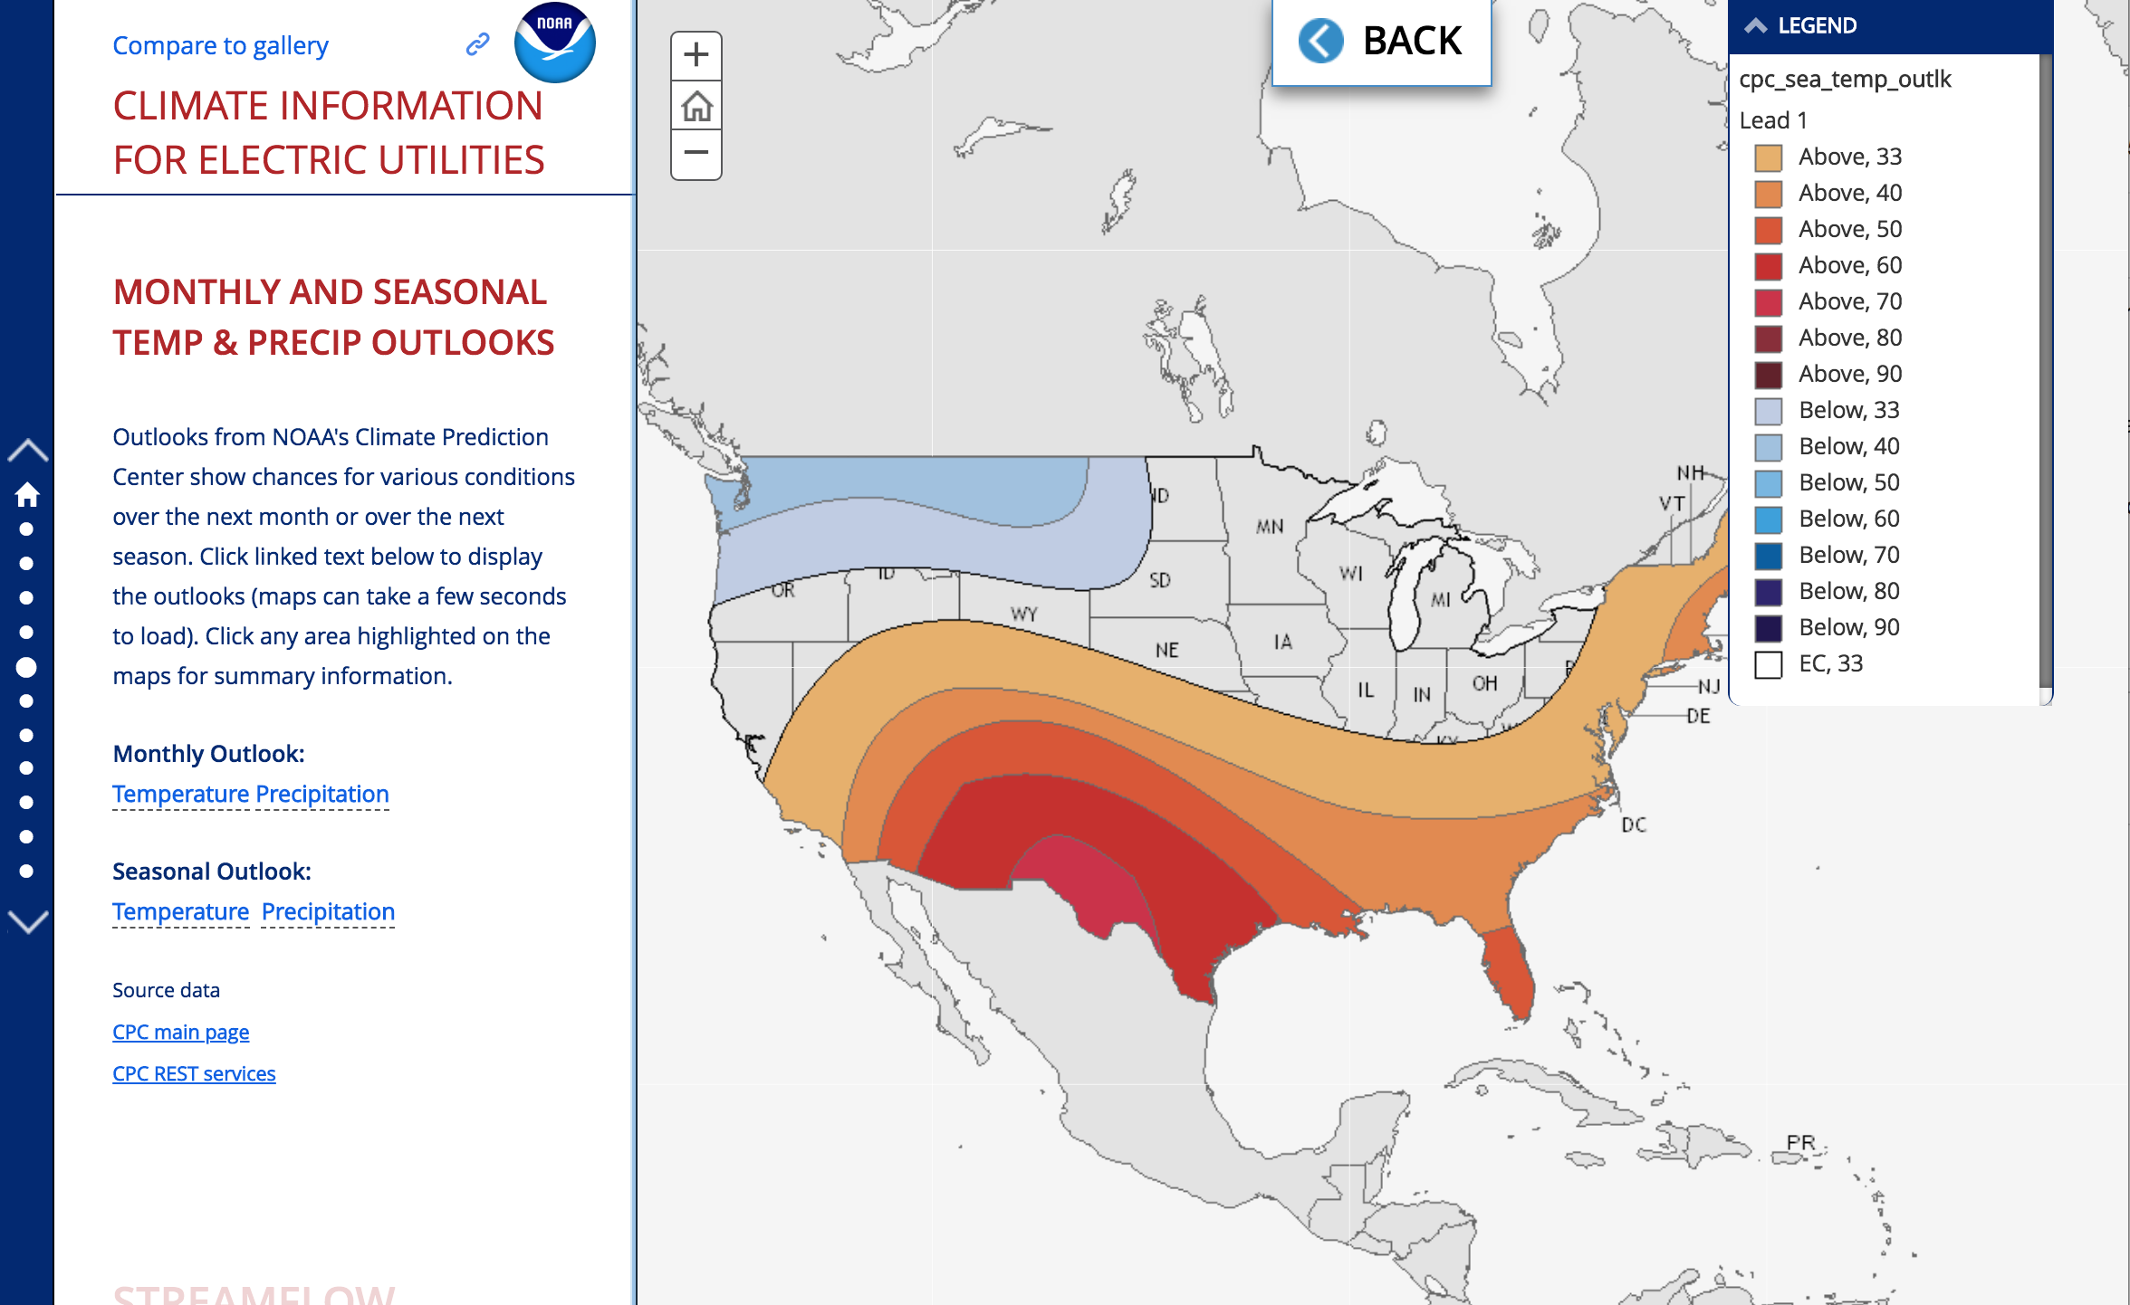
Energy
NOAA is working in a government to government relationship to offer weather and climate information to meet the requirements of DOE and its core partners
Mission Interests- Grid Sustainability and Critical Infrastructure Security
Weather and Climate Information Requirements:
Icing events,
temperature extremes,
Wet bulb temperatures,
Wind speed and duration
Water availability (drought impacts)
Sea level rise
Sample frames from the Story Map - http://arcg.is/1jOLCb

Slide 9
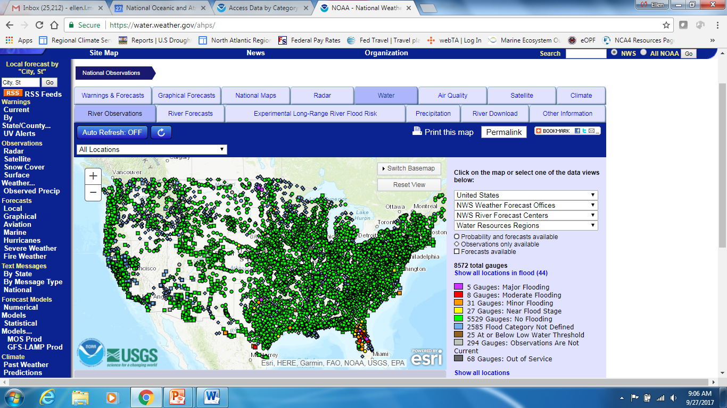
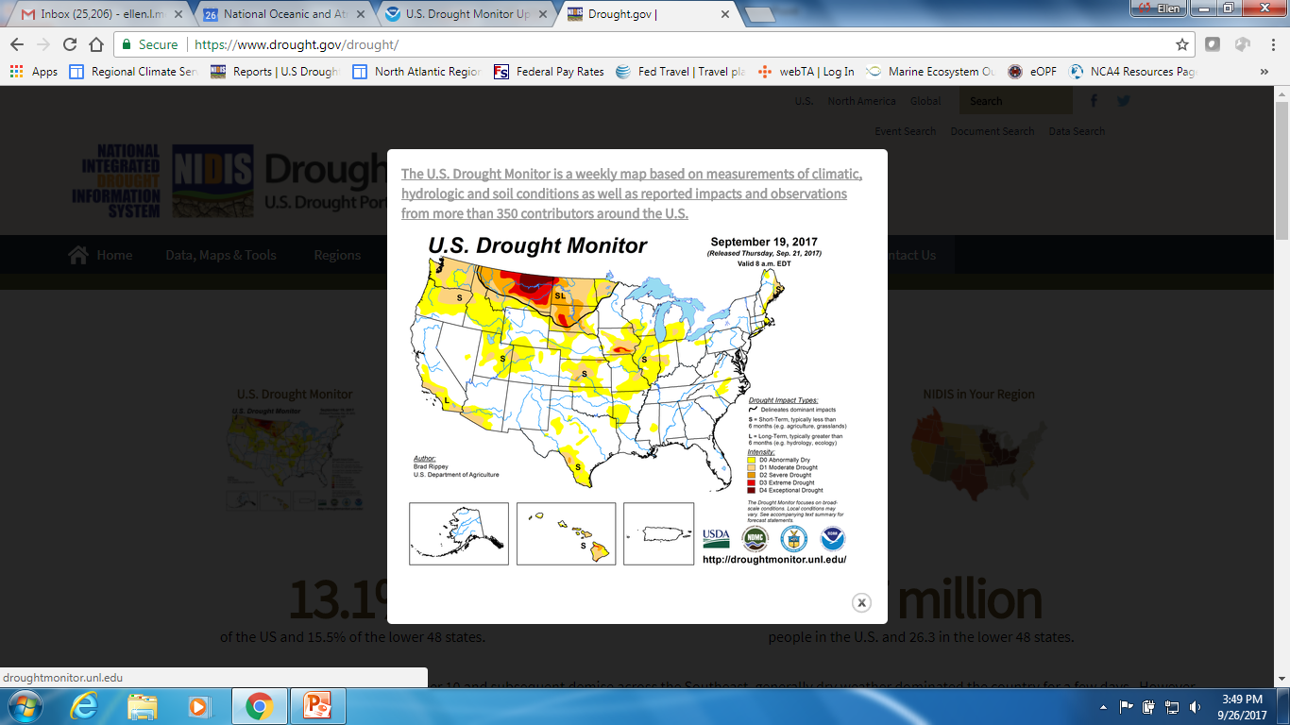
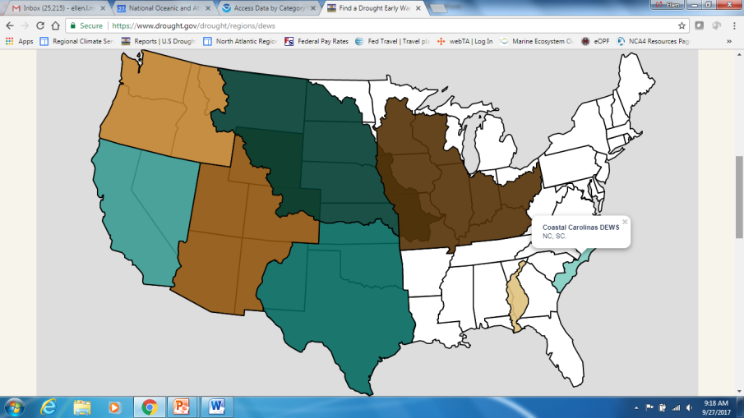
Water Resources- too much and too little
https://water.weather.gov/ahps/
River observation and forecast information: https://water.weather.gov/ahps
Snow Information: https://www.nohrsc.noaa.gov
Precipitation Frequency Estimates: http://www.nws.noaa.gov/oh/hdsc
https://www.drought.gov/drought/

Slide 10
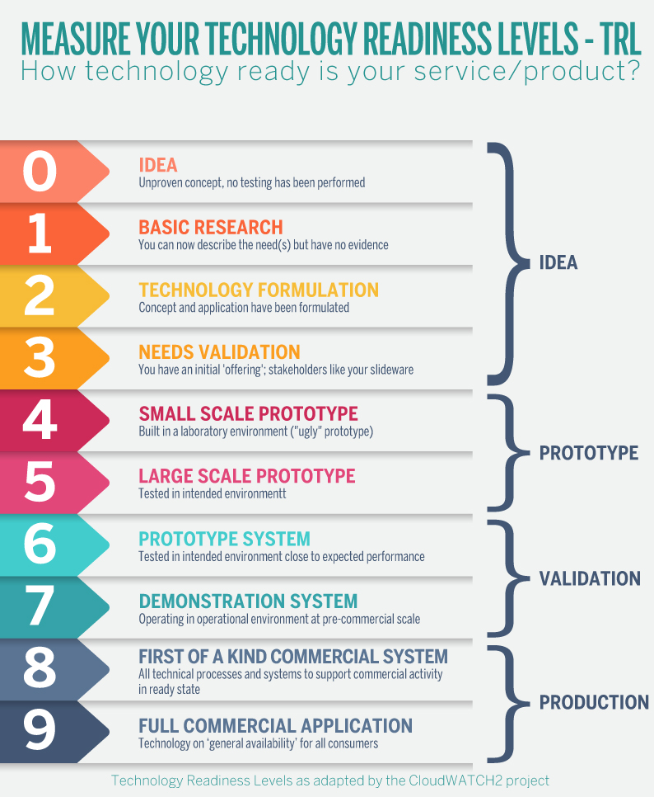
Readiness Levels
User Engagement as the Foundation—
Nurtured relationships based on a foundation of trust and mutual respect
User requirements are derived from an understanding of their decision challenges
Timely response to their requirements form the basis of ongoing engagement and use-inspired product improvement
Include user engagement as the impetus for the idea
Ensure co-production with the user community through each phase:
Does it do what you need it to do? Do you need different features? Can you work it, or can we offer training?
Is it USEFUL?
Is it USABLE?
Will it be USED?

Slide 11



Questions?
Ellen L. Mecray
NOAA National Centers for Environmental Information
Eastern Region Climate Services Director
Ellen.L.Mecray@noaa.gov
http://www.ncdc.noaa.gov/rcsd/eastern
February 24, 2020
JPSS Proving Ground Meeting, College Park, MD
Invited Speaker
Notes:
True color MODIS composite image of Earth by Reto Stockli (under subcontract to SSAI working for NASA). City lights image on night side of terminator from DMSP OLS data, courtesy Chris Elvidge, NOAA.

Slide 12
Backups

Slide 13

Why now?
NOAA must coordinate a unified service delivery/decision support mechanism that carefully leverages partnerships and informs the development of use-inspired products and services. This mechanism is a timely effort meant to best serve our customers, particularly under changing weather, water, and climate conditions.
13

Slide 14
What will this plan mean for NOAA?
Effective implementation of our service delivery plan can transform how NOAA:
Prioritizes its product lines (observations, data, and services);
Develops new, and refines existing, products; and
Transmits and translates information for decision-makers across multiple sectors
14

Slide 15
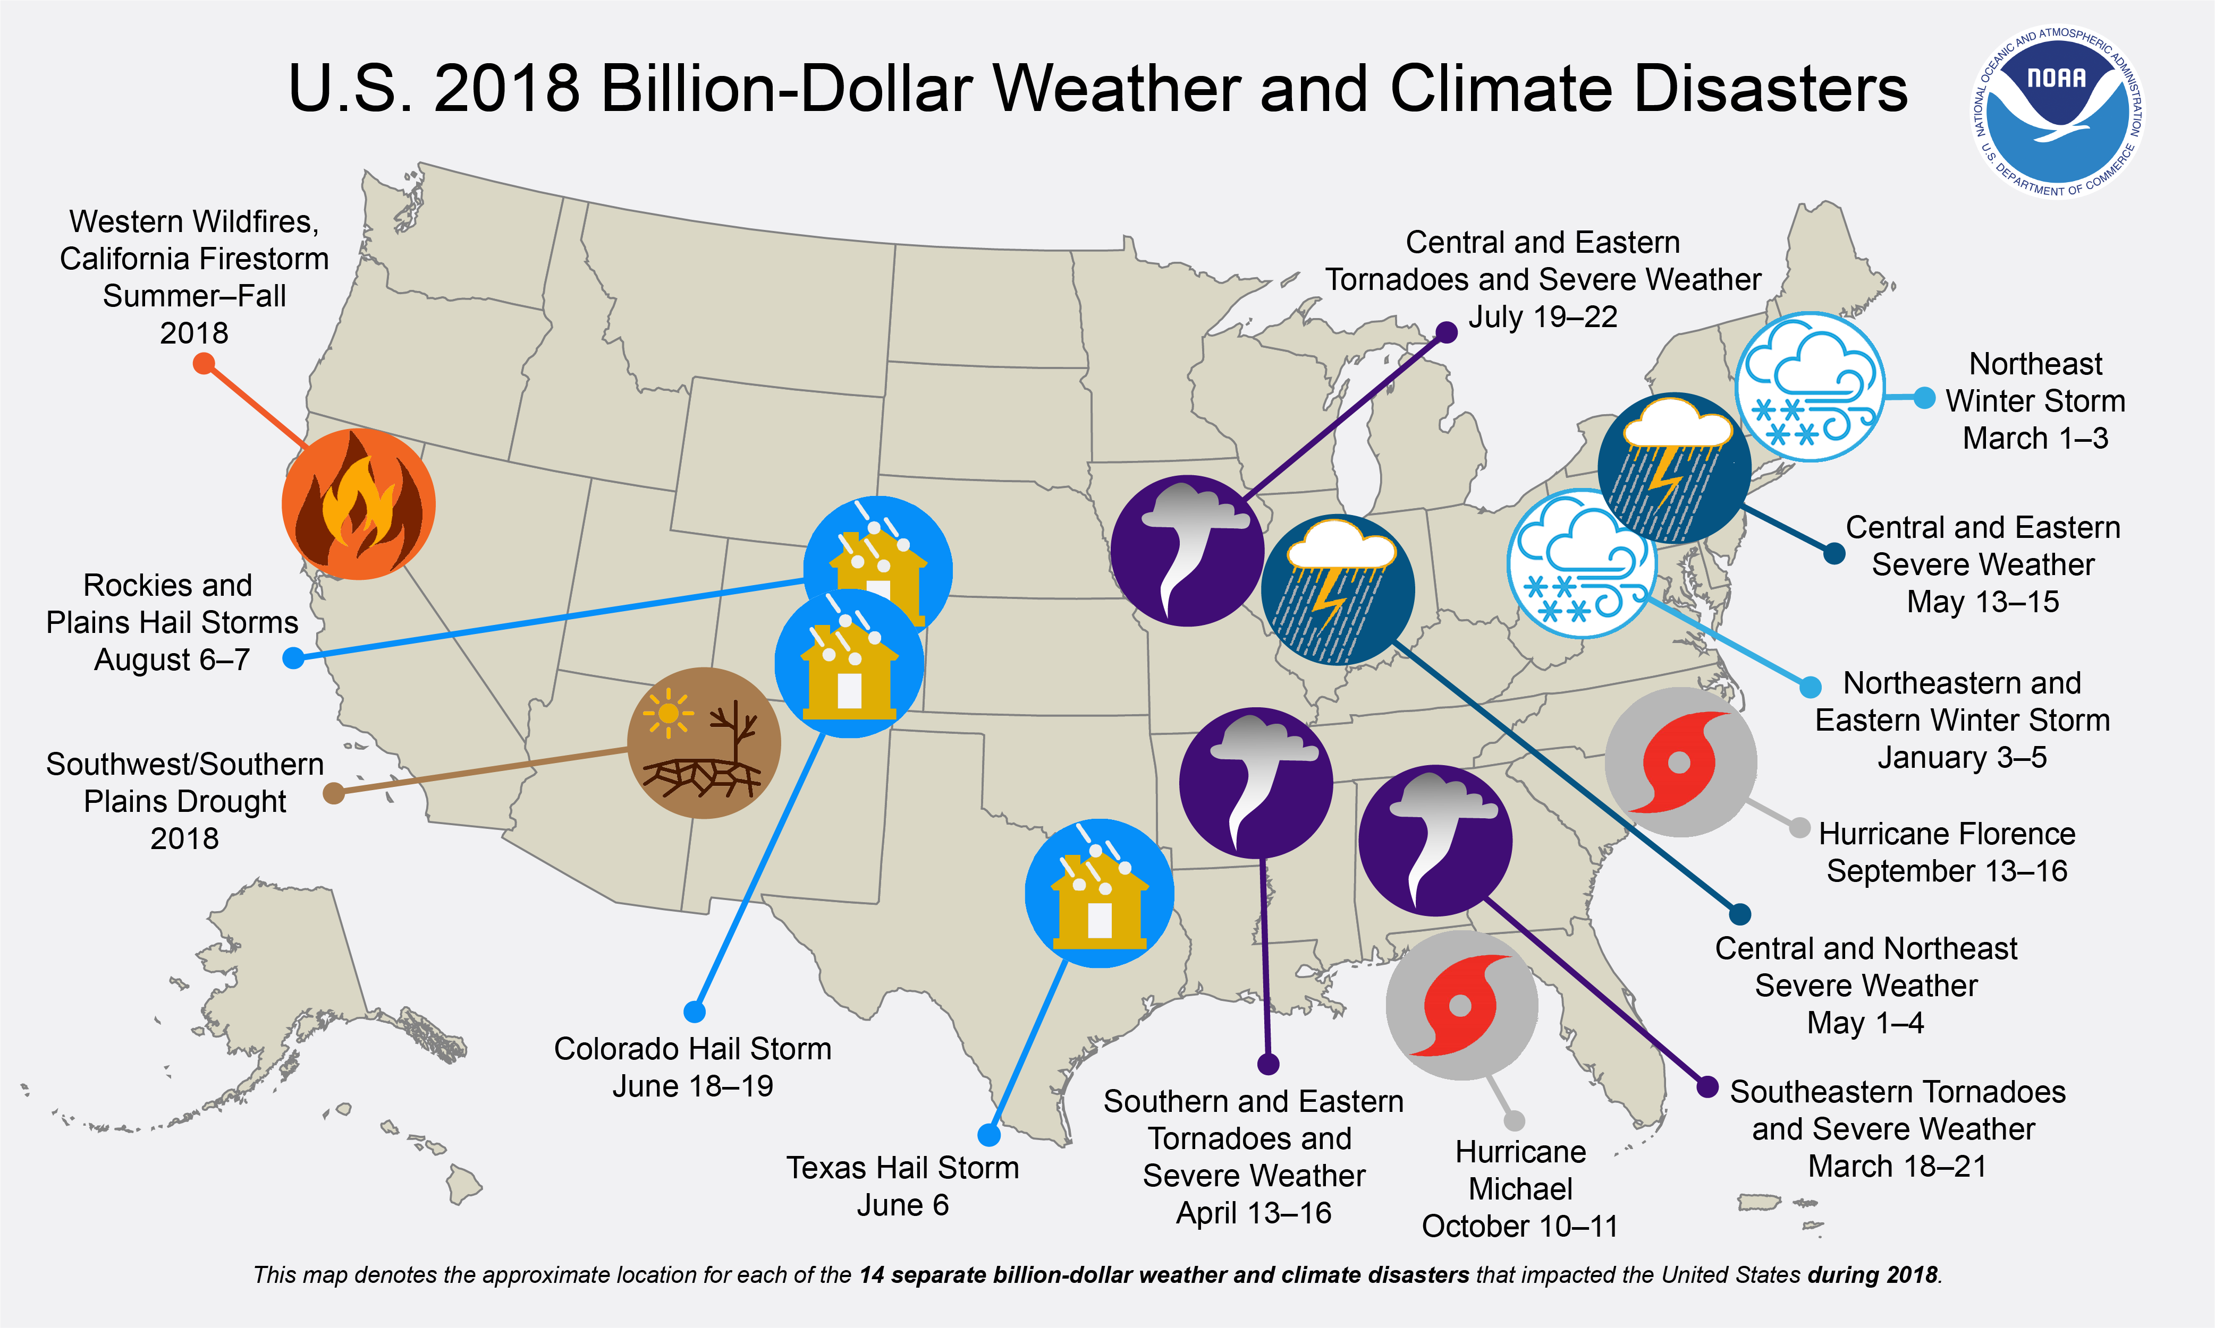
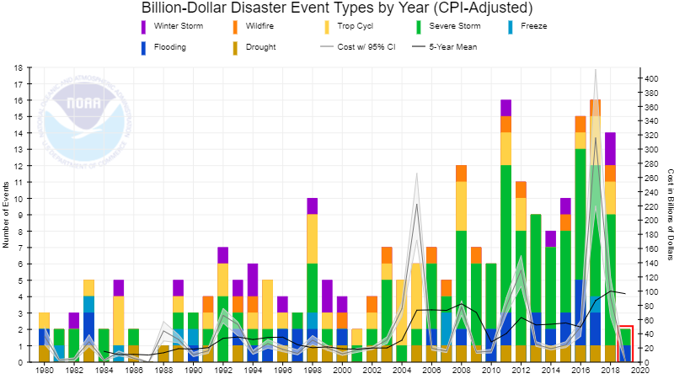
Billion Dollar Disasters
https://www.ncdc.noaa.gov/billions/
Notes:
During 2018, the U.S. experienced an active year of billion-dollar disaster events including the 4th highest total number of events, only behind the years 2017, 2011 and 2016. In 2018, the U.S. also experienced the 4th highest total costs ($91 billion) only behind the years 2017, 2005 and 2012.

Slide 16
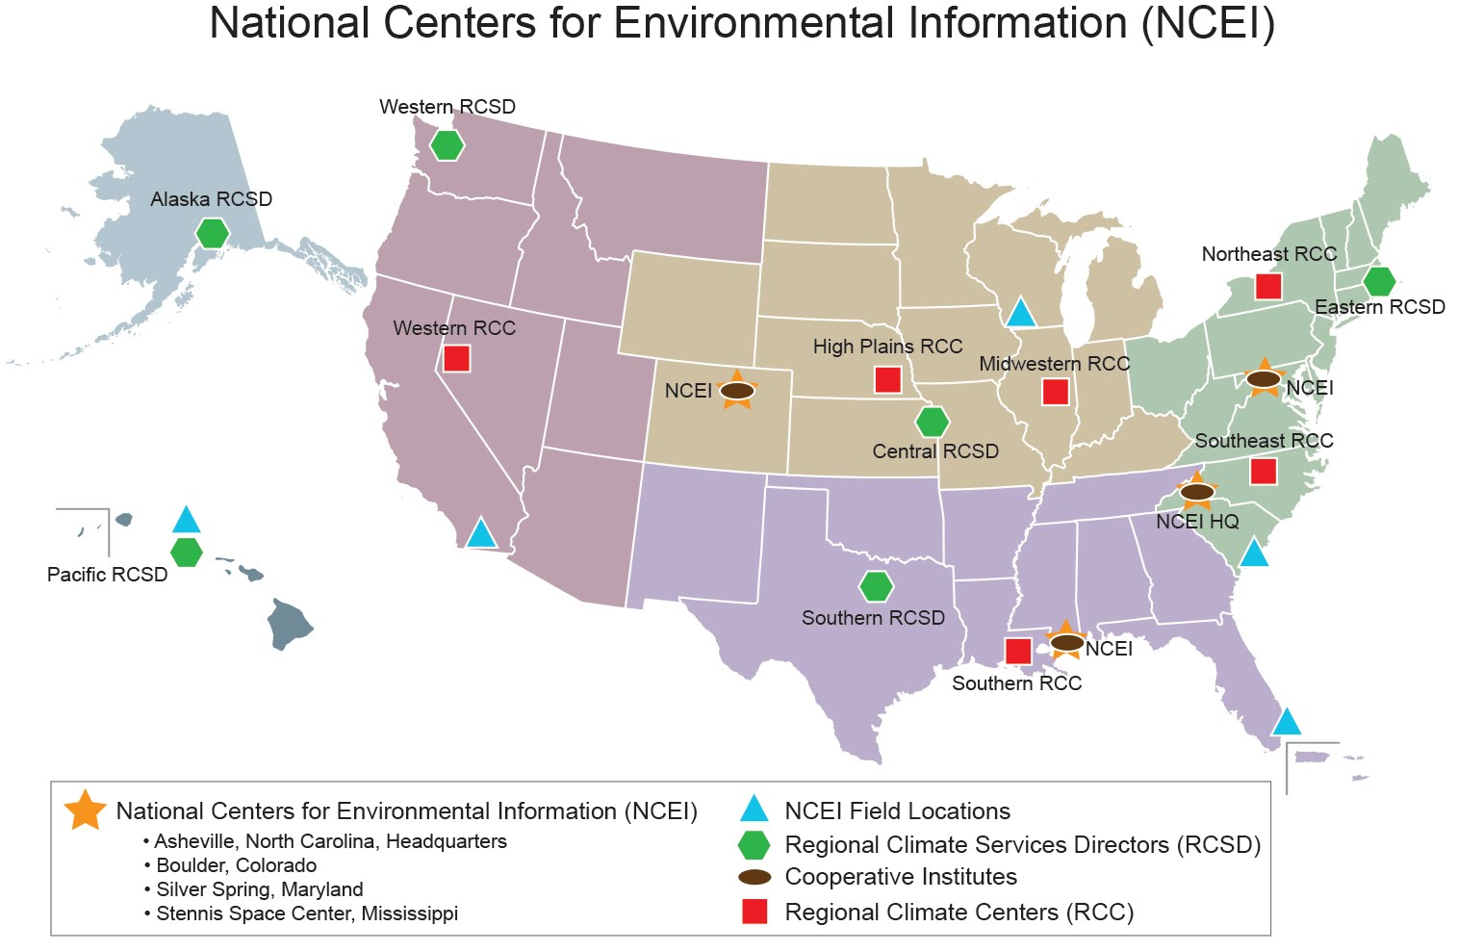
NCEI: A Nationwide Presence

Slide 17
Weather and Climate Timescales
Projections
Years
Forecast
Uncertainty
Outlooks
Seasons
Guidance
Months
Climate Prediction
Products
Threats Assessments
2 Week
Forecast Lead Time
1 Week
Forecasts
Days
Weather Prediction
Products
Watches
Hours
Warnings & Alert Coordination
Minutes
Benefits
Maritime
Health
Aviation
Agriculture
Commerce
Recreation
Life & Property
Fire Weather
Hydropower
Ecosystem
Environment
Space Operations
Emergency Mgmt
Energy Planning
Reservoir Control
Notes:
Climate and weather
There are additional activities within each of these that are clearly in the climate timescale– planning, infrastructure vulnerability assessments, etc

Slide 18
The Continuum of Regional Services
Information Needs, by sector
RCSD, others
Information Provider
NOAA, Core Partners, Academia
Technical Assistance and Tool Development
Who’s role?
Tool Delivery and Refinement
Who’s role?
Provision of information is highly dependent on the customer.
  Government to government- technical assistance, user engagement, refinement of information products
  Private sector enterprise- tailored tool development

Slide 19
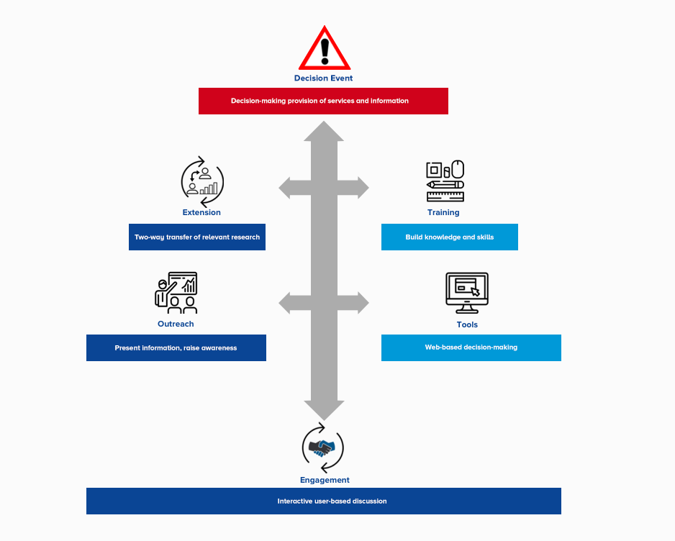
User Engagement as the Foundation
Nurtured relationships based on a foundation of trust and mutual respect
User requirements are derived from an understanding of their decision challenges
Timely response to their requirements form the basis of ongoing engagement and use-inspired product improvement

