Slide 1
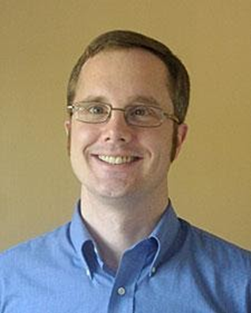
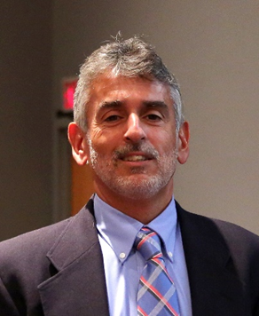
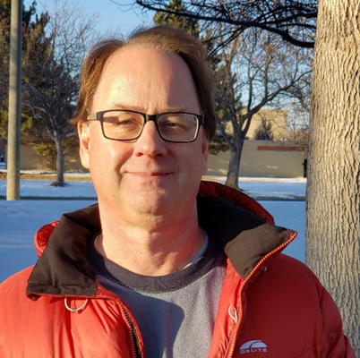
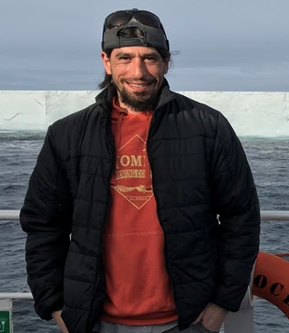
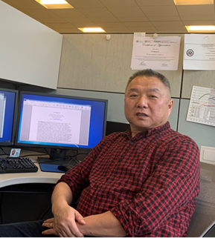
Summary of the Hydrology Panel
Moderator: Ralph Ferraro
Users: Aaron Jacobs (NWSFO), Andrew Orrison (NWS/NCEP/WPC), Pingping Xie (NWS/NCEP/CPC)
Developers: Bob Kuligowski (NESDIS/STAR), Ralph Ferraro (NESDIS/STAR), John Forsythe (CSU/CIRA)
Our primary focus was on precipitation and water vapor

Slide 2
Key Takeaways
Users ranging from NWSFO’s to National Centers rely on satellite derived products of precipitation and water vapor (andothers not necessarily within our panel - imagery, soil moisture, snow water equivalent, lightning, SST, NDVI) to help fulfill their NOAA mission goals
There is not a single product solution to their needs
The products are most useful in regions where in-situ data is lacking or unreliable, such as cceans and remote land regions (Alaska)
Ocean precip is of interest to show a forecaster whether a NWP initialized well and magnitudes/amounts moving onshore.
Specific applications include:
QPF, QPE
Magnitude of Atmospheric Rivers
Global climate monitoring (and a need for long term, consistent time series)
Developers work with a wide variety of measurements and try to fulfill the broad range of user needs ranging from “weather” to “climate”
Developers are burdened with instrument mitigation activities, post-launch check out, mandated system freezes, etc. which impedes tackling difficult retrieval issues that many users are requesting
Notes:
Part 1: Focus on Users perspective (maximum 10 mins from each panelist)
Discuss what they do and identify what is important to them. Describe the steps they take to make decisions and complete the tasks associated with the application area.
Highlight issues that make tasks time-consuming, unpredictable, or inefficient
Identify how satellite data are currently being used and ideas to improve the use of satellite data for their application area.
Part 2: Focus on Developers perspective (maximum 10 mins from each panelist)
Describe the unmet need served by their product(s), discuss the current development status of their product, describe future improvements to their products and applications to further serve unaddressed user needs..
Instructions for Users:
Users should provide attendees with an understanding of their decision-making process and the criteria they use to evaluate success as they progress toward completion of a task. Avoid describing solutions (e.g. satellite imagery and data) and instead provide perspective on your desired outcomes for each step in completing a task (such as issuing a severe thunderstorm warning), noting issues that make the process time-consuming, unpredictable, or inefficient Discuss satellite data used in their application including current shortfalls, and what they think is important to improve their capabilities. Additionally users should discuss now the satellite community can help and collaborate on future interests. Each user should limit their presentation to 5 slides and 10 minutes.
Instructions for Developers:
Developers should address the strengths of their products in meeting both met and unmet user needs, the logic behind not addressing other user needs, and how they envision developing future solutions that maximize the value of satellite data by developing solutions that address a broader range of the user’s unmet needs.. Each developer should limit their presentation to 5 slides and 10 minutes.

Slide 3
Key Challenges for Users
Improving data latency
Product spatial resolution in some cases
Data delivery/implementation/performance issues
Security
AWIPS SBN and LDM
AWIPS inability to keep up with amount of data
Staying informed of latest products and their performance characteristics
Climate users are working with inhomogeneous satellite time series to develop needed L3 data sets
Training
Data overload
Notes:
Part 1: Focus on Users perspective (maximum 10 mins from each panelist)
Discuss what they do and identify what is important to them. Describe the steps they take to make decisions and complete the tasks associated with the application area.
Highlight issues that make tasks time-consuming, unpredictable, or inefficient
Identify how satellite data are currently being used and ideas to improve the use of satellite data for their application area.
Part 2: Focus on Developers perspective (maximum 10 mins from each panelist)
Describe the unmet need served by their product(s), discuss the current development status of their product, describe future improvements to their products and applications to further serve unaddressed user needs..
Instructions for Users:
Users should provide attendees with an understanding of their decision-making process and the criteria they use to evaluate success as they progress toward completion of a task. Avoid describing solutions (e.g. satellite imagery and data) and instead provide perspective on your desired outcomes for each step in completing a task (such as issuing a severe thunderstorm warning), noting issues that make the process time-consuming, unpredictable, or inefficient Discuss satellite data used in their application including current shortfalls, and what they think is important to improve their capabilities. Additionally users should discuss now the satellite community can help and collaborate on future interests. Each user should limit their presentation to 5 slides and 10 minutes.
Instructions for Developers:
Developers should address the strengths of their products in meeting both met and unmet user needs, the logic behind not addressing other user needs, and how they envision developing future solutions that maximize the value of satellite data by developing solutions that address a broader range of the user’s unmet needs.. Each developer should limit their presentation to 5 slides and 10 minutes.

Slide 4
Key Challenges for Developers
Baseline product developers can be inhibited by sensor mitigation and post-launch check out activities
Delays/limits product advancements
Inhibited by the R20 process and often work “back door” solutions to provide users with improvements in a reasonable amount of time
This often leads to user “confusion”
Resources for product reprocessing after L1 and algorithm improvements
Keeping up with technological changes
Satisfying all user needs
Forecasters desire applied climatology products to provide context for weather events (update current products like %TPW from normal, etc.)
Specific retrieval areas:
Orographic precipitation
Regional retrieval algorithms
Multisensor, multi-spectral approaches
Notes:
Part 1: Focus on Users perspective (maximum 10 mins from each panelist)
Discuss what they do and identify what is important to them. Describe the steps they take to make decisions and complete the tasks associated with the application area.
Highlight issues that make tasks time-consuming, unpredictable, or inefficient
Identify how satellite data are currently being used and ideas to improve the use of satellite data for their application area.
Part 2: Focus on Developers perspective (maximum 10 mins from each panelist)
Describe the unmet need served by their product(s), discuss the current development status of their product, describe future improvements to their products and applications to further serve unaddressed user needs..
Instructions for Users:
Users should provide attendees with an understanding of their decision-making process and the criteria they use to evaluate success as they progress toward completion of a task. Avoid describing solutions (e.g. satellite imagery and data) and instead provide perspective on your desired outcomes for each step in completing a task (such as issuing a severe thunderstorm warning), noting issues that make the process time-consuming, unpredictable, or inefficient Discuss satellite data used in their application including current shortfalls, and what they think is important to improve their capabilities. Additionally users should discuss now the satellite community can help and collaborate on future interests. Each user should limit their presentation to 5 slides and 10 minutes.
Instructions for Developers:
Developers should address the strengths of their products in meeting both met and unmet user needs, the logic behind not addressing other user needs, and how they envision developing future solutions that maximize the value of satellite data by developing solutions that address a broader range of the user’s unmet needs.. Each developer should limit their presentation to 5 slides and 10 minutes.

Slide 5
Ideas to Improve User Experience
“Connecting the dots” – how can a unified way forward be developed to fully connect users, developers, trainers, system implementers, etc.?
On the NESDIS side, we have inconsistencies on how we do our business (caveat – it’s nobody’s fault, processes have been in place for years and its challenging to unify them)
NOAA is “big and complicated”, we need to do better connecting NESDIS to NWS needs – it goes beyond having a bunch of requirements on spreadsheets.
Meetings such as this one is extremely beneficial
There are typically several versions of climate products to capture uncertainty. This is normal in climate research but can be confusing / unworkable for forecasters. This is an example of where training can help, to know which one to use.
Notes:
Part 1: Focus on Users perspective (maximum 10 mins from each panelist)
Discuss what they do and identify what is important to them. Describe the steps they take to make decisions and complete the tasks associated with the application area.
Highlight issues that make tasks time-consuming, unpredictable, or inefficient
Identify how satellite data are currently being used and ideas to improve the use of satellite data for their application area.
Part 2: Focus on Developers perspective (maximum 10 mins from each panelist)
Describe the unmet need served by their product(s), discuss the current development status of their product, describe future improvements to their products and applications to further serve unaddressed user needs..
Instructions for Users:
Users should provide attendees with an understanding of their decision-making process and the criteria they use to evaluate success as they progress toward completion of a task. Avoid describing solutions (e.g. satellite imagery and data) and instead provide perspective on your desired outcomes for each step in completing a task (such as issuing a severe thunderstorm warning), noting issues that make the process time-consuming, unpredictable, or inefficient Discuss satellite data used in their application including current shortfalls, and what they think is important to improve their capabilities. Additionally users should discuss now the satellite community can help and collaborate on future interests. Each user should limit their presentation to 5 slides and 10 minutes.
Instructions for Developers:
Developers should address the strengths of their products in meeting both met and unmet user needs, the logic behind not addressing other user needs, and how they envision developing future solutions that maximize the value of satellite data by developing solutions that address a broader range of the user’s unmet needs.. Each developer should limit their presentation to 5 slides and 10 minutes.

