Slide 1
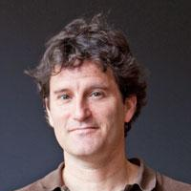
Data driven discretization for partial differential equations
*
⁺
Stephan Hoyer*
Yohai Bar-Sinai⁺
Dmitrii
Kochkov*
Jason Hickey*
Michael
Brenner*⁺
NOAA AI Workshop
April 24, 2019, College Park, MD
arXiv:1808.04930

Slide 2
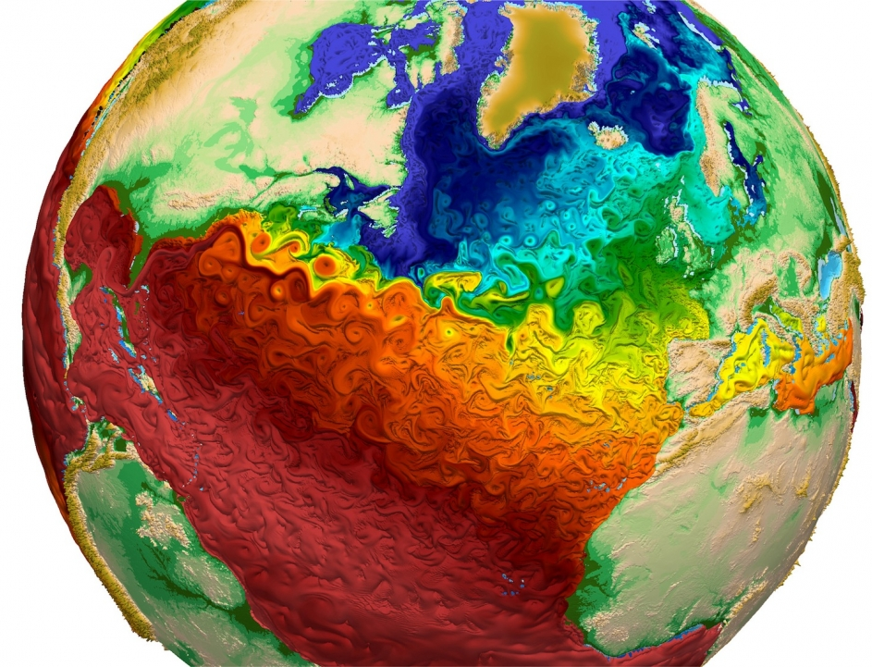
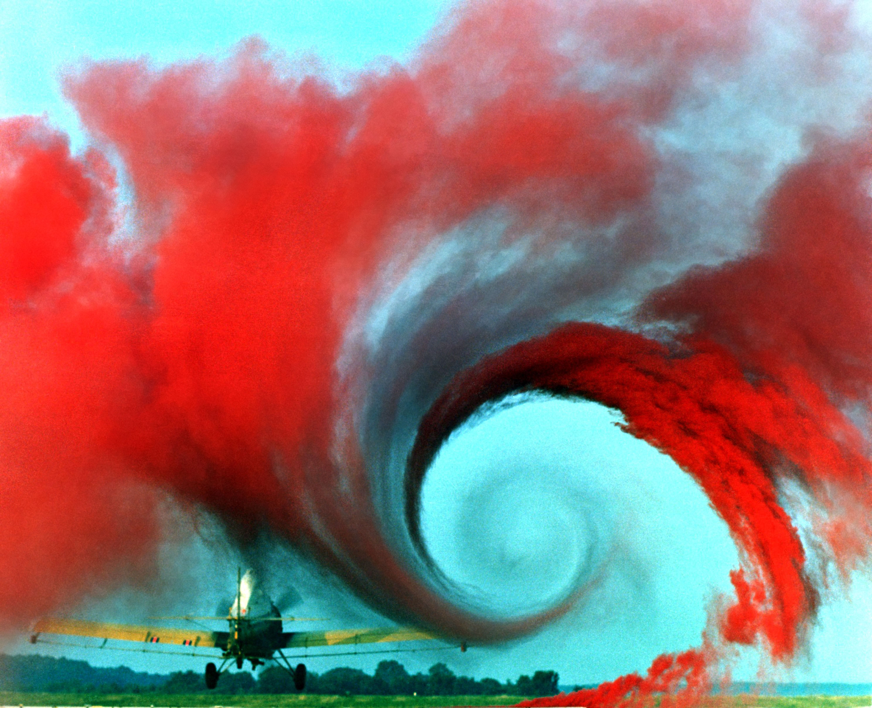
Partial differential equations (PDEs) model the everyday world -- all continuous physics
Weather and climate
Aerodynamics
Combustion
Example: Navier-Stokes:
Notes:
Sources:
http://www.climatecentral.org/news/one-image-future-climate-models-18844
NASA Wake Vortex Study https://commons.wikimedia.org/wiki/File:Airplane_vortex_edit.jpg
3D simulation of a “lifted ethylene/air jet flame in a hot coflow” from https://science.energy.gov/~/media/ascr/ascac/pdf/reports/Exascale_subcommittee_report.pdf

Slide 3
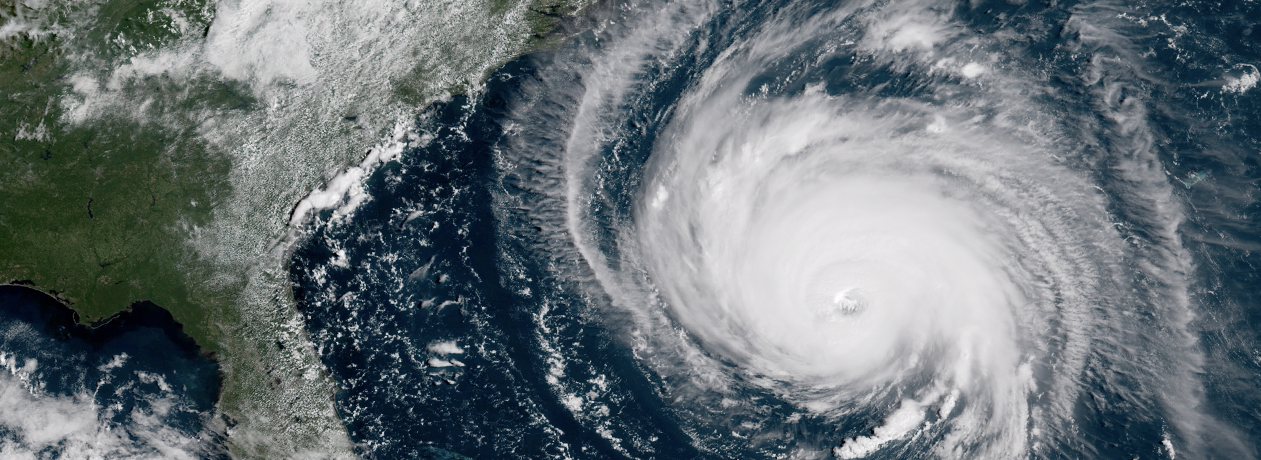
Most PDEs are solved with woefully inadequate resolution
Photo
Simulated resolution
in a state of the art weather model
The Challenge: Need dx→0 for accuracy, but runtime is O(1/dx^{d+1})

Slide 4
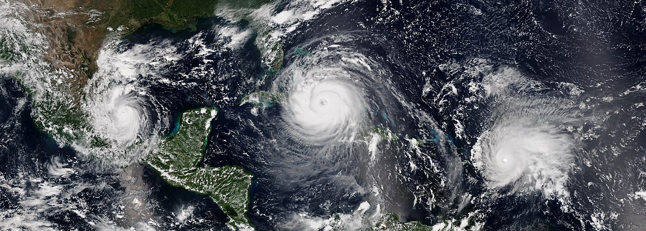
Can we exploit repeated patterns to better solve PDEs?
Traditional numerical methods don’t!

Slide 5
“Super-resolution” with machine learning
Input
Bicubic
Neural net
Original (4x resolution)
How we solve PDEs
Ledig et al (Twitter), arXiv:1609.04802
Notes:
“Photo-Realistic Single Image Super-Resolution Using a Generative Adversarial Network“ from a group at Twitter
The “Bicubic” picture is similar to the current state of the art for PDEs -- it’s a simple form of polynomial interpolation not informed by the data at all.

Slide 6
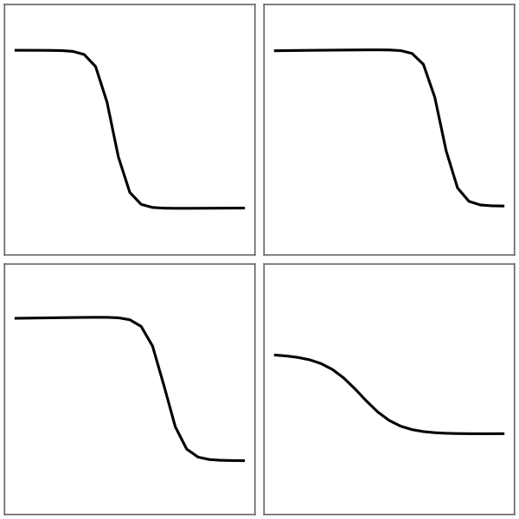
Solutions to a PDE

Slide 7
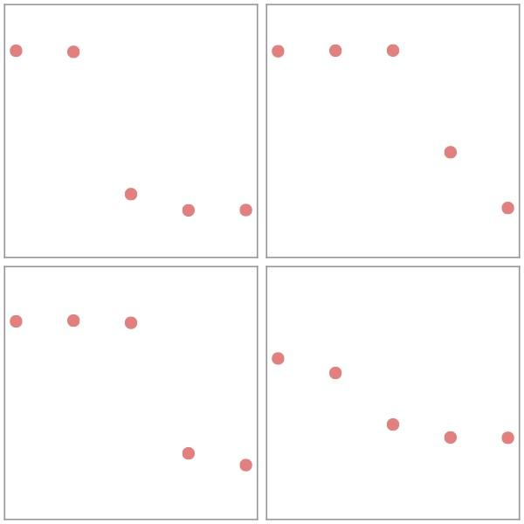
Solutions to a PDE
Choose grid points

Slide 8
Solutions to a PDE
Choose grid points
How do we estimate derivatives to advance to the next time step?

Slide 9
Solutions to a PDE
Choose grid points
How do we estimate derivatives to advance to the next time step?
Polynomial interpolation

Slide 10
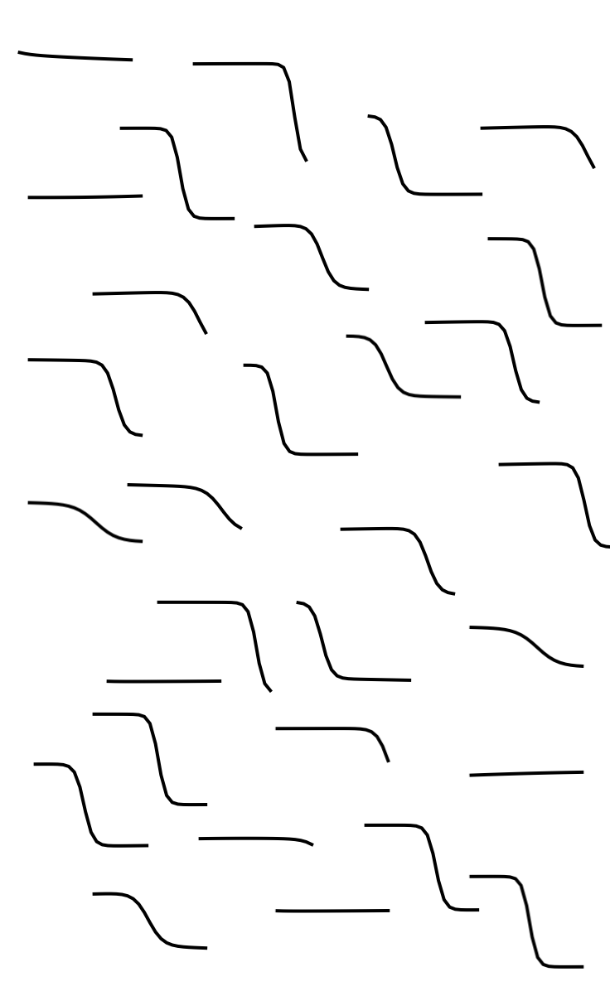
But we know these are solutions to Burgers’ equation

Slide 11
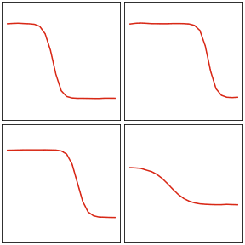
Solutions to a PDE
Choose grid points
How do we estimate derivatives to advance to the next time step?
Polynomial interpolation
Learned interpolation

Slide 12
Solutions to a PDE
Choose grid points
How do we estimate derivatives to advance to the next time step?
Polynomial interpolation
Learned interpolation

Slide 13
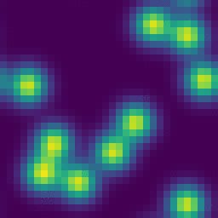
What coarse graining looks like in theory
High resolution
Exact coarse graining
4x coarse graining -> 256x speedup?

Slide 14
What coarse graining looks like in practice
Finite volume method
+ upwinding & slope limiting
Your choice of unstable or inaccurate.
Can we do better with machine learning?

Slide 15
Estimating derivatives is the central approximation for numerically solving PDEs
e.g.,
This is only part we want to replace with ML

Slide 16
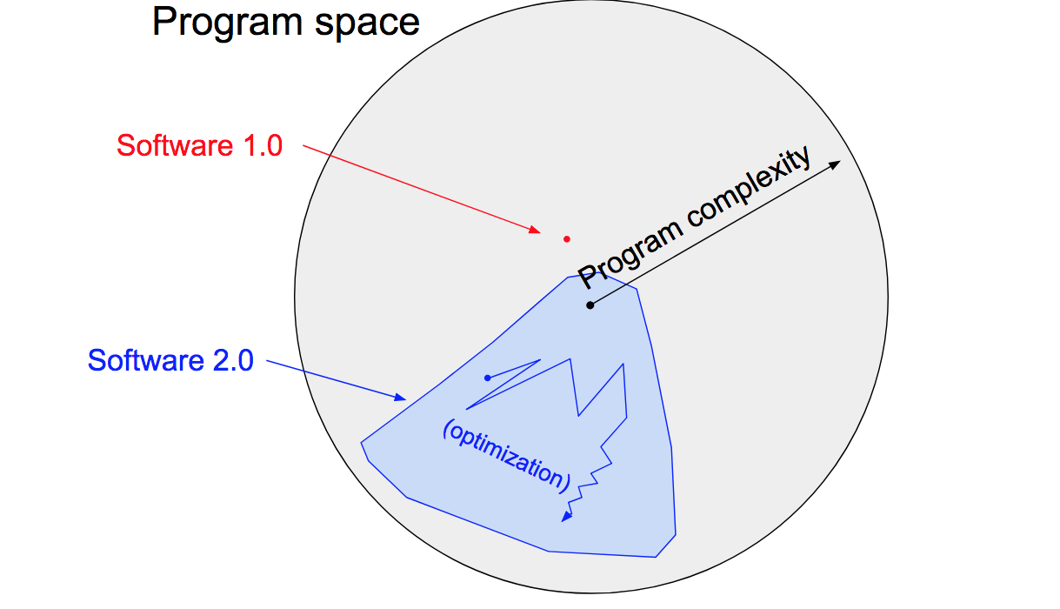
Deep learning is enabled by “differentiable programming”
Automatic differentiation
+
Many parameters
=
Self-tunable programs
Andrej Karpathy, “Software 2.0”

Slide 17
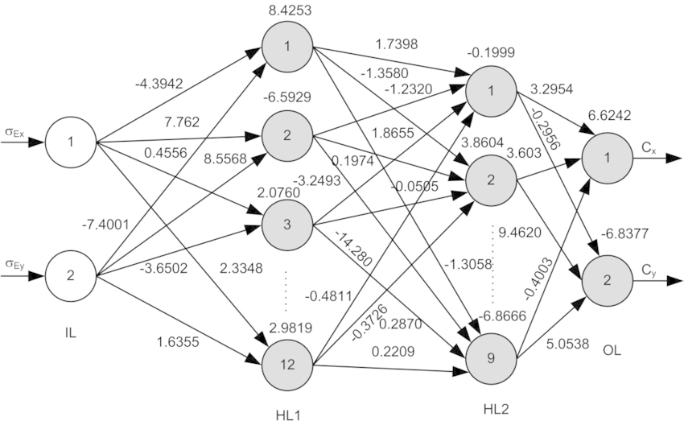
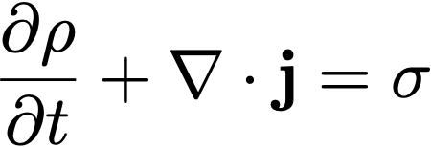
Differentiable programs allow for the best of both worlds
Machine learning for better approximations
Constraints for generalization

Slide 18
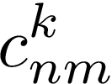
Our differentiable programs
Function value at time t
Spatial derivatives
Learned model
Coefficients
Flux (equation specific)
conv1d
polynomial accuracy
relu
conv1d
relu
conv1d
Time derivative
Function value at time t+𝚫t
(method of lines)
Loss
Notes:
We learn how to approximate spatial derivatives
Things we don’t need to learn: Conservation of mass, Physical equation, How to integrate in time
u(x_n)
c_{nm}
\frac{\partial^k u(x_n)}{\partial x^k} = \sum_m c_{nm}^k u(x_{n-m})
f(x_n) = F\left(x_n, u(x_n), \frac{\partial}{\partial x} u(x_n), \frac{\partial^2}{\partial x^2} u(x_n), \ldots\right)
\frac{\partial u(x_n)}{\partial t} = \frac{1}{\Delta x} \left[ f(x_\left{n+\frac{1}{2}}\right) - f\left(x_{n-\frac{1}{2}}\right) \right]

Slide 19
Coarse graining results for Burgers’ equation

Slide 20
We get accurate results on much coarser grids

Slide 21
Our deep models learn physical principles
It learned “upwinding”!

Slide 22
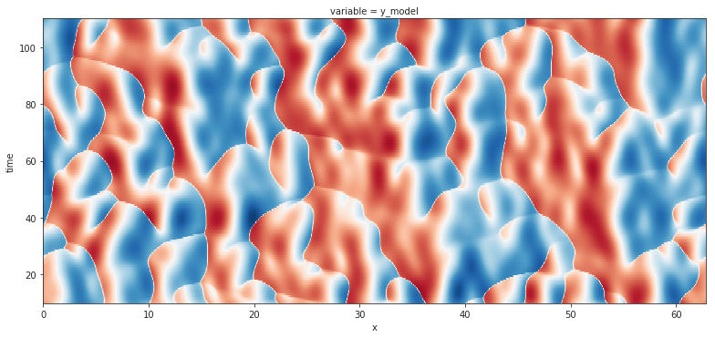
Our model extrapolates to much larger spatial domains
Size of training domain

Slide 23
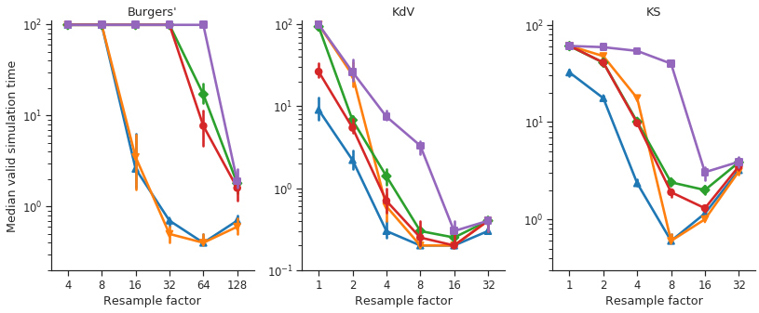
The same approach works for a suite of 1D PDEs
Burgers’
Korteweg-de Vries
Kuramoto Sivashinksy
Median valid simulation time
Resample factor
Resample factor
Resample factor

Slide 24
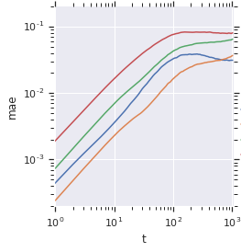
Preliminary results on 2D advection
Neural net
8x baseline
4x baseline
2x baseline
8x neural net
Mean absolute error
Comparable accuracy to 4x coarser baseline method
Time

Slide 25
We used machine learning to build better* PDE solvers
These solvers are equation specific
Can beat hand-tuned methods like WENO
Stability remains an ongoing challenge -- low loss does not mean stable!
arXiv:1808.04930
github.com/google/pde-superresolution

