Slide 1
17th GHRSST Science Team Meeting 6-10 June 2016, Washington, DC, USA
In situ SST Quality Monitor (iQuam)
www.star.nesdis.noaa.gov/sod/sst/iquam/
SST Quality Monitor (SQUAM)
www.star.nesdis.noaa.gov/sod/sst/squam/
Sasha Ignatov
Xinjia Zhou, Prasanjit Dash*,
Kai He, Maxim Kramar, Feng Xu**
NOAA STAR; CSU CIRA; GST Inc; *EUMETSAT; **Fudan University, China
Supported by JPSS & GOES-R, and NOAA ORS & PSDI Programs
Thanks to NOAA and GHRSST Colleagues and Users

Slide 2
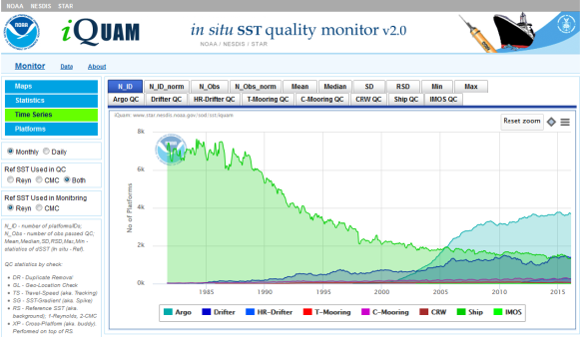
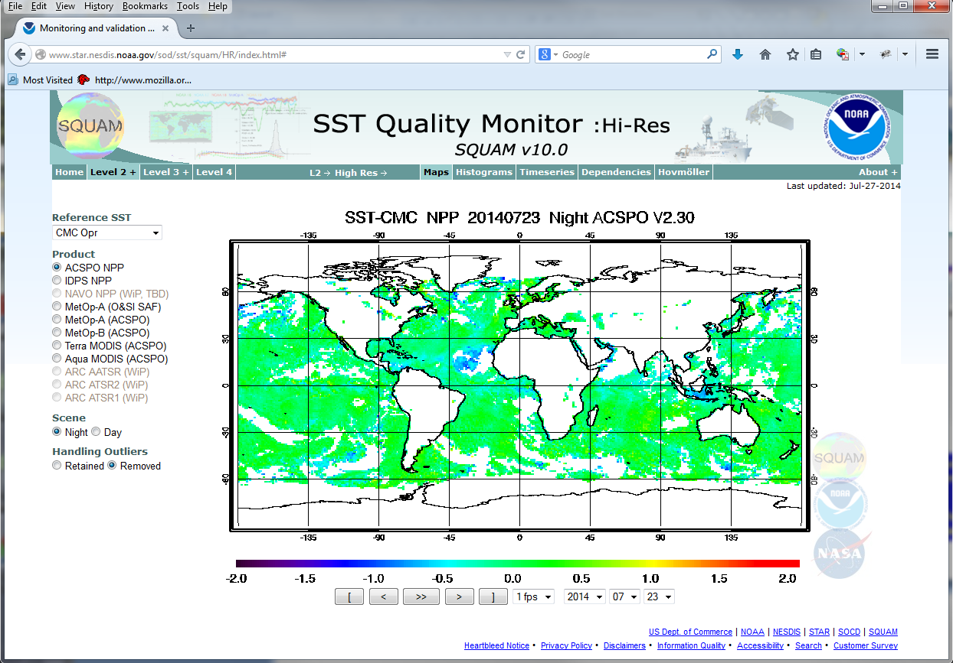
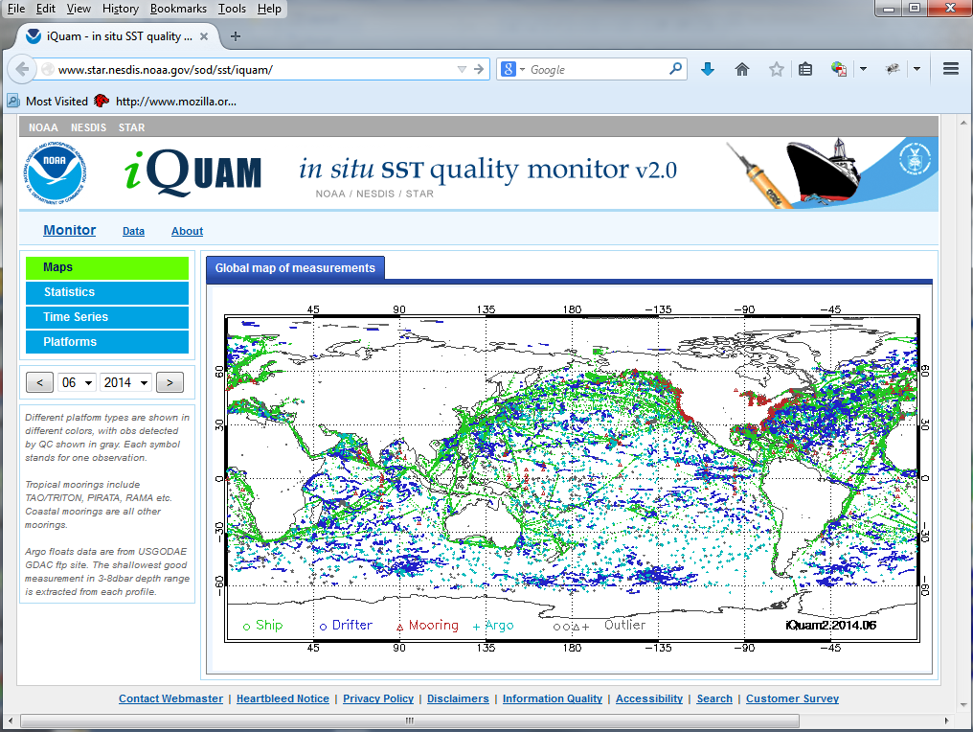
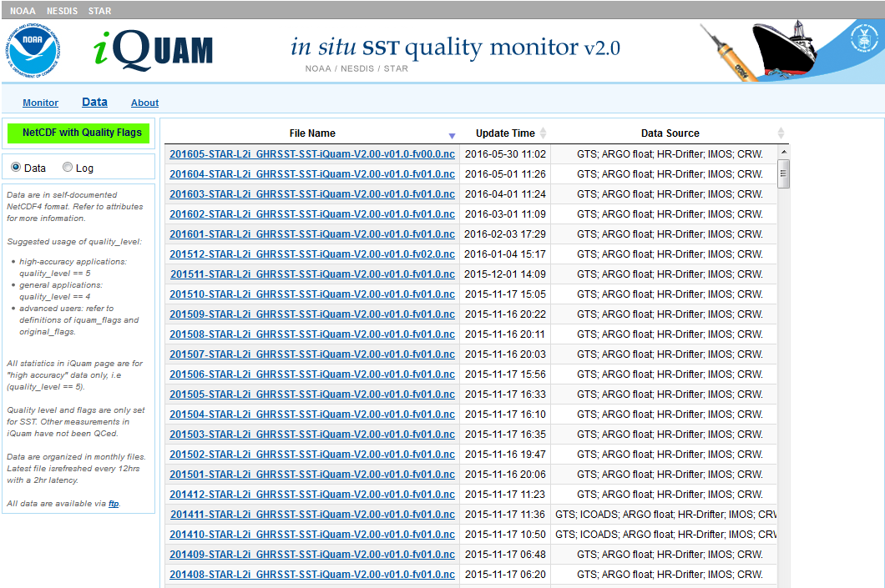
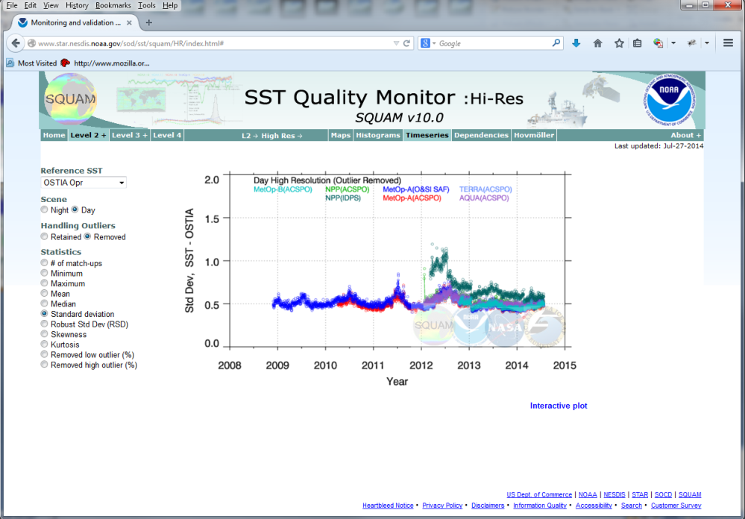
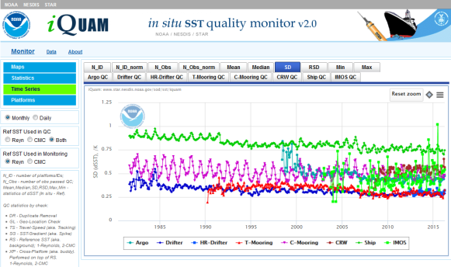
Satellite SSTs – iQuam –
Match-ups – Monitoring in SQUAM
NOAA L2
NOAA L3
NOAA L4
Satellite-iQuam- L4 Match-Ups
iQuam Data
www.star.nesdis.noaa.gov/sod/sst/iquam/
GHRSST L2
GHRSST L3
GHRSST L4
www.star.nesdis.noaa.gov/sod/sst/squam/
Monitoring in iQuam
Monitoring in SQUAM

Slide 3
Major Functionalities of iQuam
Collect in situ data (1981-pr) from multiple sources
Perform uniform and accurate QC
Monitor online statistical summaries of in situ minus reference L4 SST
by platform type (drifters, ships, tropical/coastal moorings, ARGO floats, etc)
by individual platforms/IDs
Serve QC’ed data (updated twice daily) to users
NOAA JPSS, GOES-R, Himawari, AVHRR SQUAM (US)
JPL MUR (US) – M. Chin
U. Miami MODIS, VIIRS (US) – K. Kilpatrick, L. Williams
Felyx (France/UK) – J.-F. Piolle
CMS (France) – A. Marsouin
JAXA (Japan) – Y. Kurihara, M. Kachi
Ocean University (China) – L. Guan
CMA (China) – S. Wang
SOA (China) – Q. Tu
NOAA geo-polar blended team (US) – P. Koner, J. Mittaz, A. Harris, E. Maturi
NOAA NCEI (K. Saha)
EUMETSAT (Germany) – P. Dash, A. O’Carroll

Slide 4
iQuam2 (2015) additions to iQuam1 (2009)
Extended iQuam period to 1981 (iQuam1: 1991) using ICOADS data
Improved QC
Added 2nd reference SST – CMC (iQuam1 only used Reynolds SST)
Added CMS black list, and individual QFs from data producers
Added “performance history” check (iQuam version of CMS/UKMO “black lists
Added 4 new in situ data types (in addition to the 4 available in iQuam1: ships, drifters, tropical moorings, and coastal moorings)
ARGO Floats (in 2 modes: NRT and post-processing)
High-Resolution GHRSST Drifters
IMOS Ships (ABoM/Helen Beggs)
Coral Reef Watch buoys
Improved Web interface
Added daily statistics (to available monthly)
Enhanced web graphics (interactive display; print/save capability)
Redesigned and optimized the code
Changed output format to NetCDF4 “GDS2i”

Slide 5
Data

Slide 6
Ongoing iQuam2 work
Completing transition to iQuam2 (current default: iQuam1)
Will send a 2-4 week warning via GHRSST
We recommend switching to iQuam2 NetCDFs data feed, soonest
iQuam1 hdf data continue being produced but are not supported any longer
No fixes will be possible in case the iQuam1 processing fails – use at your own risk!
iQuam2: More in situ data (e.g., ARGO floats), longer record (1981-pr), better QC
Data (structure, location) have been finalized and won’t change
Have a question? Check online FAQs
If still have questions – let us know, we will help
Working to document iQuam2 in peer-reviewed paper
Let us know what we can improve?
Tell us if you use iQuam data (to be informed about patches etc)

Slide 7
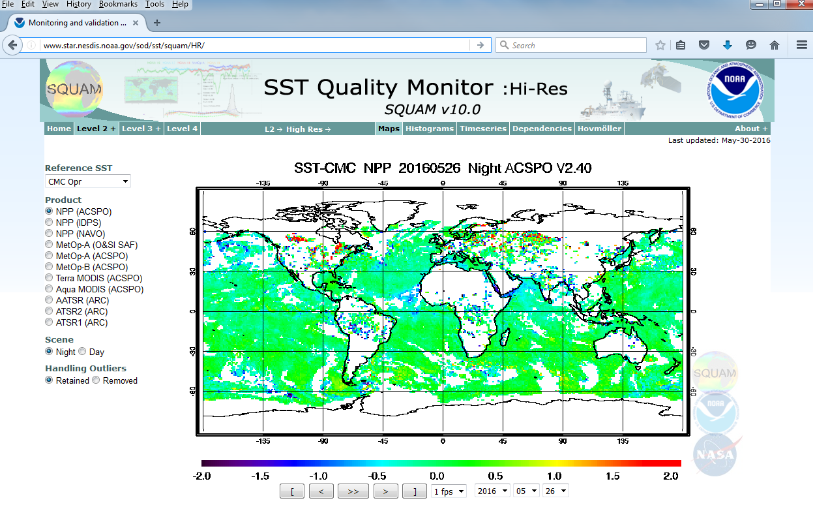
SQUAM
www.star.nesdis.noaa.gov/sod/sst/squam/
Dash, et al: The SST Quality Monitor (SQUAM), JTECH, 2010.
Notes:
Specific for nesdis

Slide 8
Major SQUAM Additions Since G16
Himawari SST
ACSPO H8 SST (14 Apr 2015 – on)
NOAA heritage H7 (MTSAT2) SST (14 Apr 2015 - 4 Dec 2015)
JAXA H8 SST (7 Jul 2015 – on)
AVHRR Reprocessing
ACSPO GAC RAN1 (2002 – 2015)
PFV5.2 (1981 – 2012)
AVHRR CCI (1991 – 2010)

Slide 9
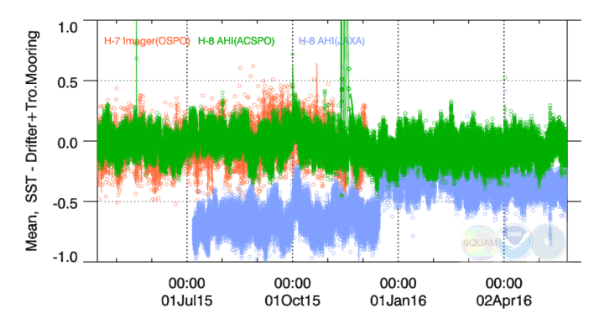
Mean Bias wrt. iQuam2 (Drifters + Tropical Moorings)
www.star.nesdis.noaa.gov/sod/sst/squam/GEO/
NOAA Heritage H7
NOAA ACSPO H8
JAXA H8
NOAA heritage H7 SST used before Dec’2015, ACSPO H8 SST after Dec’2015
JAXA skin SST (expected ~-0.17K) produced since Jul’2015
The JAXA processing apparently has changed in Dec 2015

Slide 10
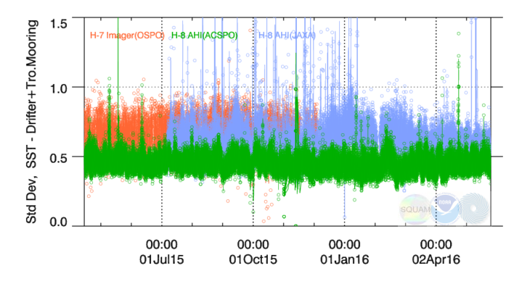
Std. Dev. wrt. iQuam2 (Drifters + Tropical Moorings)
www.star.nesdis.noaa.gov/sod/sst/squam/GEO/
NOAA Heritage H7
NOAA ACSPO H8
JAXA H8
SD for ACSPO H8 SST tends to be on a lower envelope of the 3 products
SD for JAXA SST is typically between ACSPO H8 and NOAA heritage H7
After Dec 2015, SD and outliers in JAXA SST have reduced

Slide 11
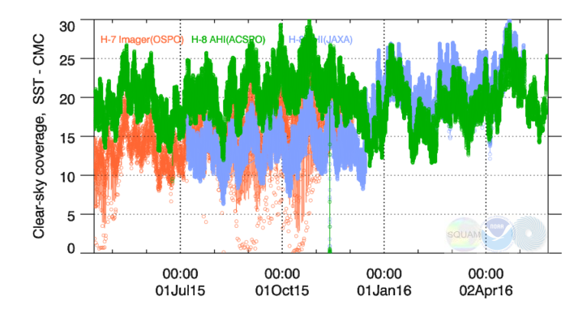
% Fraction of clear-sky ocean pixels with valid SST
www.star.nesdis.noaa.gov/sod/sst/squam/GEO/
NOAA Heritage H7
JAXA H8
NOAA ACSPO H8
ACSPO H8 SST tends to be on an upper envelope of clear-sky SST domain
H7 SST domain was smaller and less stable
JAXA H8 SST domain increased in Dec’2015, now comparable with ACSPO

Slide 12
Ongoing SQUAM Work
Reorganizing SQUAM (underway)
Regroup products, link geo, etc
Exclude products with no interest/feedback (from data producers / users)
Intuitive interface, complete functionality, fast response, dynamic graphics
We will try to contribute to CDR assessment
Tell us what we can do better

Slide 13
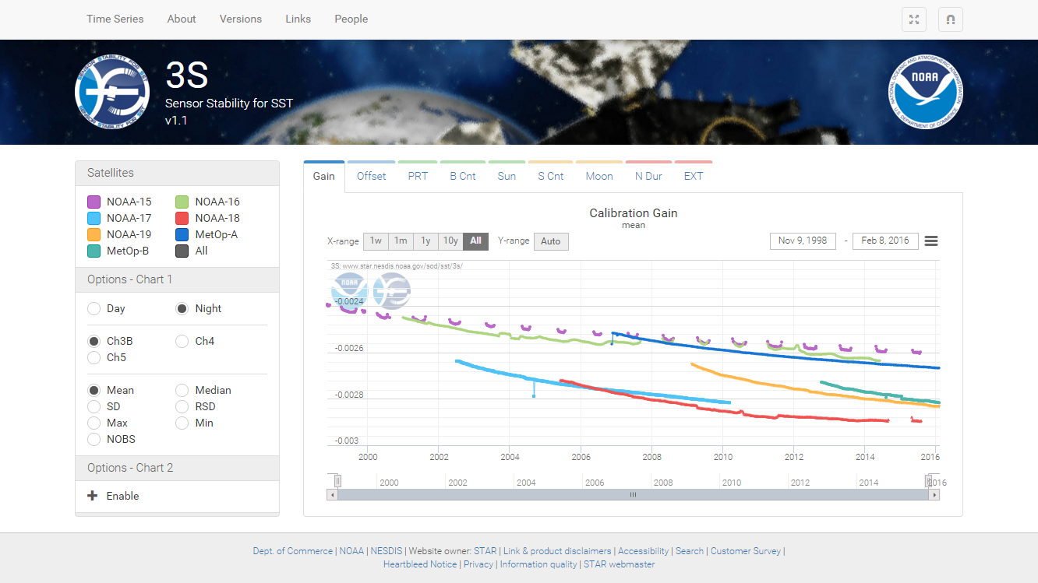
More SST Monitoring Resources at G-XVI
Feng Xu – Error Characterization in iQuam SSTs using triple-collocations with satellite data – Poster #52
Yanni Ding – ACSPO Regional Monitor for SST (ARMS) – Poster #8
Kai He – Sensor Stability for SST (3S) – Poster #14
www.star.nesdis.noaa.gov/sod/sst/arms/
www.star.nesdis.noaa.gov/sod/sst/3s/
Thank You!

