Slide 1
The Assessment of Atmospheric Profiles and Stability at selected GCOS Reference Upper Air Network (GRUAN) Sites using the NOAA Product Validation System (NPROVS)
Cassandra P. Calderella IMSG/STAR
September 2019

Slide 2
Outline
Introduction & Background
Methodology
Results
Discussion
Summary & Path Forward
References

Slide 3
Introduction & Background
Acronym | Meaning
ARM | Atmospheric Radiation Measurement
CESSRST | Center for Earth System Sciences and Remote Sensing Technologies
DOE | Department of Energy
ECMWF | European Centre for Medium-Range Weather Forecasts
EPP/MSI | Educational Partnership Program with Minority Serving Institutions
GCOS | Global Climate Observation System
GRUAN | GCOS Reference Upper Air Network
LIDAR | Light Detection and Ranging
NERTO | NOAA Experiential Research and Training Opportunities
NOAA | National Oceanic Atmospheric Administration
NPROVS | NOAA Product Validation System
NUCAPS | NOAA-Unique Combined Atmospheric Processing System
PDISP | Profile Display
RAOB | Rawinsonde Observation

Slide 4
Introduction & Background
School: University of Maryland-Baltimore County
Program: Master of Science- Atmospheric Physics
Academic Advisor: Dr. Belay Demoz
NOAA Mentor: Mr. Anthony Reale
Affiliations: NOAA-CESSRST/EPP-MSI, Joint Center for Earth Systems Technology (JCET), Center for Satellite and Applications Research (STAR), UMBC, I.M. Systems Group (IMSG)
NERTO: 12-week internship

Slide 5
Introduction & Background
Objectives:
Become familiar with NOAA NPROVS System
Using NPROVS, select co-located satellite (NUCAPS) and radiosonde observations at the SGP ARM/GRUAN and Beltsville HUBC/GRUAN sites from NPROVS.
Integrate ground ancillary measurements (LIDAR, MWR) from the selected GRUAN sites not available in NPROVS
Analyze NUCAPS profiles against radiosonde and ancillary profiles in context of their application for the derivation of atmospheric stability indices (CAPE).
Analysis includes NUCAPS comparisons against individual platforms and sensitivity to changes in weather and regional aspects.
The overall goal for supplementing NPROVS analysis with ground ancillary data and atmospheric stability (CAPE) were met.

Slide 6
Methodology
Data Collection:
Identify collocated satellite, NWP and radiosonde observations at the Southern Great Plains and Beltsville GRUAN sites for the summer 2020 period.
Subsample to a time window of -1.5 to 2.0 hours and a distance window of 100 km to ensure that the radiosonde launch coincides with the overhead passing of the satellite.
Append ancillary profiles from each site (not included in NPROVS) that are collocated with the observations from Step 2; Raman LIDAR located at the Southern Great Plains DOE-ARM site and the Microwave Radiometer located at the HUBC Beltsville campus.
Perform vertical statistics for collocated profiles (excluding) using NPROVS.
Calculate scatter plots for all profiles from Step 2.
Provide case studies for selected cases

Slide 7
Methodology
Vertical statistics:
Include ECMWF, NUCAPS NOAA-20 (Old), and NUCAPS NOAA-20 (New) with Radiosonde as the baseline reference. LIDAR and MWR vertical statistics cannot be computed at this time, so they are excluded from this process.
$\overline{x}=\frac{(\sum{x})}{n}$ defines the mean while $S= \sqrt{\frac{{\sum{(x−\overline{x}) }}^{2}}{N}}$defines the standard deviation (the square root of the variance)
X-axis scales for temperature range from -2 to +4 while x-axis scales for water vapor range from -25 to +75
Mixing ratio differences are reported in percent error. $δ=\left|\frac{satellite−raob}{raob}\right|∗100\%$
Produce NPROVS vertical statistical analysis (plots)

Slide 8
Methodology
CAPE Calculations:
Prepare collocated profiles including Raman LIDAR and MWR data for NWS SHARPPY CAPE calculation (courtesy of R. Esmaili, STAR/ITC)
$CAPE=g\int_{LFC}^{EL}{\frac{(T_{v,parcel}−T_{v,env})}{T_{v,env}}dz}$, where g = 9.81m/s², the LCL is the lifting condensation level, the LFC is the level of free convection, EL is the equilibrium layer, and T_{v} is the virtual temperature.
Produce summary tables and scatter plots of CAPE for each platform
Produce case study Skew-T Ln-P plots showing profiles and CAPE (highest CAPE from each site)

Slide 9
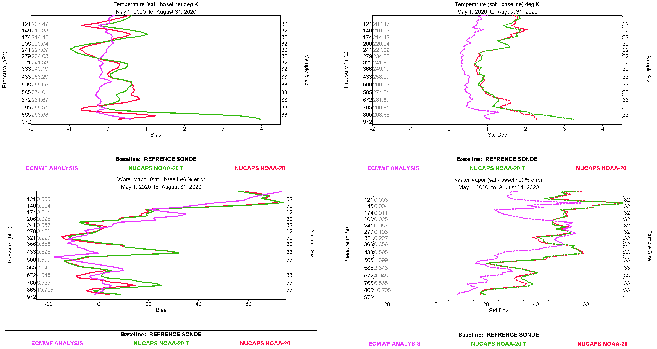
Results: SGP
Vertical profile statistics of collocated profiles for temperature (top) and moisture (bottom) showing bias (left) and standard deviation (right) vs. radiosonde at SGP: Plots are color coded with NOAA Op (red), NOAA Test (green), ECMWF (purple); pressure range consistent with CAPE (Figure on slide 12)
Notes:
*put all vstats to 100* *make SGP more obvious*

Slide 10
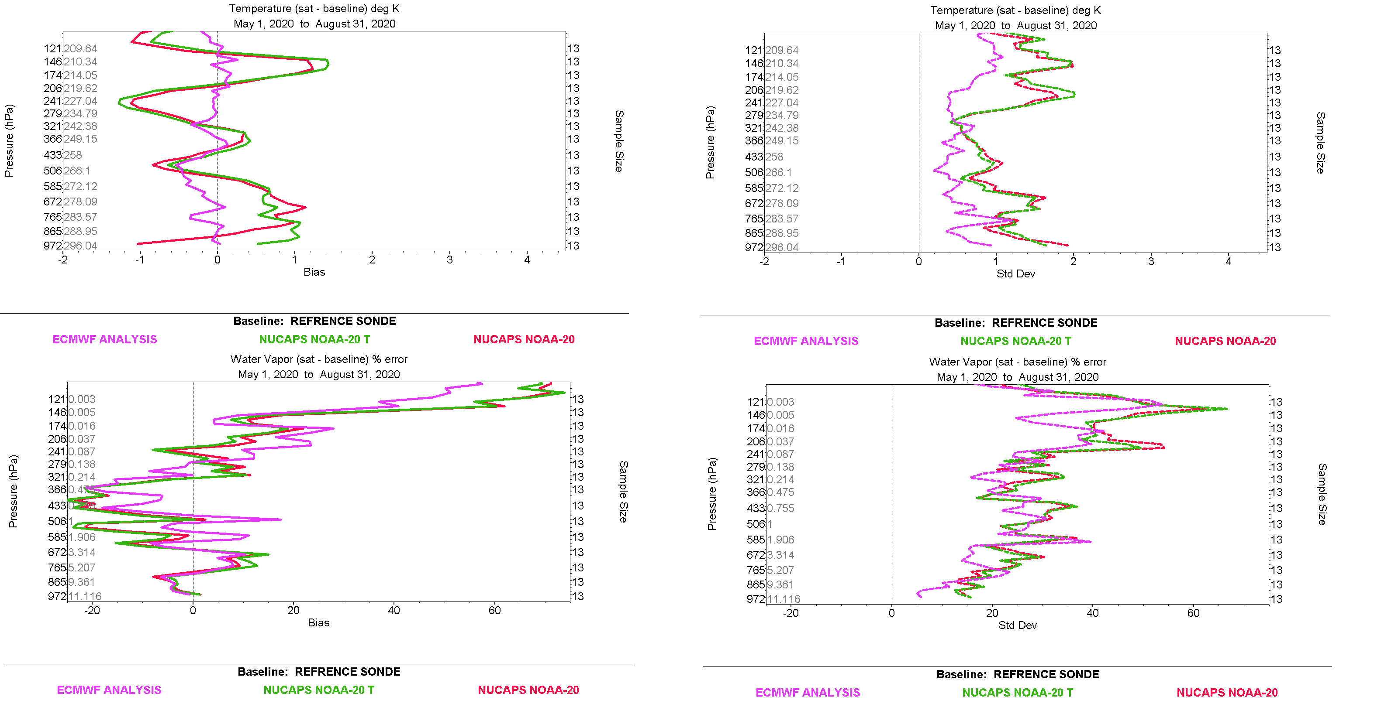
Results: Beltsville
Vertical profile statistics of collocated profiles for temperature (top) and moisture (bottom) showing bias (left) and standard deviation (right); BV
Notes:
*change to 100*

Slide 11
Discussion: Vstats
RAOB vs. ECMWF, NUCAPS (Old vs. New); New NUCAPS (green) implemented on July 15th, 2021 replacing OLD (red)
NUCAPS New appeared warmer in lower layer (below 700 hPa) versus Old, particularly at SGP (+3K); CAPE implications
ECMWF showed reduced temperature bias (vs Raob) compared to NUCAPS, as expected
Moisture variation higher for all platforms; hint of moistening for New vs Old (vs Raob) in lower layer; CAPE implications (particularly at SGP)
Results at SGP and Beltsville show sizeable regional differences for NUCAPS; smaller sample size at Beltsville vs SGP (13 vs. 33) ‘likely’ a factor
Notes:
*add slide numbers for vertical statistics?*

Slide 12
Results: SGP
CAPE scatter plots vs. RAOB for Raman LIDAR (upper left), ECMWF (upper right), NUCAPS Oper (bottom left), NUCAPS Test (bottom right); SGP: Plots are color coded similar to previous slide; correlation coefficient and slopes are on the plots
Notes:
*put asterisk on case study points*

Slide 13
Results: Beltsville
CAPE scatter plots vs. RAOB for Raman LIDAR (upper left), ECMWF (upper right), NUCAPS Oper (bottom left), NUCAPS Test (bottom right); BV; correlation coefficient and slope are on plots

Slide 14
Discussion: Scatter Plots
CAPE and ancillary data add capability relative to NPROVS
At SGP, RAOB CAPE better correlated with respective platform CAPE; RAOB ‘not always’ the highest CAPE
At Beltsville, RAOB CAPE less correlated with platform CAPE; RAOB ‘generally’ the highest CAPE
Overall, ECMWF, LIDAR and MWR CAPES better correlated with Raob CAPE (and each other) than for NUCAPS; LIDAR at SGP shows overall lower CAPE.
NUCAPS (both versions) show lower correlation with Raob CAPE, good dynamic range at SGP
NUCAPS New (v3, Oper since 7/15) showed overall higher correlation than Old (v2.5, Oper prior to 7/15) with systematically higher CAPE values (y-intercept), a good thing ?
Notes:
*add slide numbers for vertical statistics?*
At SGP, RAOB CAPE better correlated with platform CAPE; RAOB not always the highest CAPE
CAPE values overall lower at Beltsville vs. SGP; sampling advantage at SGP possibly a factor

Slide 15
Results: SGP
Vertical profiles including CAPE calculations (shaded) for selected case studies; SGP
Notes:
-Overall compatible with RAOB
-SGP shows more consistency
-second set of plots below the LFC- integrate into CAPE discussion

Slide 16
Results: Beltsville
Vertical profiles including CAPE calculations (shaded) for selected case studies; BV
Notes:
*show numbers for CAPE near 300 km*
*put these results in report*

Slide 17
All levels of sounding or pseudotemp are used for the calculation of CAPE. The unit of CAPE is J/kg and it describes the maximum amount of potential energy which the air parcel has available for convection.
CAPE is calculated by integrating over height the (virtual) temperature difference of lifted air parcel and the environment. In a thermodynamic diagram this represents the area that is between the curve of lifted air parcel and that of the environment.
The integration normally is started from level of free convection (LFC) which is the level above which the lifted parcel is warmer than environment.
The upper limit for the integration is the level of neutral buoyancy (LNB) in which the parcel and environment curves meet again

Slide 18
Discussion: Case Studies
Skew-T LnP CAPE Charts add capability relative to NPROVS
Shows the location of positive buoyancy (CAPE), the LCL, the LFC, and the EL for each platform
CAPE values (shaded areas) and profile structures at SGP show more consistency across all platforms compared to Beltsville; higher sample size at SGP a possible factor
Highest level for Microwave Radiometer is 300 hPa
Notes:
-More representative samples at SGP
-Beltsville tries to launch on clear, calm days (might be a hindrance)- dedicated launches
-SGP has synoptic launches within 1.5 to 2 hours (launching 4 times a day)
-Surface-based CAPES
-Mixed layer CAPE

Slide 19
Summary & Future Work
Vstats and Skew-T LnP charts can be used in conjunction with one another to study CAPE and its effects
Warmer, more moist air leads to higher CAPE
Future work will involve computing vstats for LIDAR and MWR
Try to collect MWR data that extends past 300 hPa.
Work continues to resolve issues and concerns (i.e., use of srfc air temp in CAPE, uncorrelated 0 values , etc…)

Slide 20
References
Berndt, Emily, et al. “Gridded Satellite Sounding Retrievals in Operational Weather Forecasting: Product Description and Emerging Applications.” Remote Sensing, vol. 12, no. 20, 2020, p. 3311. Crossref, doi:10.3390/rs12203311.
Blumberg, W. G., K. T. Halbert, T. A. Supinie, P. T. Marsh, R. L. Thompson, and J. A. Hart, 2017: "SHARPpy: An Open Source Sounding Analysis Toolkit for the Atmospheric Sciences." Bull. Amer. Meteor. Soc. doi:10.1175/BAMS-D-15-00309.1.
“Center for Satellite Applications and Research - NOAA / NESDIS / STAR.” NOAA / NESDIS / STAR Website, 2020, www.star.nesdis.noaa.gov/smcd/opdb/nprovs/index.php.
Reale, Tony, et al. “The NOAA Products Validation System (NPROVS).” Journal of Atmospheric and Oceanic Technology, vol. 29, no. 5, 2012, pp. 629–45. Crossref, doi:10.1175/jtech-d-11-00072.1.
Wallace. Atmospheric Science - An Introductory Survey (2nd, 06) by Wallace, John M – Wallace John Michael - Hobbs, Peter V [Hardcover (2006)]. 2nd ed., Academic, Hardcover(2006), 2006.

Slide 21
Extra

Slide 22
Results: SGP
Date | Time | RAOB | ECMWF | NT | NO | LIDAR
5/19/20 | 17:40:00 | 0 | 0 | 2745 | 1350 | 0
5/19/20 | 19:19:00 | 0 | 0 | 2802 | 1376 | 0
5/20/20 | 17:29:00 | 0 | 0 | 1197 | 313 | 0
6/1/20 | 17:33:00 | 0 | 47 | 2114 | 1436 | 208
6/5/20 | 17:31:00 | 1394 | 931 | 4208 | 2636 | 534
6/6/20 | 5:38:00 | 0 | 2023 | 23 | 0 | 1892
6/7/20 | 17:29:00 | 2111 | 1284 | 181 | 140 | 1081
6/16/20 | 17:28:00 | 2833 | 625 | 2665 | 1217 | 1153
6/17/20 | 5:36:00 | 1336 | 1992 | 102 | 0 | 537
6/17/20 | 17:28:00 | 2332 | 965 | 2381 | 1190 | 929
6/21/20 | 17:32:00 | 2812 | 2850 | 2509 | 1293 | 1147
6/22/20 | 17:38:00 | 1222 | 652 | 1292 | 547 | 329
6/26/20 | 17:26:00 | 3895 | 3070 | 5055 | 3142 | 2498
6/27/20 | 17:34:00 | 3347 | 3164 | 3484 | 2756 | 2386
6/28/20 | 17:25:00 | 5148 | 3373 | 3197 | 1979 | 1306
7/1/20 | 17:39:00 | 5042 | 3689 | 3726 | 2445 | 3089
7/2/20 | 17:31:20 | 2212 | 4031 | 6009 | 4149 | 1040
7/3/20 | 17:32:00 | 1051 | 1519 | 151 | 75 | 506
7/7/20 | 17:24:00 | 0 | 937 | 3110 | 1538 | 1019
7/12/20 | 17:28:00 | 3104 | 1274 | 2697 | 1758 | 2773
7/13/20 | 17:25:00 | 551 | 494 | 1061 | 650 | 13
8/13/20 | 17:26:00 | 956 | 2754 | 3204 | 2483 | 1381
8/14/20 | 17:23:00 | 2181 | 2964 | 1716 | 1054 | 2066
8/15/20 | 17:26:00 | 5 | 3990 | 2324 | 1414 | 2456
8/18/20 | 17:29:00 | 142 | 238 | 1295 | 101 | 0
8/19/20 | 17:25:00 | 0 | 11 | 1156 | 176 | 0
8/20/20 | 5:41:00 | 0 | 0 | 0 | 0 | 0
8/20/20 | 17:27:00 | 777 | 99 | 494 | 69 | 36
8/24/20 | 17:25:00 | 703 | 971 | 2466 | 1417 | 638
8/25/20 | 5:39:00 | 2 | 94 | 0 | 0 | 16
8/25/20 | 17:25:00 | 727 | 470 | 698 | 190 | 6
8/26/20 | 17:27:00 | 2456 | 1854 | 1817 | 1567 | 1190
8/30/20 | 17:28:00 | 956 | 1042 | 1453 | 1245 | 392
Tabulated values of CAPE shown in previous scatter plot (case studies highlighted): SGP
Notes:
*fix table to have same identifiers* NT- NUCAPS New, NO- NUCAPS Old

Slide 23
Results: Beltsville
Date | Time | RAOB | ECMWF | NT | NO | MWR
5/24/20 | 17:51:00 | 0 | 0 | 0 | 0 | 0
6/7/20 | 18:14:00 | 159 | 0 | 0 | 0 | 223
6/9/20 | 6:15:00 | 0 | 0 | 0 | 0 | 0
6/21/20 | 5:45:00 | 691 | 441 | 3 | 3 | 71
6/27/20 | 18:15:00 | 1287 | 1194 | 650 | 205 | 1604
6/28/20 | 18:20:00 | 7423 | 1984 | 678 | 171 | 2524
7/4/20 | 6:40:00 | 405 | 91 | 66 | 0 | 825
7/12/20 | 17:30:00 | 0 | 50 | 765 | 455 | 1651
8/11/20 | 6:27:00 | 1912 | 1499 | 49 | 8 | 0
8/18/20 | 18:38:00 | 1545 | 60 | 257 | 0 | 1251
8/26/20 | 6:46:00 | 0 | 0 | 0 | 0 | 30
8/30/20 | 7:11 | 0 | 0 | 0 | 0 | 0
8/30/20 | 16:53:00 | 6 | 4 | 0 | 0 | 0
Tabulated values of CAPE shown in previous scatter plot (case studies highlighted): BV

