Slide 1
VHI of Major Wheat Area of Australia
Wei Guo
7/18-26/2016

Slide 2
Data Source of Major Wheat Area of Australia
Source: USDA,
Contact: Shannon, Harlan - OCE HShannon@oce.usda.gov
Date: Thu, 14 Jul 2016 13:29:57
5 shapefiles (zipped) that outline the Australia wheat belt. The shapefiles delineate the wheat belt on a state-by-state basis as follows:
Maj_wheat_WA_JUL_2016 = Western Australia
Maj_wheat_SA_JUL_2016 = South Australia
Maj_wheat_VIC_JUL_2016 = Victoria
Maj_wheat_NSW_JUL_2016 = New South Wales
Maj_wheat_QLD_JUL_2016 = Queensland
When wheat is in the reproductive and filling stages of development, the shapefiles are used to calculate the average VHI value weekly within each state.
During the past growing season, I calculated averages for each state the first week the VHI data were made available on your web site. I also calculated averages for each state seven weeks later, when the final VHI data were posted on your web site. Significantly, I found that the final VHI data provided a much better estimate of wheat yields than the initial VHI data.

Slide 3
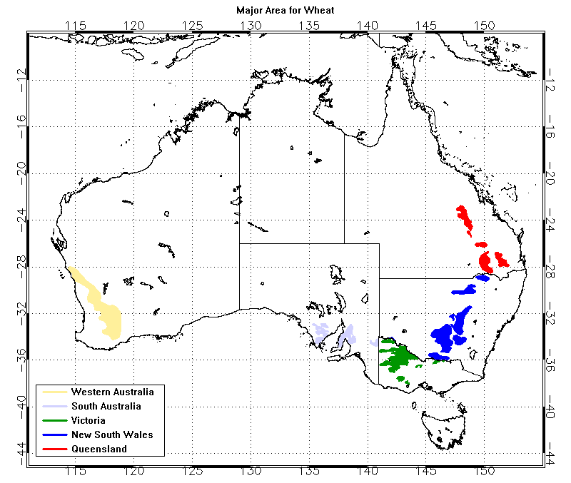
Major Wheat Area of Australia
The small images with blue background are mask files generated from the polygons provided by USDA.

Slide 4
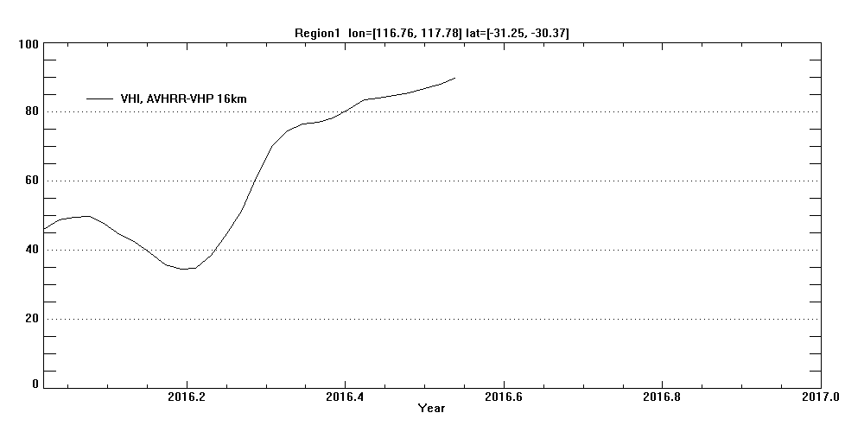
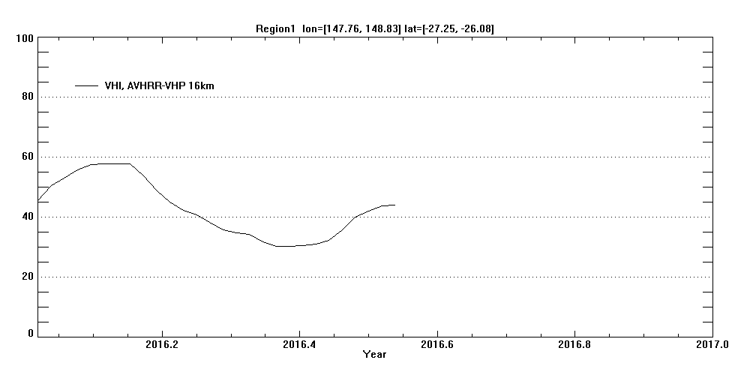
VHI, 2016
From “TSviewer”
A rectangle area in Western Australia (WA)
A rectangle area in Queensland(QLD)

Slide 5
VHI averaged for wheat area of Western Australia

Slide 6
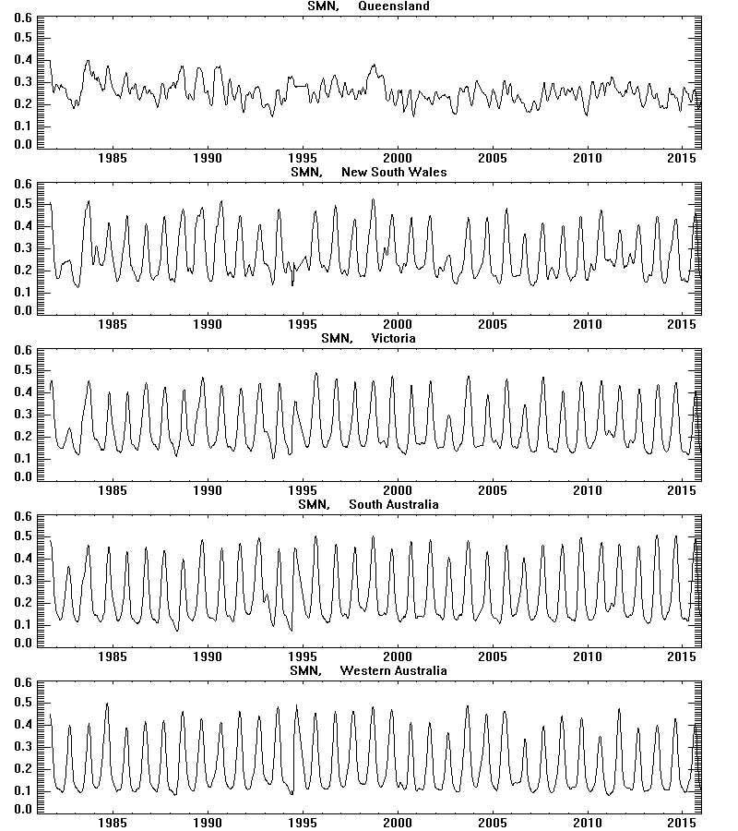
SMN and SMT time series

Slide 7
VHI time series

Slide 8
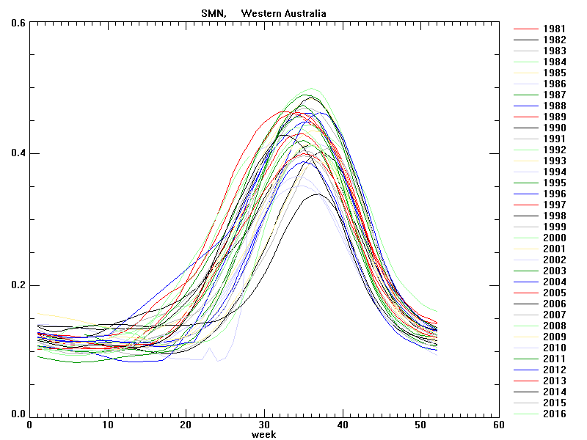
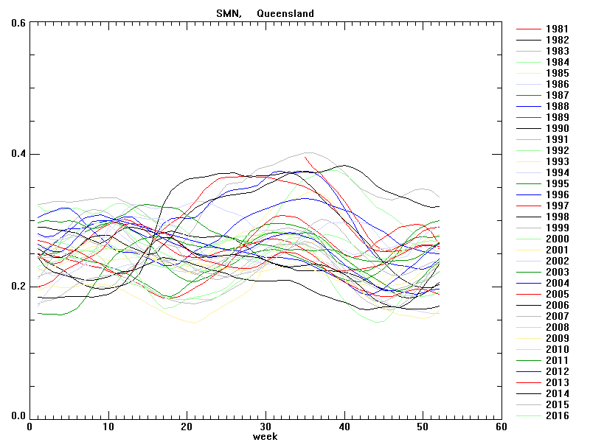
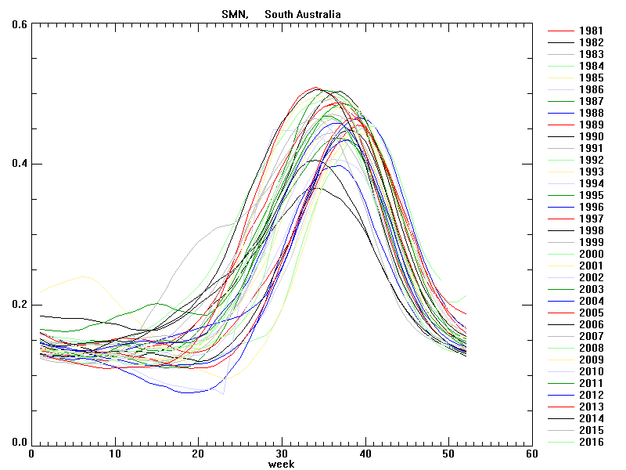
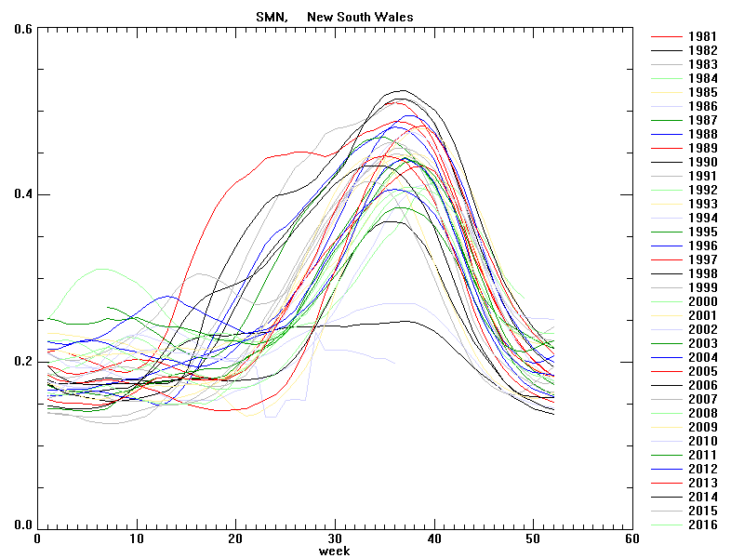
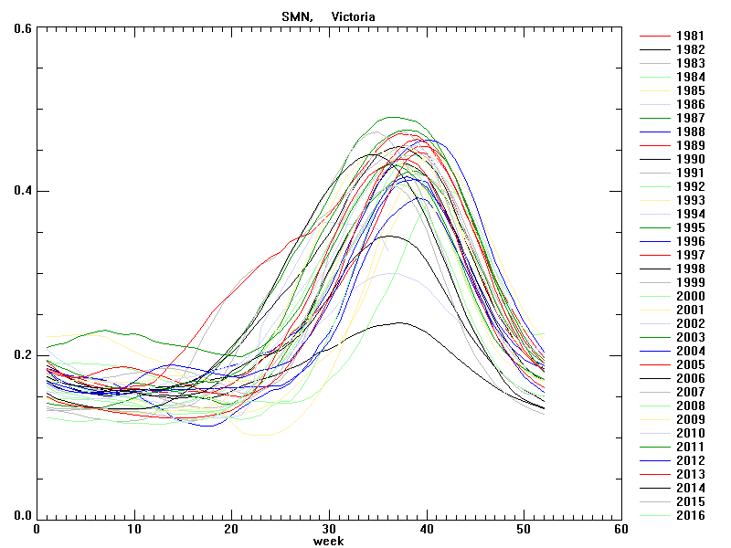
SMN time series for each year, averaged for the selected regions
Western Australia
Queensland
South Australia
New South Wales
Victoria

Slide 9
SMN time series for each year for major wheat area

Slide 10
SMT time series for each year for major wheat area

Slide 11
VHI time series for each year for major wheat area

Slide 12
Comparing data from 4km and 16km

Slide 13
Comparing SMN Time series of major wheat area derived from 4km and 16km data sets
color: from 4km dataset
Grey: from 16km dataset

Slide 14
Comparing SMT Time series of major wheat area derived from 4km and 16km data sets
color: from 4km dataset
Grey: from 16km dataset

Slide 15
Comparing VHI Time series of major wheat area derived from 4km and 16km data sets
color: from 4km dataset
Grey: from 16km dataset

