Slide 1
VHI of Major Wheat Area of Australia
Wei Guo
7/26/2016

Slide 2
Data Source of Major Wheat Areas of Australia
Source: USDA,
Contact: Shannon, Harlan - OCE HShannon@oce.usda.gov
Date: Thu, 14 Jul 2016 13:29:57
5 shapefiles (zipped) that outline the Australia wheat belt. The shapefiles delineate the wheat belt on a state-by-state basis as follows:
Maj_wheat_WA_JUL_2016 = Western Australia
Maj_wheat_SA_JUL_2016 = South Australia
Maj_wheat_VIC_JUL_2016 = Victoria
Maj_wheat_NSW_JUL_2016 = New South Wales
Maj_wheat_QLD_JUL_2016 = Queensland
When wheat is in the reproductive and filling stages of development, the shapefiles are used to calculate the average VHI value weekly within each state.
During the past growing season, I calculated averages for each state the first week the VHI data were made available on your web site. I also calculated averages for each state seven weeks later, when the final VHI data were posted on your web site. Significantly, I found that the final VHI data provided a much better estimate of wheat yields than the initial VHI data.

Slide 3
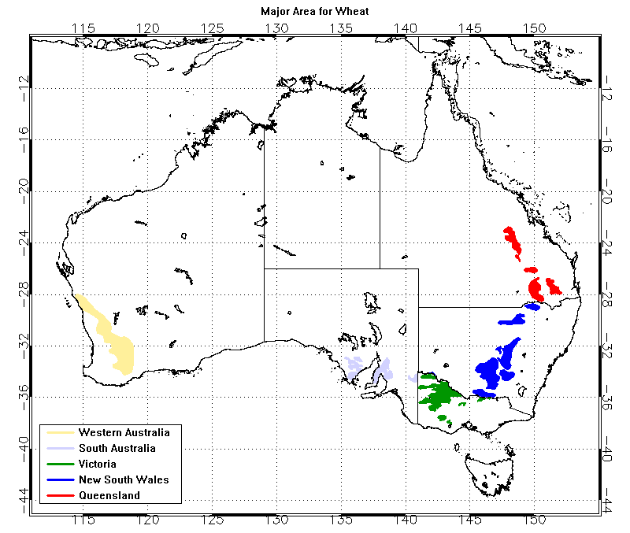
Major Wheat Areas of Australia
The small images with blue background are mask files generated from the polygons provided by USDA.

Slide 4
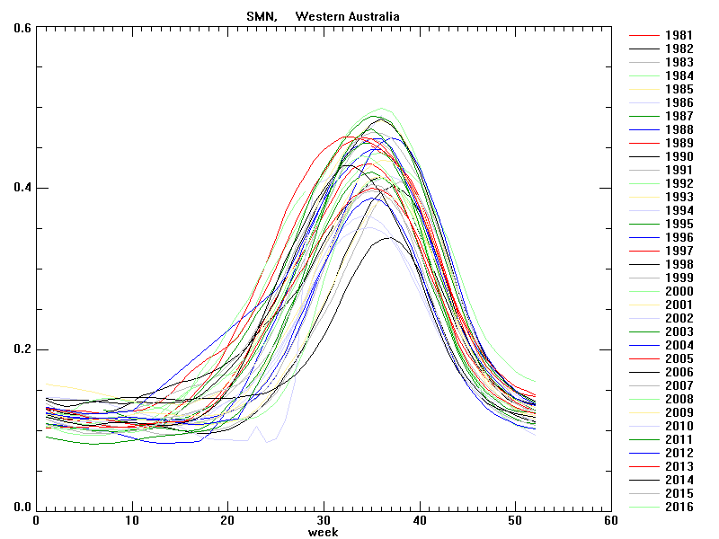
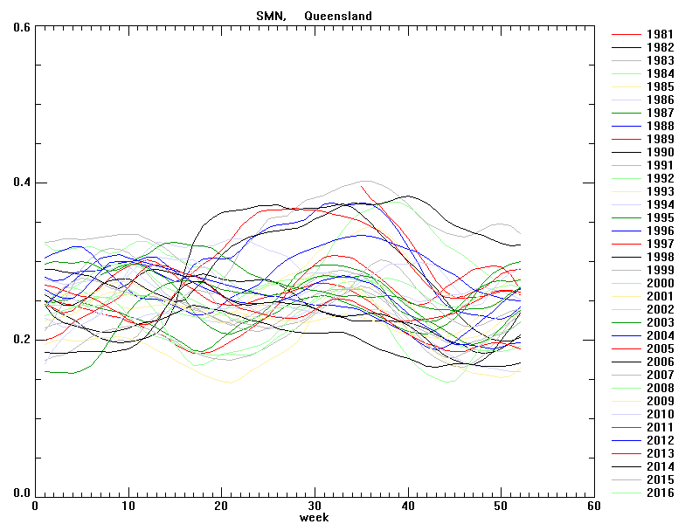
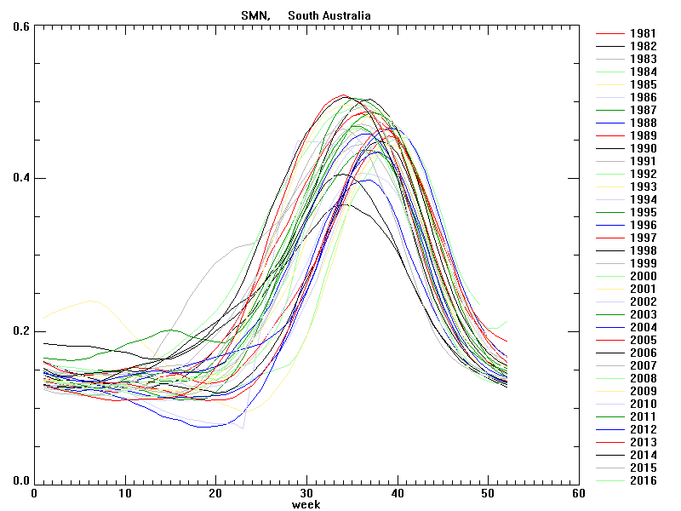
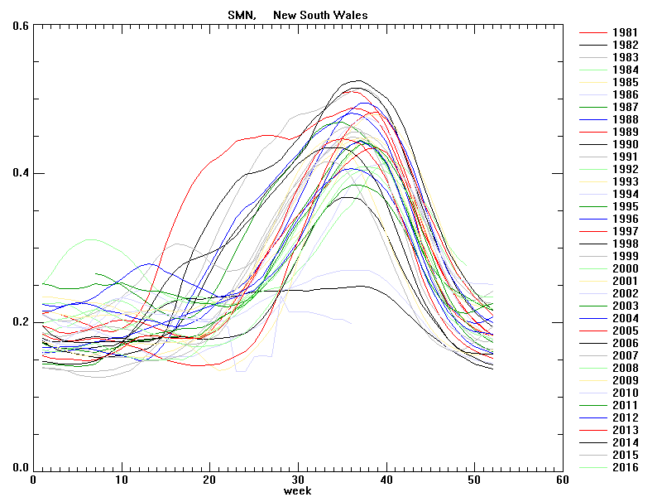
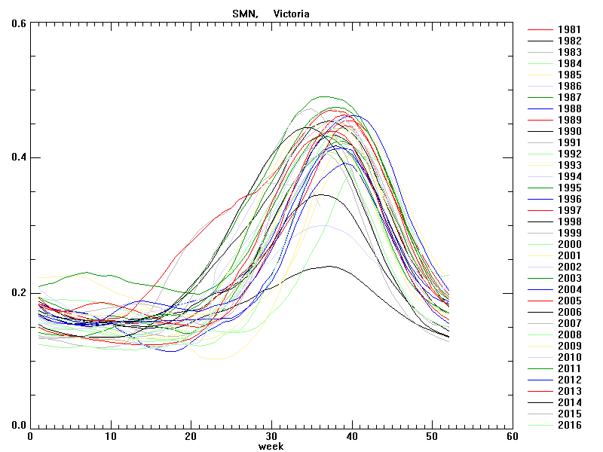
SMN time series for each year, averaged for Major Wheat Area of Australia
Western Australia
Queensland
South Australia
New South Wales
Victoria

Slide 5
Area of Major Wheat area
Number of pixels on 4km lat-lon grid
../resources/Sys/GIS/AustraliaWheat/mask/Maj_wheat_AUS_mask_G04.hdf
Western Australia np= 5952
South Australia np= 2275
Victoria np= 3395
New South Wales np= 5894
Queensland np= 3054
By using above the value, we can calculate the "weighted average of VHI of the 5 regions" which is equivalent to the "mean VHI value over all pixels of 5 regions".
ratio_by_Area 0.289353 0.110598 0.165046 0.286534 0.148469
year, week,WA,SA,VIC,NSW,QLD, averageVHIof5regions, weightedAverageVHIof5Regions
1981, 35, 47.176, 51.986, 56.858, 66.005, 66.775, 57.760, 57.611
1981, 36, 49.108, 52.102, 57.495, 65.895, 67.666, 58.453, 58.389
1981, 37, 51.891, 53.227, 60.064, 66.027, 66.015, 59.445, 59.535
1981, 38, 54.341, 54.556, 62.531, 66.480, 64.605, 60.503, 60.719
1981, 39, 56.157, 56.777, 65.375, 67.031, 62.775, 61.623, 61.845
1981, 40, 57.100, 58.870, 68.016, 67.257, 61.777, 62.604, 62.702
1981, 41, 58.351, 59.986, 69.874, 66.574, 61.457, 63.248, 63.251
1981, 42, 58.763, 59.966, 70.708, 65.378, 61.391, 63.241, 63.153
1981, 43, 56.696, 59.585, 70.987, 64.324, 60.133, 62.345, 62.070
1981, 44, 55.249, 59.180, 69.795, 62.597, 58.529, 61.070, 60.677
1981, 45, 53.926, 58.202, 67.796, 60.327, 57.257, 59.502, 59.017
... ...

Slide 6
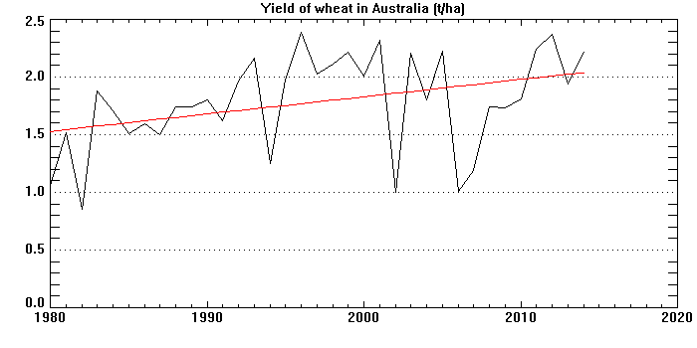
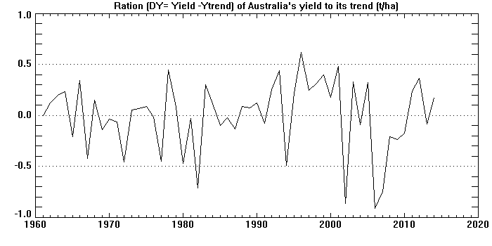
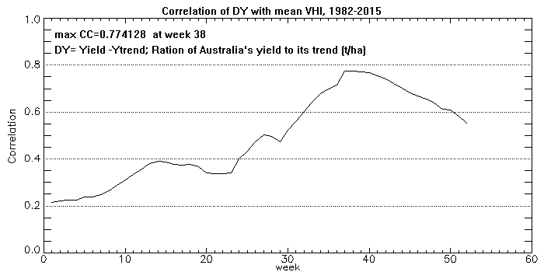
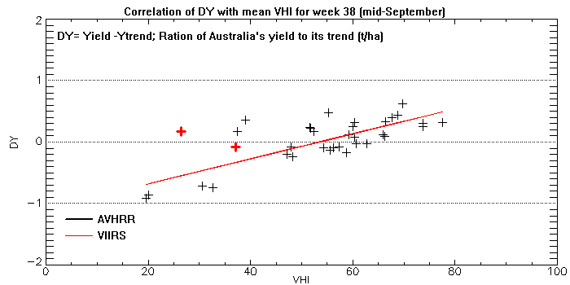
Correlation Between VH and DY for the major wheat area of Australia

Slide 7
Time series of VHI for Australia’s major wheat areas

Slide 8
Time series of VHI for Australia’s major wheat areas

Slide 9
Comparison on VHI from VIIRS 4km vs. 500m
VHI from 4km
dataset
VHI from 500m
dataset
2016 week 26
Data was extracted from sampled (16km) files which were created from VIIRS 4km and 500m data sets respectively. The major difference of VIIRS 4km and 500m data sets is the high resolution climatology (using MODIS and AVHRR).

Slide 10
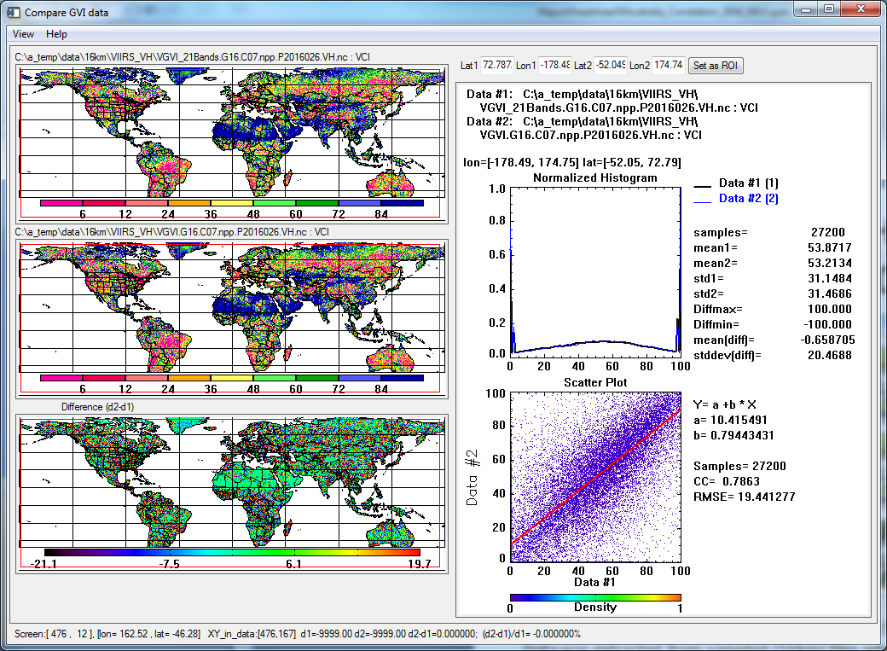
Comparison on VCI from VIIRS 4km vs. 500m
VCI from 4km
dataset
VCI from 500m
dataset
2016 week 26
Data was extracted from sampled (16km) files which were created from VIIRS 4km and 500m data sets respectively. The major difference of VIIRS 4km and 500m data sets is the high resolution climatology (using MODIS and AVHRR).

Slide 11
Comparison on TCI from VIIRS 4km vs. 500m
TCI from 4km
dataset
TCI from 500m
dataset
2016 week 26
Data was extracted from sampled (16km) files which were created from VIIRS 4km and 500m data sets respectively. The major difference of VIIRS 4km and 500m data sets is the high resolution climatology (using MODIS and AVHRR).

Slide 12
Comparison on SMN from VIIRS 4km vs. 500m
SMN from 4km
dataset
SMN from 500m
dataset
2016 week 26
Data was extracted from sampled (16km) files which were created from VIIRS 4km and 500m data sets respectively. The major difference of VIIRS 4km and 500m data sets is the high resolution climatology (using MODIS and AVHRR).

Slide 13
Comparison on SMT from VIIRS 4km vs. 500m
SMT from 4km
dataset
SMT from 500m
dataset
2016 week 26
Data was extracted from sampled (16km) files which were created from VIIRS 4km and 500m data sets respectively. The major difference of VIIRS 4km and 500m data sets is the high resolution climatology (using MODIS and AVHRR).

