Slide 1
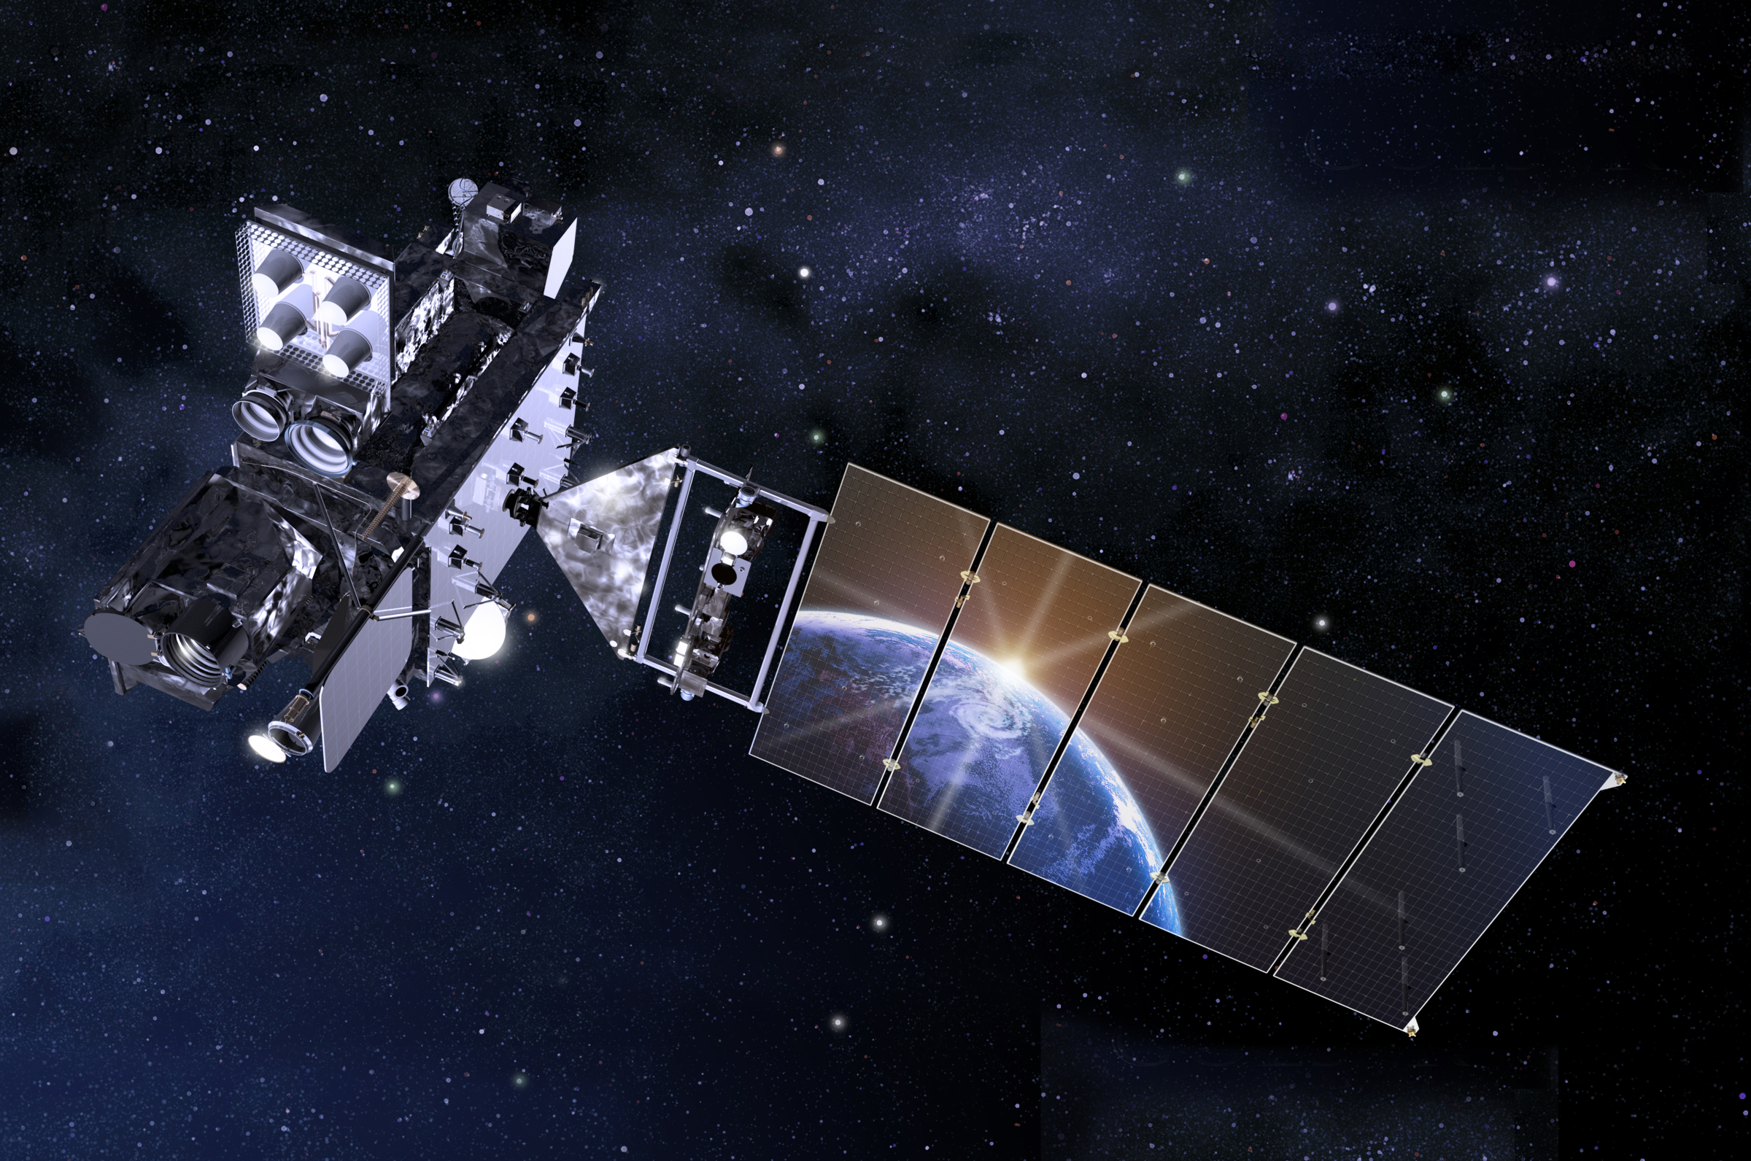
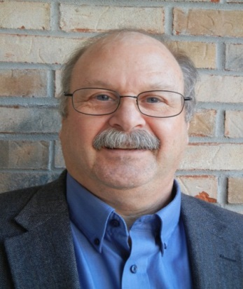
The GOES-R Cal/Val Program:
Planning for Cal/Val
Steve Goodman
GOES-R Series Chief Scientist
http://www.goes-r.gov
GOES-R AWG 2nd Validation Workshop
NOAA Center for Weather and Climate Prediction, College Park, MD January 9-10, 2014

Slide 2
Cal/Val Planning
The AWG and CWG requires each team to do the traditional cal/val activities (vicarious cross-calibration, cross-comparisons with other satellites (GSICS).
Does not include conducting, participating in, or deploying additional assets in field campaigns that offer additional high fidelity product validation.
Program Science Office funded some limited proposals in 2011 for new, intermittent (field campaign) and sustaining ground validation measurements.
No CLASS L0 archive- CWG IV&V teams require local L0 compute/storage infrastructure augmentation

Slide 3
Cal/Val Support from Program Science Office
Legacy Atmospheric Profiles
GPS Met TPW Validation (Seth Gutman)
NAST-I (Allen Larar)- deferred to PLT ER2 deployment
GLM Lightning Detection
Lightning network data for sustaining cal/val
Airborne GLM Simulator (ER2/Global Hawk) in development
CHUVA -GPM Campaign in Brazil 2011-2012 cross-comparisons
WMO-HyMex 2012 (field campaign support for VSP)
Aerosols, Clouds
DSCOVER field campaign (S. Kundragunta/Russ Dickerson) airborne spectral measurements
Aerosol, Cloud, Surface Radiation and Sounding instrumentation (Feltz/Pierce), eg, DC3 field campaign
Radiation
Surfrad upgrades, portable system (Jos. Michalsky/Ellsworth Dutton)
L1B Radiances-Sonora Desert AVIRIS Campaign (UMCP GRA Scott Ozog)

Slide 4
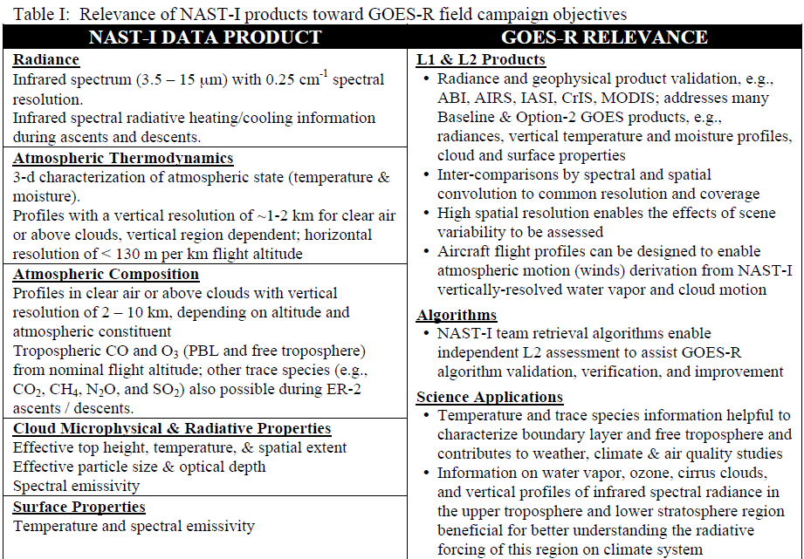
Allen Larar Cal/Val proposal

Slide 5
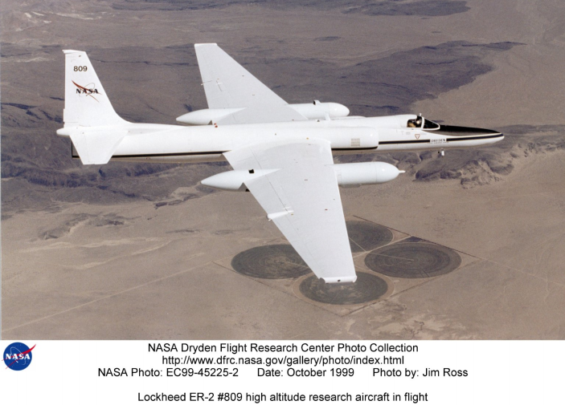
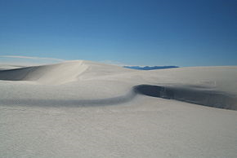
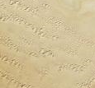
ABI Vicarious Calibration for L1B Validation and Verification
Dates: Spring 2011
Location: White Sands Missile Range (WSMR), NM and Sonora Desert, Mexico
Overarching Objectives:
Vicarious calibration of GOES-R ABI and GLM for the purpose of long-term monitoring and L1b validation and verification
These sites are not perfect Lambertian surfaces, thus
Seasonal variability of reflectance is introduced into long-term reflectance time series
This variability cannot be removed objectively without knowledge of the surface BRDF characteristics
Airborne radiometeric measurements taken over these sites over the course of a diurnal cycle can allow BRDF to be estimated, which can be used to correct anomalies in reflectance times series
WSMR
Sonora Desert, Mexico
WSMR and Sonora Desert BRDF to be measured in Spring 2011 using ER-2 airborne radiometers – Advanced Visible Infrared Imaging Spectrometer (AVIRIS), MODIS/ASTER Airborne Simulator (MASTER), and NPOESS Airborne Simulator Testbed – Interferometer (NAST-I).
Flight plans coordinated with NASA Dryden ER-2 team, Mexican Government and WSMR, as well as with MODIS and/or AVHRR instrument underpasses
WSMR flight support gained from NASA’s AERONET facility at WSMR, and Forecast and weather data support from El Paso, Texas NWS Line Office

Slide 6
Opportunities for Collaboration
JMA - Himawari
Sandy supplement enables full 16 ch imager data access
NESDIS MOU for cal/val joint analysis, L2 product assessments
Heidinger/Pavolonis algorithm visit to JMA
JMA cal/val scientist 1 month VSP visit to STAR in early FY15 after launch of Himawari
EUMETSAT MSG SEVERI and MTG FCI and LI
SAF collaborations, VSP visits
Convection Working Group (1-2.5 min rapid scan)
CHUVA-GLM Campaign with INPE/CPTEC
JPSS, NASA (GPM), CMA, KMA, CNR (Italy), INPE, Argentina

Slide 7
ER-2 Payload Configuration for JPSS SDR & EDR Flights
Baseline payload for SDR-centric campaign
S-HIS (UW)
ultra-spectral, SI-traceable infrared spectral radiance
0.5 cm⁻¹, unapodized, 3.3 to 18 micron
NAST-I (NASA LaRC), Recently refurbished
ultra-spectral, SI-traceable infrared spectral radiance
0.25 cm⁻¹, unapodized, 3.7 to 15.5 micron
NAST-M (MIT-LL), undergoing upgrades
Multi-spectral microwave radiometer
54, 118, 183, and 425 GHz (current); K/KA-band receiver at 30 GHz almost complete
eMAS (NASA Ames), undergoing upgrades
High spatial resolution radiance
Multi-spectral Vis/IR imager
CPL (NASA GSFC), Recently refurbished
Cloud height and density
Dropsondes (availability TBD)
T&q profiles below aircraft – only over water
In-situ (availability TBD)
T,q, trace species along aircraft profile
ER-2
CPL
eMAS
NAST-I
S-HIS
NAST-M
Notional sensor payload configuration may require changes after recent sensor upgrades.
Courtesy Mitch Goldberg

Slide 8
Candidate Field Campaigns
(notional, not all-inclusive)
Spring 2014 ER2 GLM Simulator-GPM IPHEX -HMT SE North Carolina –Lightning, Precip, Fog, Clouds
Front Range Air Pollution and Photochemistry Éxperiment (FRAPPÉ) Aerosol/Cloud Campaign with DISCOVR-AQ
Pan Am Games- Env Canada, Toronto- Clouds, SVR, July, September 2015
PECAN- warm season precipitation, central US June 1-July 15
GPM OLYMPEX- precipitation, clouds, snow cover, Olympic Peninsula Nov 2015-February 2016
GOES-R PLPT Spring 2016 Severe Wx ER2 Mission in Central US
September 2017- RELAMPAGO, Argentina- SVR storms

Slide 9
GOES-R Algorithm Development Executive Board Recommendation
“FINDING: Insufficient Validation. Reporting of measurement validation lacked completeness and was rarely independent.
RECOMMENDATION: Continue to pursue more complete data sets even after 100% delivery. Measurement validation must be conducted with thoroughness and completeness within a sustained validation/verification framework and should consider using “human in the loop.” This recommendation was made in our previous report .
AWG teams should leverage participation in targeted field campaigns where there is a potentially rich source of detailed validation data to validate, refine, and improve their algorithms. Campaigns planned by NOAA, NASA, NSF, DOE etc are good candidates as well as international campaigns in Europe under the SEVERI (ABI proxy) coverage umbrella (sjg).
Science Week 2013- IAC (VonderHaar) recommended continue GSICS cross-validation, being careful this aspect not diminished at expense of field campaigns

Slide 10
Summary
It would help facilitate Program Planning if AWG teams might identify field campaigns, ground validation measurements, and experiments they might participate in-name, dates if known. These might be in their GOES-R val plans already or perhaps envisioned as leveraging their JPSS algorithm work.
Back-up slides describe some candidate campaigns that might be of interest in which case we would like interested teams to identify the traceability from the measurement to the science algorithm spec to be verified and additional gap filling resources/assets in the field needed beyond what their AWG funding already provides.

Slide 11
Back-up Known or Planned Campaigns

Slide 12
WWRP Lake Victoria Project THORPEX Follow-on HIW Project
Scientific field project to understand the dynamics of the lake and severe thunderstorms
Capacity build to establish a research and operational legacy
Develop a prototype sustainable nowcasting system for East Africa, particularly over the Lake
Implementation of the nowcasting system within the context of the existing Severe Weather Forecast Demonstration Project
Verification and validation of the nowcasts using the field project.
Meteorological Understanding
Scientific Validation
Statistical Verification

Slide 13
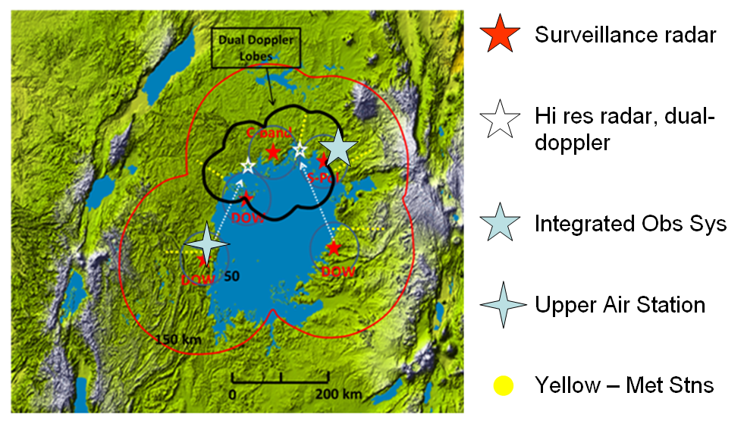
WMO High Impact Weather Field Deployment (NSF)

Slide 14
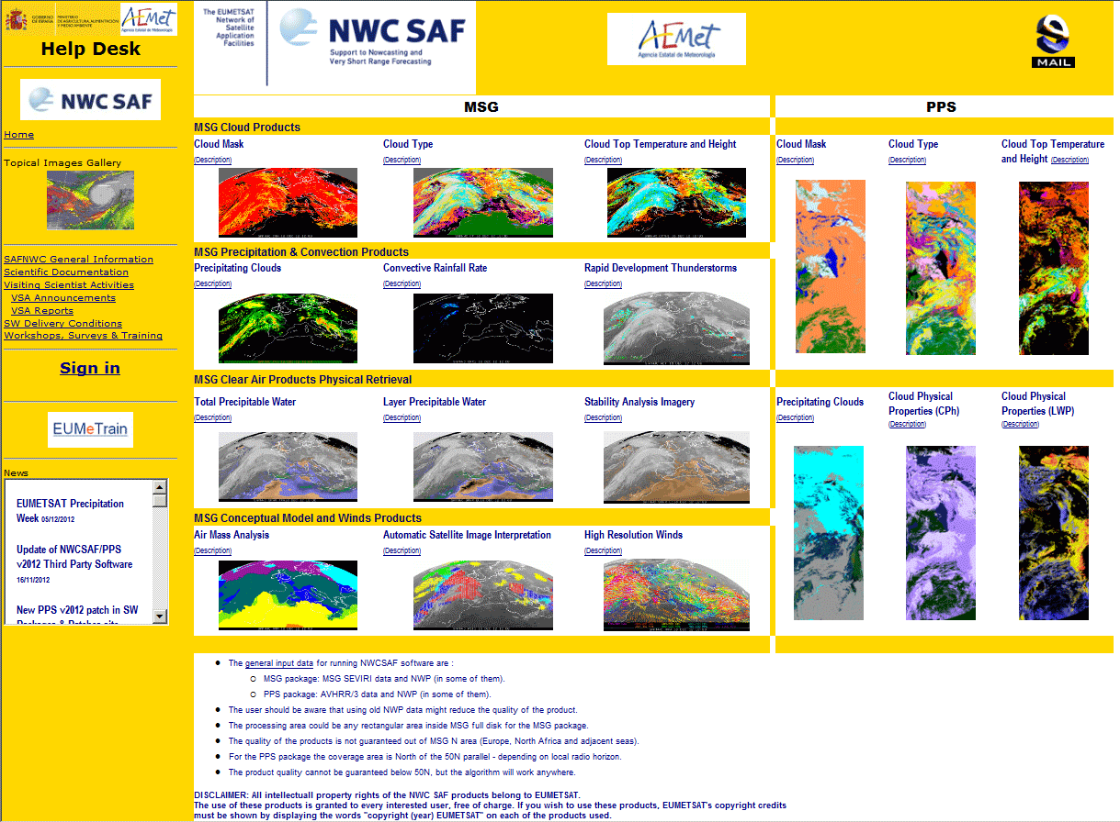
Nowcasting Sat Application Facility

Slide 15
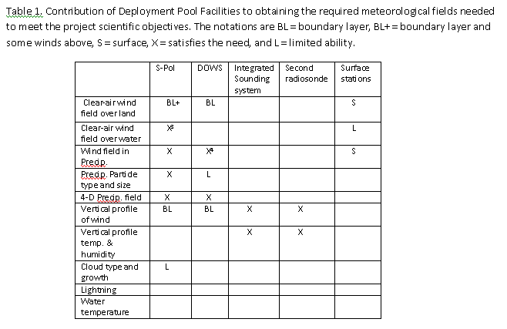
NSF Request

Slide 16
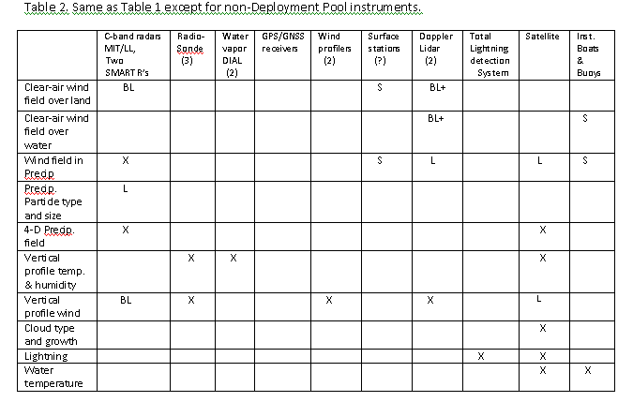
Seeking donor funding

Slide 17
Facilities have already been requested to National Science Foundation due to long lead time required. Very Positive Feedback from NSF for 2016 but need non-NSF funding for operating, capacity building, project office, analysis

Slide 18
Paula Salio

Slide 22
Matt Schwaller

Slide 23
