Slide 1
Validated Stage 1
Science Maturity Review
for
OMPS Nadir Ozone Profile EDRs
Presented by
L. Flynn, NOAA
September 3, 2014
Notes:
Version 4:24pm 9/2/2014

Slide 2
Outline
Algorithm Cal/Val Team Members
Product Requirements
Evaluation of algorithm performance to specification requirements
  Evaluation of the effect of required algorithm inputs
  Quality flag analysis/validation
  Error Budget
Documentation
Identification of Processing Environment
Users & User Feedback
Conclusion
Path Forward

Slide 3
Ozone Cal/Val Team Membership
EDR | Name | Organization | Task
Lead | Lawrence Flynn | NOAA/NESDIS/STAR | Lead Ozone EDR Team
Member | Irina Petropavlovskikh | NOAA/ESRL/CIRES | Ground-based Validation Lead
Member | Craig Long | NOAA/NWS/NCEP | Product Application Lead
Member | Trevor Beck | NOAA/NESDIS/STAR | Algorithm development and ADL implementation
Member | Jianguo Niu | STAR/IMSG/SRG | Algorithm development, trouble shooting, Limb Profiler science
Member | Eric Beach | STAR/IMSG | Validation, ICVS/Monitoring, Data management
Member | Zhihua Zhang | STAR/IMSG | V8 Algorithms implementation & modification
JAM | Maria Caponi | JPSS/Aerospace | Coordination, DRs, CCRs
Member | Bhaswar Sen | NGAS | Current Algorithms
Raytheon team members with major contributions include Derek Stuhmer and Daniel Cumpton.

Slide 4
Table 4.2.4 - Ozone Nadir Profile (OMPS-NP)
Attribute | Threshold | Objective
Ozone NP Applicable Conditions: 1. daytime only (3)
a. Horizontal Cell Size | 250 X 250 km (1) | 50 x 50 km2
b. Vertical Cell Size | 5 km reporting
1. Below 30 hPa ( ~ < 25 km) | 10 -20 km | 3 km (0 -Th)
2. 30 -1 hPa ( ~ 25 -50 km) | 7 -10 km | 1 km (TH -25 km)
3. Above 1 hPa ( ~ > 50 km) | 10 -20 km | 3 km (25 -60 km)
c. Mapping Uncertainty, 1 Sigma | < 25 km | 5 km
d. Measurement Range
Nadir Profile, 0 - 60 km | 0.1-15 ppmv | 0.01 -3 ppmv (0-TH) 0.1-15 ppmv (TH-60 km)
e. Measurement Precision (2)
1. Below 30 hPa ( ~ < 25 km) | Greater of 20 % or 0.1 ppmv | 10% (0 -TH)
2. At 30 hPa ( ~ 25 km) | Greater of 10 % or 0.1 ppmv | 3%
3. 30 -1 hPa ( ~ 25 -50 km) | 5% -10% | 1%
4. Above 1 hPa ( ~ > 50 km) | Greater of 10% or 0.1 ppmv | 3%
f. Measurement Accuracy (2)
1. Below 30 hPa ( ~ < 25 km) | Greater of 10 % or 0.1 ppmv | 10% (0 -15 km)
2. 30 -1 hPa ( ~ 25 -50 km) | 5% -10% | 5% (15 -60 km)
3. At 1 hPa ( ~ 50 km) | Greater of 10 % or 0.1 ppmv | 5% (15 -60 km)
4. Above 1 hPa ( ~ > 50 km) | Greater of 10 % or 0.1 ppmv | 5% (15 -60 km)
g. Refresh | At least 60% coverage of the globe every 7 days (monthly average) (2,3) | 24 hrs. (2,3)
 | (16.7° FOV) | v2,0, 9/22/12
Notes: 1. The SBUV/2 has a 180 km X 180 km cross-track by along -track FOV. It makes its 12 measurements over 24 Samples (160 km of along-track motion). The OMPS Nadir Profiler is designed to be operated in a mode that is able to subsample the required HCS. 2. The OMPS Nadir Profiler performance is expected to degrade in the area of the South Atlantic Anomaly (SAA) due to the impact of periodic charged particle effects in this region. 3. All OMPS measurements require sunlight, so there is no coverage in polar night areas.
Notes:
Ozone Nadir Profile Description:
The Ozone Nadir Profile is an EDR created from measurements made by the OMPS Nadir Profiler and the OMPS Nadir Mapper sensors. This product will continue the heritage ozone profile products made by the POES SBUV/2. These products have vertical resolution between 7 and 10 km in the middle and upper stratosphere. When an OMPS Limb Profiler instrument is present, the OMPS measurements can be used to make (limb) ozone profile EDRs with high vertical resolution (< 3 km) throughout the stratosphere. The detailed vertical structure of lower stratospheric ozone (12 to 25 km altitude region) has been shown to be a useful contributor to extended range (beyond 1 week) forecast skill in global models. It is also a key region for monitoring interactions between the expected ozone recovery and climate change.

Slide 5
Independence and Long Term Stability
The OMPS 5% to 10% accuracy requirements were for its minimal performance as a stand-alone instrument.
By using other assets we can set/correct its bias close to 2%.
The long-term stability of the accuracy at 2% was also a stand-alone requirement, that is, the system was designed so that products’ accuracy was not allowed to wander around between +5% and -5%.
Users expect a stable product – applications are negatively affected by both short term jumps and discontinuities and longer term drifts.
Over the course of a mission, new adjustments to the measurement characterizations are phased in as changes warrant.

Slide 6
Data Product Maturity Definition
Validated Stage 1:
  Using a limited set of samples, the algorithm output is shown to meet the threshold performance attributes identified in the JPSS Level 1 Requirements Supplement with the exception of the S-NPP Performance Exclusions.

Slide 7
Ozone Profile Product, IMOPO
The spectral measurements from the OMPS Nadir Profiler and Nadir Mapper of the radiances scattered by the Earth’s atmosphere are used to generate estimates of the ozone vertical profile along the orbital track (IMOPO). The algorithm uses ratios of Earth radiance to Solar irradiance at a set of 12 wavelengths (at approximately 252, 273, 283, 288, 292, 298, 302, 306, 313, 318, 331 and 340 nm) with eight from the Nadir Profiler and four from the Nadir Mapper to obtain estimates of the total column ozone, effective reflectivity, and the ozone vertical profile in 12 Umkehr Layers. The radiances for the four longer wavelength are obtained from the 25 Nadir Mapper FOVs co-located with a single Nadir Profiler FOV. The longer channel radiance/irradiance ratios are used to generate estimates of the total column ozone and scene effective reflectivity. The total column ozone is used to generate a first guess ozone profile that becomes the A Priori for a maximum likelihood ozone profile retrieval using the ratios for the eight shortest wavelengths (including 313 nm at high SZA). Additional information is in the OMPS Nadir Profile Algorithm Theoretical Basis and Operational Algorithm Description Documents, and a volume of the Common Data Format Control Book at: http://npp.gsfc.nasa.gov/documents.html
OMPS NP ATBD 474-00026_Rev-Baseline.pdf
OMPS NP OAD 474-00067_OAD-OMPS-NP-IP-SW_RevA_201
Intermediate Product CDFCB
474-00001-04-01_CDFCB-Vol4-Part1_Rev-_Block-1-1_31Mar2011.pdf20127.pdf

Slide 8
Nine Things to Know about the OMPS NP SDR
System linearity is stable and well-corrected.
Dark currents continue to trend higher but measurement signal-to-noise ratios remain high – weekly dark updates are flowing into the system and have good accuracy. The products are properly flagged in the SAA.
Stray light corrections have been implemented and reduce this error significantly.
An annual cycle of wavelength scale shifts has been identified. Causes, corrections and impacts have been investigated.
A second round of Day 1 Solar spectra are in testing.
Soft Calibration adjustments can be used to remove much of the bias with SBUV/2 results.
Evidence of changes in the Dichroic throughput due to a ground-to-orbit shift are under investigation.
The first year of solar measurements shows good long-term stability of instrument throughput and wavelength scales. There is some degradation at the shorter channels, e.g., 0.5%/year at 253 nm. Time-dependent (twice a year) Calibration Factor Earth values will be needed at some point in the future.
Solar variability is not currently modeled in the SDR.
KEY: Work needed to reach V1. Future work.
Notes:
There have been some new problems/situations created that require more EDR work.
Some of it is near term, but the lessons has to be that stuff happens.
The first is the removal of the CrIMSS products from the IDPS. We will need
some support for evaluating and reworking the EDR for this change. The second
is the need to improve the SDR wavelength scale. While this is SDR work, we need
to evaluate its effects on the EDR. The third is the soft calibration to provide improved
solar spectra in the SDR. Again, while it is an SDR improvement, it has significant and
complex affects on the EDR. The fourth is the placement of the V8 Profile algorithm.
If the powers that be decide this should go into IDPS we would need more NGAS
support. Finally, there is a STAR/DPA -- DPE mix. The same pool of NGAS personnel
who are creating the test data for our deliveries are also participating in the DPE
testing of the deliveries. For obvious reasons this means that there need to be two
people in this chain. Unless there is a program that will share them with us there
are manpower allocation problems.
We have solved many of the OMPS EDR algorithm problems. There are three open
ones that are not fully SDR produced/solved. The first is the SO2 Index, the second
is the profile mixing fraction behavior, and the third is the ozone out of range. We are
also looking at information concentration/outlier detection and removal that may be
best done at the EDR input level. There is also the work on smaller FOVs. The
current SDR algorithm can handle a nine-fold (three by three) reduction in the size
of the FOVs for the Nadir Mapper and a twenty-five-fold (five by five) reduction
in size for the Nadir Profiler but the EDRS need to be tweaked (changes in hardcoded
dimensions for input processing and output) to handle these cases.

Slide 9
Evaluation of algorithm performance to specification requirements
Findings/Issues from Provisional Review
  SDR performance
    Stray light errors present
    Wavelength Scale (Annual Cycle)
    Solar Activity (Mg II Index)
    Absolute Calibration or radiance/irradiance ratios
  EDR performance
    252 nm channel switched off
    Snow/Ice not using the best data sets
    Switched profile and total column error flags
Improvements since Provisional
  Algorithm Improvements
    Stray light correction implemented (in SDR)
    Smear/Bias error found and corrected (in SDR)
    Corrected switched profile and total column error flags
    Turned on 252 nm channel in retrieval February 2014
    NM/NP mismatch found and corrected (in Glueware)
  Calibration Table Updates in Progress
    Continued weekly updates of Dark Tables
    New Day 1 Solar and Wavelength Scale in testing
    Awaiting new Day 1 solar results and Soft Calibration via Calibration Factor Earth (CFE) table

Slide 10
Evaluation of algorithm performance to specification requirements
Findings/Issues in the last week
  Glueware has hardcoded wavelengths that differ from the input parameters and RT LUT. Differences at the 13 channels are 1.54 0.13 -0.06 0.06 0.14 0.00 -0.08 -0.06 -0.01 0.00 0.05 -0.17 -0.18 nm. Differences in ozone-cross sections (Alphas) are less than 1%.
Cal/Val Activities for evaluating algorithm performance:
  Comparisons to NOAA-18 and NOAA-19 SBUV/2
    Zonal means (with SAA region removed)
    Chasing orbits (Opportunistic Formation Flying – OFF)
    Comparisons include initial and final residuals (biases and standard deviations), ozone layer and ozone mixing ratio profiles, total ozone and reflectivity
    www.star.nesdis.noaa.gov/icvs/prodDemos/index.php
  Comparisons to Umkehr retrievals
    Overpass data sets for NOAA network of Umkehr stations

Slide 11
Biases and offsets from stray light, initial calibration errors and mismatched FOVs appear in the comparisons to NOAA-19 SBUV/2 ozone profiles for “chasing” orbits.
Chasing orbit comparisons of SBUV/2 and OMPS-NP Version 6 Ozone Profiles for July 10, 2013. Figures (a)-(l) show the 12 Umkehr layer amounts versus latitude for the two products. The layer boundaries are given in hPa within the figures. The two orbits are within 50 km and 15 minutes of each other at the Equator.
Notes:
http://www.star.nesdis.noaa.gov/icvs/prodDemos/proComparison.php

Slide 12
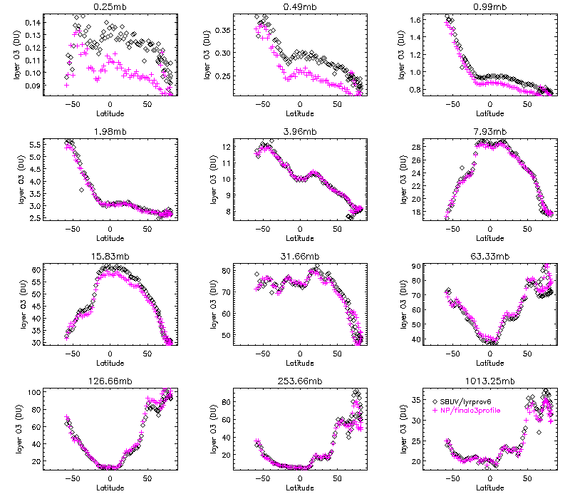
Biases and offsets from stray light, initial calibration errors (252 nm turned on) and (Mismatched FOVs; Fixed) appear in the comparisons to NOAA-19 SBUV/2 ozone profiles for “chasing” orbits.
Chasing orbit comparisons of SBUV/2 and OMPS-NP Version 6 Ozone Profiles for May 23, 2014. Figures (a)-(l) show the 12 Umkehr layer amounts versus latitude for the two products. The layer lower boundaries are given in hPa above the figures. The two orbits are within 20 km and 15 minutes of each other at the Equator.

Slide 13
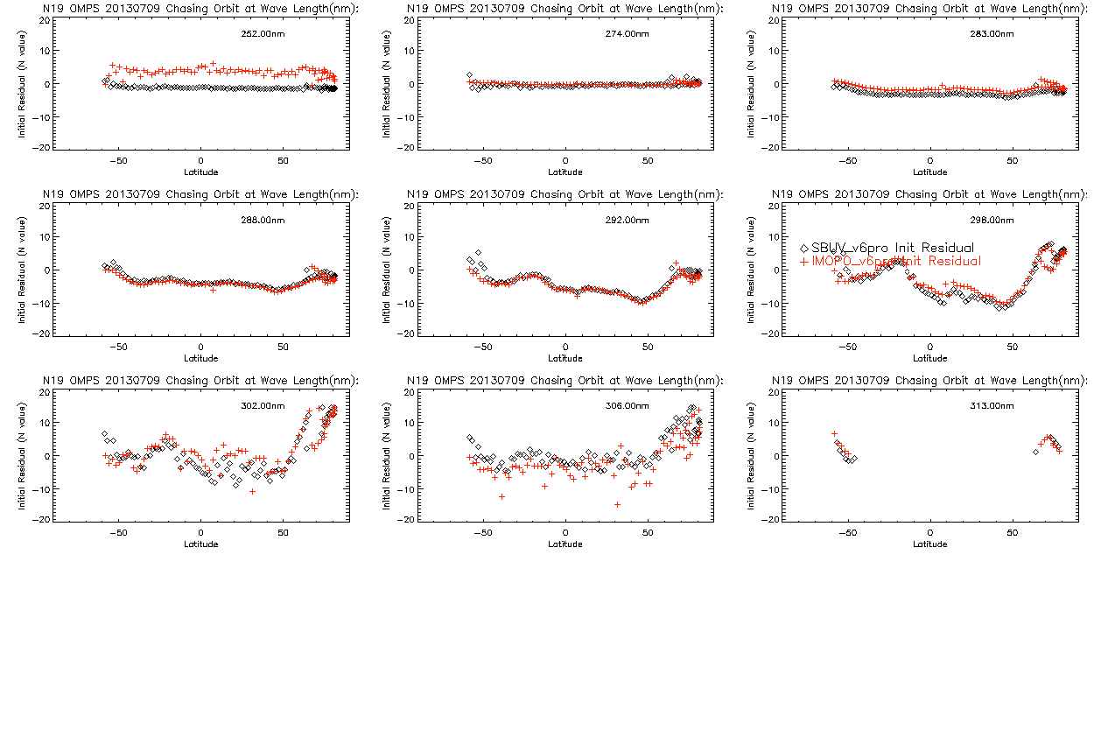
Chasing orbit comparisons of NOAA-19 SBUV/2 and OMPS-NP Version 6 results for July 10, 2013. Figures show channel initial measurement residuals versus latitude for the nine profiling wavelengths for the two products.

Slide 14
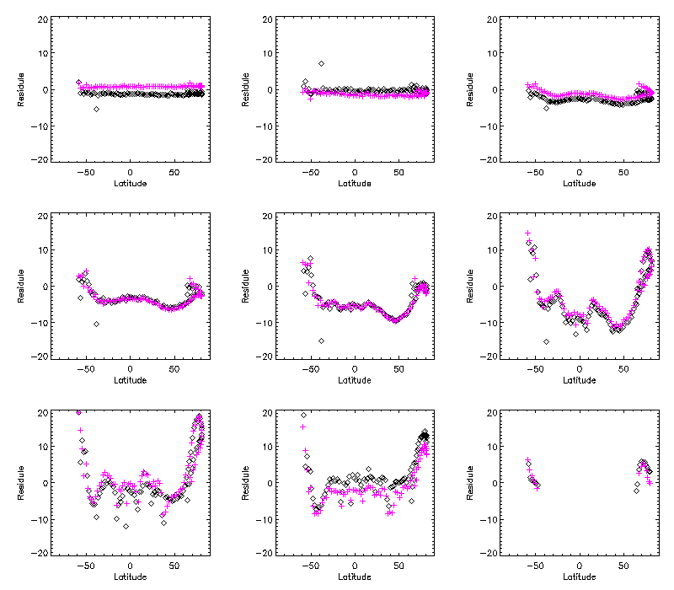
C-Sigma up/down/up
Calibration Biases
Chasing orbit comparisons of NOAA-19 SBUV/2 and OMPS-NP Version 6 results for May 23, 2014. Figures show channel initial measurement residuals versus latitude for the nine profiling wavelengths for the two products.
Notes:
C Sigma up/down/up
298, 302, and 306 nm channels need adjustments (after total ozone adjustments).

Slide 15
Adjustments using A, K, and Dy
The Averaging Kernel, A, is the product of the Jacobian of partial derivatives of the measurements with respect to the ozone profile layers, K, and the measurement retrieval contribution function, Dy:
A = Dy # K
For a linear problem, the retrieved profile, Xr, is the sum of the A Priori Profile, Xa, plus the product of the Averaging Kernel, A, times the difference between the Truth Profile, Xt, and Xa:
Xr = Xa + A # [Xt – Xa]
The measurement change, ΔM, is the Jacobian times a profile change, ΔX:
ΔM = K # ΔX
The retrieval change, ΔXr, is the contribution function times a measurement change, ΔM:
ΔXr = Dy # ΔM

Slide 16
+ ΔXr
* Dy # ΔM
Comparison of actual differences in annual tropical zonal mean profiles retrieved by NOAA-16 and NOAA-17 SBUV/2 for 2003 with those predicted by their differences in their initial residuals. The “+” symbols are ΔXr computed directly and the * symbols are Dy ΔM with ΔM computed from the initial residuals.
See also www.atmos-meas-tech.net/5/2951/2012/amt-5-2951-2012.html
DeLand, M. T., Taylor, S. L., Huang, L. K., and Fisher, B. L.: Calibration of the SBUV version 8.6 ozone data product, Atmos. Meas. Tech., 5, 2951-2967, doi:10.5194/amt-5-2951-2012, 2012.
Notes:
Dy, measurement contribution function; deltaM, difference in annual tropical zonal mean initial measurement residuals.
http://www.atmos-meas-tech.net/5/2951/2012/amt-5-2951-2012.html
Citation: DeLand, M. T., Taylor, S. L., Huang, L. K., and Fisher, B. L.: Calibration of the SBUV version 8.6 ozone data product, Atmos. Meas. Tech., 5, 2951-2967, doi:10.5194/amt-5-2951-2012, 2012.

Slide 17
Open DRs at or since Provisional
DR # | Short Description
7334 | Impact of dichroic shifts (Use NP < 310 nm)
7335 | Impact of time-dependent solar activity
7283 | Use of Medium Resolution Data in Nadir Profile
7260 | Impact of Annual wavelength scale shift cycle
7013 | Activate 252 nm Channel (CCR Completed)
4802 | Snow/Ice flag is 0 everywhere
4256 | Improved Algorithm for OMPS Nadir Ozone Profile EDR
7623 | Stray light correction (New, CCR completed)
7630 | Incorrect spatial pixel for bias calculation (New, CCR completed)

Slide 18
Open DRs Today
DR # | Short Description
7334 | Impact of dichroic shifts (SDR stable; Soft Calibration 5074)
7335 | Impact of solar activity (SDR small; endure, future)
7283 | Use of Medium Resolution Data in Nadir Profile (Future; J1)
7260 | Impact of wavelength scale shift (Small after 7450; endure)
4802 | Snow/Ice flag is 0 everywhere (Small; endure for Val Stage1)
4256 | V8 Algorithm for Profile EDR (Future)
7654 | Day 1 Solar Spectra (SDR Update in testing)
7450 | Day 1 Wavelength Scale (SDR Update to annual average in testing; endure 7260)
5074 | Generate soft calibration coefficients (Set SDR CFE using initial residuals and chasing orbits from NOAA-18/19 SBUV/2; time-dependent CFE for future degradation.)
NEW #### | Incorrect wavelengths hardcoded in glueware. (SDR small after 5074; endure until CCR for Mx8.8)
Notes:
New DR on wavelengths – Alpha off by 0.5%.
A.i. Turn on the 253 nm channel in the retrieval algorithm -- DONE.
A.ii. First version of the stray light correction. – March 17 in Mx8.3 DONE.
A.iii. Improved/tuned stray light correction table -- April (SDR Table Tuning) Analysis shows there is room for improvement. Mg II Index suggests error may be within performance. Need to evaluate impact on upper layer ozone directly. Which channels are the best proxies?
A.iv. New Day 1 Solar irradiance spectrum and wavelength scale – September (SDR Table Tuning)
Simple -0.115 nm shift relative to Day 0.
Annual wavelength scale variations and wavelength dependent shifts. Future.
Hard-coded wavelengths in glueware are incorrect.
Proper matchup for Nadir Mapper and Nadir Profiler FOVs – TTO May 19 in Mx8.4 DONE. Missing NM -> fill in Mx8.5 . DONE
A.vi. Error in smear subtraction creating offset bias error – Correct code (in Mx8.6), Change Input Bias to 742.7 counts CCR submitted. DONE
A.vii. Soft Calibration adjustments including dichroic to Day 1 Solar or CF Earth – September (SDR Table Tuning).
A.viii. Annual variations in the wavelength scale correlated with temperature gradients. SDR. Need to include dichroic interaction with wavelength and calibration factors. FUTURE
A.ix. Adjustments to Day 1 Solar for solar activity. SDR. FUTURE
10. Algorithm Paths Forward
OMPS NP V8Pro in ADL to converge POES, CDR and JPSS:
C.i. Provide 12 soft calibration adjustments
C.ii. Change to work with smaller FOVs (just along track at 50KM)
C.iii. Put in N-value fitting (Noise reduction, outlier identification and removal, and information concentration)
C.iv. Add Solar Activity / Scale Factors

Slide 19
Evaluation of the effects of marginal algorithm corrections
Desired Algorithm Improvements in SDR
  Better Stray Light correction
  Annual cycle of Wavelength Scales
  Variations for Solar Activity
  Time-dependent Instrument Degradation
  Outlier detection / information concentration
Evaluation of the effect of marginal algorithm inputs
  Error Bounds and Sensitivity Analyses

Slide 20
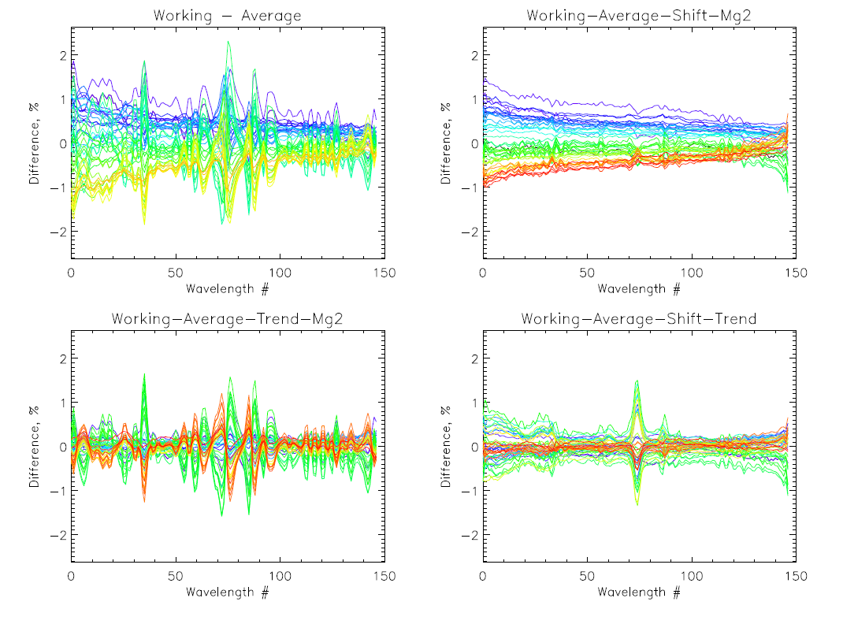
Analysis of Solar Measurements for the Working Diffuser
All Variations
Instrument and Working Diffuser Degradation
Wavelength Shift Effects < 1%
Solar Activity Effects < 1%
Retrieval Channel Locations

Slide 21
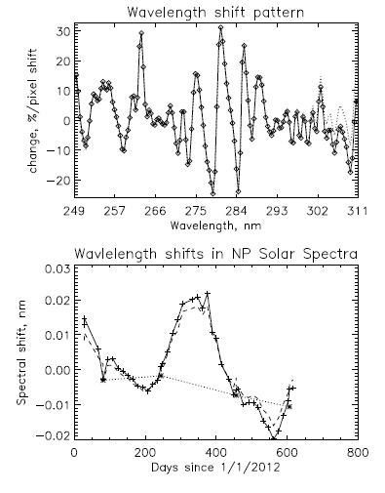
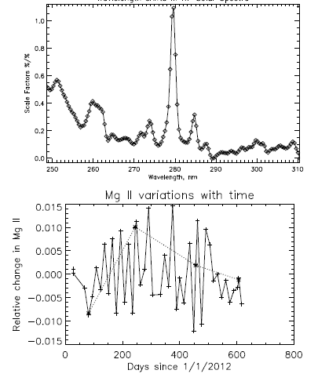
Spectral Patterns and Their Temporal Coefficients
Solar activity pattern

Slide 22
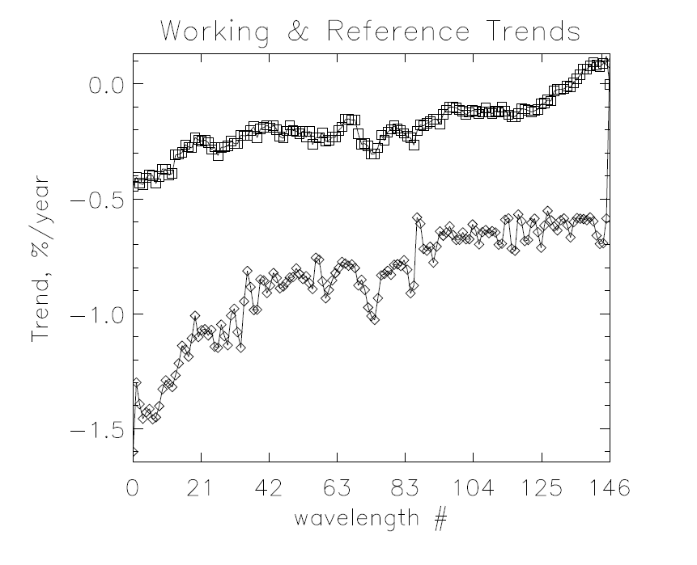
Diffuser and Instrument Degradation
Reference/Instrument
Throughput degradation is at the smaller end of the range for heritage BUV instruments.
Working
250 nm
310 nm

Slide 23
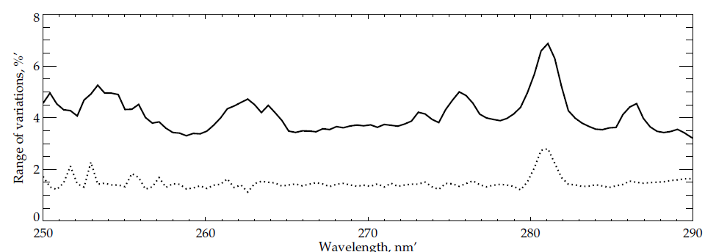
Variations (Maximum minus Minimum) in shorter wavelength channels from linear fit with 299 nm variations.
May 15, 2013 vs. May 16, 2014
The solid line shows the range of variations relative to polynomial fits of Earth radiances for low SZA cases that are correlated with similar variations for the 299 nm wavelength channel. The solid line shows the behavior before applying a laboratory-based stray light correction and the dotted line shows the behavior with the correction applied. The correction reduces the stray light by over 50% and the errors are now within limits. The vertical red lines are retrieval channel locations.
Notes:
% Layer O3 / % Reflectivity
2013 April 1st
OMPS -12.8385 -8.63500 -5.69450 -3.09687 -2.14902
SBUV/2 -1.79121 -1.02818 -0.481300 0.134237 0.0825660
2013 May 1st
OMPS -15.6586 -10.3020 -6.70976 -3.43819 -2.59988
SBUV/2 -2.02118 -1.26577 -0.751157 0.0446392 -0.185982
2014 May 15th
OMPS -4.59342 -3.11101 -1.97659 -1.10884 -1.98181
SBUV/2 -7.15280 -4.08495 -1.65302 1.26124 -0.613306

Slide 24
Scatter Plots of Ozone Layer Variations versus Reflectivity Variations for the first five orbits of May 15, 2013
Correlations are evidence of stray light impact.
Upper Left Umkehr Layer 12 and above (> 0.25 hPa) Upper Right Umkehr Layer 11 (0.5 – 0.25 hPa)
Lower Left Umkehr Layer 10 (1.0 – 0.5 hPa) Lower Right Umkehr Layer 9 (2.0 – 1.0 hPa)
Without corrections, stray light contributes to both the accuracy and precision
error budgets for the upper layers.

Slide 25
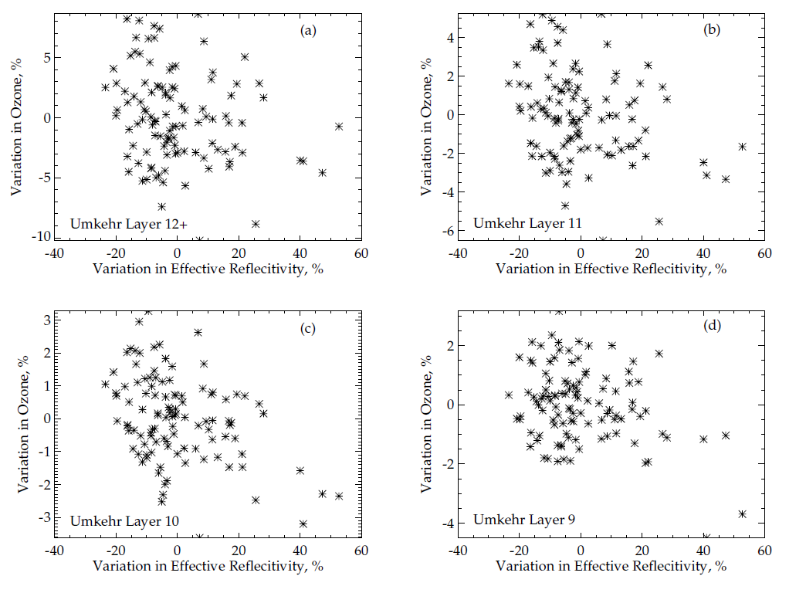
Scatter Plots of Ozone Layer Variations versus Reflectivity Variations for the first five orbits of May 16, 2014
Reduced stray
light impact.
Scatter gives an upper limit on effect of instrument noise on the retrieval precision as there are real variations for different orbits and latitudes.
Notes:
Scatter is an upper limit on effect of instrument noise as there are real variations for different orbits.

Slide 26
Instrument Performance
Requirement | Specification/Prediction Value | On-Orbit Performance
Non-linearity | < 2% full well | < 0.46%
Non-linearity Knowledge | < 0.5% | ~0.1%
On-orbit Wavelength Calibration | < 0.01 nm | < 0.01 nm #
Stray Light NM Out-of-Band + Out-of-Field Response | ≤ 2% | average ~± 1%*
Intra-Orbit Wavelength Stability | <0.02 nm | < 0.01 nm
SNR | Channel Dependent | As good as SBUV/2 at Alg. Channels &
Inter-Orbital Thermal Wavelength Shift | <0.02 nm | 0.03-nm amplitude annual cycle^
^CCD Read Noise | <60 –e RMS | < 25 –e RMS
Detector Gain | >43 | ~45
Absolute Irradiance Calibration Accuracy | < 7% | 1~10% , average: ~7%
Absolute Radiance Calibration Accuracy | < 8% | < 5%
# After new analysis of Day 1 Solar
* After measurement-based correction using prelaunch characterization
^ Regular annual cycle affects accuracy and stability
& Information concentration possible by using near-by channels.
C. Pan
Notes:
From C. Pan SDR Provisional.
New notes from L. Flynn.

Slide 27
Error Impacts on Precision/Accuracy
The sensitivity of the ozone retrievals to radiance/irradiance ratio errors is approximately 1.6%::1% .
Wavelength scale produces radiance variations of ±1%
  1.6%/1% x 1% = 1.6% O3 effects
and ozone cross-section, alpha, of ±0.4 %,
  0.02 nm x 100%/5 nm x 1%/1% = 0.4% O3 effects
Solar activity produces irradiance variations of ±1%
  1.6%/1% x 1% = 1.6% O3 effects
Instrument degradation is -0.5%/year at 253 nm
  1.6%/1% x 0.5%/year = 0.8%/year O3 effects (annual update to CFE)
Stray light errors are now approximately 1/3 of the original errors with radiance variations of ±1%
  1.6%/1% x 1% = 1.6% O3 effects
New DR####: Small (1% in alpha) error from incorrect channel assignment in glueware. Will be removed to first order with soft calibration as it is primarily a bias.
Notes:
Differences 1.54 0.13 -0.06 0.06 0.14 0.00 -0.08 -0.06 -0.01 0.00 0.05 -0.17 -0.18 nm.

Slide 28
Quality flag analysis/validation
Quality Flags
  Switched names corrected. (July 2013)
  SAA Functioning properly.
  Ascending/Descending fixed (August 2013).
  Terrain pressure limit fixed (February 2013)
  No snow ice reported.
Other quality flag analysis/validation Provided in Provisional report. Summary on the next slide.

Slide 29
IMOPO Error Flags
Individual Flags
  Sun Glint, SAA, and Eclipse are all set correctly
  SO2 Index is running too negative; it and the Volcano Contamination Index (VMI) are affected by initial calibration uncertainties.
  Snow/Ice is always zero – DR #4802
Profile Error Codes*
  Code 1 is set correctly (Lower three layers)
  Code 2 is set correctly (BestTOZ vs ProTOZ)
  Code 3 is set correctly (large final residuals – often for data in SAA)
  Code 5 is set correctly (C outside of range – often for data in SAA)
  Codes 4, 6, 7 & 8 conditions are not met in samples
  Code 9 (Bad counts/missing measurements)
  Code 20 Invalid or out-of-range inputs – Flagged all terrain pressure > 1.001 atm. until fixed in February 2013.
  Descending Flag (+10) in error, fixed with DR 5046/CCR881 in Mx8.0.
Total Ozone Error Codes*
  Codes 1 & 2 are set correctly by comparing S x Omega to 1.5 and 3.5 atm-cm, respectively
  Code 4 is set correctly (Pair differences)
  TOZ Error Code 5 matches PRO Code 2
  Code 7 not seen; Photometer Reflectivity difference is not in the output. All channels are coincident.
  Codes 8 & 9 conditions are not met in samples; Codes 3 & 6 are Spares
  Code 20 Invalid or out-of-range inputs – matches profile behavior
  Descending Flag (+10) matches Profile Error behavior
  *Profile and total ozone error flags were switched in the HDF5 output. This was fixed with the implementation of PCR 27740 in 2013.
Notes:
For total ozone code 7, the subroutine BESTOZ.F has 0.15; the OAD has 0.05 – although ecode is used as a name for both error codes and the OAD has 0.15 for the profile Code 7.
252 nm channel was turned off. Check IOPTS for NO_2520_RAD_INDEX = 8 in NP_CONSTANTS.F

Slide 30
Documentation
The following documents will be checked to ensure consistency with current codes and performance, updated as needed, and provided to the EDR Review Board before AERB approval:
  ATBD
474-00026 (April 2011) Joint Polar Satellite System (JPSS) OMPS Nadir Profile Ozone Algorithm Theoretical Basis Document (ATBD)
  OAD
474-00067 Revision C: Joint Polar Satellite System (JPSS) Operational Algorithm Description (OAD) Document for Ozone Mapping and Profiler Suite (OMPS) Nadir Profile (NP) Intermediate Product (IP) Software
474-00448-03-22 Joint Polar Satellite System (JPSS) Algorithm Specification Volume III: Operational Algorithm Description (OAD) for the Ozone Nadir Profile EDR
  Updated README file for CLASS
Revising Provisional Release Readme.
Algorithm References:
  Version 6: Bhartia, P. K., McPeters, R. D., Mateer, C. L., Flynn, L. E., and Wellemeyer, C.: Algorithm for the estimation of vertical ozone profiles from the backscattered ultraviolet technique, J. Geophys. Res.-Atmos., 101, 18793–18806, 1996.
  Version 5: http://ntrs.nasa.gov/archive/nasa/casi.ntrs.nasa.gov/19900007911.pdf
  Version 8: Bhartia, P. K., McPeters, R. D., Flynn, L. E., Taylor, S., Kramrova, N. A., Frith, S., Fisher, B., and DeLand, M.: Solar Backscatter UV (SBUV) total ozone and profile algorithm, Atmos. Meas. Tech. Discuss., 5, 5913\u20135951, doi:10.5194/amtd-5-5913-2012, 2012.
Notes:
Bhartia, P. K., McPeters, R. D., Mateer, C. L., Flynn, L. E., and Wellemeyer, C.: Algorithm for the estimation of vertical ozone profiles from the backscattered ultraviolet technique, J. Geophys. Res.-Atmos., 101, 18793–18806, 1996.

Slide 31
Identification of Processing Environment
IDPS Mx8.6 (With planned revision for Mx8.8 February 2015)
Algorithm version (Version 6 SBUV algorithm) as adapted for OMPS with additional CCRs.
IDPS Build: I1.05.08.05 (Mx 8.5)
EDR version: Mx 8.5
LUT Version: PS-1-O-CCR-13-0829-JPSS-DPA-002-PE
PCT Version: N/A
Environment for testing: Linux (ADL Mx 8.x) and AIX (ADA Mx 8.x)

Slide 32
Users & User Feedback
Users list
  NCEP, NASA, NRL, Environment Canada, EuMetSat
Feedback from users
  BUFR product in testing at NCEP, EC, and EuMetSat
Downstream product/application list
  NCEP assimilation (UV Index and weather)
  Ozone Hole Monitoring (Six-month Stratospheric Summaries)
  Ozone Layer Assessments
  TOAST daily ozone maps
Reports from downstream product teams on the dependencies and impacts
  Calibration bias creates offsets with NOAA-19 SBUV/2 products
  Desire for averaging kernels in BUFR product (with V8Pro)

Slide 33
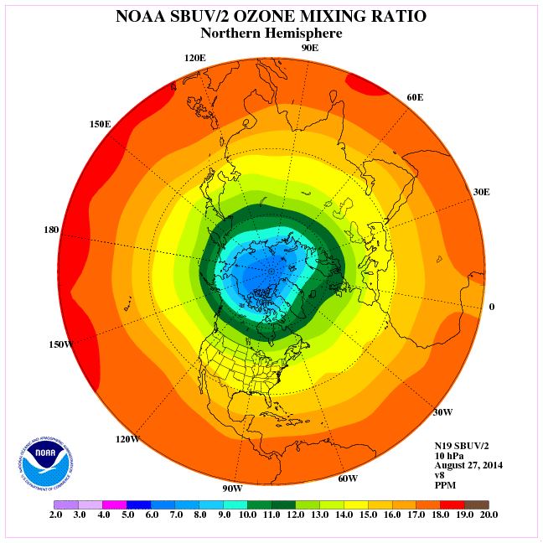
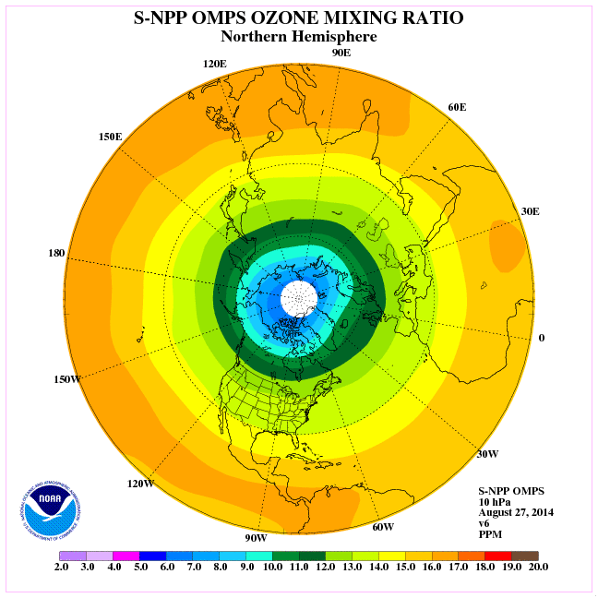
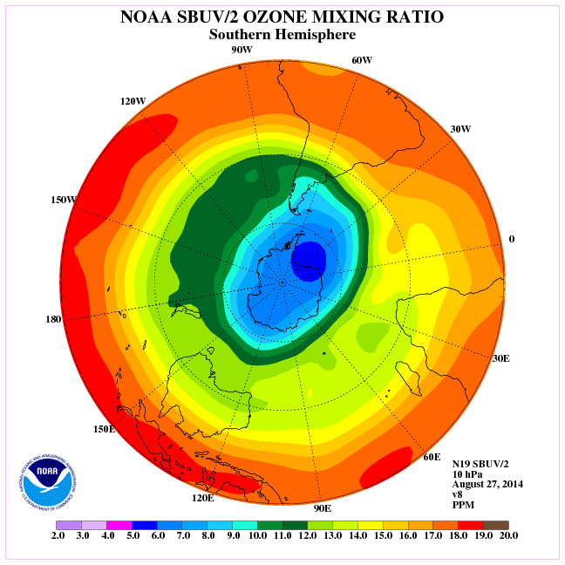
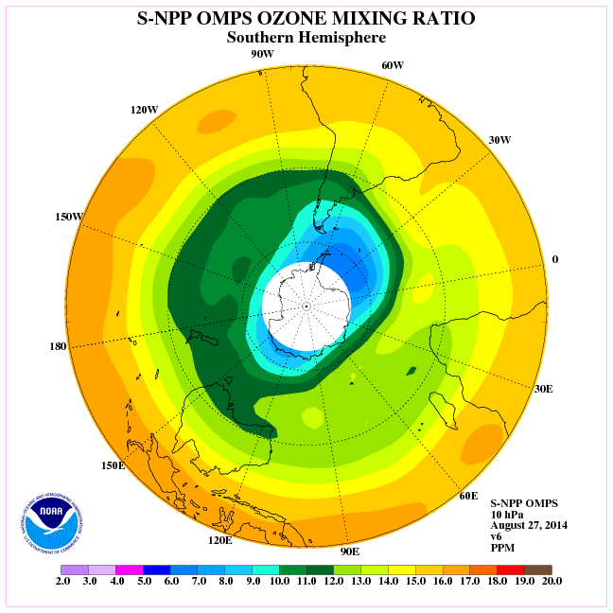
Ozone Mixing Ratio - 2 hPa : Aug 27, 2014
SBUV/2 NH
OMPS NH
SBUV/2 SH
OMPS SH

Slide 34
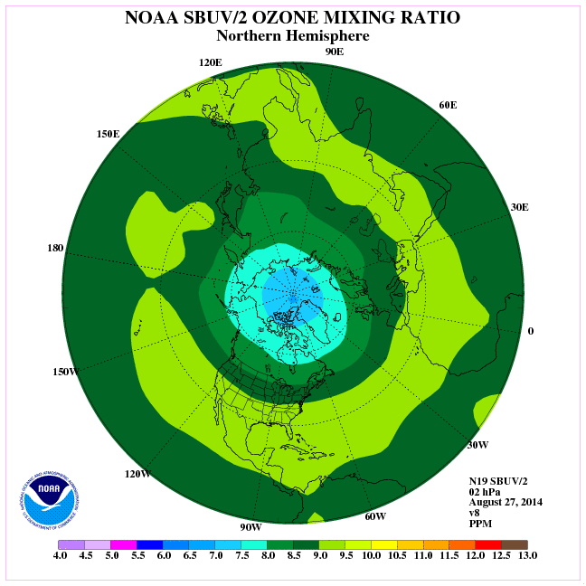
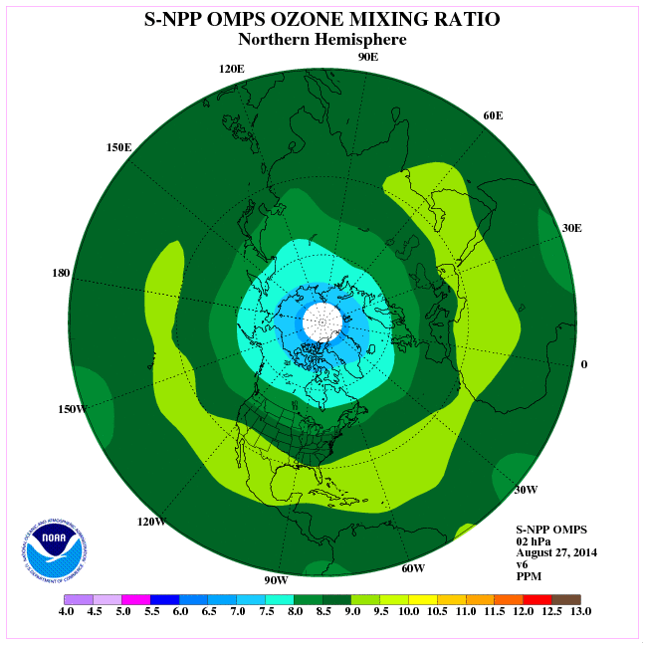
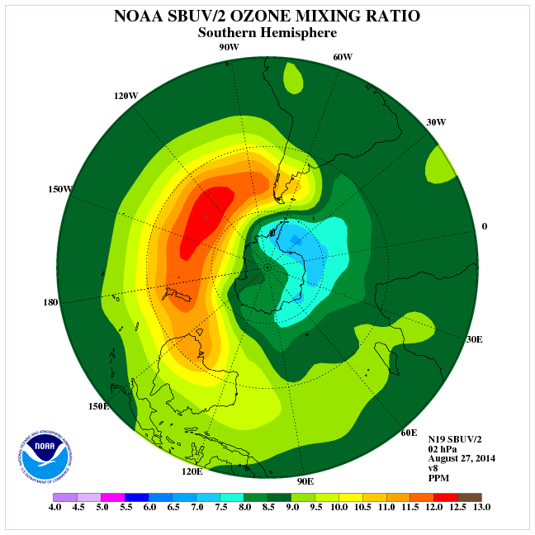
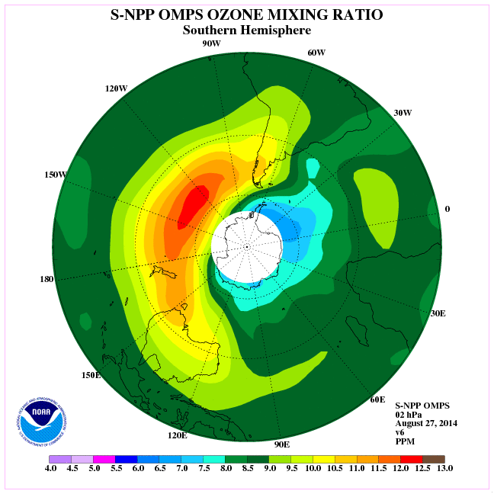
Ozone Mixing Ratio - 2 hPa : Aug 27, 2014
SBUV/2 NH
OMPS NH
SBUV/2 SH
OMPS SH

Slide 35
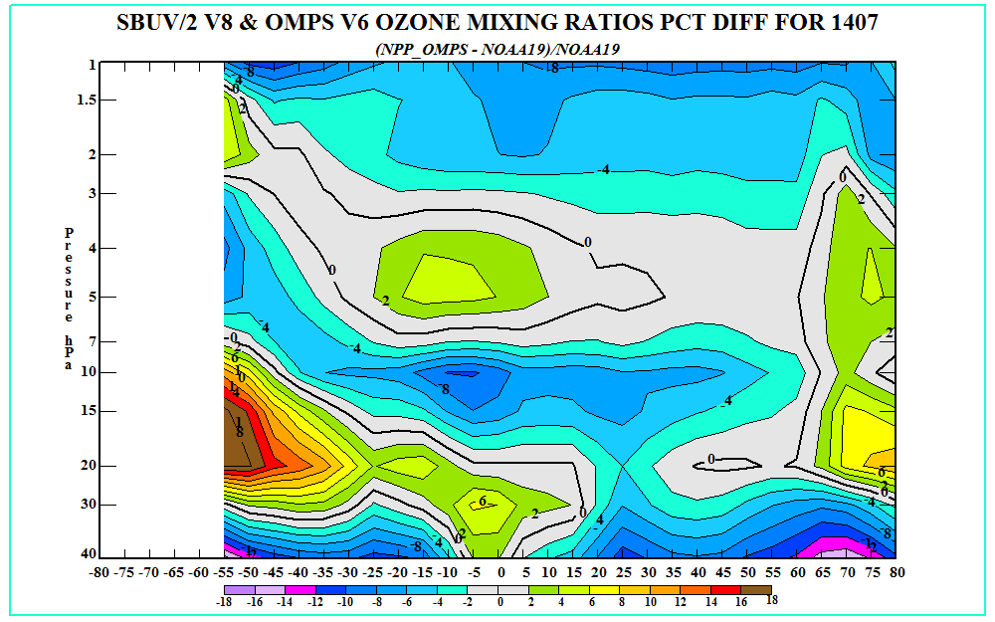
Monthly Mean Ozone Mixing Ratio Differences : July 2014
Comparison with N19 SBUV/2
Agreement
OMPS Lower
OMPS Higher

Slide 36
Conclusion
Cal/Val results summary:
  Team recommends product advancement to Validated Stage 1 Maturity effective with key corrections
    CCRs for three SDR DRs (All to Tables not to Code)
      DR 7654 OMPS NP SDR Nadir Profiler Day 1 solar irradiance spectrum update
      DR 7450 OMPS NP SDR OMPS NP Wavelength Scale
      DR 5047 OMPS NP IP Generation of soft calibration coefficients for NP IP – Use chasing orbits and calibrate to NOAA-19 SBUV/2
    CCR to change hard-coded wavelengths in Glueware.

Slide 37
Path Forward
Areas with planned further improvements
  Information concentration / outlier detection
  Implement V8Pro algorithm and Small FOV
  Model solar activity
  Snow/Ice – use daily forecast tilings
  Implement annually varying wavelength scale
Planned Cal/Val activities / milestones
  December 2014 – Show improved comparisons to NOAA-19 SBUV/2 and ground-based Umkehr with new SDR.
  March 2015 – extend analysis to show Validated Stage 2.
  July 2015 – demonstrate stability and annual cycle analysis to show Validated Stage 3.
Notes:
DR4802: snow/ice flag is 0 everywhere for NP EDR - The NP product, IMOPO, does not have the Snow/Ice flag set anywhere -- It is always 0, even over Greenland and Antarctica.
We should use the Snow/Ice Tiling as input.

Slide 38
Backup

Slide 39
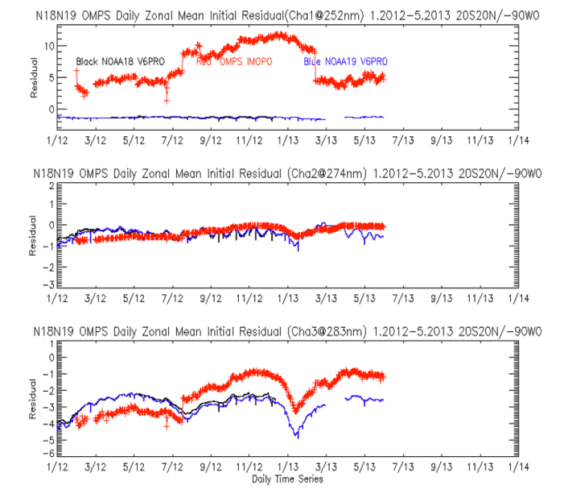
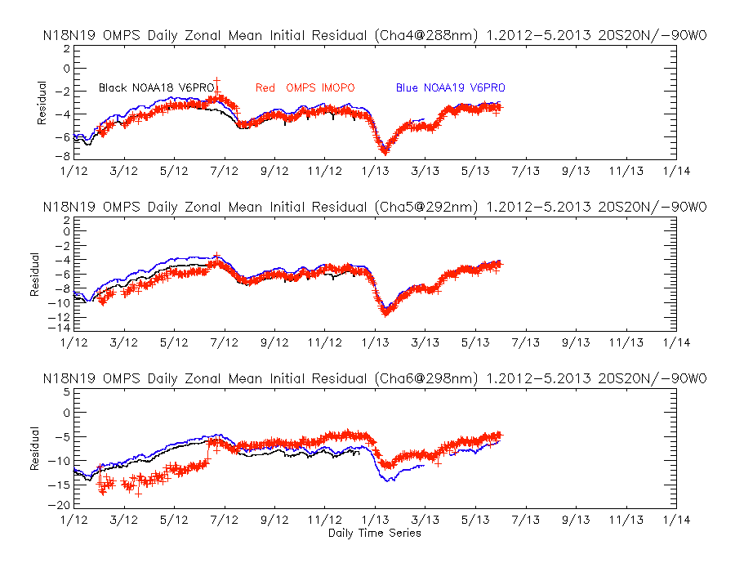
Initial Measurement Residuals for OMPS-NP and SBUV/2 Version 6 Algorithm
Weekly Dark Updates Began
(a)
(d)
(b)
(e)
Change in Day 1 Solar for OMPS NP
Change in Day 1 Solar for OMPS NM
(c)
(f)
The six figures show the initial measurement residuals for profile wavelengths (a) Top – 252 nm (b) Second – 274 nm, and (c) Third– 283 nm (c) fourth – 288 nm (b) Fifth – 292 nm, and (c) Bottom – 298 nm for the V6PRO product from OMPS compared to the V6PRO product for the operational POES NOAA-18 and POES NOAA-19 SBUV/2 for the equatorial daily zonal means (20N to 20S) with 0-90W removed to avoid the SAA effects.
The OMPS soft calibration can be set to remove the differences in these residuals and consequently reduce the biases in the ozone profile products.

Slide 40
Requirements (1 slide)
Product Requirements from JPSS L1RD
Attribute | Threshold | Objective
Geographic coverage
Vertical Coverage
Vertical Cell Size
Horizontal Cell Size
Mapping Uncertainty
Measurement Range
Measurement Accuracy
Measurement Precision
Measurement Uncertainty

Slide 41
Error Budget
Compare analysis/validation results against requirements, present as a table. Error budget limitations should be explained. Describe prospects for overcoming error budget limitations with future improvement of the algorithm, test data, and error analysis methodology.
Attribute Analyzed | L1RD Threshold | Analysis/Validation Result | Error Summary

Slide 42
State of the Ozone Profile Product
The OMPS Nadir Profile product is created by using the Version 6 SBUV/2 algorithm.
The product is currently at provisional status awaiting new Day 1 solar spectra and wavelength scales and soft calibration adjustments to force it to agree with the NOAA-19 ozone profile products. These should be in place by the end of the year.
An upgrade of the algorithm to the Version 8 SBUV/2 algorithm is progressing through testing and should be in operations by early next year.

