Slide 1
Surface Program
Status and Outlook of the USCG Polar Icebreaker Program
Mr. David Raboy
7th Symposium on the Impacts of an Ice-Diminishing Arctic on Naval and Maritime Operations | 19 July 2017

Slide 2
Agenda
Mission Need
USCG Icebreaker Fleet
Icebreaker Operations
New Heavy Polar Icebreaker

Slide 3
Mission Need
Assured access to high latitudes is critical to national security, sovereign presence, and maritime domain awareness
Increased human activity in the Polar regions has resulted in increased economic and security interests
Swift action is necessary to rebuild the U.S. polar icebreaking capability

Slide 4
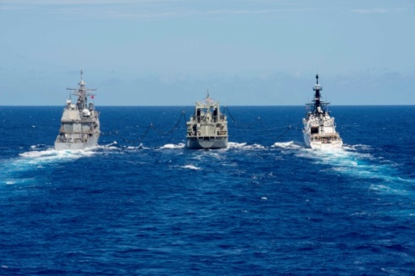
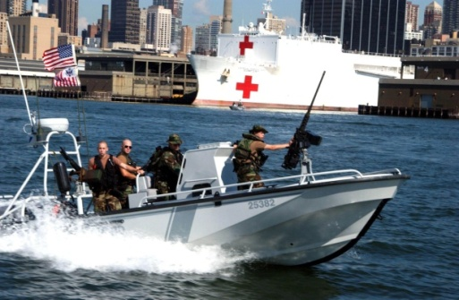
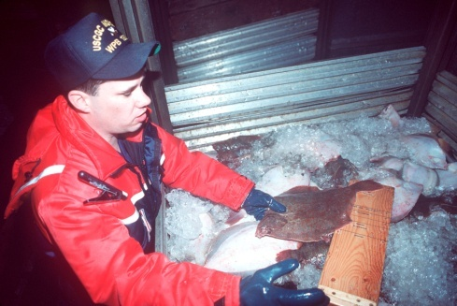
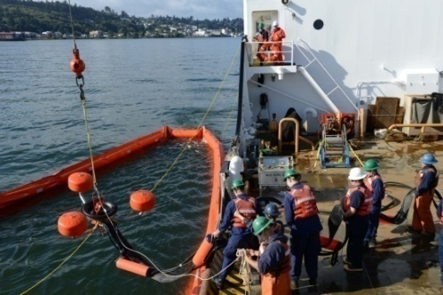
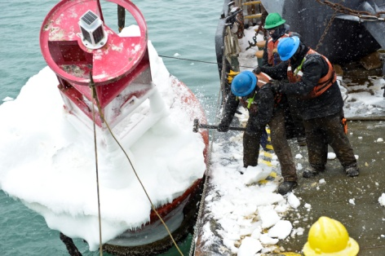
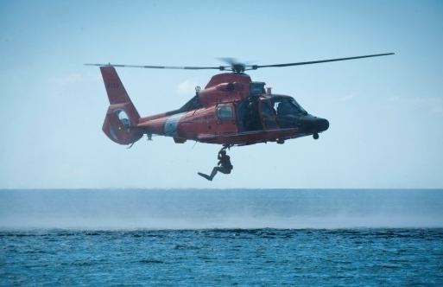
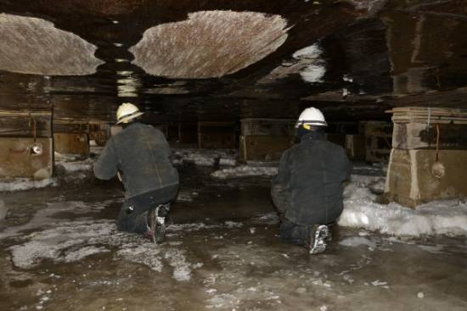
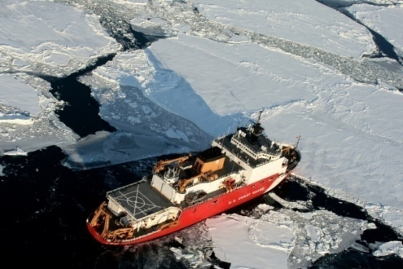
Polar Icebreaker Missions
Defense Readiness
Ports, Waterways & Coastal Security
Living Marine Resources & Other Law Enforcement (i.e. EEZ Enforcement)
Marine Environmental Protection
Aids to Navigation
Search and Rescue
Marine Safety
Ice Operations

Slide 5
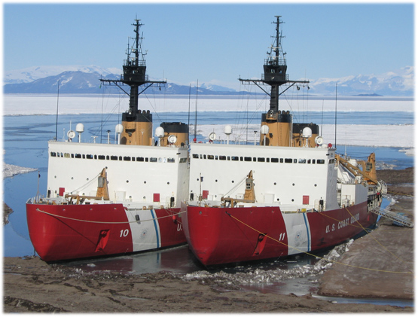
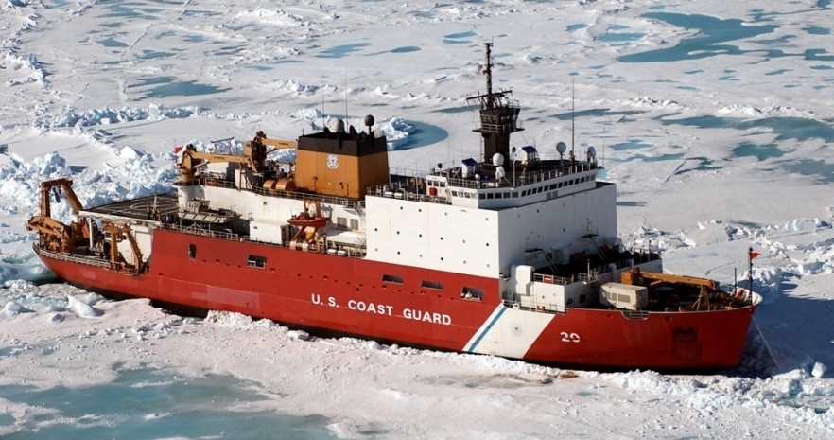
Current USCG Polar Icebreaker Fleet
Platform | Year Commissioned | Design Service Life | Icebreaking Capacity
POLAR STAR | 1976 | 30 | 6ft @ 3kts / 21 ft back & ram
HEALY | 2000 | 30 | 4.5 ft @ 3kts / 8 ft back & ram
POLAR SEA | 1978 | 30 | 6ft @ 3kts / 21 ft back & ram

Slide 6
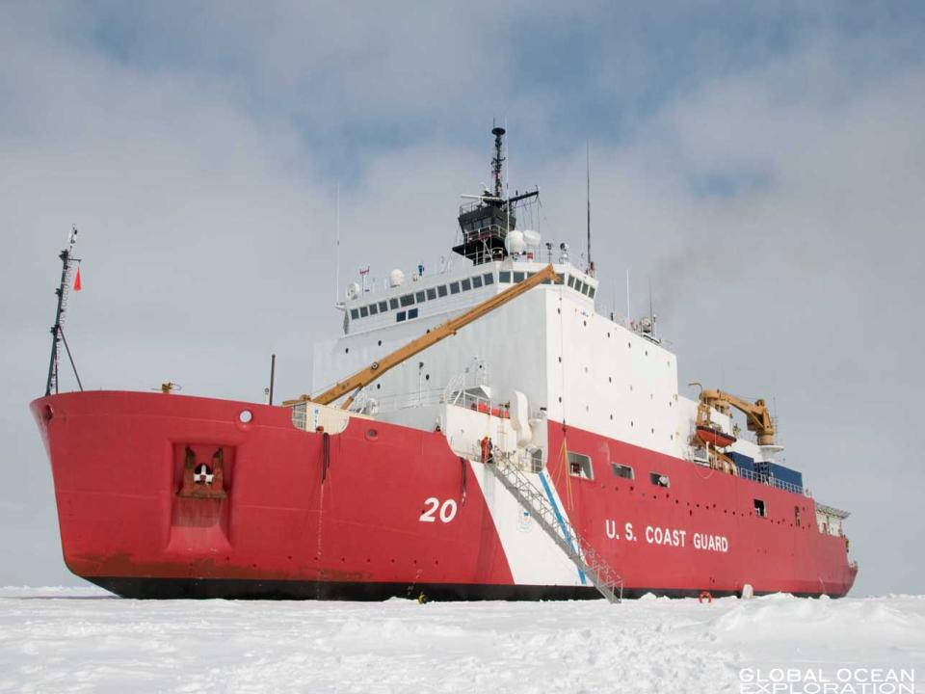
CGC HEALY
Commissioned in 2000
16,600 tons
Diesel-electric
30,000 horsepower
Can break 4.5’ of ice at 3kts
Up to 9’ backing & ramming

Slide 7
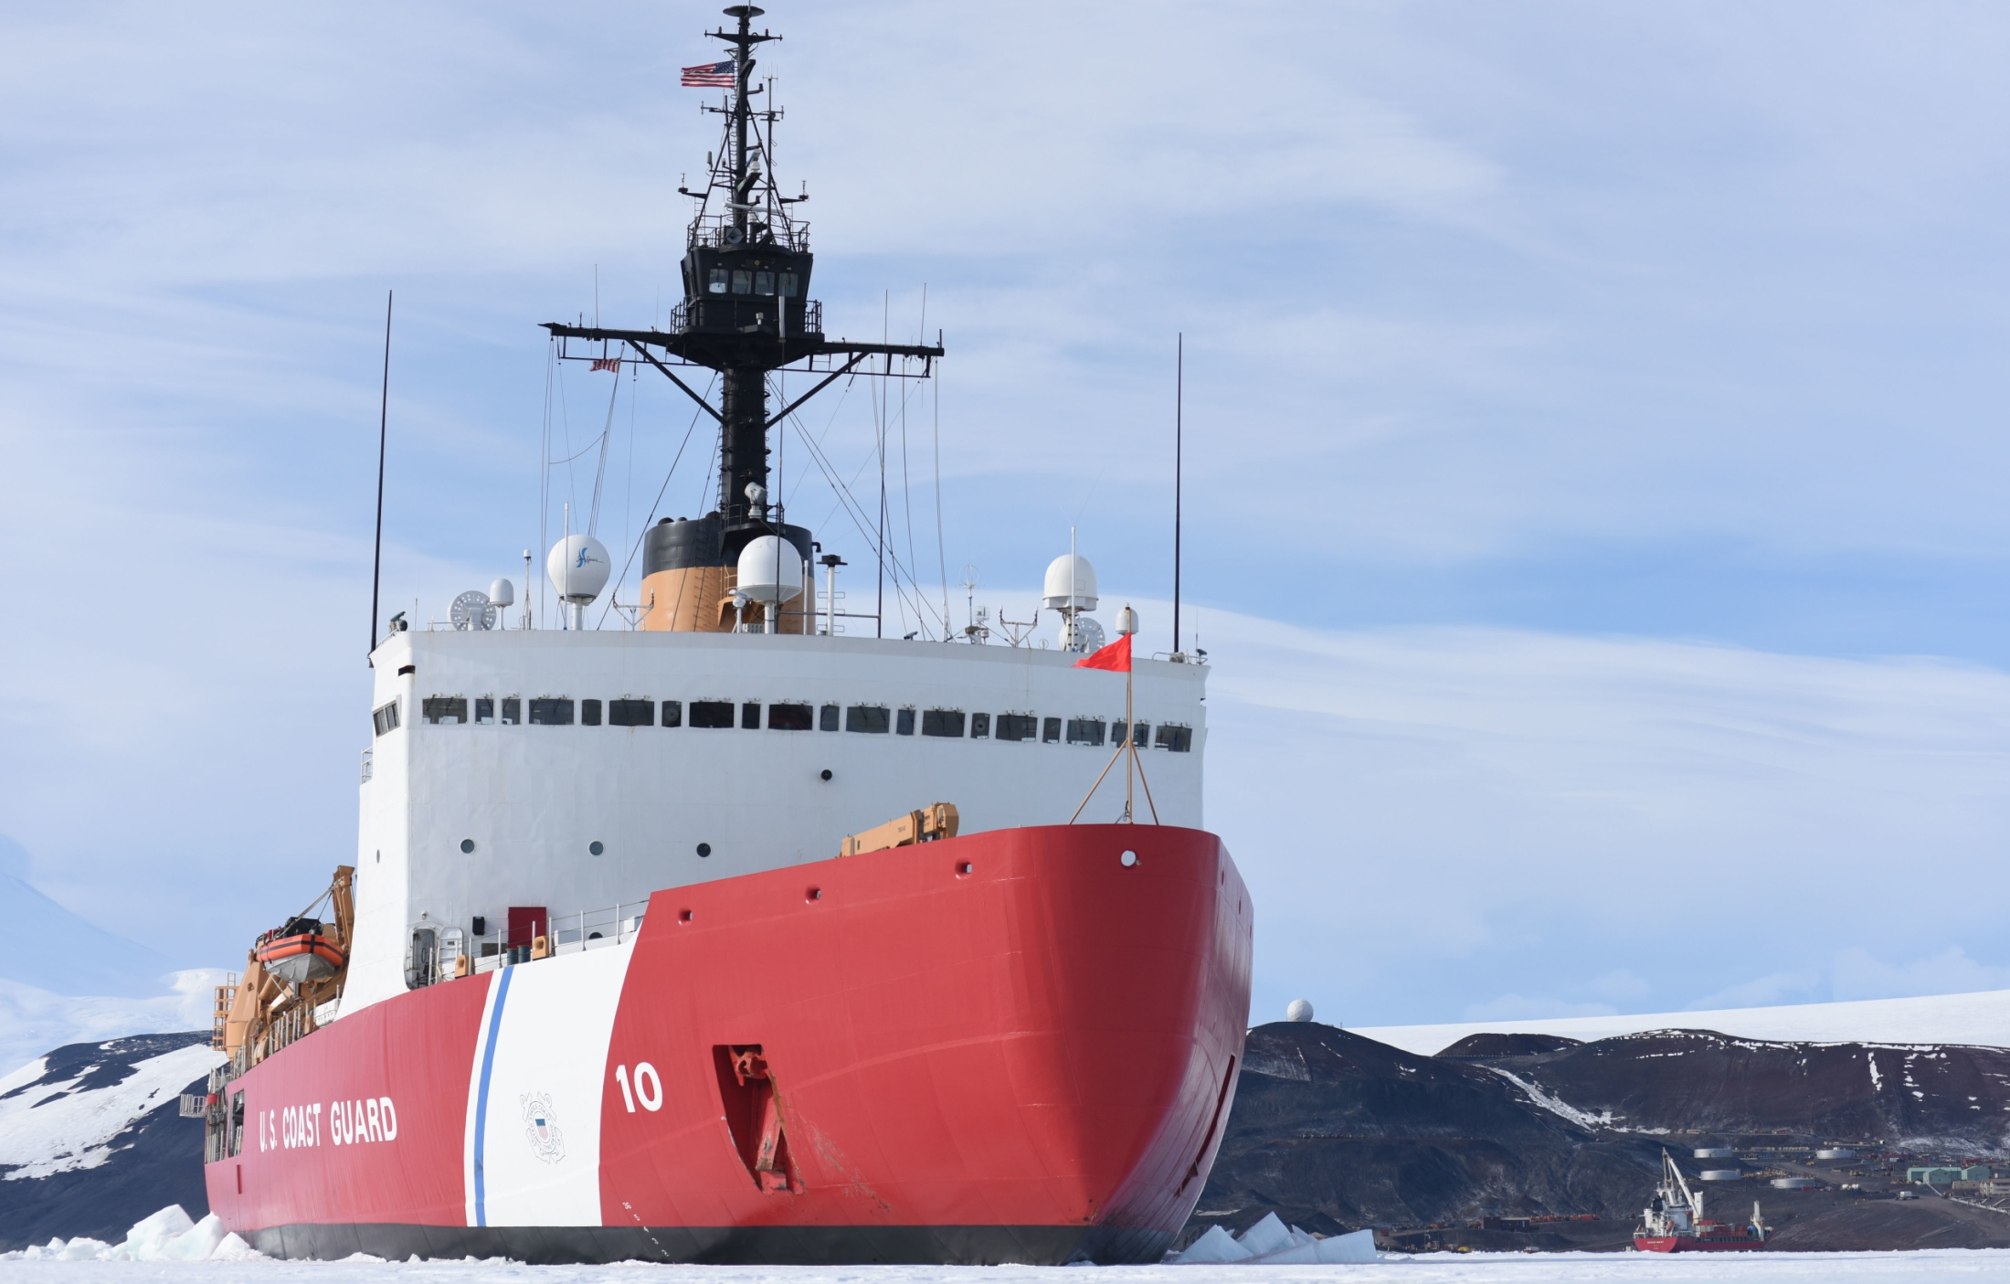
CGC POLAR STAR
Commissioned in 1976
Refit in 2013
13,000 tons
Diesel-electric & gas turbines
75,000 horsepower
Can break 6’ of ice at 3kts
Up to 21’ backing & ramming

Slide 8
Heavy Polar Icebreaker Program
2013: USCG establishes Heavy Polar Icebreaker acquisition program; completes reactivation of POLAR STAR (provides estimated 7-10 years of additional service)
February 2016: Acquisition adjusted to accelerate delivery of the lead Heavy Polar Icebreaker
July 2016: USCG & USN commit to establishing an Integrated Program Office (IPO)
February 2017: Integrated Program Office awards five contracts to industry to identify approaches to further reduce acquisition cost and production timelines

Slide 9
Heavy Polar Icebreaker Key Characteristics
Icebreaking: At least 6 ft of ice at a continuous speed of 3 kts
Endurance: At least 80 days underway without replenishment
Interoperability with Federal partners

Slide 10
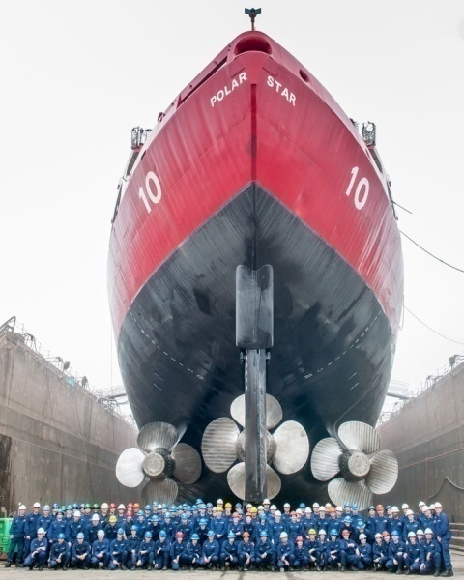
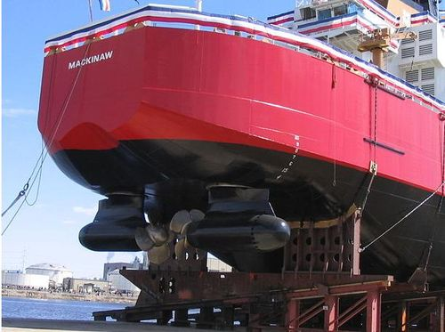
40 Years of Change in Icebreaking

Slide 11
Schedule for Heavy Polar Icebreaker Program

Slide 12
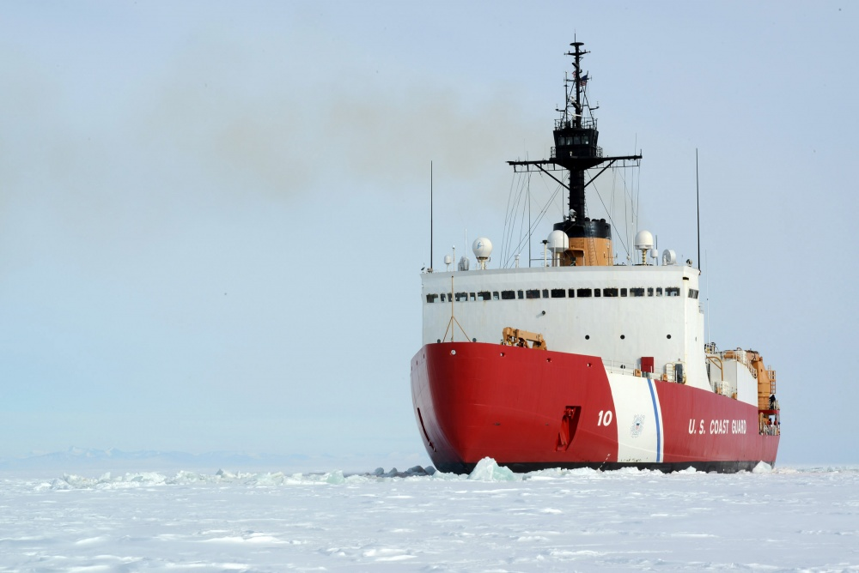
Questions
For inquiries:
Icebreaker@USCG.MIL

