Slide 1
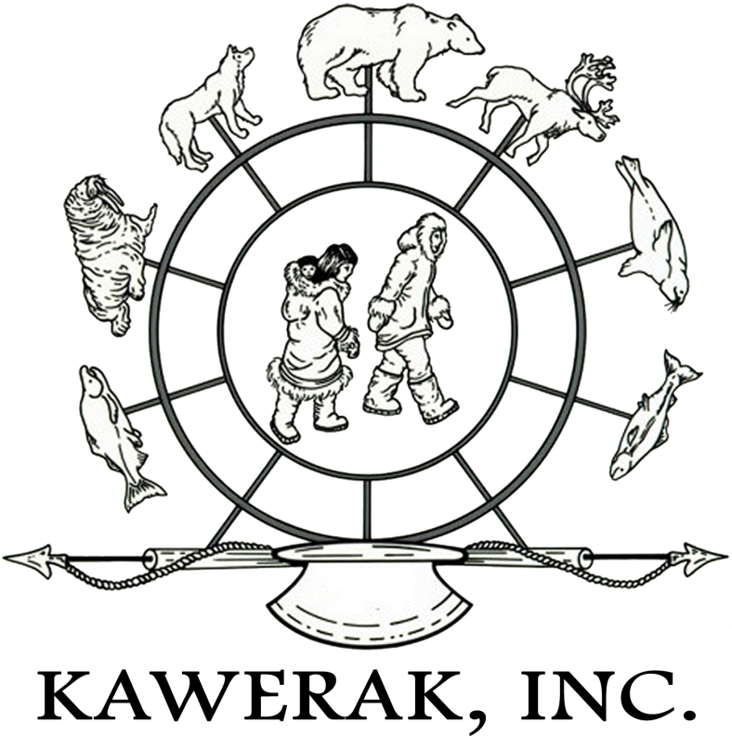
7th Symposium on the Impacts of an Ice-Diminishing Arctic on Naval and Maritime Operations Arctic Marine Infrastructure

Slide 2
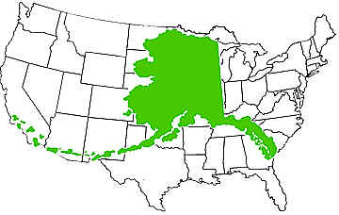
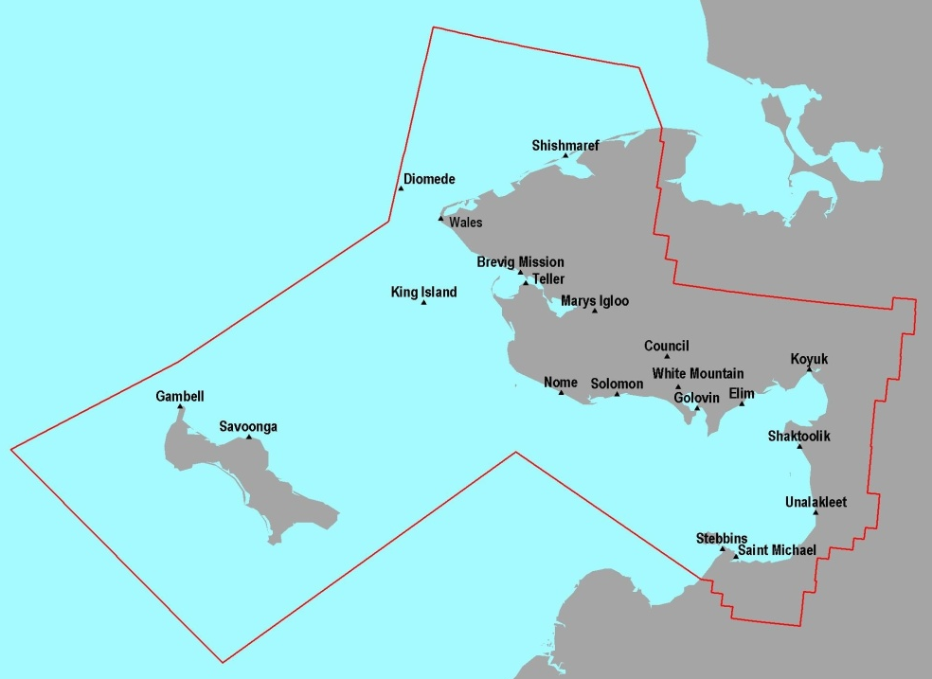
Bering Strait Region
Population: 9,492 (2010)
Inupiaq
Saint Lawrence Island Yupik
Central Yupik
Kawerak was incorporated under state law in 1973
Self-Governance Compact since 1992
Service area the size of Virginia (water and land base)

Slide 3
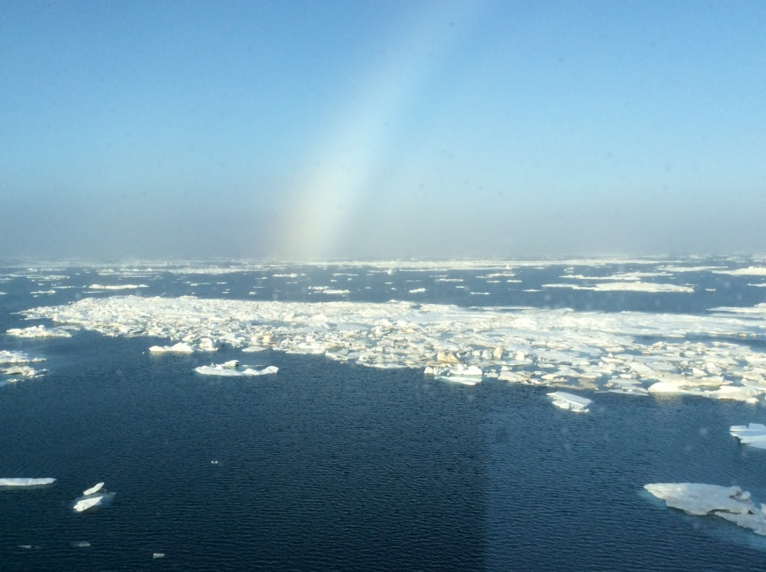
Kawerak, Inc.,
Vision
Our people and tribes are thriving.
Mission
To advance the capacity of our people and tribes for the benefit of the region.
Core Purpose
To work together to achieve the highest quality of life in partnership with our tribal members and communities while living and celebrating our Native cultures.
Goals
Strengthen culture, wellness and pride.
Diversify and enhance regional economies.
Enhance tribal and organization effectiveness.
Develop community infrastructure.
Protect, enhance and control our resources.
Priority 1: Culture & Language
Priority 2: Public Safety & Well Being
Priority 3: Arctic Resource Enhancement & Protection
Priority 4: Regional Capacity Building
Priority 5: Internal capacity building
Divisions
Education, Employment & Supportive Services
Community Services
Transportation
Natural Resources
Cultural and Regional Planning

Slide 4
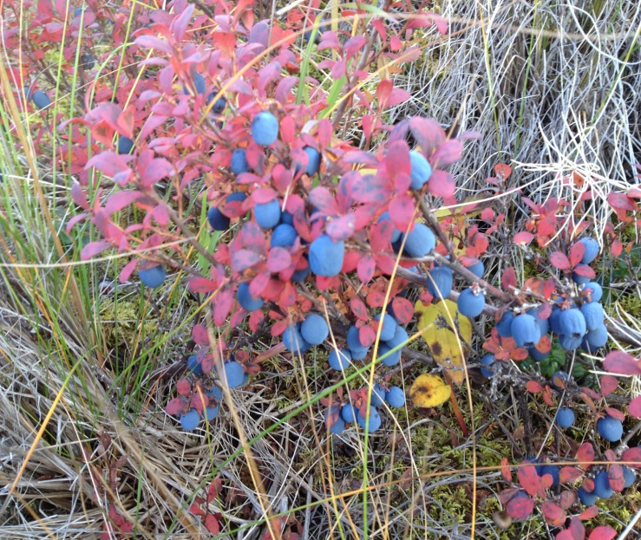
Kawerak’s Involvement in Arctic Issues
Kawerak programs are involved in many Arctic related subjects, Social Science using Traditional Knowledge to create policy recommendations. We work with other non-profits organizations, university-based researchers and State, Federal and international agencies.
Kawerak advocates in policy development
U.S. Coast Guard, Bering Strait Port Access Route Study
Arctic Waterway Safety Committee
Inuit Circumpolar Council-Alaska (PP to AC)
Marine Mammal Coalition/Co-Management Groups
State of Alaska Arctic Policy
US Arctic Policy
International Arctic Policy
www.kawerak.org
“The physical, biological and socio-economic impacts of climate change in the Arctic have to be seen in the context of often interconnected factors. For example, food security for many indigenous and rural residents in the Arctic is being impacted by climate change and in combination with globalization and resource development projected to increase significantly in the future.“ IPCC 2014 Polar Regions Chapter
Societal benefits/gains: Human Health & Wellness, Food Security, Environment, Social and Economic Development and Opportunities.

Slide 5
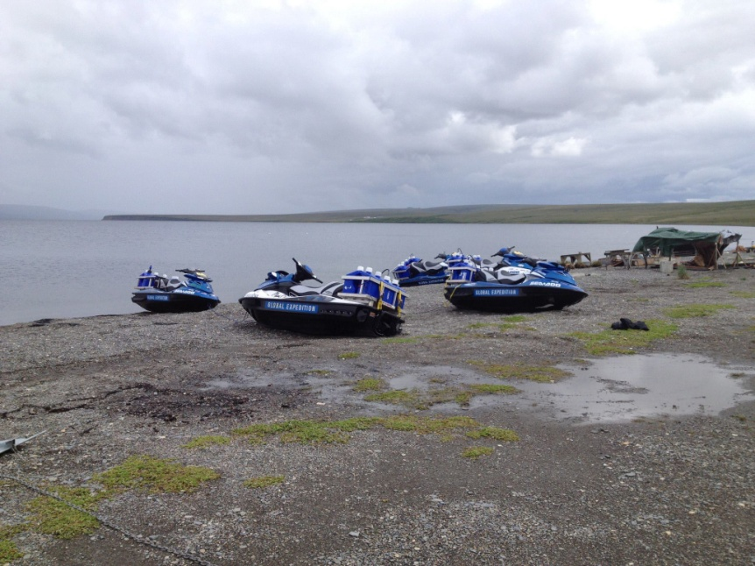
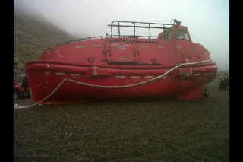
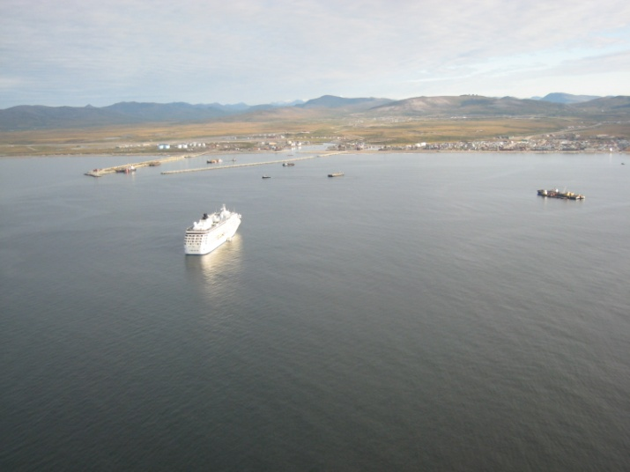
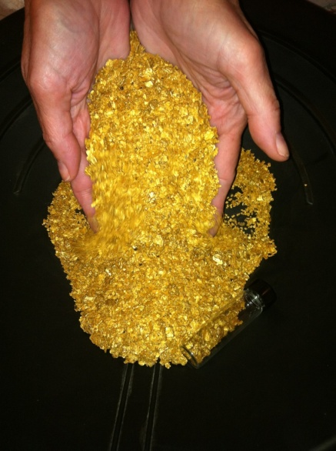
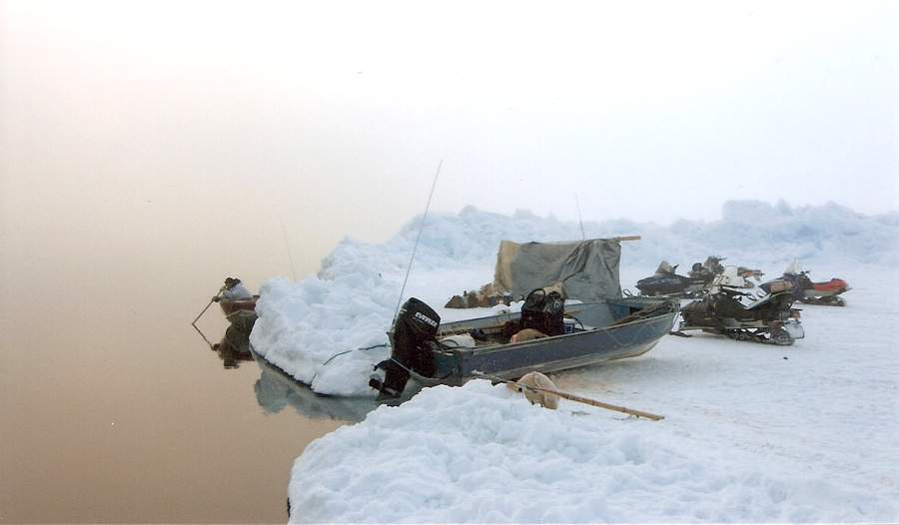
Opening of the Arctic Ocean there is an increase in vessel traffic-
2010 2011 2012 2013 2014 2015 2016
Transit through the Bering Strait 242 239 316 344 255 452 369
Port of Nome Vessel Calls 296 272 444 496 498 635 751
Bering Straits numbers courtesy of Marine Exchange of Alaska
Notes:
Barge tracking by Marine Exchange of Alaska, March 2015.

Slide 6
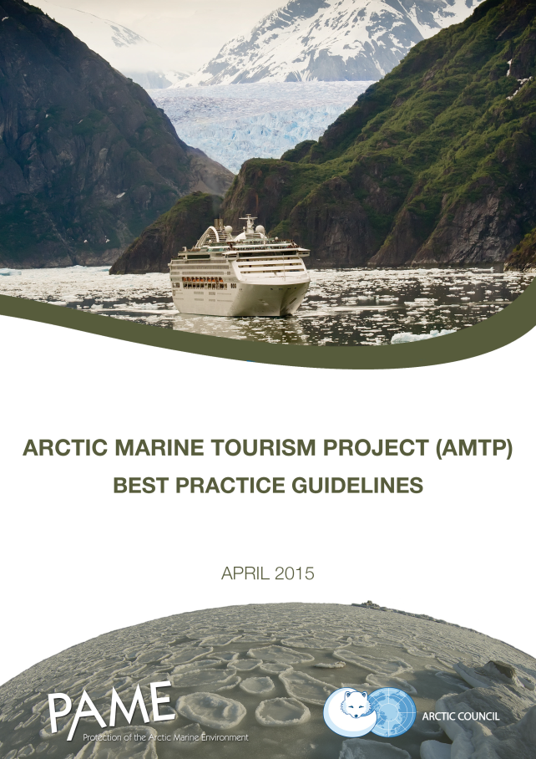
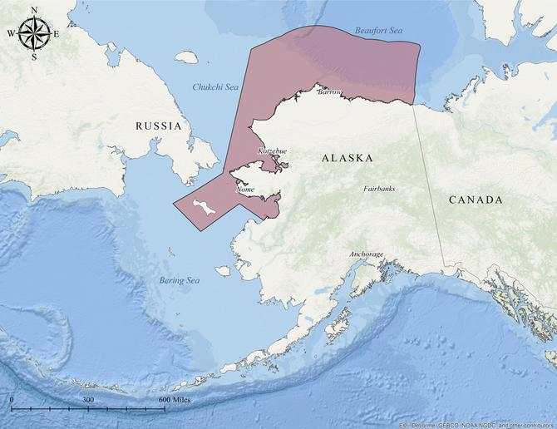
April 2016 Arctic Waterways Safety Plan out
for public comment www.arcticwaterways.org
Arctic Coast Marine Infrastructure Inventory
By Paul Fuhs and Denise Michels Co-Chairs
submitted to SDWG’s “Arctic Maritime &
Aviation Transportation Infrastructure
Initiative” or AMATII
www.arcticinfrastructure.org
“Develop a standardized framework for, and encourage the
preparation of, site-specific guidelines for near-shore and
coastal areas of the Arctic visited by passengers of marine
tourism vessels and pleasure craft”

Slide 7
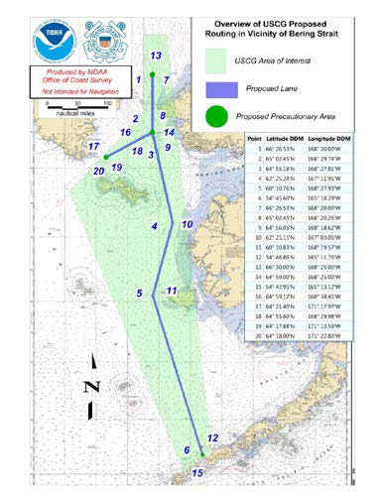
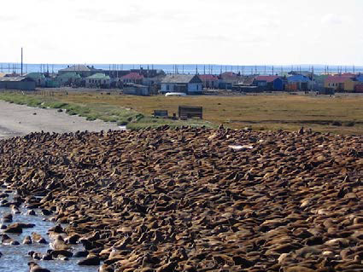
USCG
“Marine Safety Information Bulletin 01-16
Voyage Planning Notice for Vessels
Transiting the Bering Strait”
Geofencing on AIS and not MPA’s-
Marine Mammals have no boundaries
Bering Straits Port Access Route
Study Docket USCG 2014-0941

Slide 8
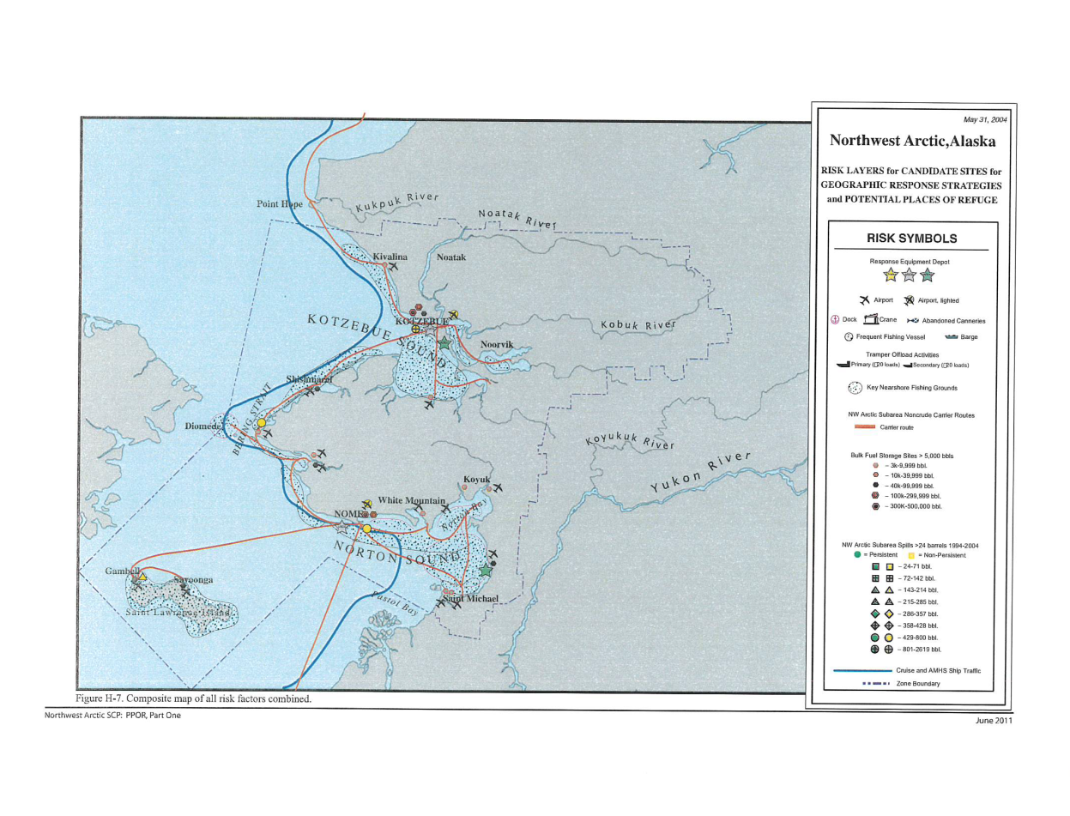
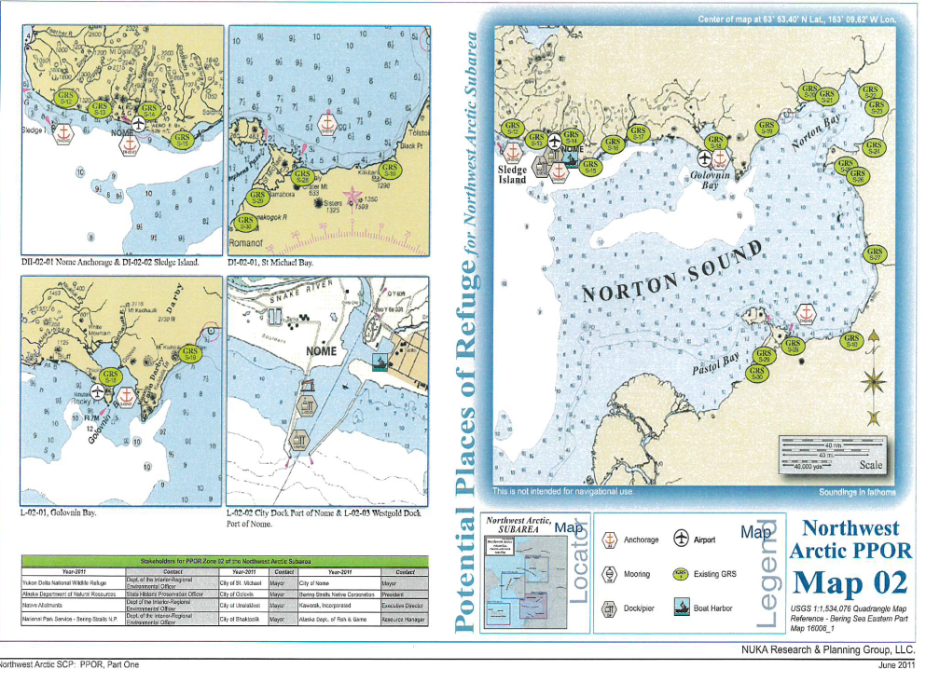
State of Alaska, Department of Environmental Conservation
Spill Prevention and Response (SPAR)
http://dec.alaska.gov/spar/ppr/nwappor/110627nwapart1riskmaps.pdf

Slide 9
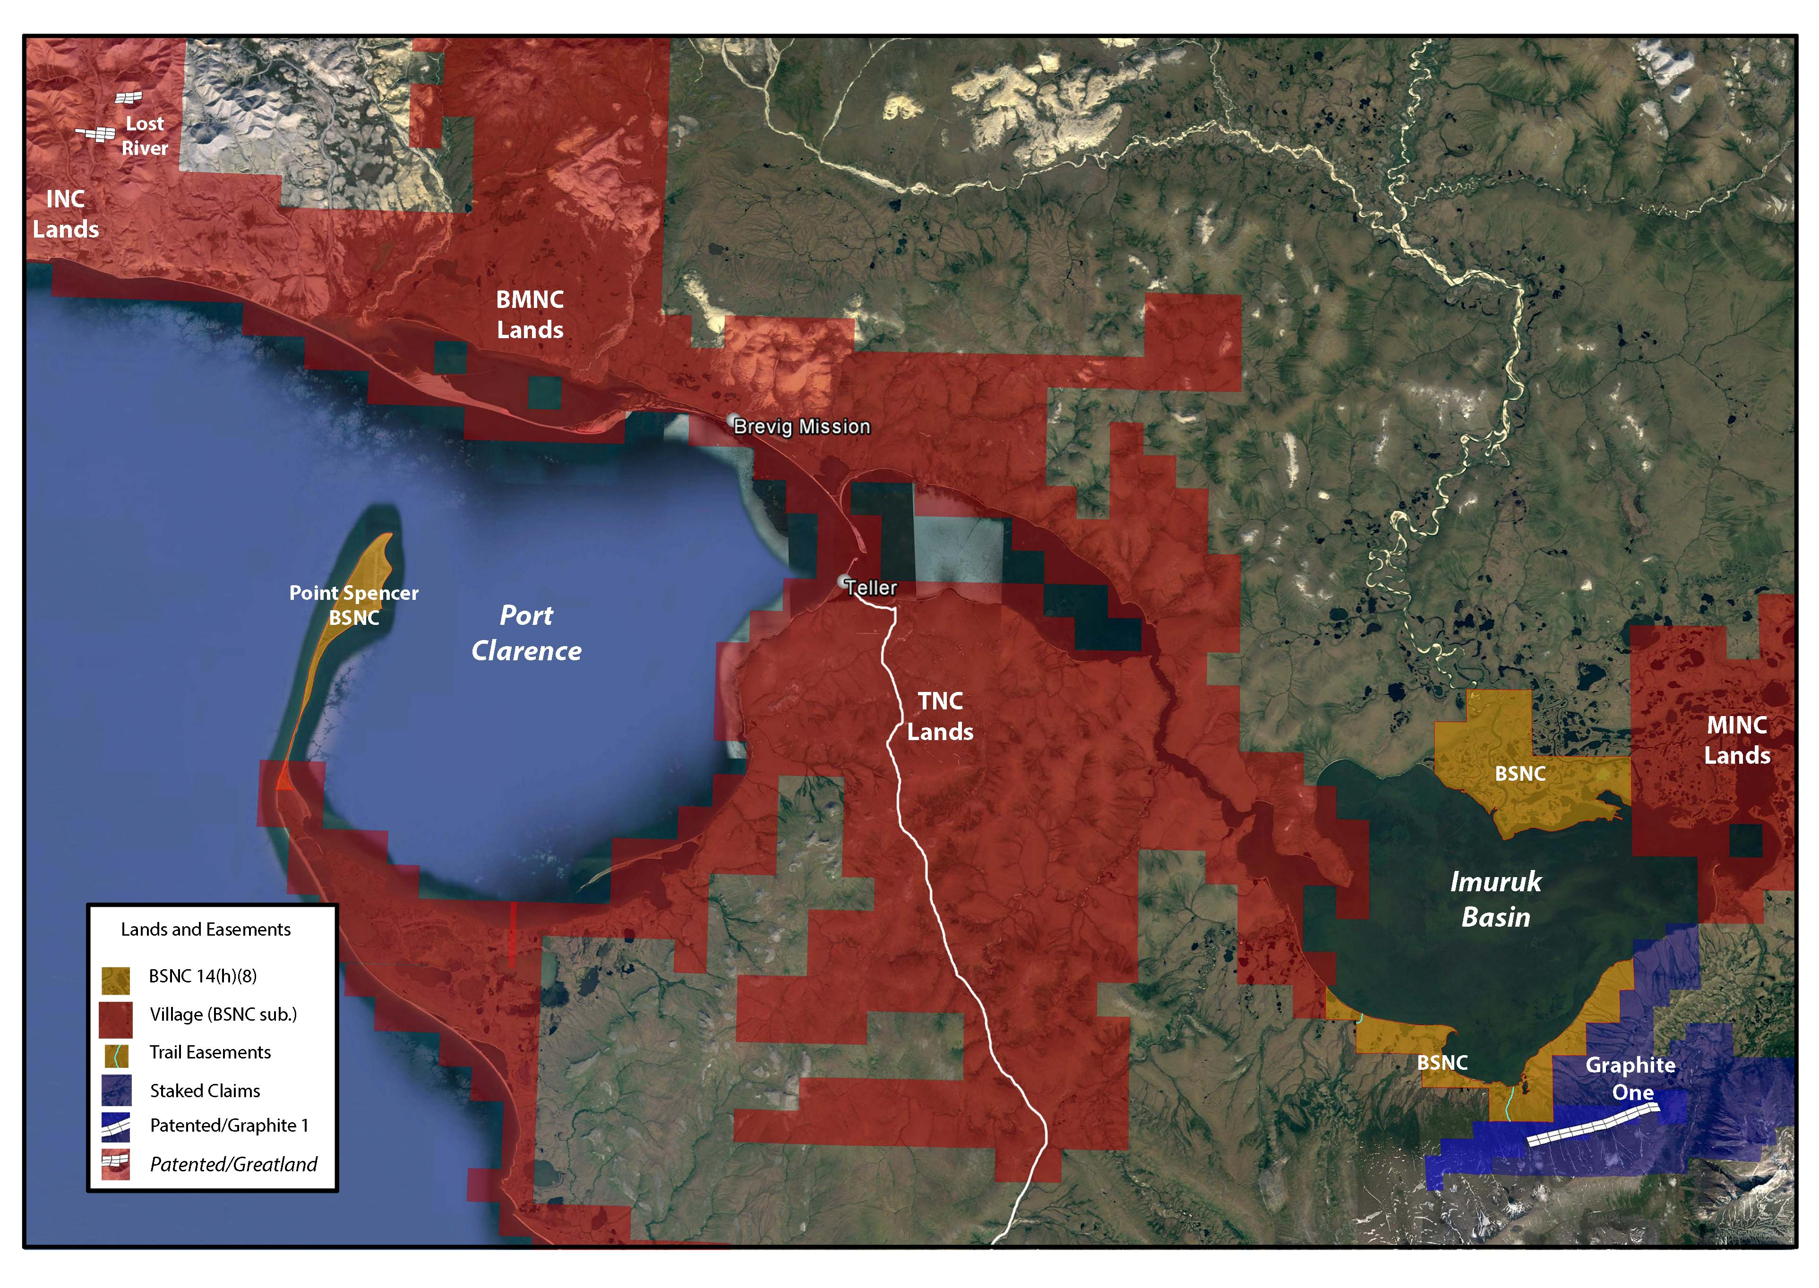
Port Clarence – Port of Refuge. Map courtesy of Bering Straits Native Corporation

Slide 10
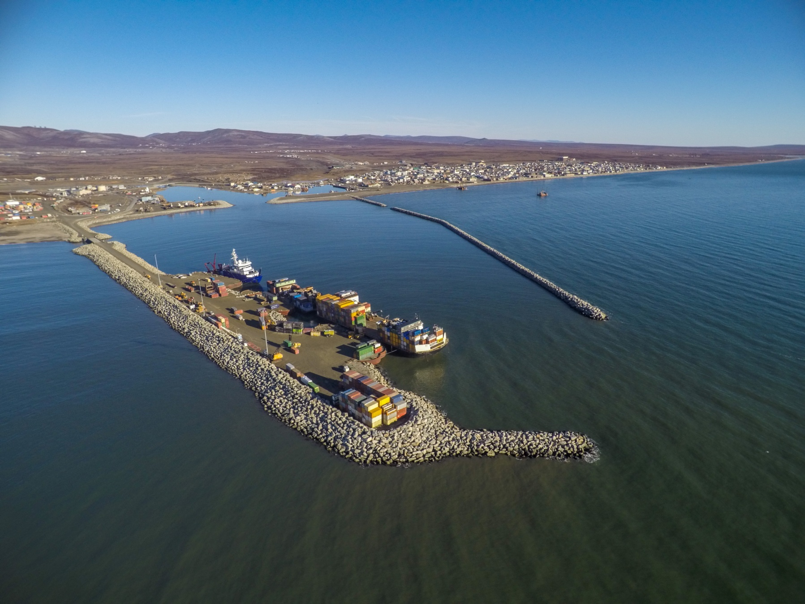
Port of Nome, Alaska Photo from the Port of Nome

Slide 11
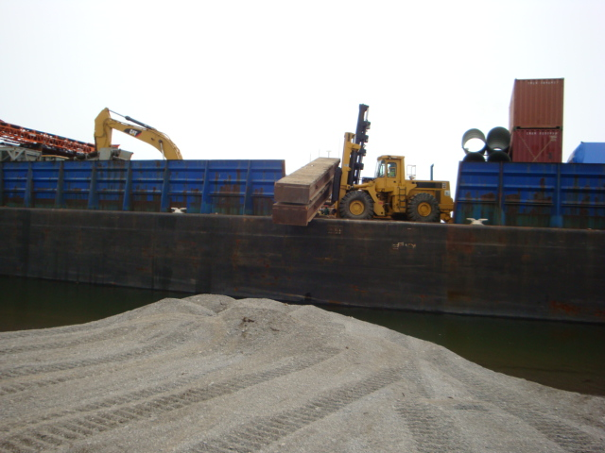
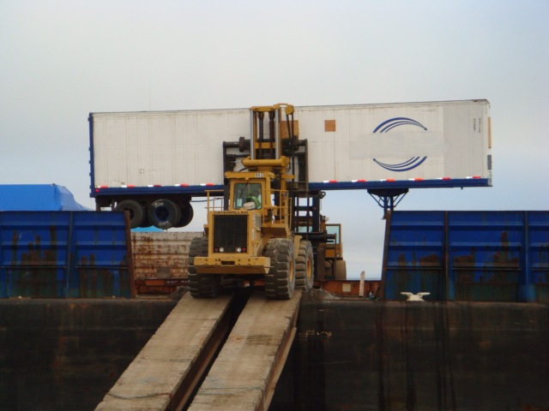
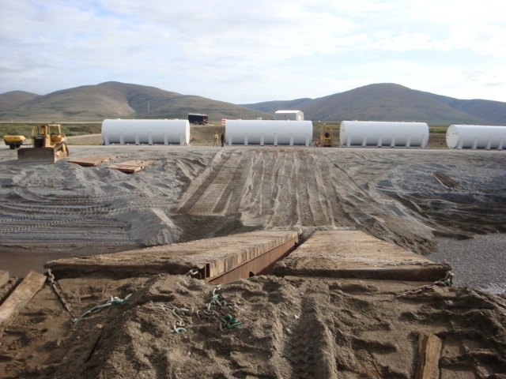
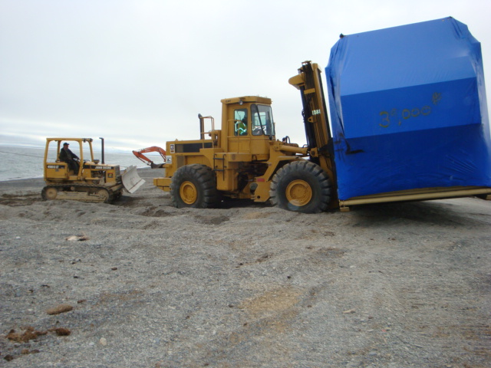
Brevig Mission, Alaska

Slide 12
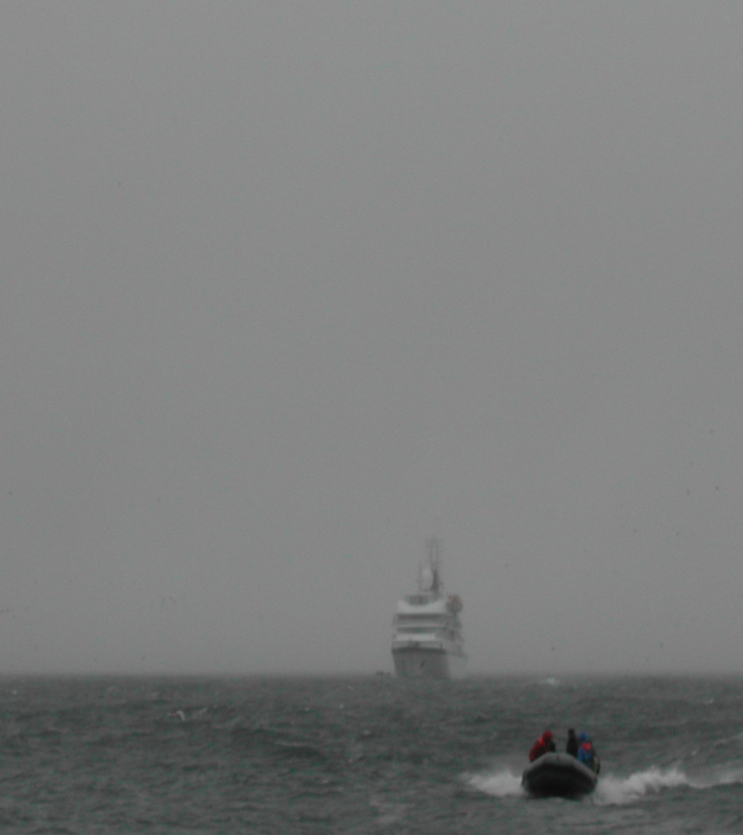
Little Diomede, Island

Slide 13
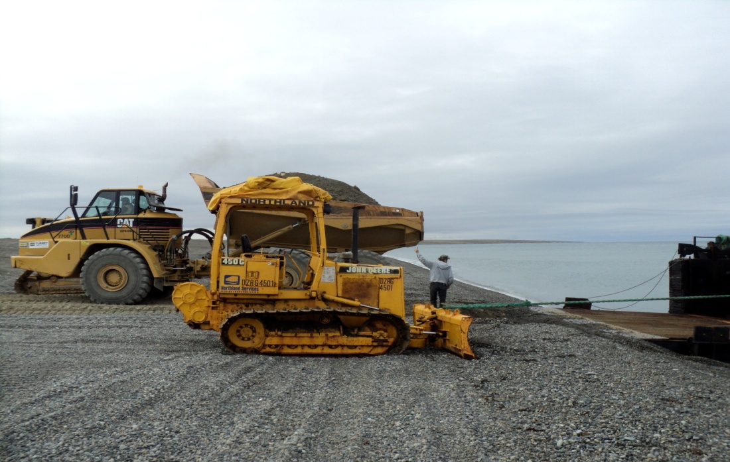
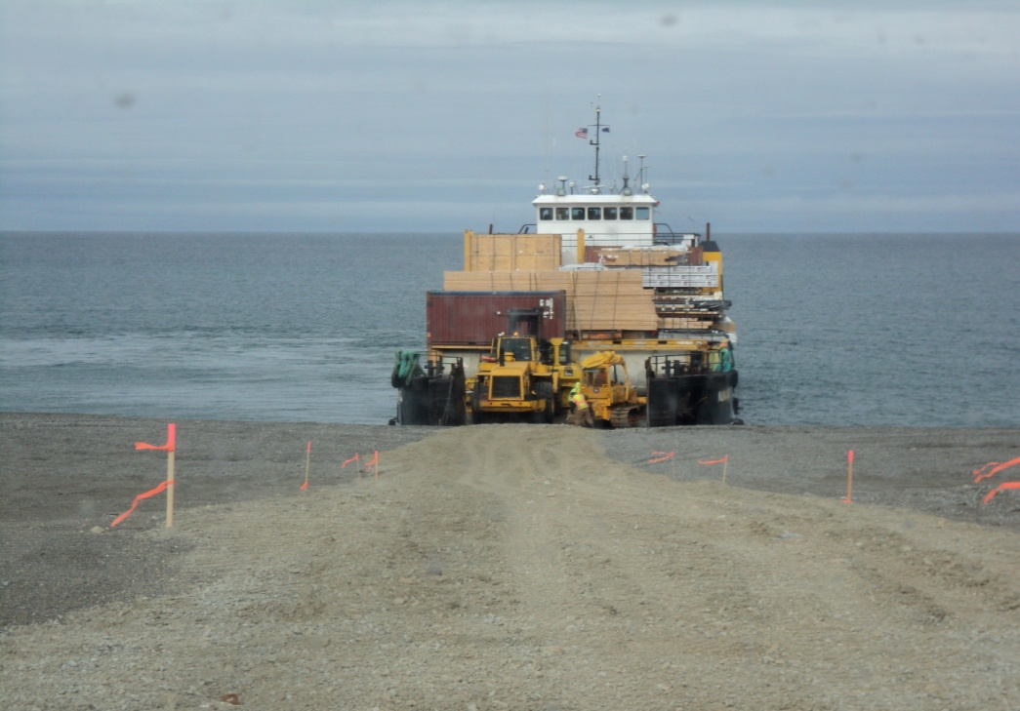
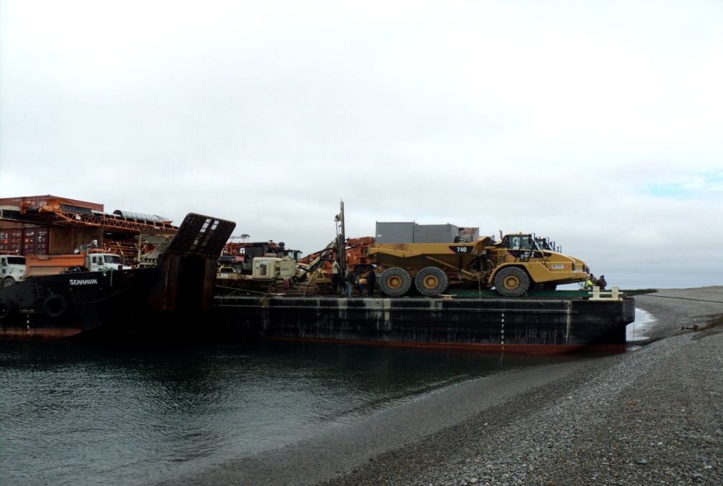
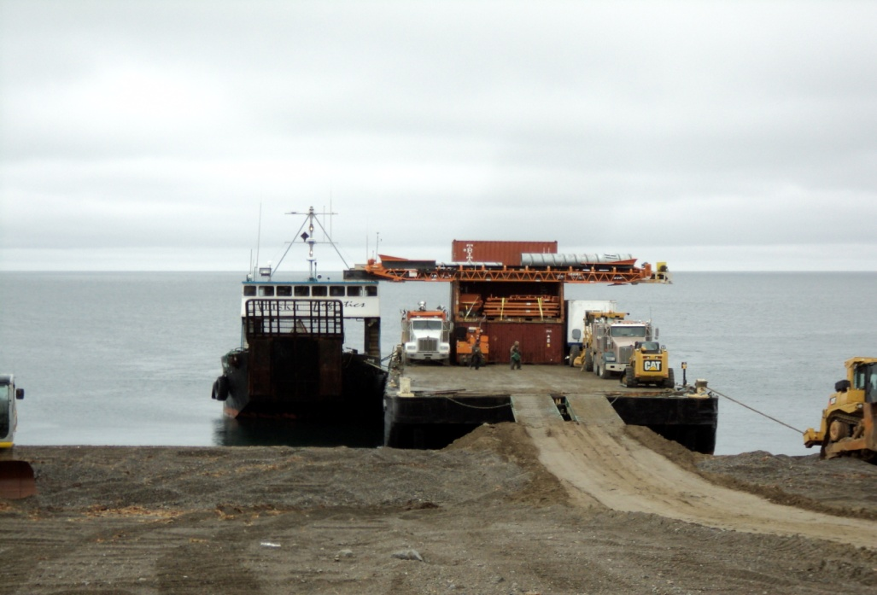
Gambell, Alaska

Slide 14
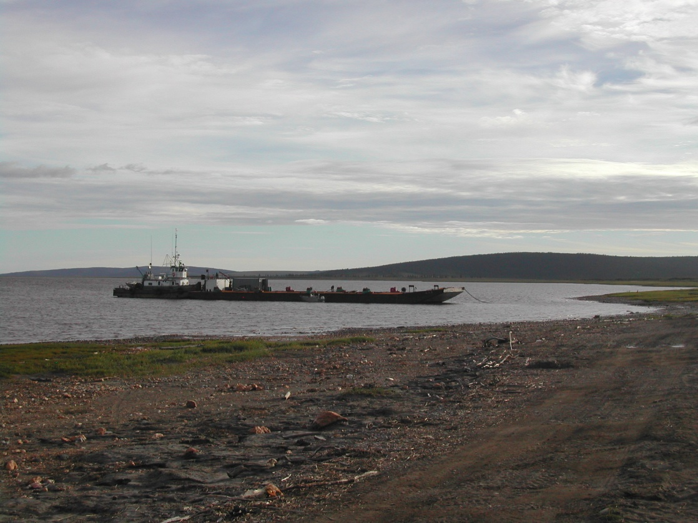
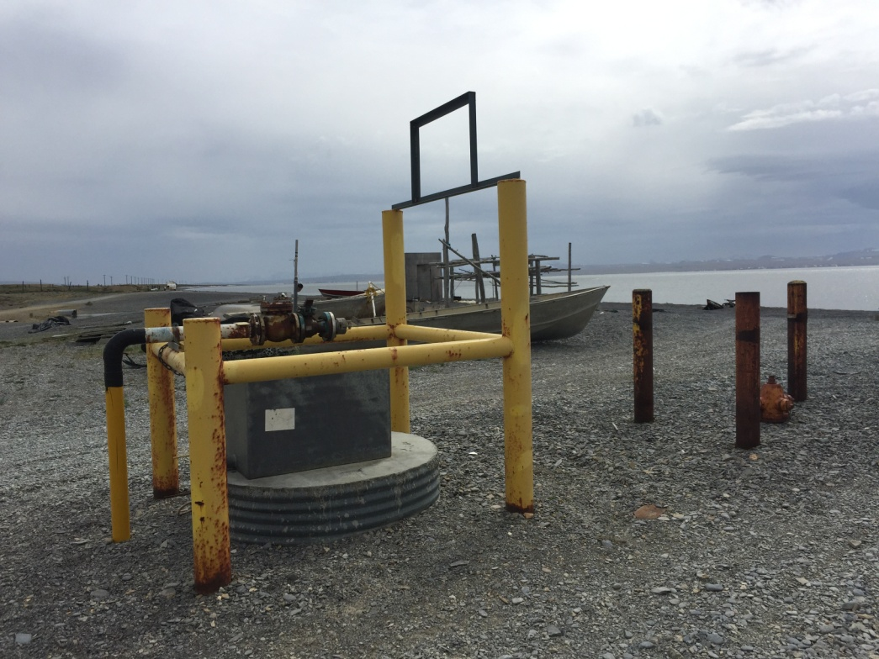
Typical fuel barge operation to a fuel header on shore

Slide 15
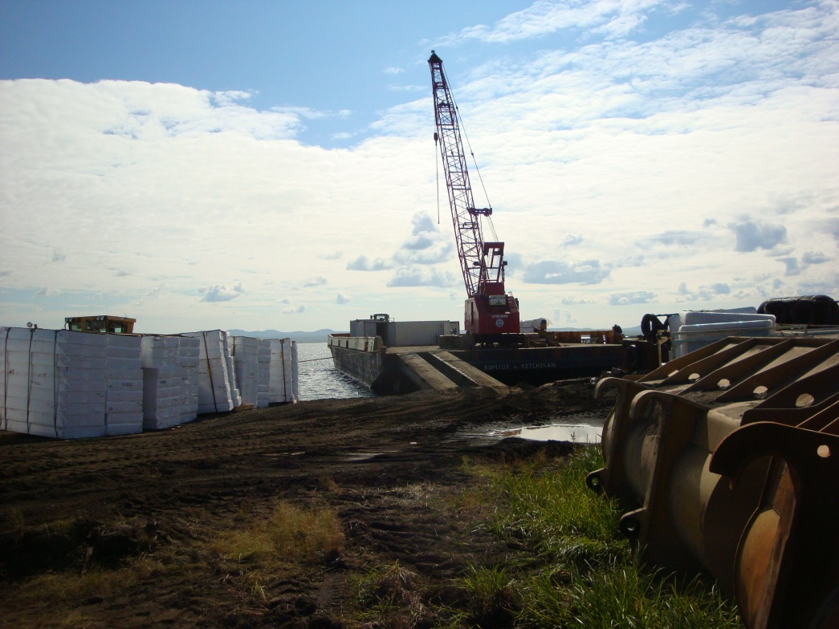
St. Michael, Alaska

Slide 16
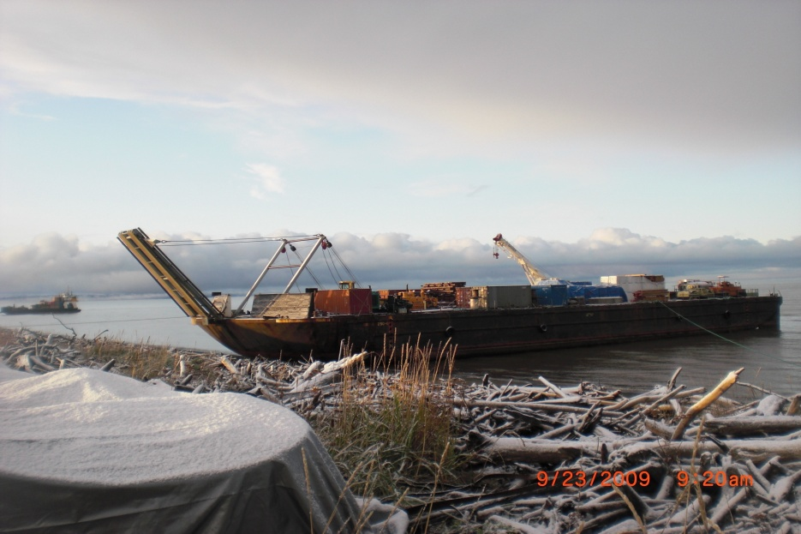
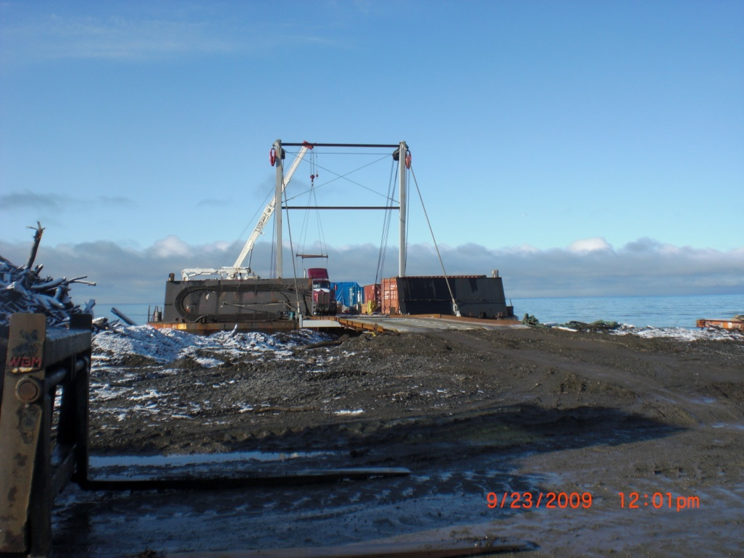
Unalakleet, Alaska

Slide 17
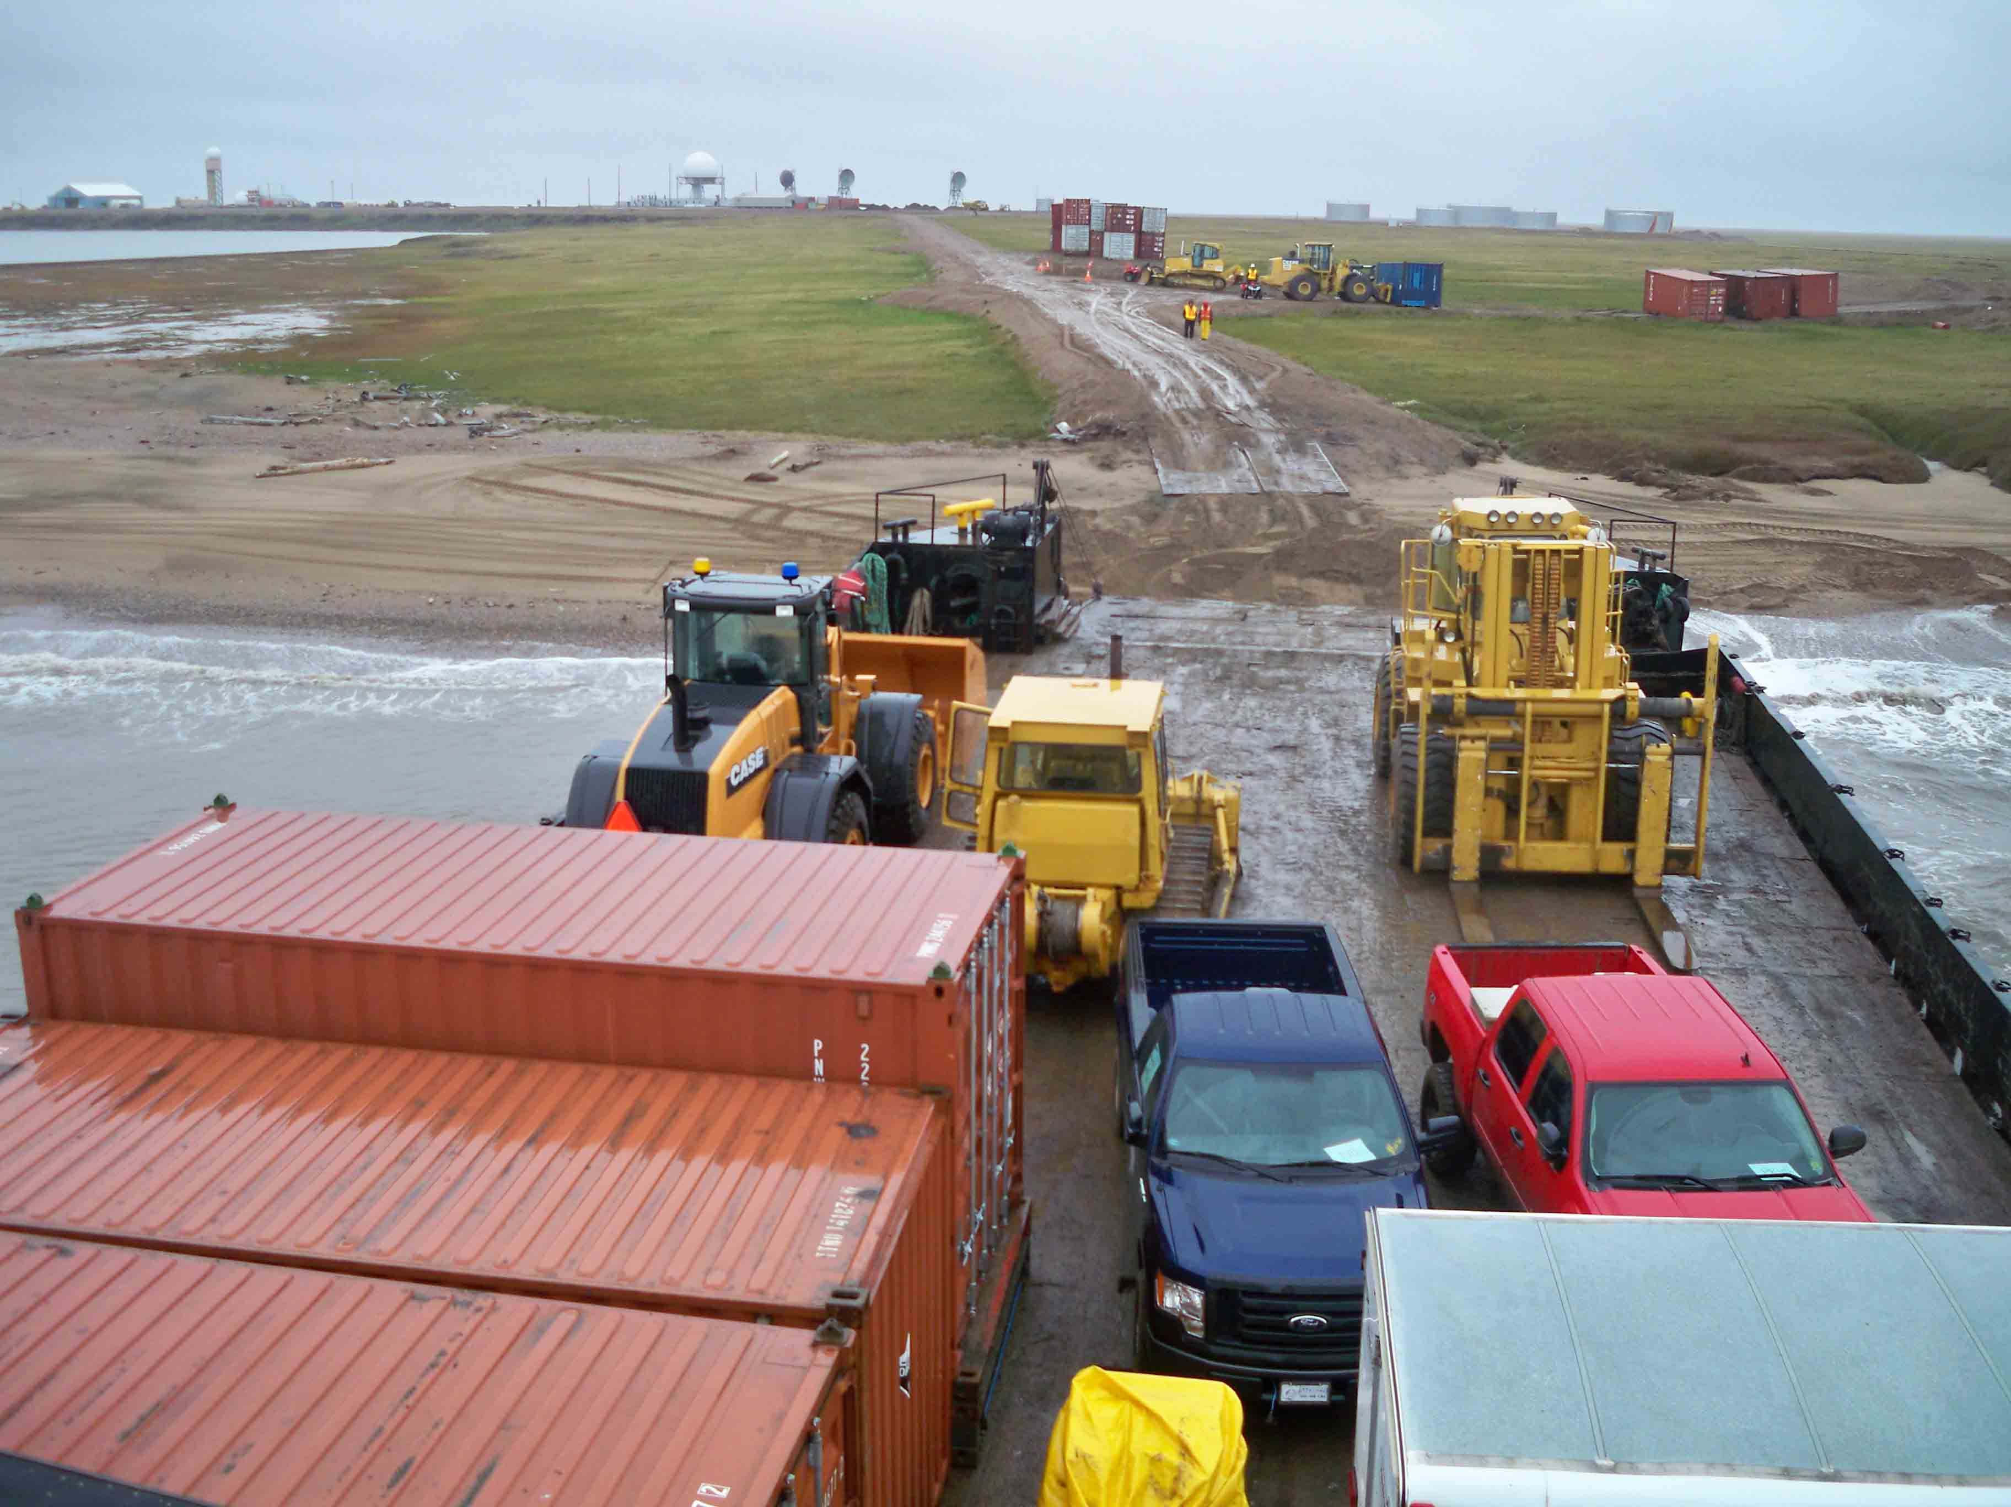
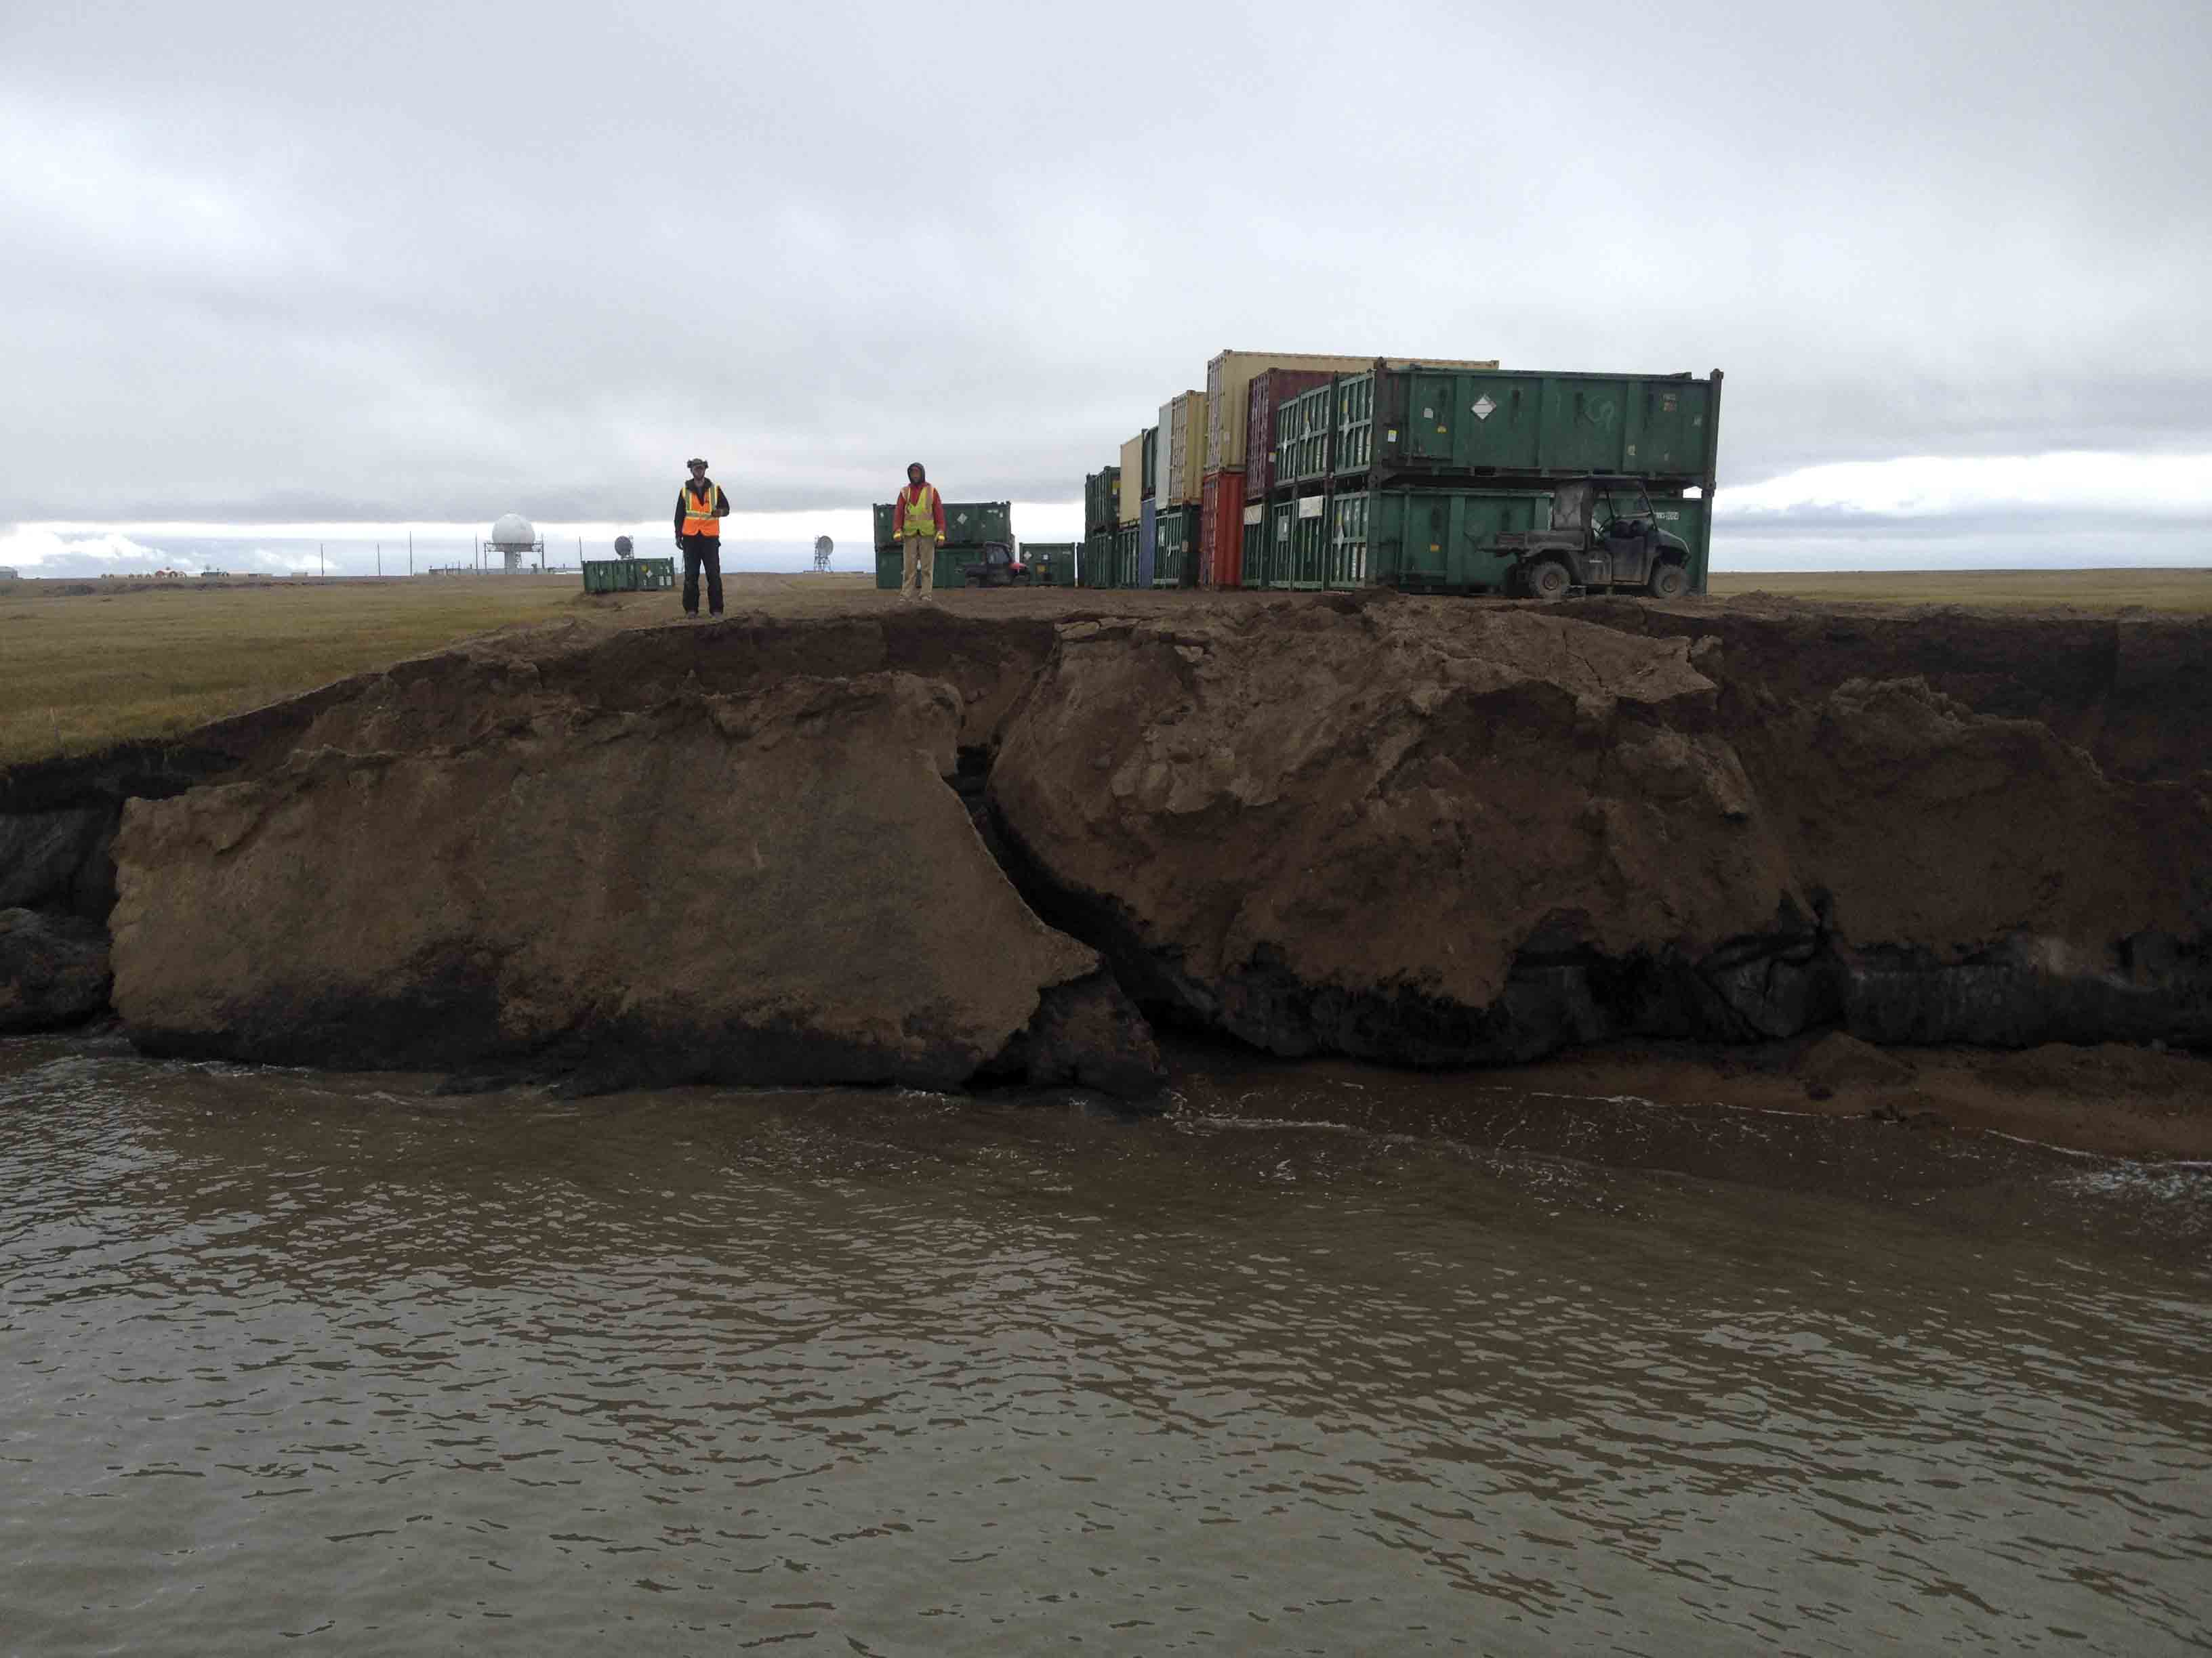
Point Lonely in 2009 Point Lonely in 2014 - sever coastal erosion
Photo’s courtesy of Bowhead-Crowley a UIC Bowhead-Crowley Joint Venture

Slide 18
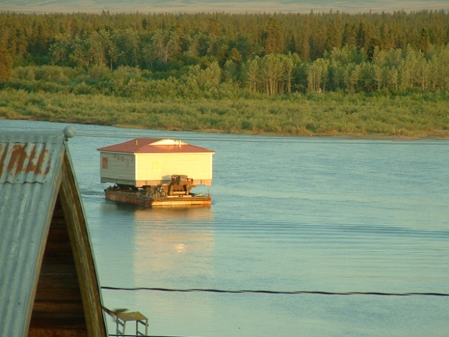
Barging up river to White Mountain, Alaska

Slide 19
Upcoming
Quintillion’s subsea fiber optic cable live in 4th Q 2017
National Defense Authorization Act of 2016’s Strategic Arctic Ports for national security report
Graphite One
IMO to work with Russian Government on Bering Strait PARS

Slide 20
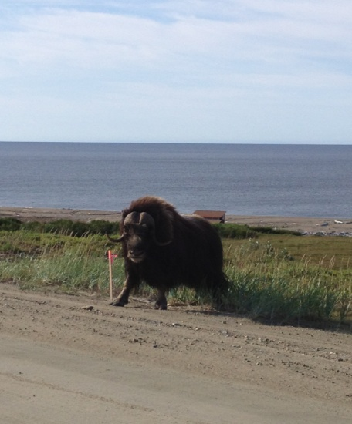
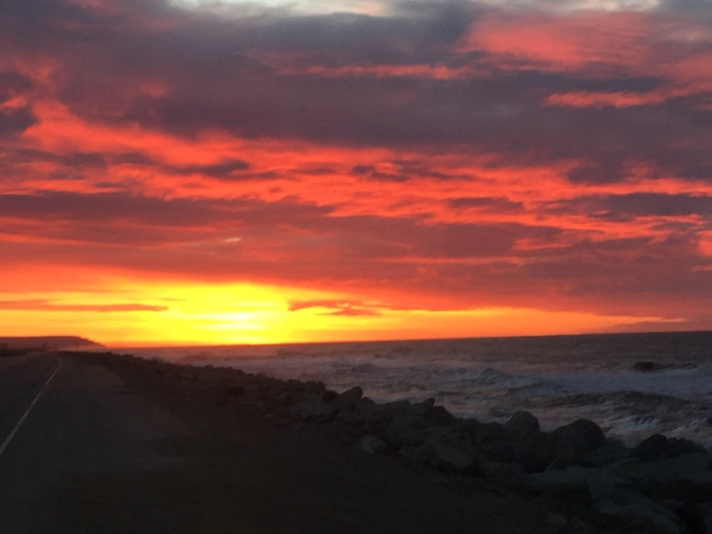
Quyanna-Thank You
Denise Michels, Director of Transportation
Kawerak Representative on ICC-Alaska Board
Port of Nome Commissioner
dmichels@kawerak.org
(907) 443-4251
www.kawerak.org

