Slide 1
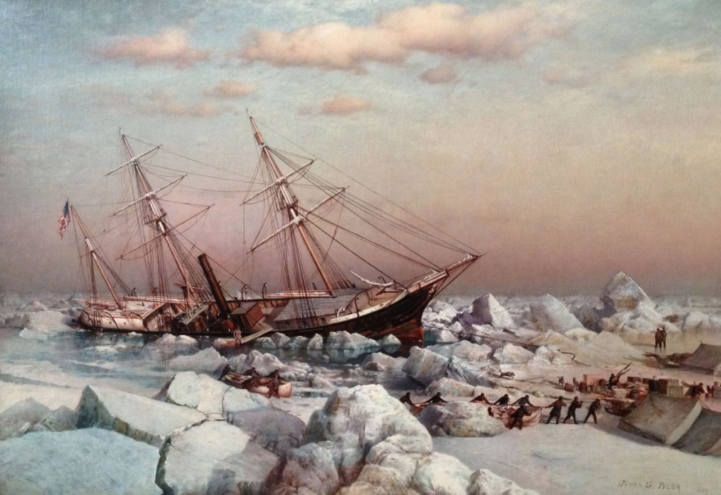
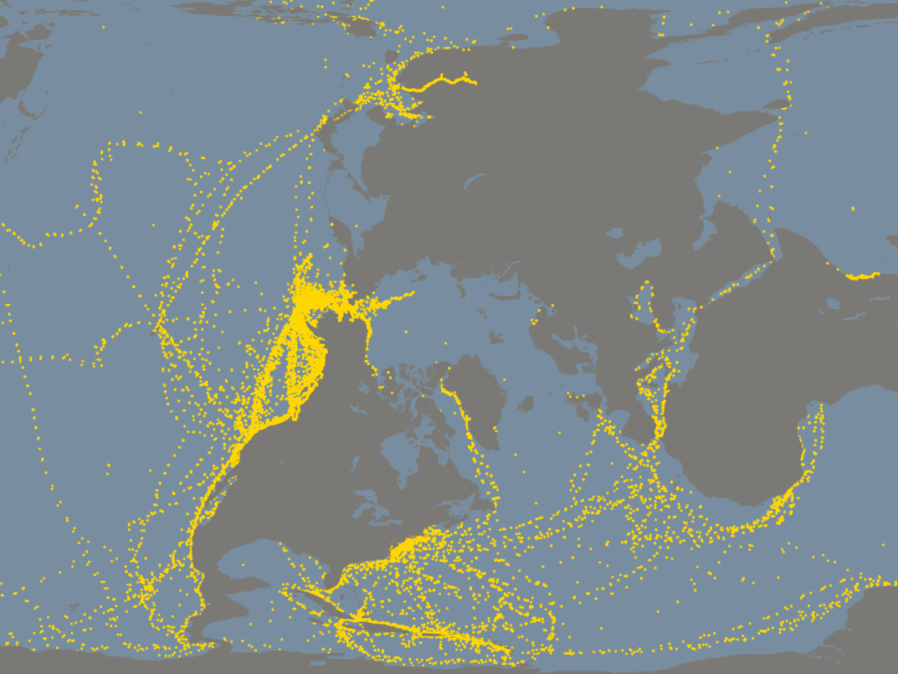
Jeannette search expedition 2016:
technical and scientific background
Courtesy of Vallejo Gallery
Kevin Wood
Vladimir Smolin
Aleksey Ostrovskiy
Kathleen Crane
Key questions:
Navigation – location of the wreck, accessiblity
Likelihood it has been crushed by sea-ice
Identification of the wreck
Scientific and cultural justifications
U.S. fleet positions from Old Weather

Slide 2
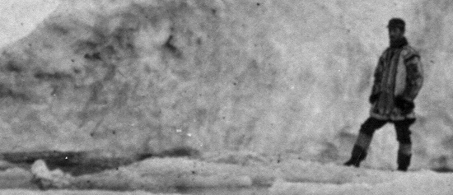
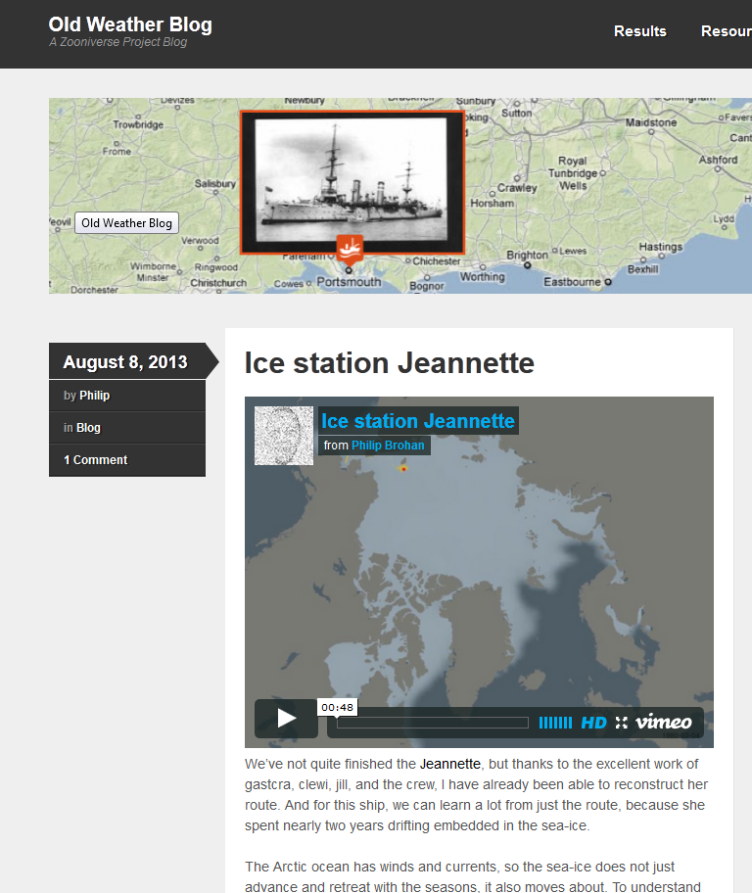
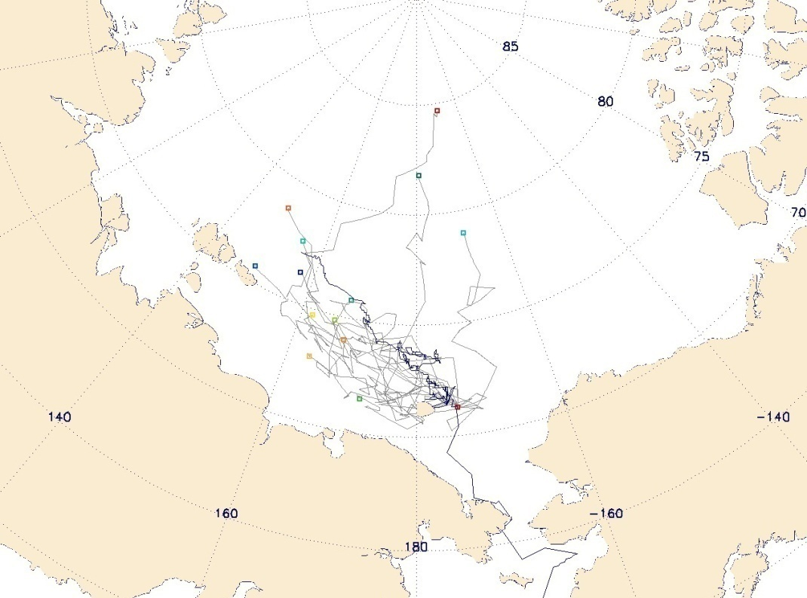
NEW USE FOR OLD DATA
HIGHLIGHT
Jeannette: an accidental ice station
Track
IABP vectors -
Jeannette’s actual track and alternate realizations based on modern drift-buoy vector field
(more than half of modern cases drift out of the sea ice – not shown)
http://blog.oldweather.org/2013/08/08/ice-station-jeannette/

Slide 3
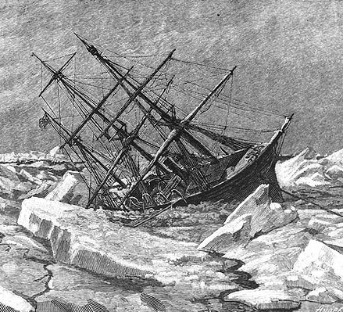
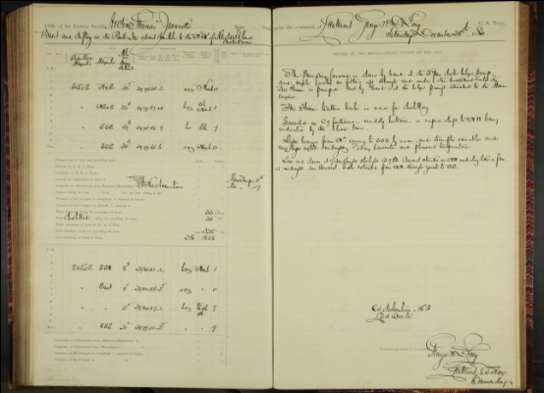
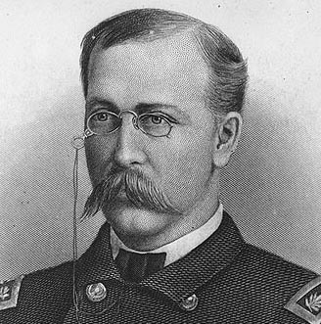
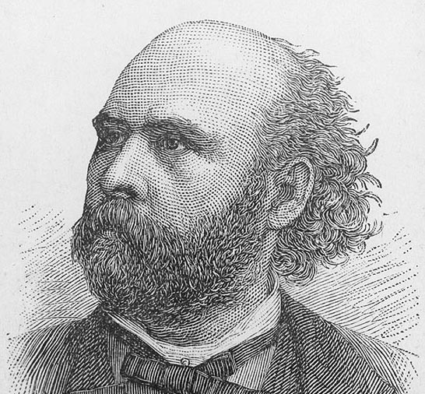
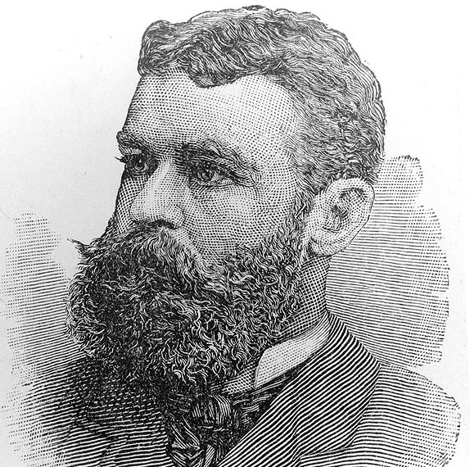
HIGHLIGHT
Logbooks of the Jeannette
Goal: find a way to the North Pole via Bering Strait
Beset in the ice in Sept. 1879 – crushed and sank June 1881
Famous for inspiring Nansen’s drift in the Fram
George W. DeLong
(1844-1881)
George W. Melville
(1841-1912)
James M.M. Ambler
(1848-1881)

Slide 4
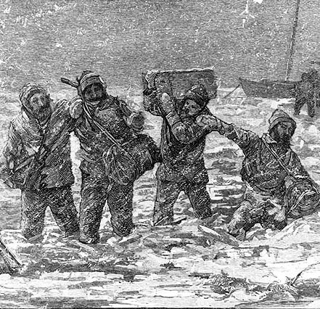
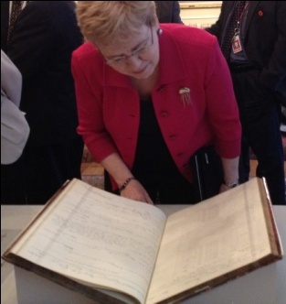
NEW USE FOR OLD DATA
HIGHLIGHT
Logbooks perilous journey
…Bubokoff and Kolinkin hoisted the box containing the precious books and records of the expedition into the top of a high tree, lashing it fast; but the water continuing to rise they became frightened and raised and lashed it still higher, when Kolinkin fell from the tree and was borne away by the current into the branches of another, where he remained without food for several days.
G. Melville (Ch. Engineer of the Jeannette) – In the Lena Delta
De Long’s men carry the logbooks ashore through a mile of broken ice
Today, at the National Archives

Slide 5
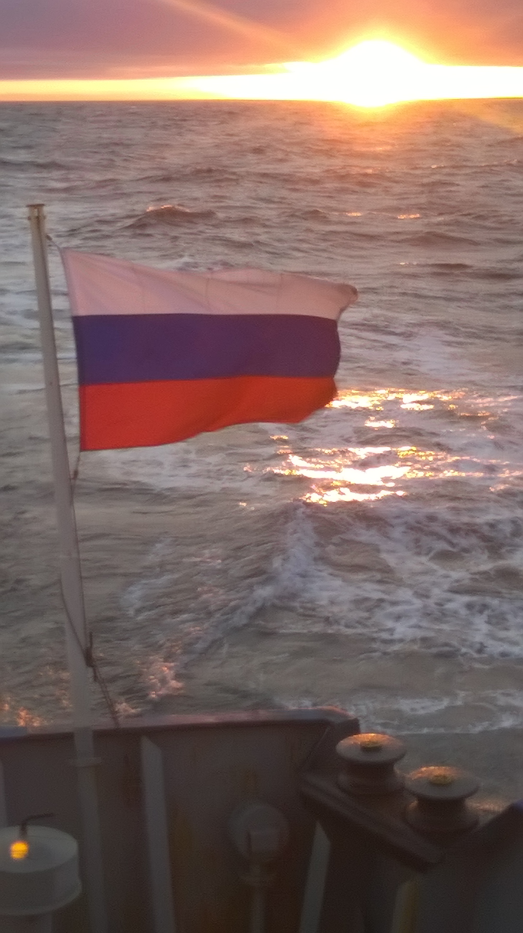
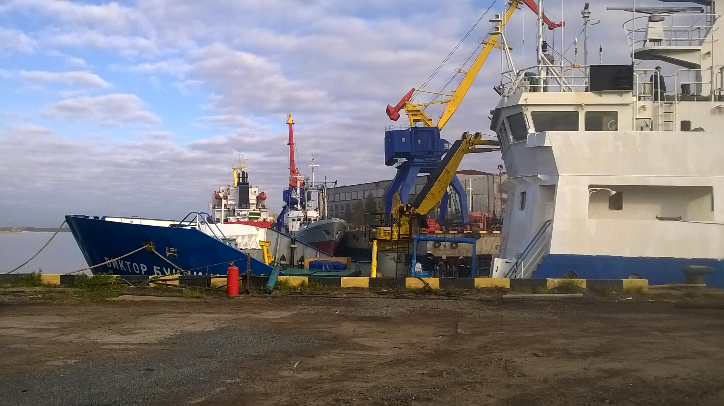

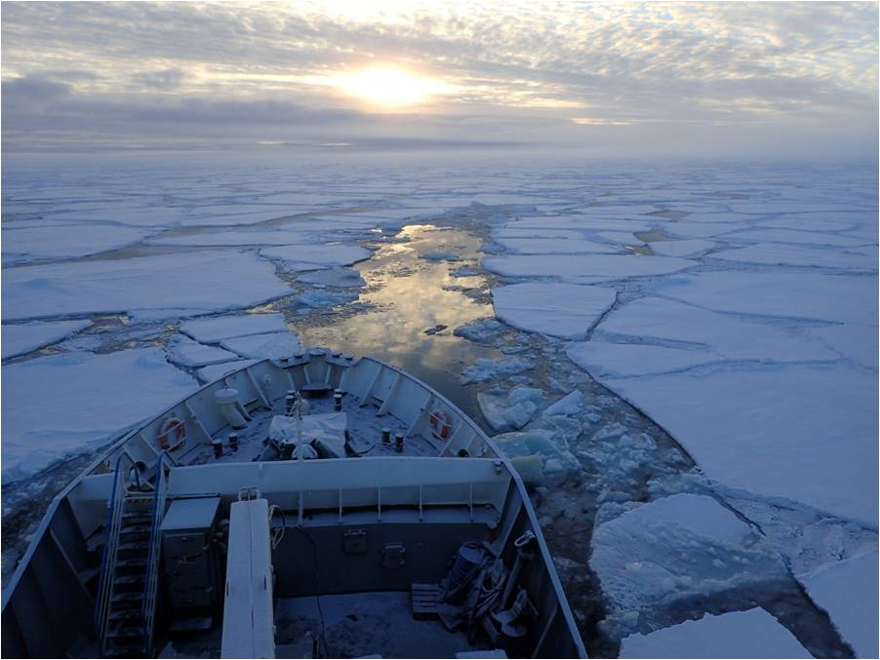

Slide 6
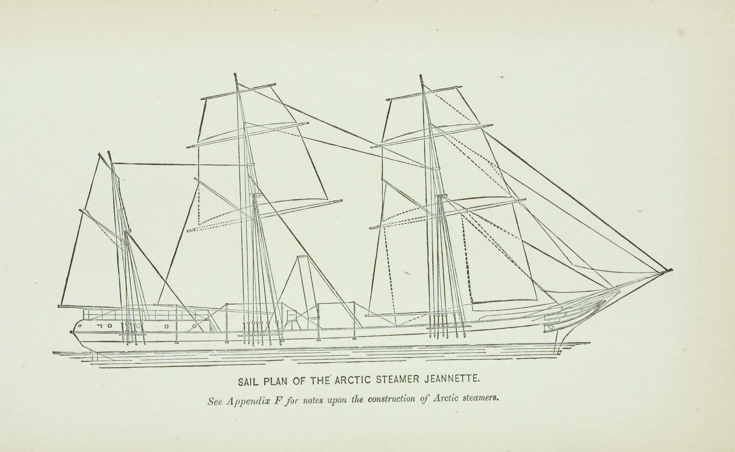
Sail plan of the Jeannette when fully rigged for sea

Slide 7
At 4 A.M. the Jeannette went down. First righting to an even keel, slowly sunk.
A sonar profile we could expect to see if the wreck is intact.
The maintop-mast fell by the board, then the foretop-mast – and finally the mainmast, near the main truss – when she finally sank; the foremast was all that was standing.

Slide 8
Russian expedition set to locate sunken US Navy ship
On August 28, 1879, the USS Jeannette sailed into the Arctic and toward the North Pole via the Bering Strait. However, the vessel froze fast in just a few days and drifted with sea ice north of the Siberian coast for almost two years. The expedition was well-equipped for research projects, and the crew conducted numerous observations during the entire drift.
The vessel was crushed by ice-floes and sank in June 1881. All of the crew members were saved, and the ship logs and substantial amounts of data survived. That expedition proved a sensation in its time. If located, the ship's remains will provide unique opportunities for scientific research.
Potanen Foundation, endorsed by Prince Albert 2 , The Russian Geographical society
and the National Geographic Society
If the wreck is intact identification will be relatively easy.
If it has been damaged by sea-ice then more difficult.
SUPPORT

Slide 9
The invited participants:
Russian Geographical Society 1
OAO, 2
Center for Coastal and Ocean Mapping, USA 1
University of Hawaii, 1
Naval Research Laboratory, 1
University of Washington, 1
Oceanography Magazine,1
NOAA Office of Ocean Exploration, 1
Underwater Archeology, US Navy, 1
National Geographic partners, 1

Slide 10
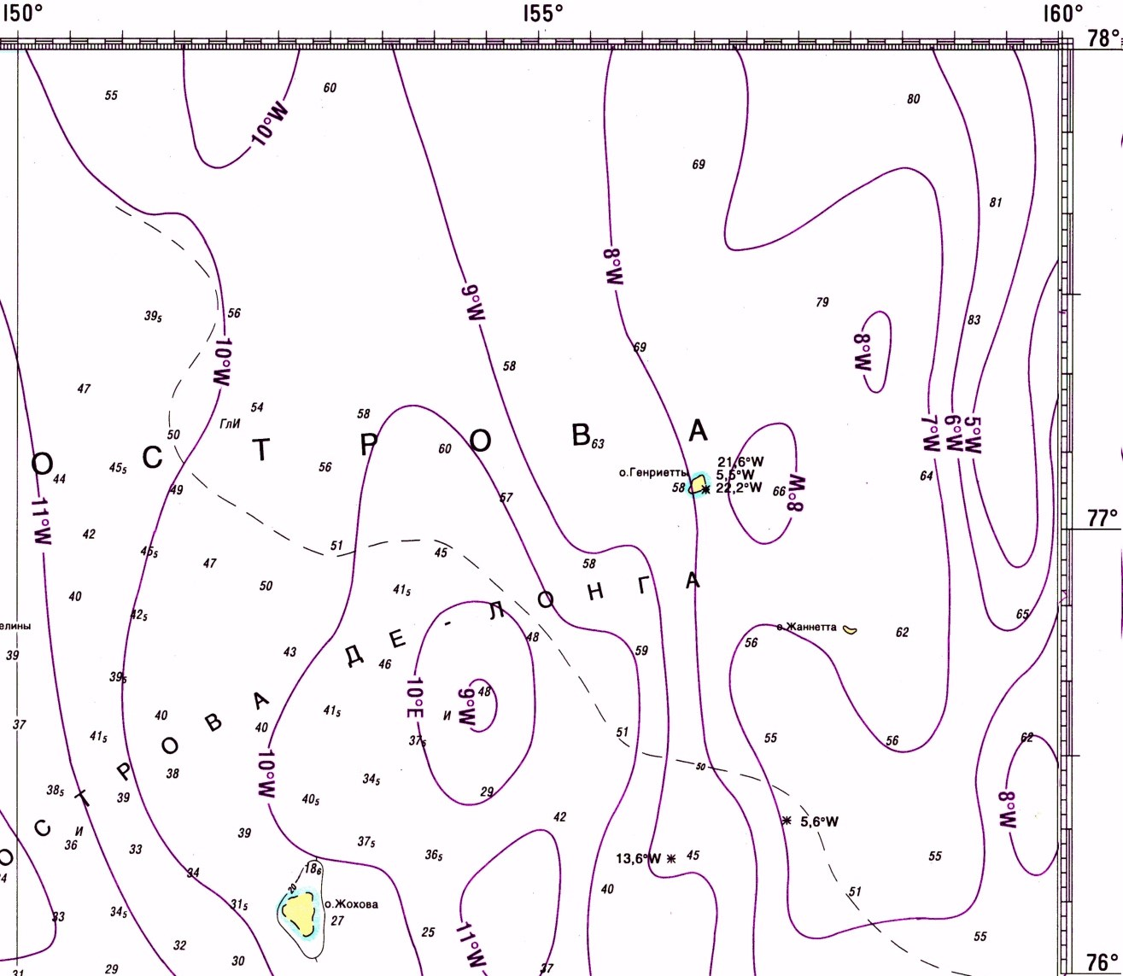
Likely position of the Jeannette based on De Long’s navigation
Best estimate
given longitude
error ~12 nm
14.06
Sounded 70 m
14.07
12.06
09.06
08.06
12.07
09.07
08.07
De Long’s
position for
Henrietta Is.
De Long’s positions:
June 9th, Thursday.
N. 77° 14' 20", E. 156° 7' 30“
June 12th, Sunday (June 13th true date)
N. 77° 14' 57"., E. 154° 58' 45"
Jeannette sinks
June 14th
N. 77° 14’, E. 153° 58’ 45”
De Long’s
position for
Jeannette Is.
Comparison with modern island positions suggests a ~12 nm bias in longitude
Not an automatic search solution – additional analysis useful

Slide 11
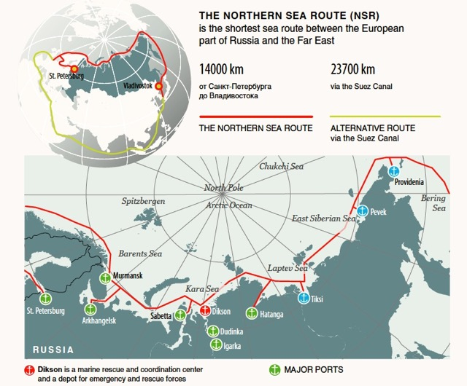
Jeannette
location

Slide 12
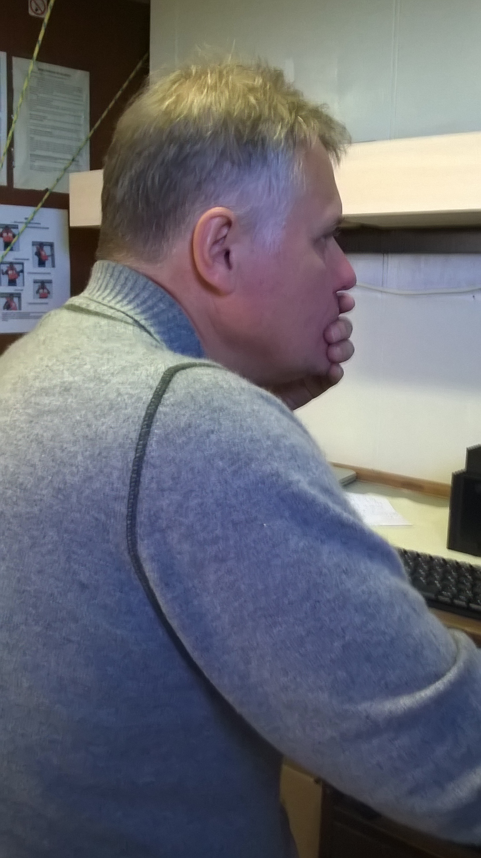
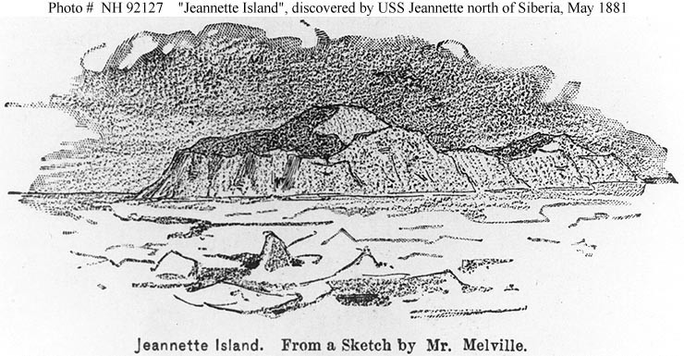
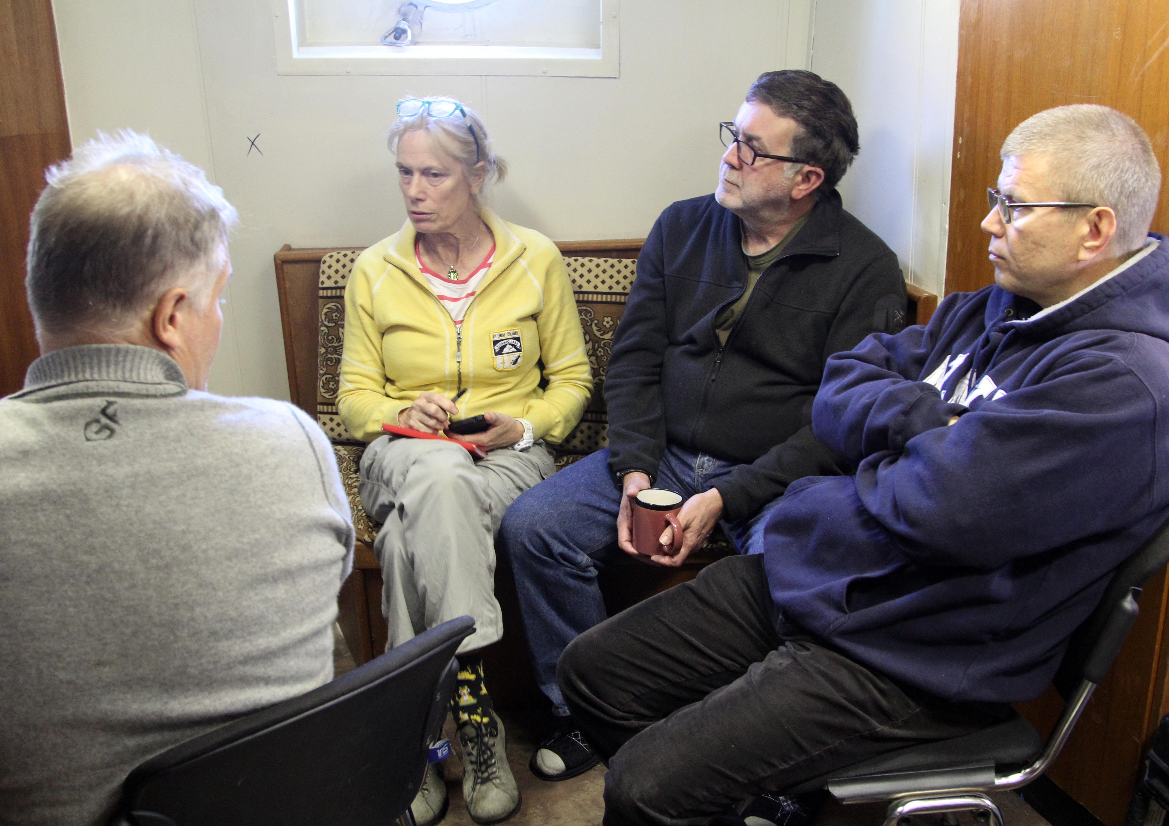
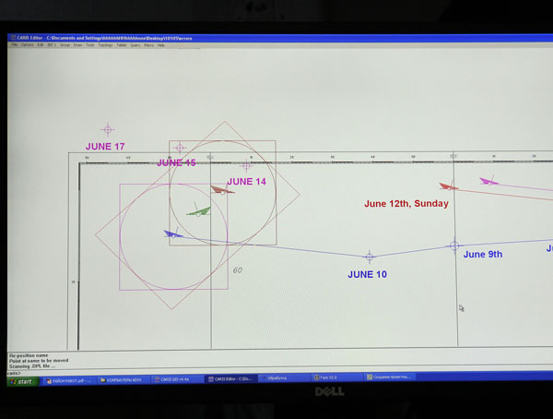
Our best estimate of the site of the Jeannette based on De Longs bearings to the neighboring islands

Slide 13
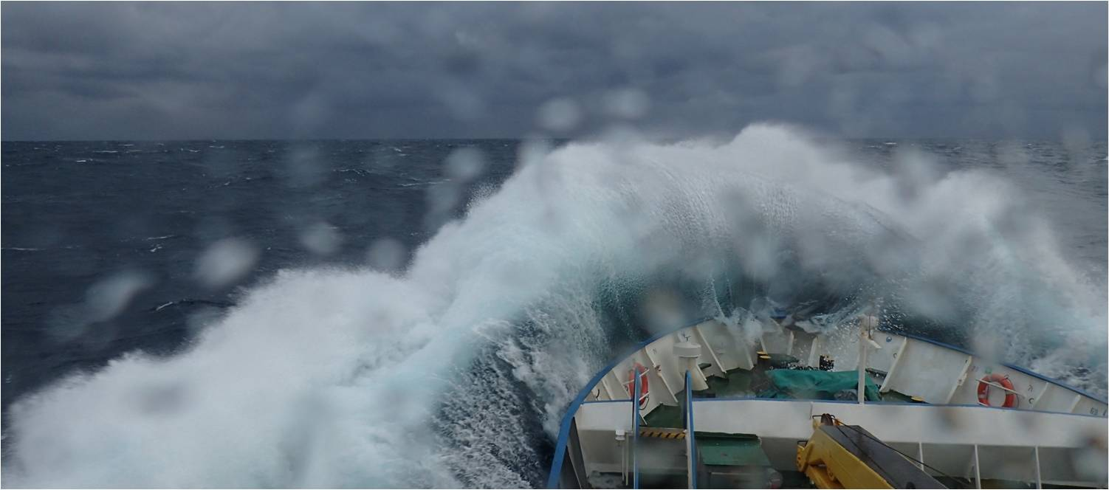
Storm at Kara Gate, Less ice means more waves. The White, Kara and Laptev Seas were ice free and upon departure from Arkhangelsk the East Siberian Sea was nearly ice free.

Slide 14
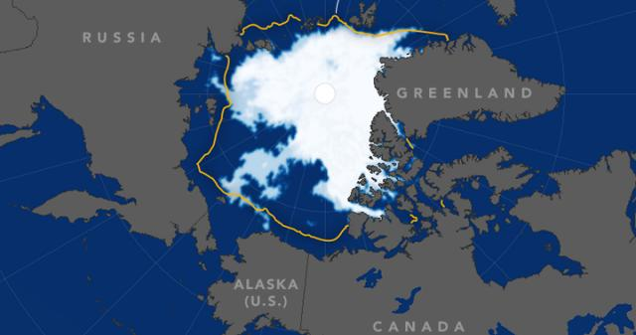
Ice Corridor from the North over the De Long Islands, October, 2016

Slide 15
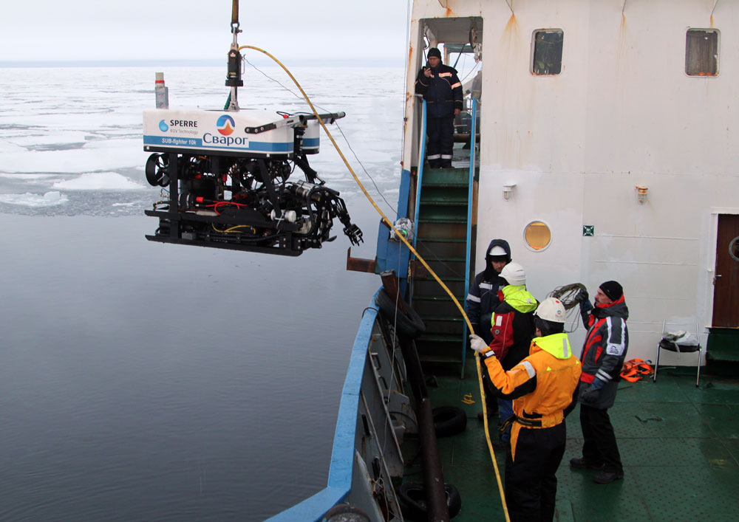
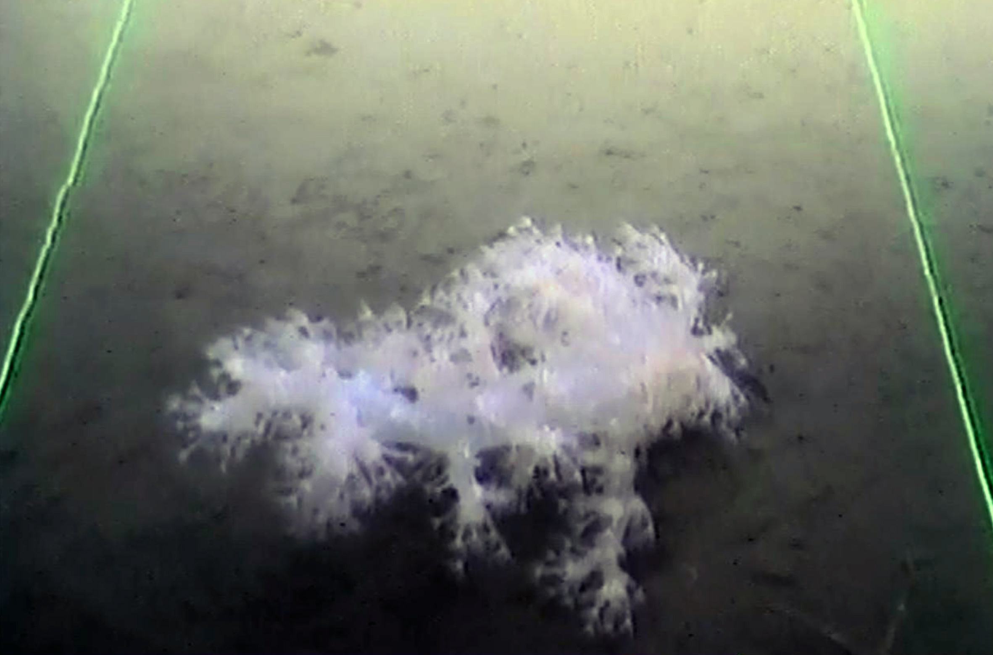
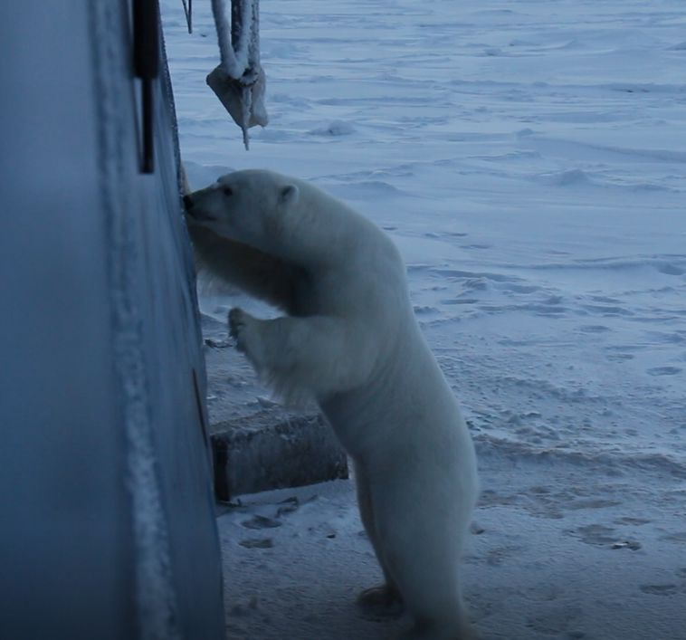
All water column, sediment and biological samples will be offered to the RUSALCA team for analysis. Identification of benthic species was carried by Dr.Bodil Bluhm, Former RUSALCA scientist, University of Tromso, and University of Alaska.
Benthic imaging in Polynias northwest of Henrietta Island. Once sea ice covered the area, Polar Bears arrived. In contrast to the Jeannette expedition we had no hunters on board, nor did we have enough food to survive a long period of drifting in the ice.

Slide 16
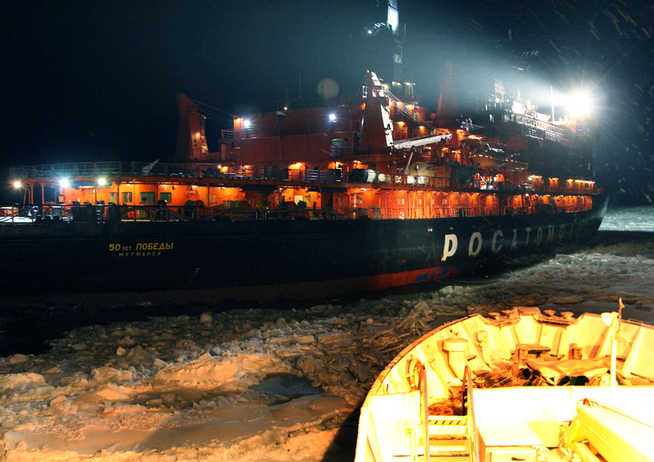

Slide 17
LESSONS LEARNED
* Do not carry out the expedition in October, go for September.
* Do not depend upon an ice strengthened vessel, because the ice cover is unpredictable. Better to use an icebreaker
* Stage the expedition from a Russian Far Eastern or Alaskan port
* Equip the expedition with autonomous underwater vehicles that can safely work underneath the sea ice cover
* Do not depend on any operations that require tethered cables
*Make sure the expedition and participants have a way to be rescued; A rescue operation in US waters would have been more complicated.

Slide 18
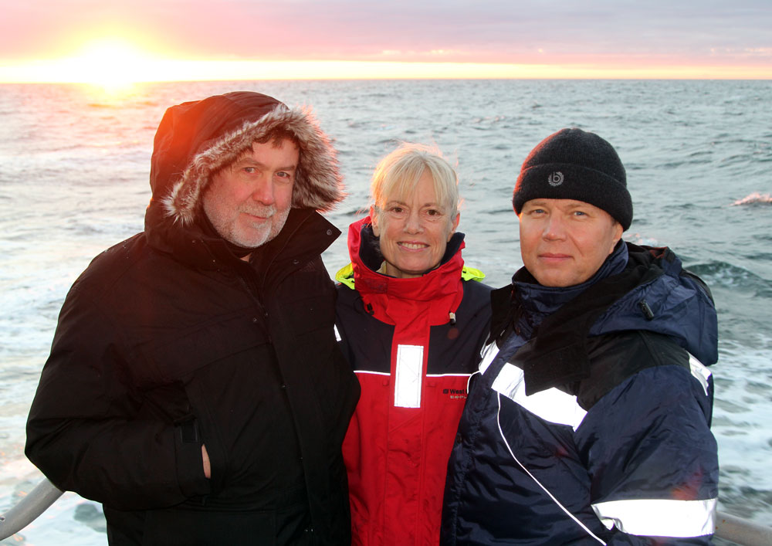
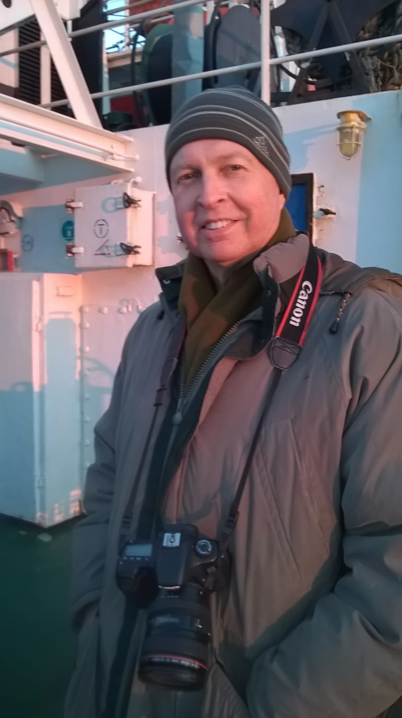
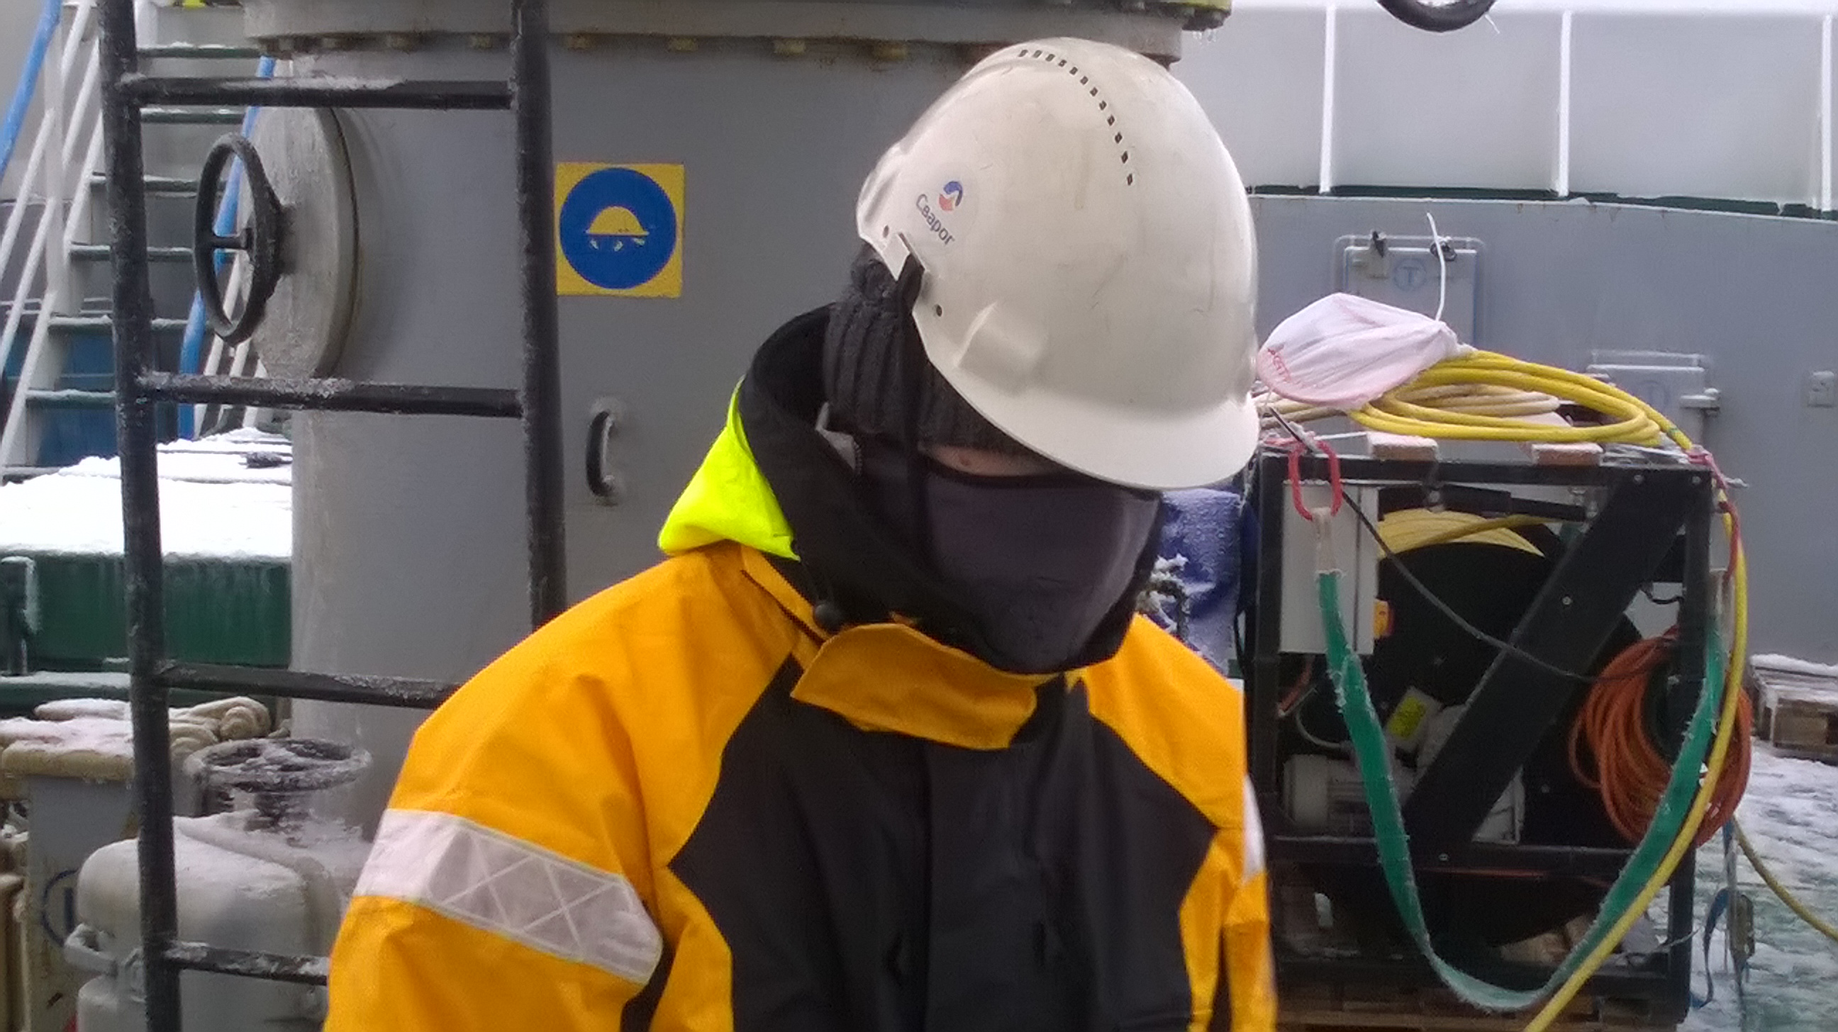
THANK YOU

Slide 20
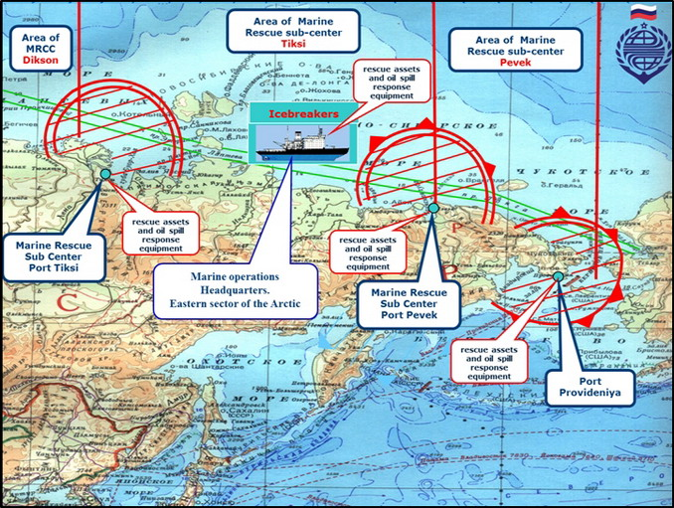
Future sites identified for Marine Rescue along the
Northern Sea Route

Slide 21
Scientific inquiry related to the wreck itself
What is the relation between the wreck of known date and sea-floor gouges?
Does this reveal new details about the long-term change in sea-ice thickness or dynamics or provide relative dating of gouges?
Could we measure sea-ice growth over several years with a ULS mooring?
A direct comparison to historical data.
Measure sediment deposition on a positively dated object for paleo-proxy applications
Analysis of biota on and around the wreck (e.g. colonization communities, invasives)
Autonomous vehicles (AUVs, ice-measuring profiling floats and buoys)
Exploration and discovery
What can be done depends on the type of permission, nature of work (touch/no touch) and collaboration with US and RF Navy experts

Slide 22
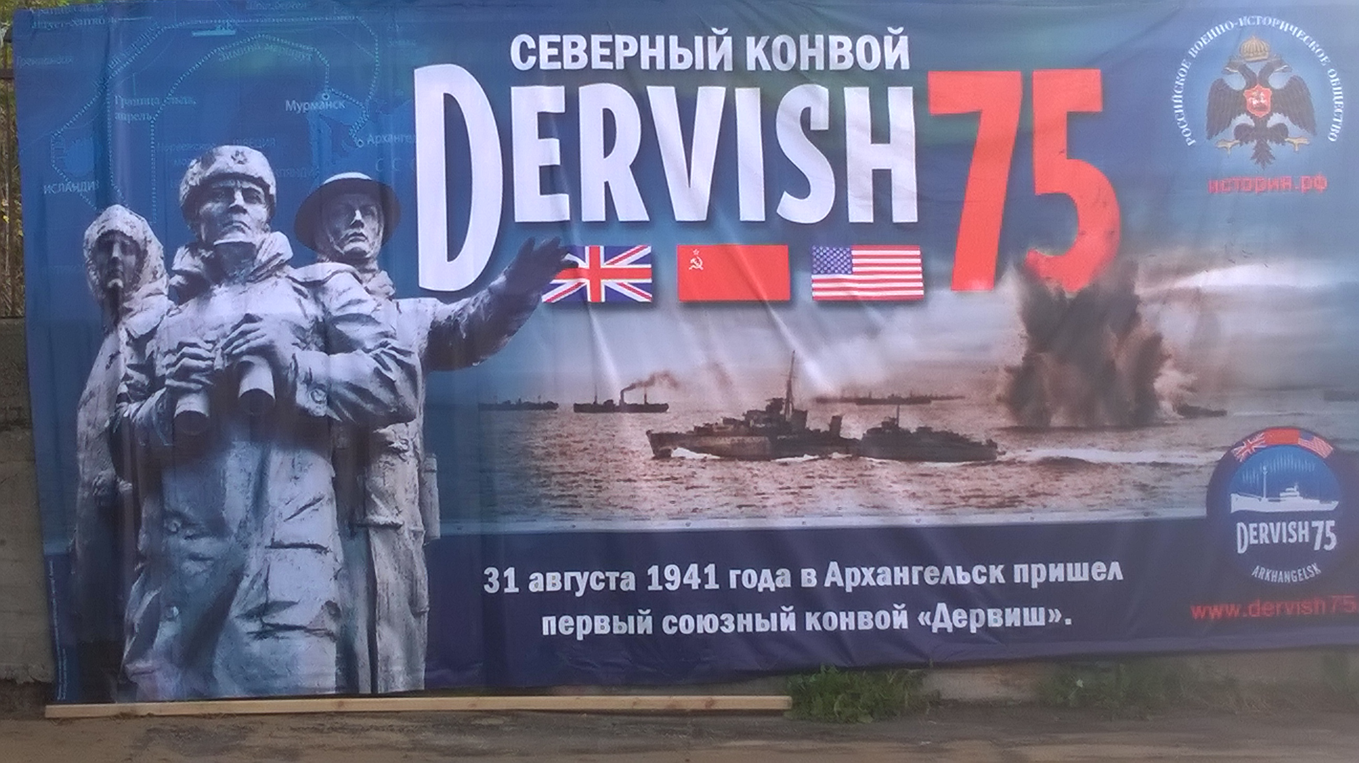
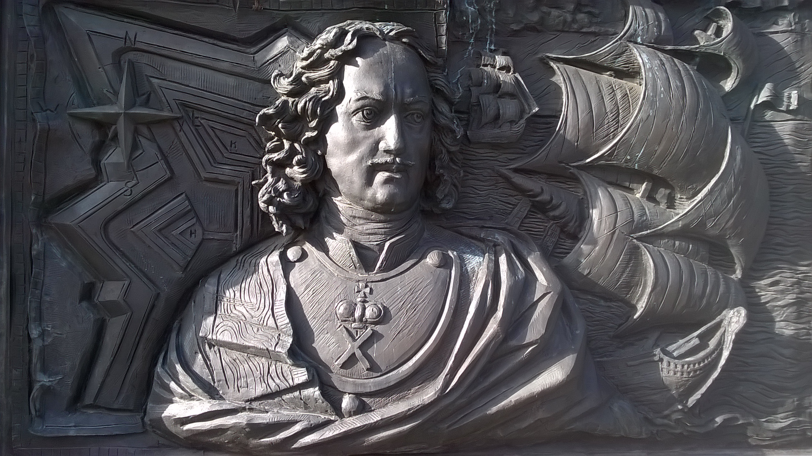
Arkhangelsk, large seaport on the White Sea and the launching point for many Arctic Expeditions celebrates the British, USSR and US 75th anniversary of the DERVISH Convoys during WWII

Slide 23
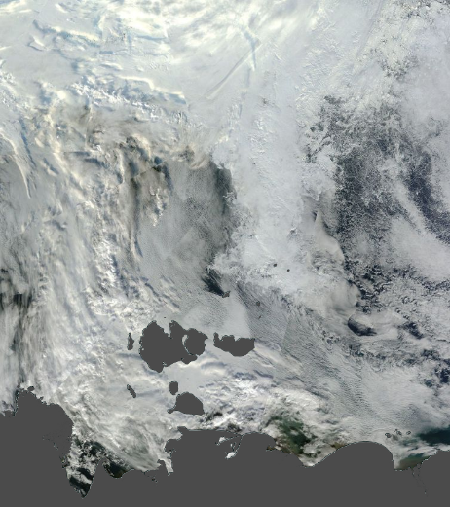
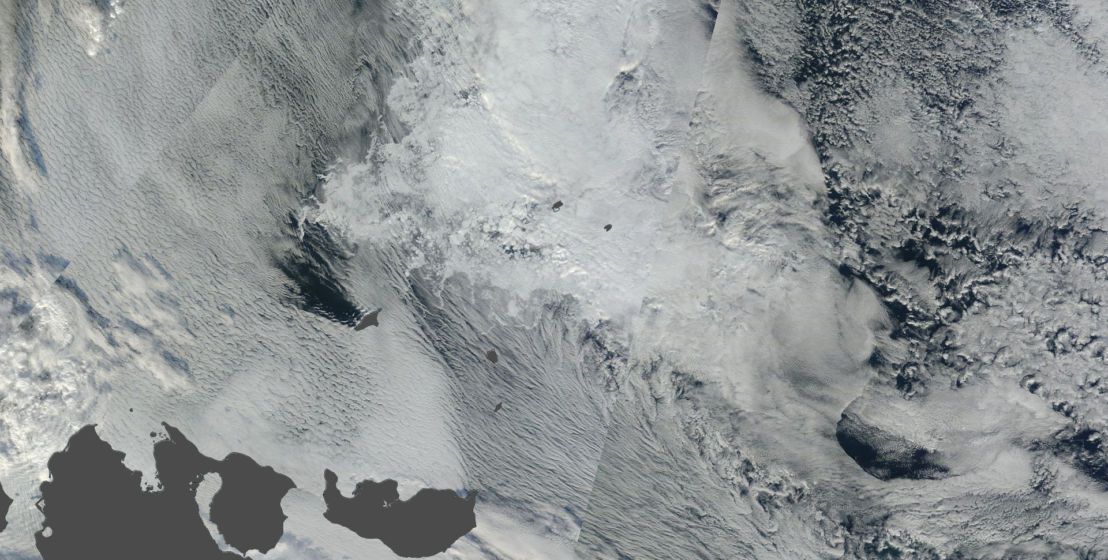
Access to site: MODIS true-color, 13 Sept 2015
N

