Slide 1
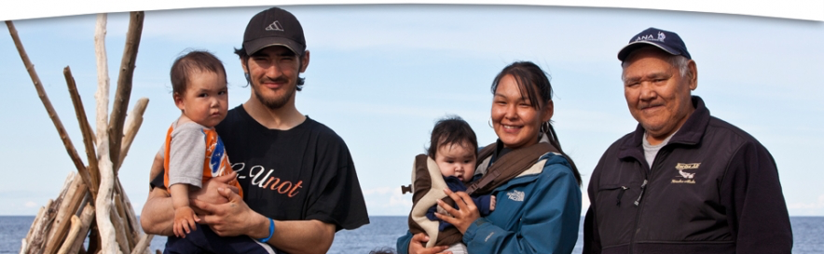
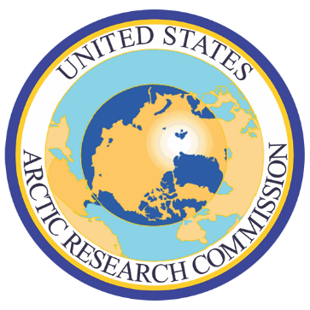
Perspectives from an Alaskan Native and a USARC Commissioner
Nana.com
Kasaŋnaluk Marie Greene
Commissioner, USARC
7/20/17
Notes:
[Opening Slide]
Uvlullautaq, good afternoon.
[– progress to the next slide for introduction]

Slide 2
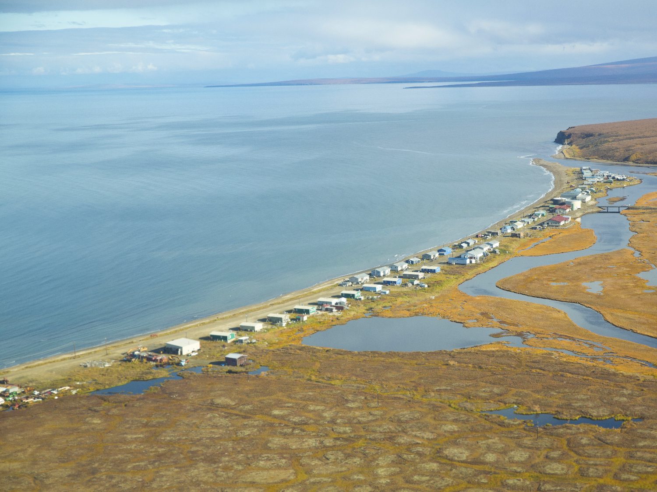
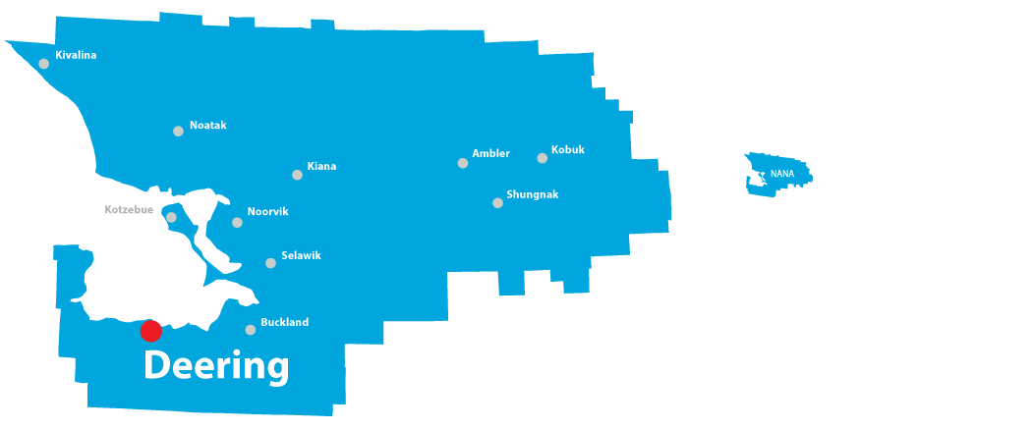
Ipnaitchiaq
(Deering, Alaska)
COLLABORATION: Essential for the Future of the Arctic
COLLABORATION: Essential for the Future of the Arctic Kasaŋnaluk Marie Greene
Notes:
Uvuŋa Kasaŋnaluk, Ipnachaiġmii.
My name is Kasaaŋnaaluk Marie N. Greene. I was born in Deering, Alaska, and now live in Kotzebue, on the northwest coast, in the Arctic region. I have a master’s degree in Rural Development, and a lifetime of Inupiat knowledge and experience.
For 20 years, I worked for the NANA Regional Corporation, one of the original 13 Alaska Native Corporations incorporated after the passage of the Alaska Native Claims Settlement Act of 1971. For the last 13 of those years, I served as the President and CEO of NANA, which is a for-profit, billion dollar corporation with a social and cultural mission that benefits more than 14,300 Alaska Native shareholders of Inupiat descent.
I am here, today, as a presidentially appointed commissioner ofthe U.S. Arctic Research Commission, to share my perspectives on the topic of an ice-diminishing Arctic on naval and maritime operations, and how those operations, in turn, impact those of us who live there.

Slide 3
Iñupiat Ilitqusiat
“the real people”
“that which makes us who we are“
Knowledge of Family Tree
Knowledge of Language
Sharing
Humility
Respect for Others
Responsibility to Tribe
Love of Children
Cooperation
Hard Work
Respect for Elders
Respect for Nature
Hunter Success
Avoid Conflict
Family Roles
Humor
Spirituality
Domestic Skills
COLLABORATION: Essential for the Future of the Arctic Kasaŋnaluk Marie Greene
Notes:
Before getting into details, it’s important for me to tell you the core philosophy of the Inupiat …
As Iñupiaq, we are responsible for:
The survival of our culture
Our values
Our traditions
Retaining, teaching, and living our Iñupiat way of life
We have 17 values in our culture, while some are unique, some are universal to all people of the world.

Slide 4
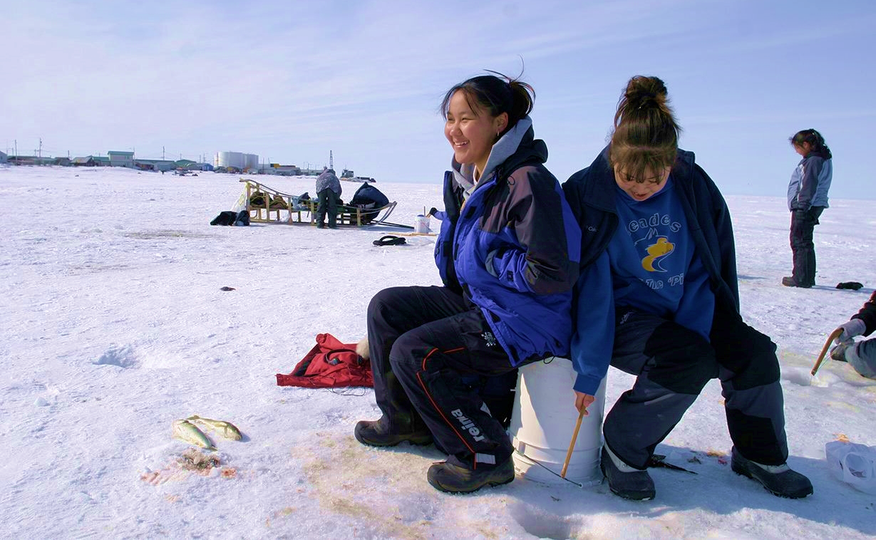
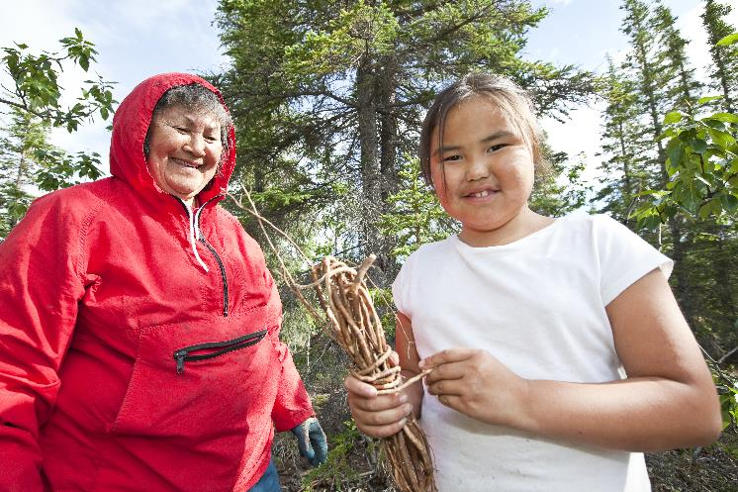
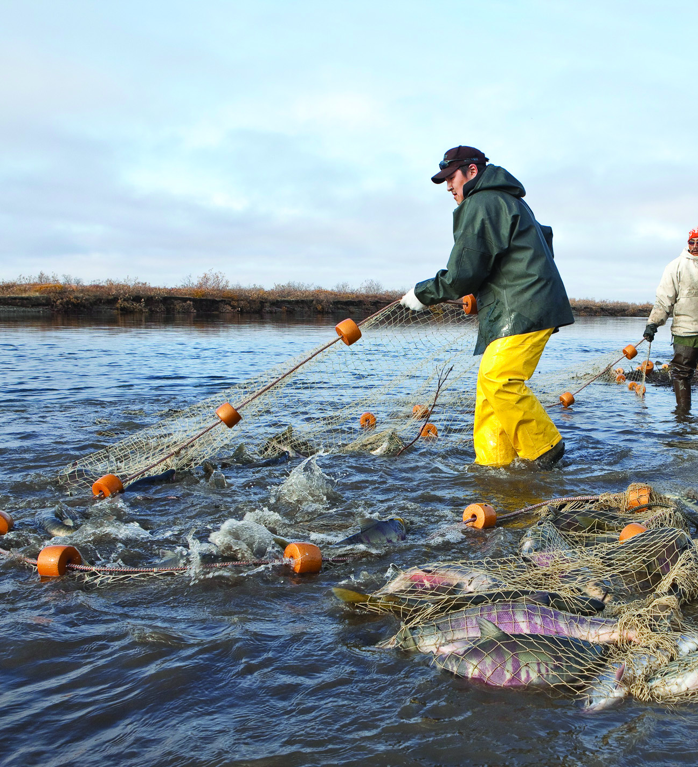
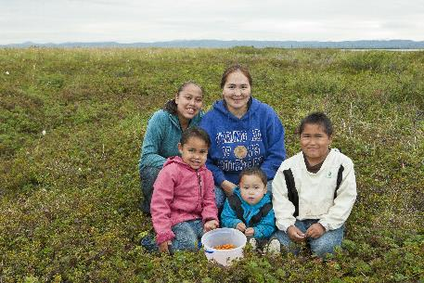
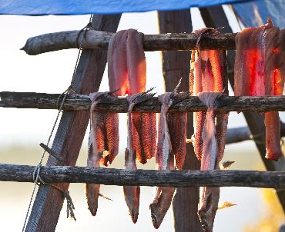
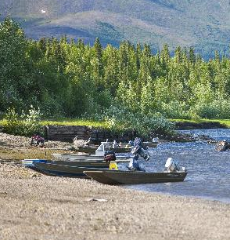
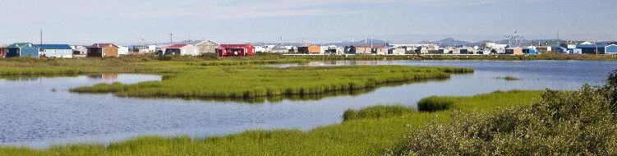
Iñupiaq Culture
Subsistence Culture
COLLABORATION: Essential for the Future of the Arctic Kasaŋnaluk Marie Greene
Notes:
To Iñupiaq, “subsistence” means the customary and traditional activities of harvesting, processing, distributing, and consuming wild animals, fish, and plants through a socioeconomic way of life that has endured for thousands of years.
Subsistence activities constitute a way of being and relating to the world, and thus comprise an essential component of Alaska Native identities and cultures, including our spiritual identity. In the NANA region, it was determined, in 1999, that over 60% of daily caloric intake was from subsistence, or “country” foods.
To you, the term "subsistence" may imply the bare minimum needed to survive. Yet, since the beginning, those of us who subsisted on the land did more than just survive. We thrived. Even in Alaska's cold, frozen Arctic, there was generally plenty for those of us who did the work and gathered what the land and sea offered.

Slide 5
Traditional Knowledge
A living body of knowledge
Pertains to explaining and understanding the universe and living and acting within it
It’s acquired and used by indigenous communities through long-term sociocultural, spiritual, and environmental engagement
It’s integral to communities, is transmitted inter-generationally, is practical, widely applicable, and integrates personal experience with oral traditions
It’s deeply rooted in history, but is adaptable and dynamic, and does not preclude change
COLLABORATION: Essential for the Future of the Arctic Kasaŋnaluk Marie Greene
Notes:
Through our thousands of years of living, surviving, and thriving in the Arctic, our people inherited traditional or indigenous knowledge from the generations that came before us.
It is our body of knowledge and includes our understanding of the world around us.
When our traditional ways of knowing and knowledge are connected with western-based science, the result could produce knowledge that will help us all with management, regulations, and other decisions that impact the future of the Arctic including its stakeholders.

Slide 6
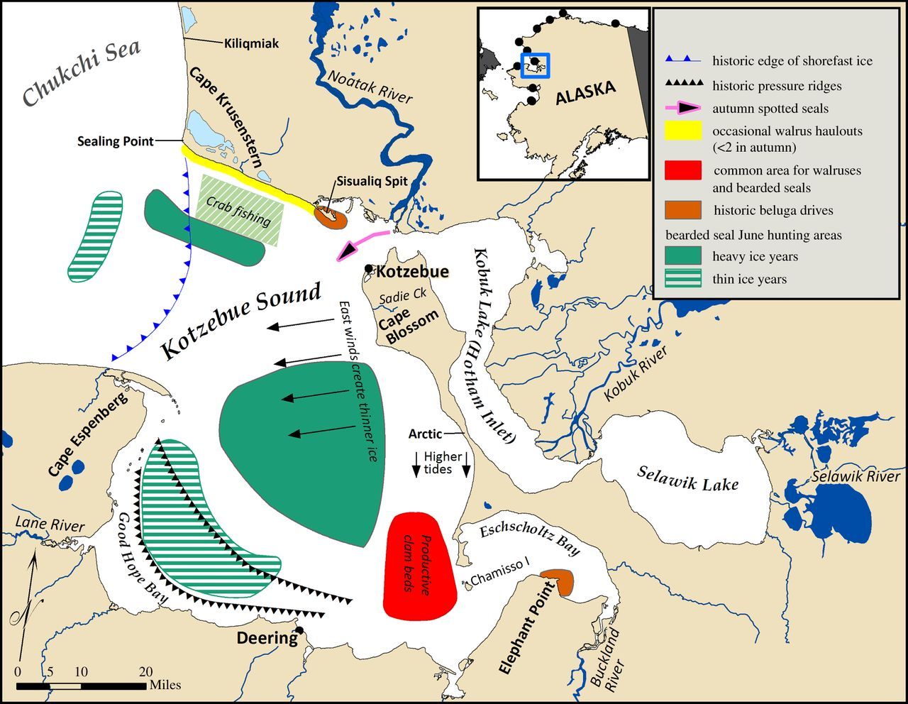
Ice-diminishing Arctic Impacts Subsistence
Changing
Marine mammal behavior, habitat use, and migration
Weather and sea ice distribution, thickness
Hunting seasons reduced, less safe, and farther from home
Food Security
Bearded seal Alex Whiting
COLLABORATION: Essential for the Future of the Arctic Kasaŋnaluk Marie Greene
Henry P. Huntington et al.
Biol. Lett. 2016;12:20160198
Notes:
When it comes to subsistence, diminishing sea ice means shorter, less safe, greater distances to travel to find marine mammals, greater variability in caribou populations and distributions. Greater distance also means increased cost for subsistence gathers to obtain traditional foods.
This map is based on detailed observations reported, in January 2016, by Inupiat hunters, to anthropologist Henry Huntington, who used them to make this map, representing conditions between 2007 and 2016.

Slide 7
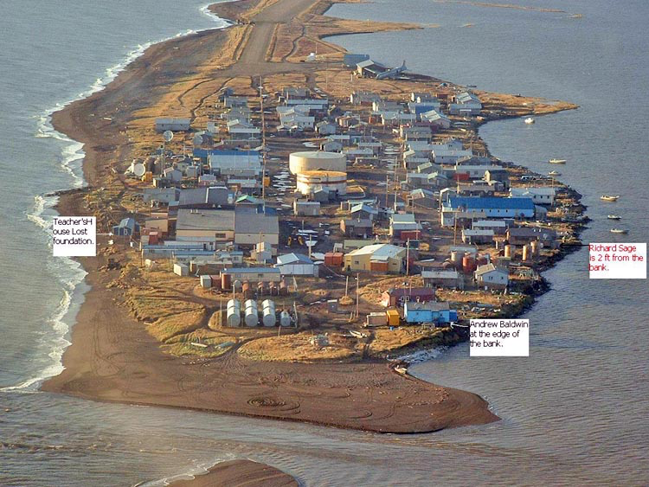
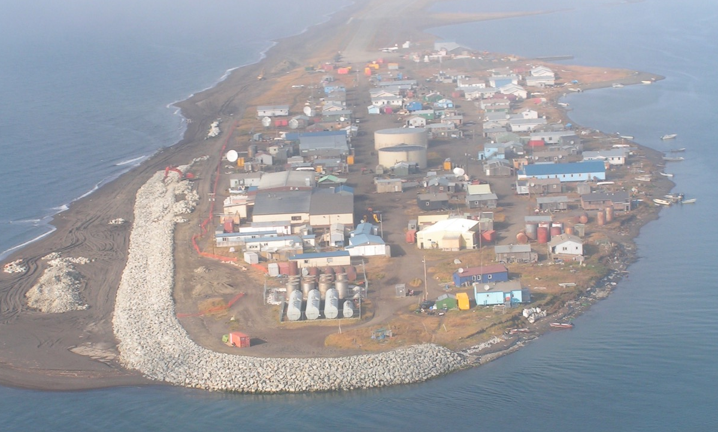
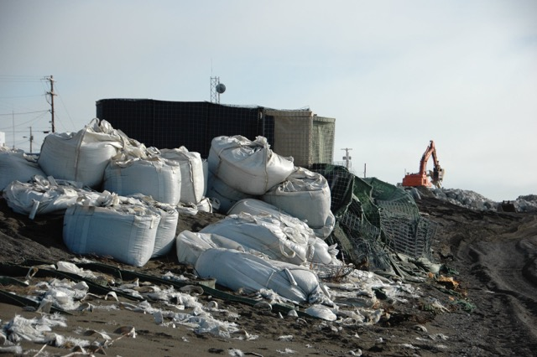
Kivalina Erosion
A sandy spit 80 air miles NW of Kotzebue
~450 residents, 97% Inupiat
Inundation predicted by 2025
Permafrost thaw and coastal erosion
Relocation costs between $100 & $400 M
USACE built a 1,600’ long riprap (rock) revetment for $13.4M
AVEC, pre-2009
COLLABORATION: Essential for the Future of the Arctic Kasaŋnaluk Marie Greene
Farrell, 2009
Notes:
The impacts of diminishing ice in the Arctic leave communities with few resources to address these issues vulnerable.
Kivalina is experiencing diminished shore-fast ice and overall reduction in ice cover. When this happens and winds whip up the waves across the long distances (fetch) the beach is pounded with waves causing erosion and flooding. When shorefast ice and ice cover water were present for longer periods of time, the waves were not hitting the community as hard. The intensity of storms in the fall and winter are increasing. The sea level is also rising, which intensifies the problems of the waves and the thawing permafrost.
However, this is just one piece of the challenge.
According to a U.S. Army Corps of Engineers report in 2014, the unofficial cost of a 1,200 foot long riprap wall was $13.5M or about $11,200 per linear foot. Though this project was completed, the community continues to be hammered by fall and winter storms threatening the well-being of residents. Erosion also has left the community stranded with respect to water and sewer or other infrastructure upgrades that impact human health and well-being. Throughout my professional career at Maniilaq and NANA, this have been affecting the physical, mental, and spiritual well-being of the community.
In the upper left is a photo of Kivalina before and during revetment construction in summer 2009. Note protection of tank farm, at the end of the spit. Note the old system, bags can be seen both in the big photo, on the right and close up, in the lower left-hand corner.

Slide 8
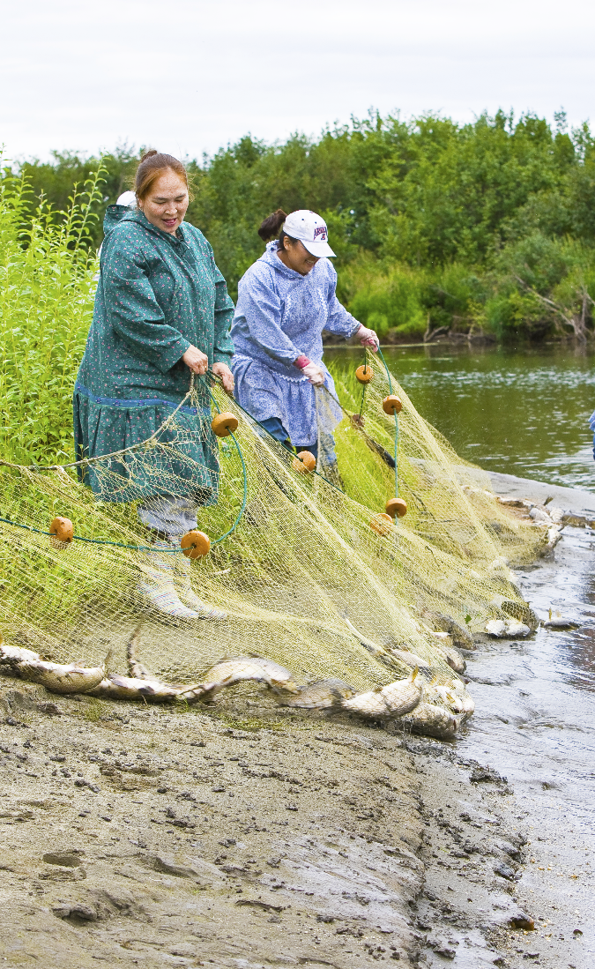
Collaboration
Examples of Success
Atautchikun
Together as one
Collaboration
To work jointly with another person or group in order to achieve something
COLLABORATION: Essential for the Future of the Arctic Kasaŋnaluk Marie Greene
Notes:
These are just two examples of the impacts that diminishing ice in the Arctic is having on the people of Northwest Alaska.
Diminishing ice in the Arctic presents challenges and opportunities.
Though these challenges are faced daily by communities like Kivalina, there is hope that derives from one of the central aspects of our culture - collaboration.
Atauchikun. It means together as one and describes the importance of working together for the whole. As communities we work hard to provide for each other. This was necessary for survival in the Arctic and continues to be necessary today in a more modern world.
Collaboration is key to the future of the Arctic. All of you who have interests in the Arctic are a part of our community. You impact us through your research and the regulations and legislation developed that are informed by this research.
We have a responsibility to each other and to the future generations of the Arctic to work together. Whether it is through research, economic development or infrastructure projects.
Each stakeholder knows that survival in the Arctic is possible. However, survival in the Arctic for all stakeholders is only possible when we collaborate together.
One of the greatest opportunities is for scientists, agencies, and governments to collaborate with those who hold indigenous knowledge to understand the Arctic and the impacts that the diminishing ice is having on our people and the environment.
There are a few examples of successful collaboration I will highlight that relate to subsistence, community sustainability, and economic development.

Slide 9
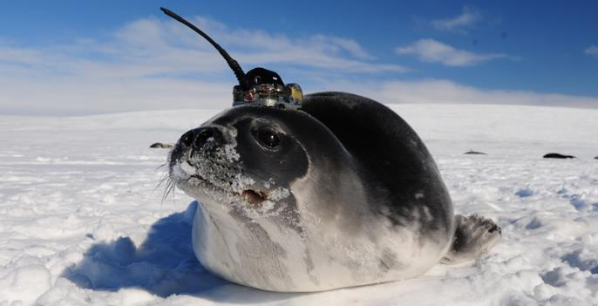
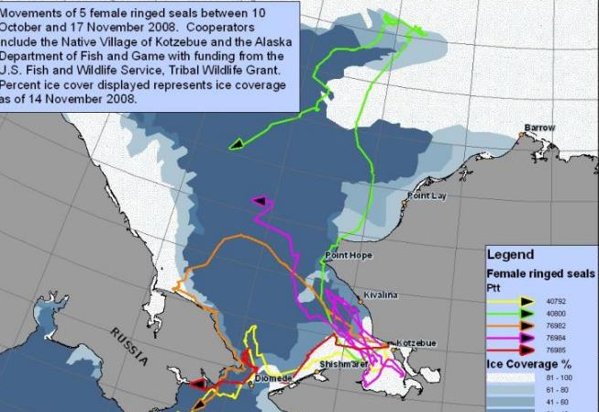
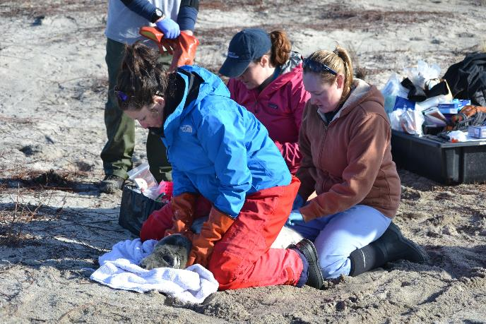
Kotzebue Seal Ice Projects
SUCCESSFUL COLLABORATION
Inuit Knowledge used to improve locating and tagging
Better understanding of key traditional food source activity
COLLABORATION: Essential for the Future of the Arctic Kasaŋnaluk Marie Greene
Notes:
Alex Whiting with the Native Village of Kotzebue, Environmental Protection Director, and indigenous knowledge holders, Willie and John Goodwin, have successfully combined indigenous knowledge with western science to demonstrate the detailed migration patterns of these seals, and how they evolve seasonally, and over longer timescales, in significant part due to diminishing Arctic sea ice.
The map in the lower left shows the migration patterns of five female ringed seals. You can see from this map and others how important the Arctic ocean is to these seals as well as how they overlap with maritime activities.

Slide 10
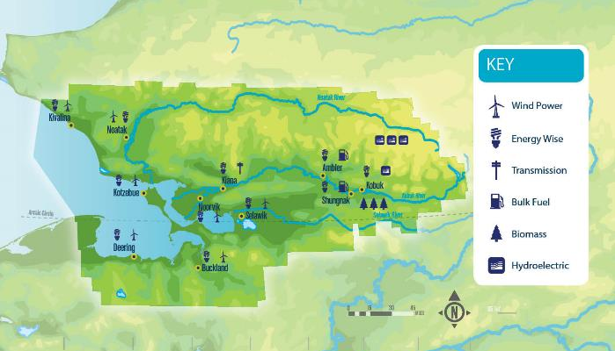
Northwest Arctic Alternative Energy
Successful collaboration
Inuit Knowledge, Local Leadership & Technical Expertise
Consultation
First regional energy plan in the State of Alaska
Deployment
COLLABORATION: Essential for the Future of the Arctic Kasaŋnaluk Marie Greene
Notes:
Collaboration between regional entities, communities, technical experts and agencies have been key to addressing the high cost of living in Northwest Alaska.
Communities like Noatak and those in the Upper Kobuk have experienced significant declines in river water levels causing all fuel and other supplies to be brought in by plane.
Due to the increased cost of fuel facing the region in 2007 – all the entities serving the region came together to host an energy strategy session. This led to the development of the first regional energy plan in the State of Alaska. This plan was developed utilizing indigenous knowledge and technical experts that identified sites to test for renewable energy that could be used to reduce dependence on diesel for power generation.
Today, wind turbines and solar power have been deployed in communities. Efforts are continuing to establish micro-grids and to access natural gas to reduce the cost of living in the region.

Slide 11
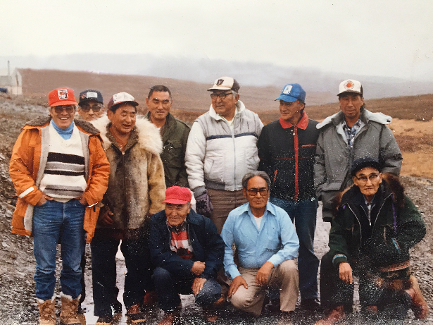
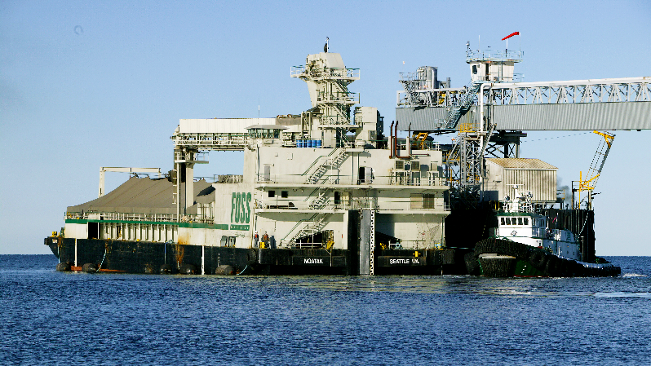
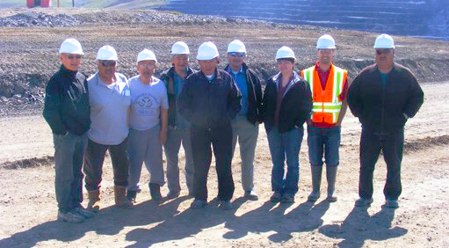
Red Dog Mine Subsistence Committee
Successful collaboration
Reviews all subsistence and environmental issues
Determines the shipping season to minimize impact on harvests
Provides guidance on interaction with the villages
COLLABORATION: Essential for the Future of the Arctic Kasaŋnaluk Marie Greene
Notes:
Successful collaboration utilizing indigenous knowledge is also important to economic development in the Arctic.
Red Dog Mine is owned by NANA and operated by Teck, a Canadian mining company. Under NANA’s agreement with Teck, the operations of the Mine includes a Subsistence Committee. This Committee is central to the operation of the Mine when it comes to any environmental concern, minimizing impacts to subsistence resources and activities, as well as providing guidance to the Mine on how to engage with our communities.
The collaboration has been key, especially in the shipping operations in the summer. The same fall storms that hit Kivalina, can impact the shipping season from the Port. Last year, Red Dog had its longest shipping season due to decreased ice, but had more delays than usual because of increased in storms.

Slide 12
Conclusions
Diminishing ice directly impacts our subsistence “operations” in the marine environment.
It also impacts our 21st century business operations (mining, shipping, ports & harbors, oil and gas exploration, tourism, SAR, spill response).
Indigenous knowledge and science are powerful when combined to understanding and addressing the diminishing Arctic sea ice. After all, we live there, and have, for 10,000 years.
COLLABORATION: Essential for the Future of the Arctic Kasaŋnaluk Marie Greene
Notes:
Collaboration is essential for the future of the Arctic. When we combine our knowledge – it is possible to more holistically and efficiently understand the changing Arctic and impacts the diminishing ice is having on the land, water, air, wildlife, and the people of the Arctic.
This is a powerful combination and when scientists and indigenous knowledge holders work together, I know we – all of us – can adapt to these changes.

Slide 13
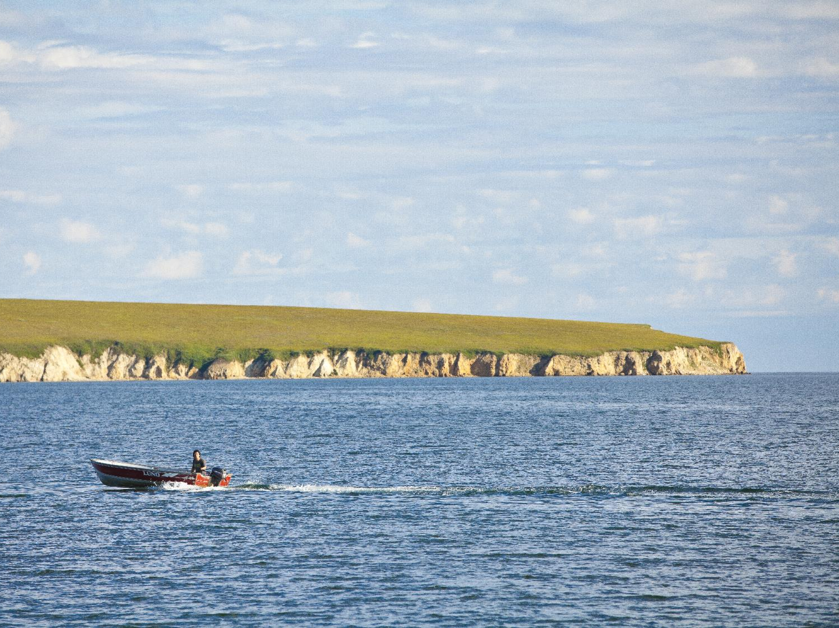
Taikuu!
Notes:
Taikuu!

