Slide 1
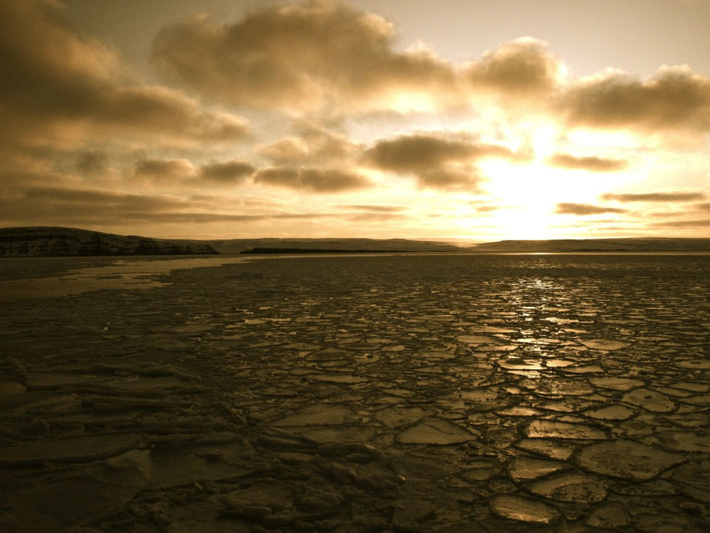

NOAA’S Arctic Research Program
Jeremy Mathis, Sandy Starkweather, Monique Baskin, and Emily Osborne
Office of Ocean and Atmospheric Research
www.arctic.noaa.gov

Slide 2
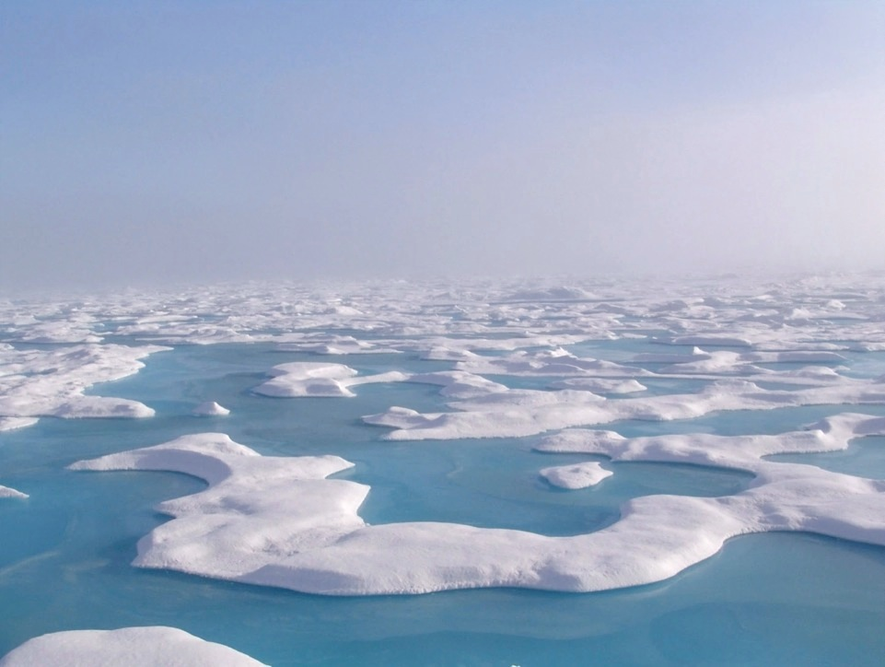
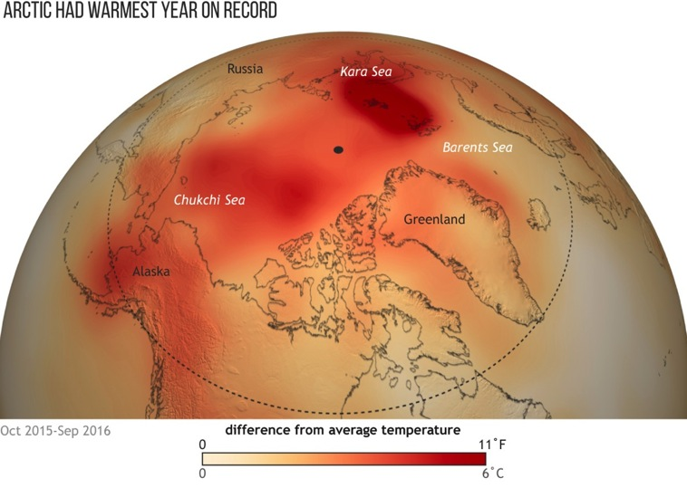
2016 Was The Warmest Year On Record
www.arctic.noaa.gov/Report-Card
For larger versions, visit: http://bit.ly/2016ArcticReportCard

Slide 3
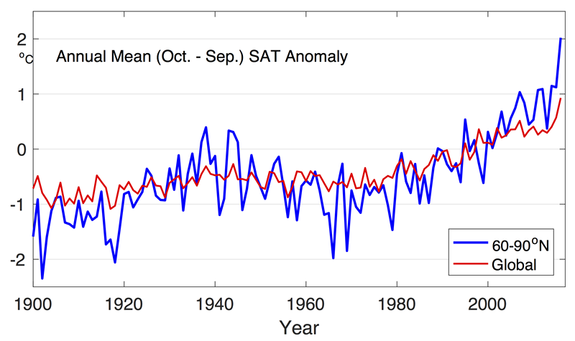
Surface Air Temperatures
Arctic temperatures continue to increase at double the rate of the global temperature increase.
}
Arctic Amplification
2016 Arctic Report Card
2016

Slide 4
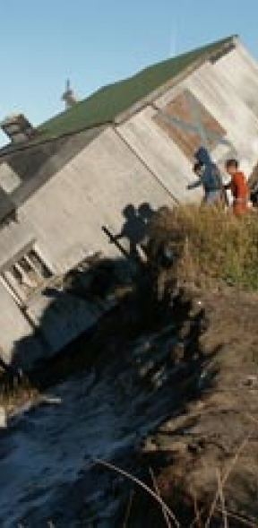
Unprecedented Changes
The average Arctic surface air temperature for 2016 was by far the highest since 1900, and new monthly record highs were recorded for January, February, October – December.
Minimum sea ice extent at the end of summer 2016 tied with 2007 for the second lowest in the satellite record.
In 37 years of Greenland ice sheet observations, only one year had earlier onset of spring melting than 2016.
Global connections to Arctic change are becoming more pronounced, including sea level rise and the propagation of extreme weather events.

Slide 5
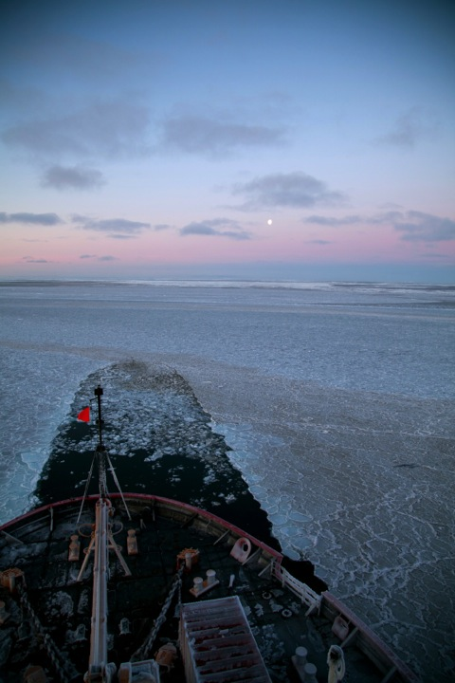
NOAA’s Arctic Mission
To determine how the Arctic system is changing on time scales of weeks to decades, particularly with respect to the consequences that the loss of sea ice may have on Arctic ecosystems, coastal management, economic development and northern hemisphere severe weather events.

Slide 6
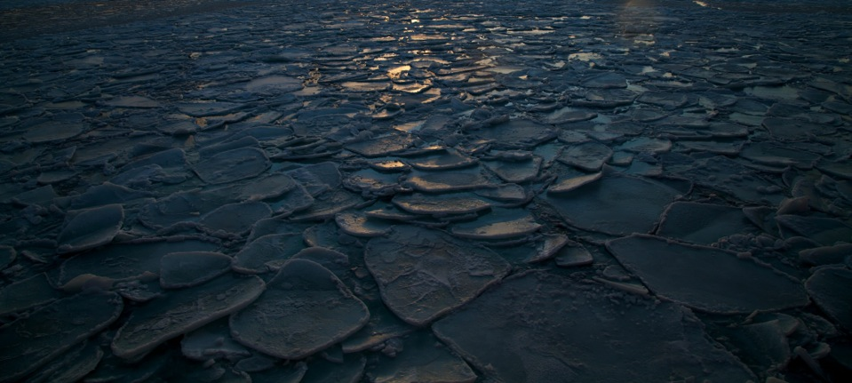
NOAA Arctic Priority #1
Develop sustained Arctic observing and data management capabilities to improve coupled ocean-sea ice-atmosphere monitoring and modeling efforts in order to advance understanding of climate impacts on ecosystems and biological resources.

Slide 7
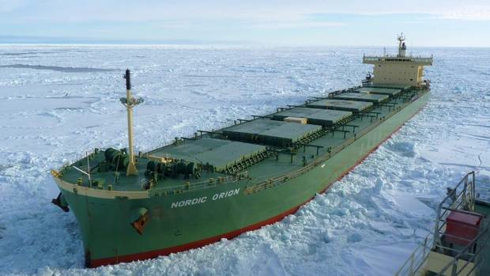
NOAA Arctic Priority #2
Enhance the scientific framework and capabilities forming the foundation for navigation services and spill response, to support increased ship traffic and commercial development across the Arctic Basin.

Slide 8
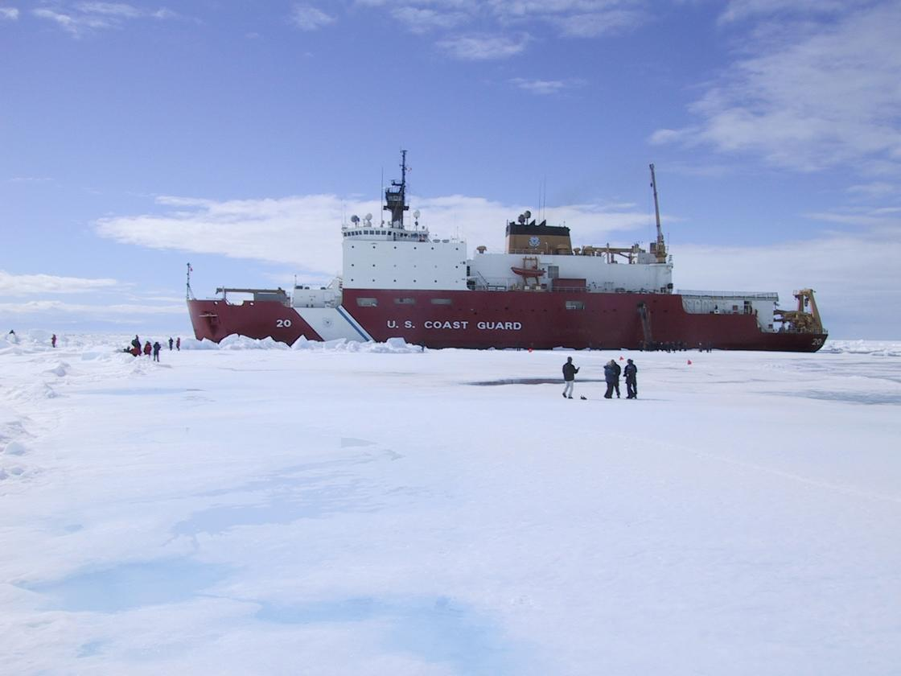
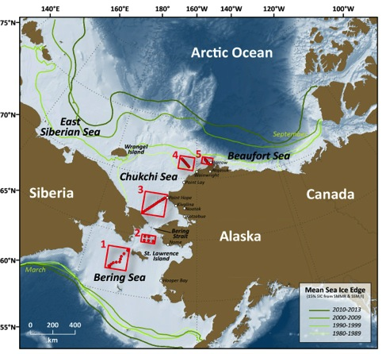





Arctic Research Program LOE 1
Distributed Biological Observatory (DBO)
http://www.arctic.noaa.gov/dbo
DBO regions are centered on “hotspots” located along a latitudinal gradient
The DBO serves as a change detection array, via standardized sampling of biophysical processes
Building links to coastal ecosystem health via Community Observations
Notes:
Change MAP to 4 sites

Slide 9
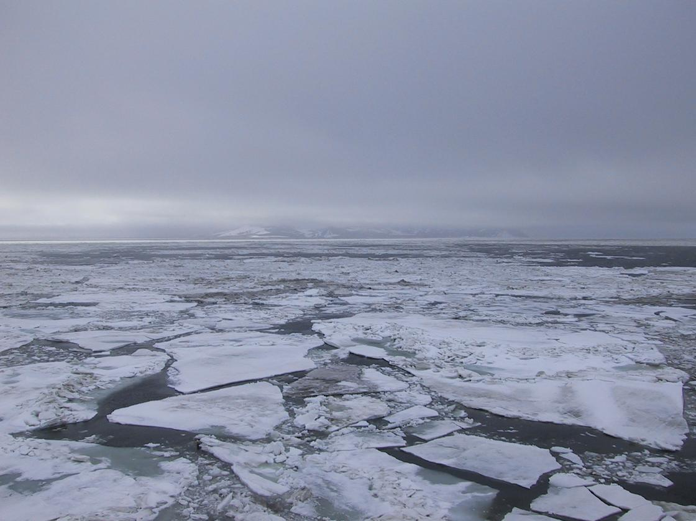
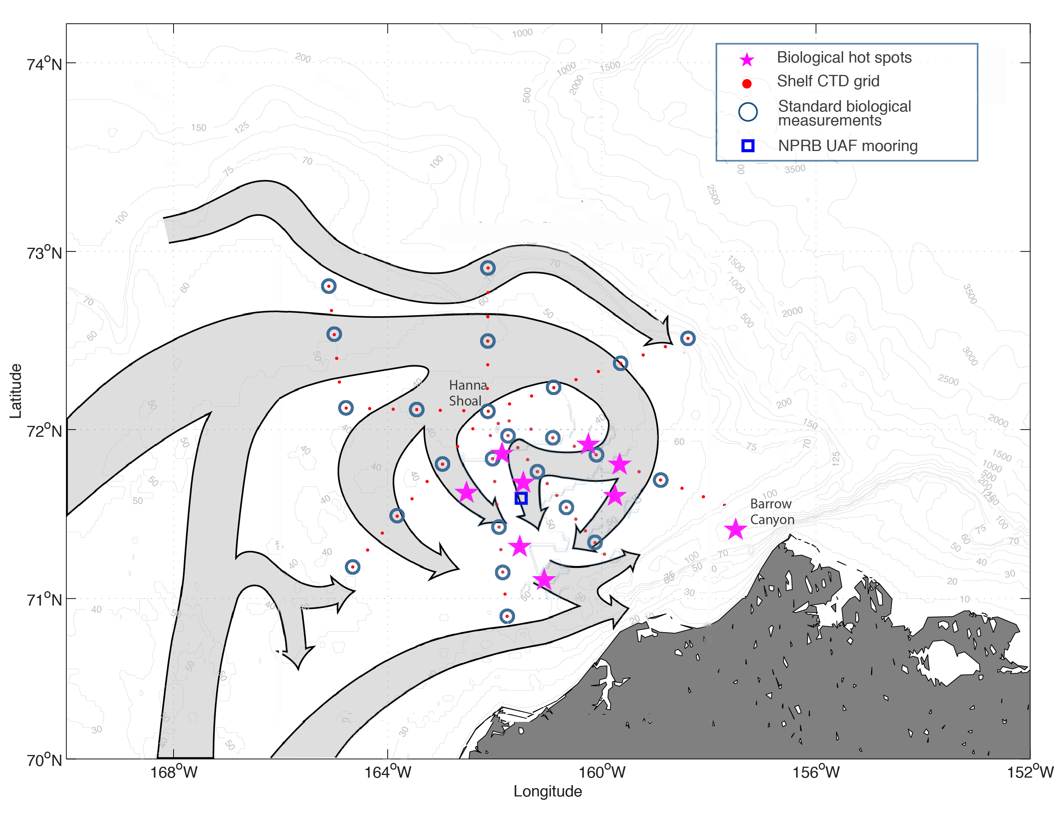
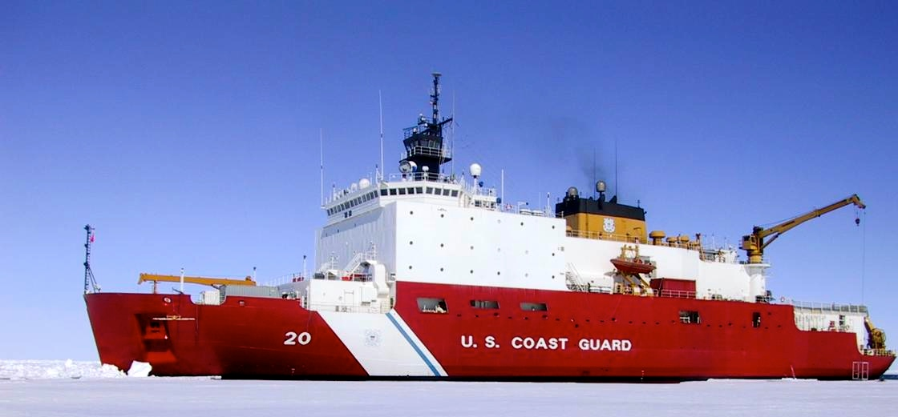
Arctic Research Program LOE 1
NOAA DBO 2017 – Northern Chukchi Integrated Study (NCIS)
Identify the physical and chemical drivers that create the biological “hot spots” at the head of Barrow Canyon and other parts of the Northern Chukchi Shelf.
Partnering with the USGC to conduct a 22-day cruise.
Includes
  Physics
  Chemistry (OA)
  Biology
  Marine Mammals
  Outreach

Slide 10
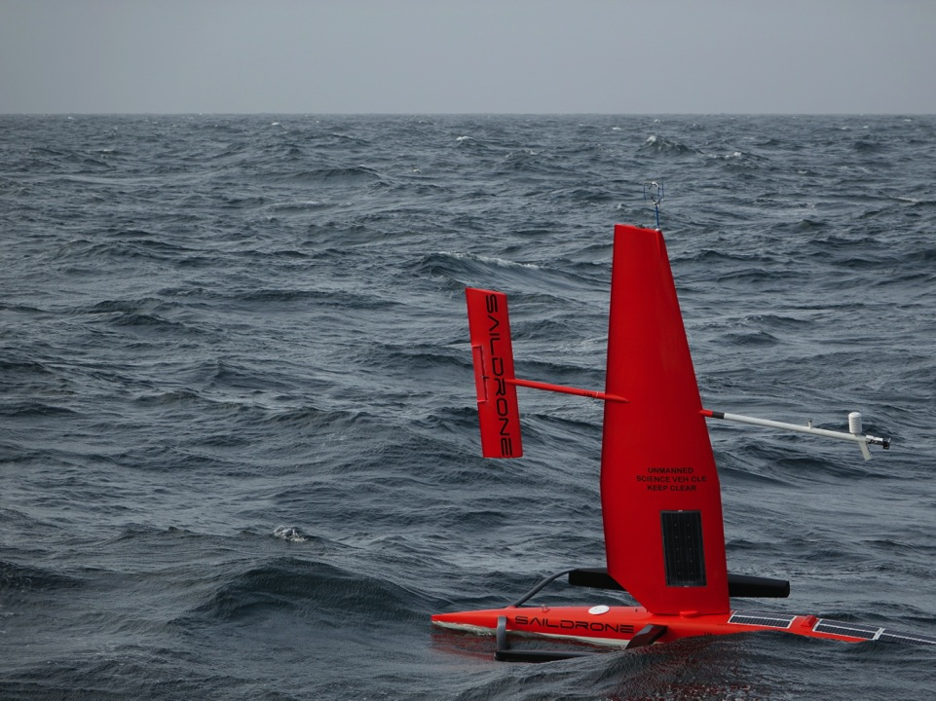
Arctic Research Program LOE 2
Annual surveys of the Arctic Ocean using unmanned drones and gliders
Notes:
A closer look shows that those tools were able to capture the things we had hoped to capture, including ice melt and river water.

Slide 11
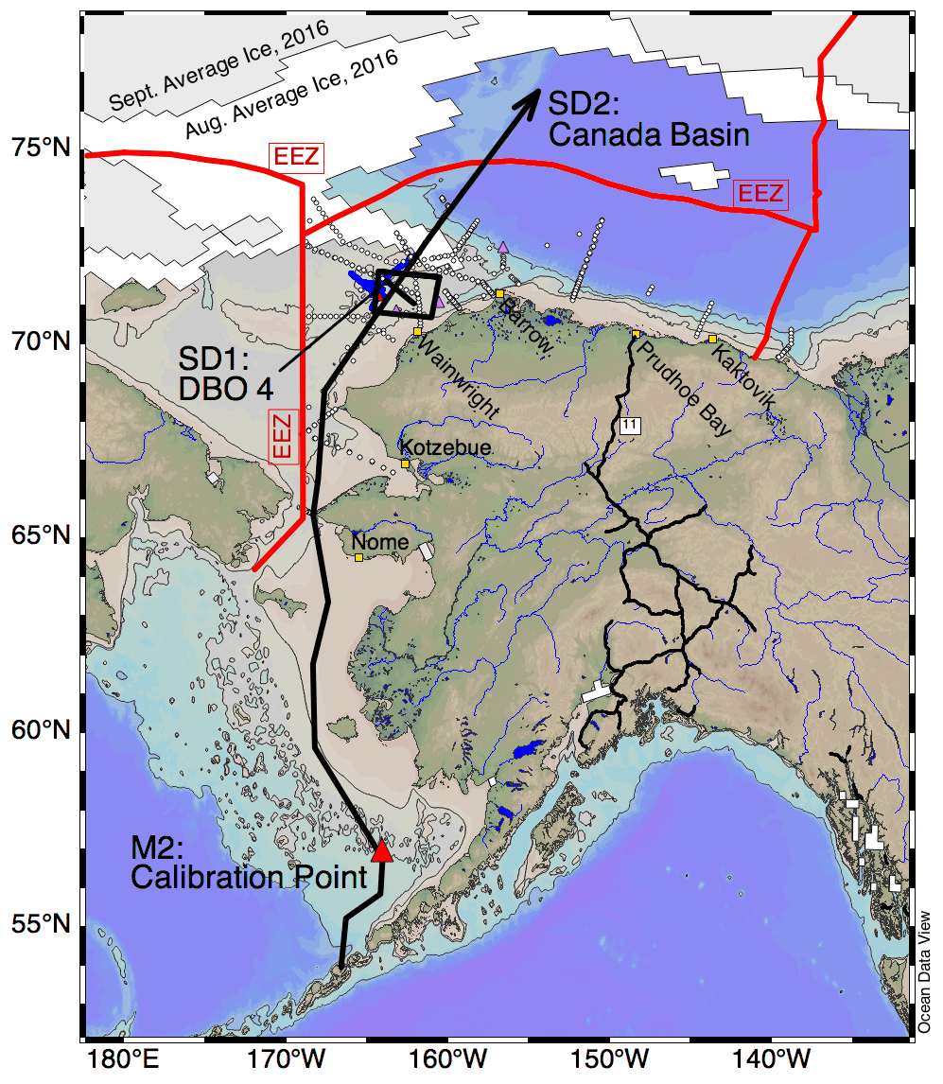
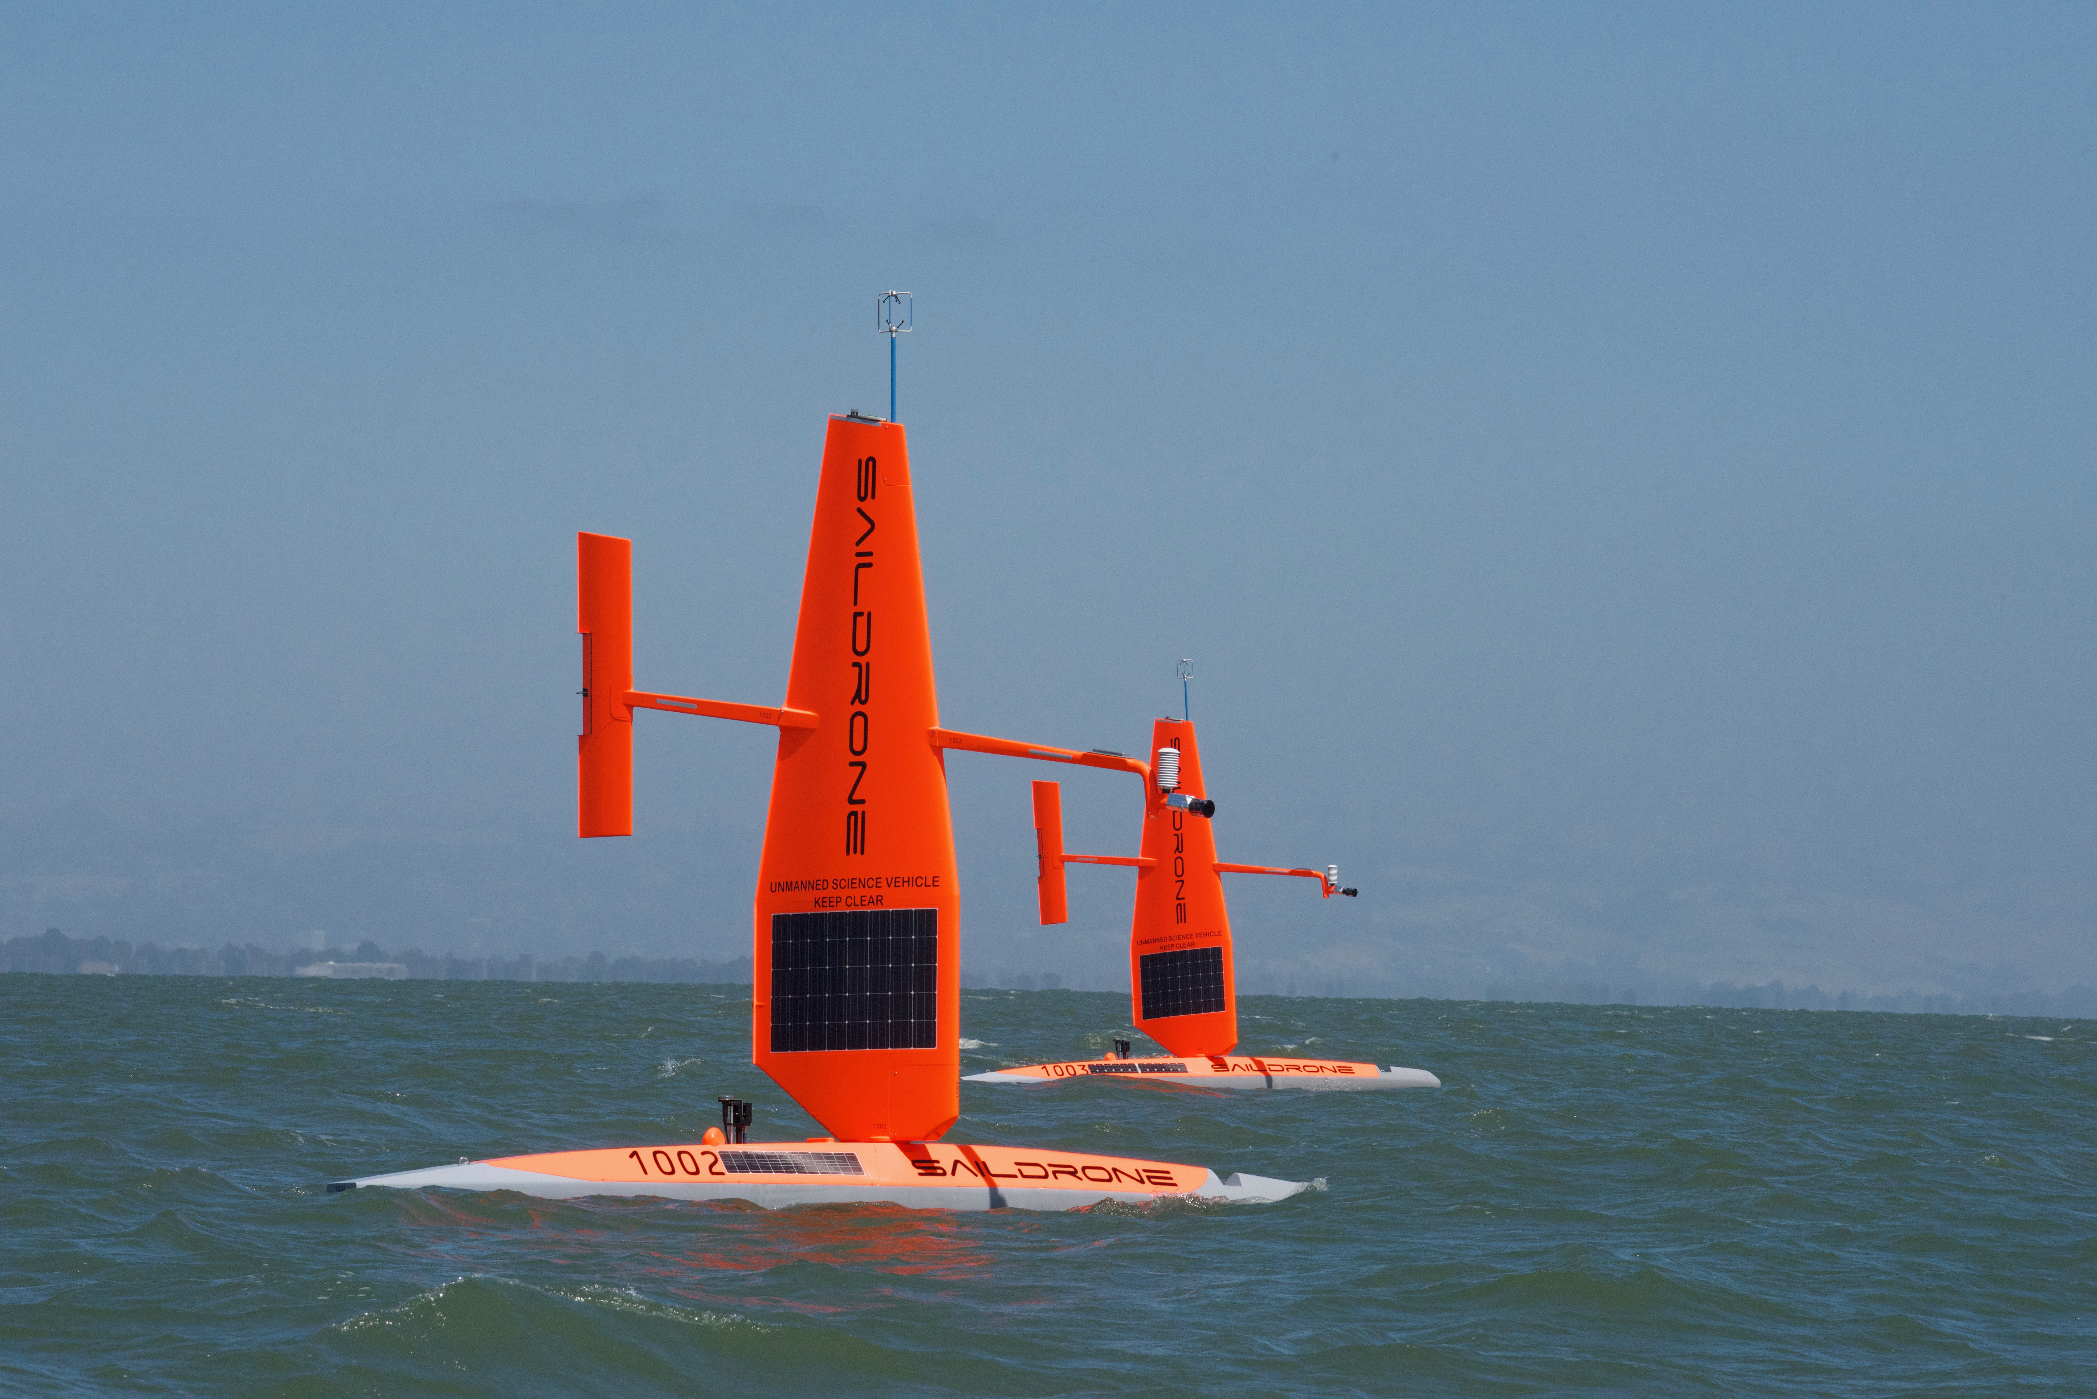
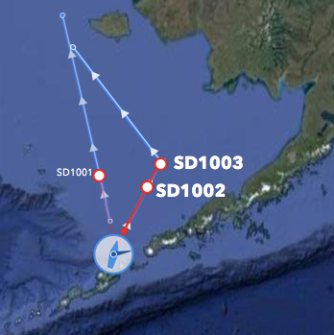
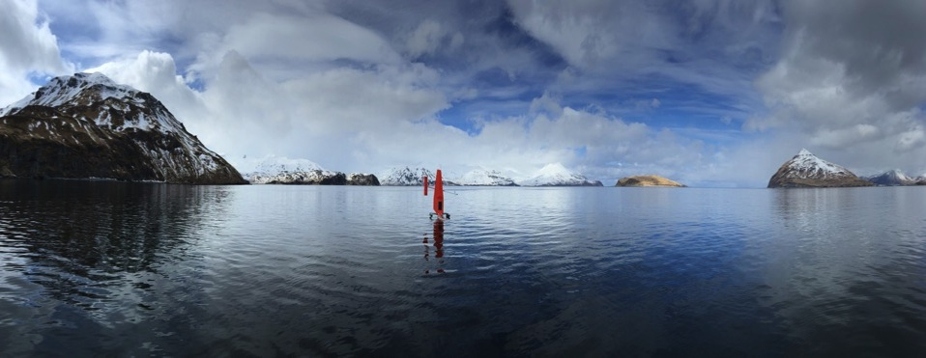
Arctic Research Program LOE 2
Arctic SailDrone in 2017

Slide 12
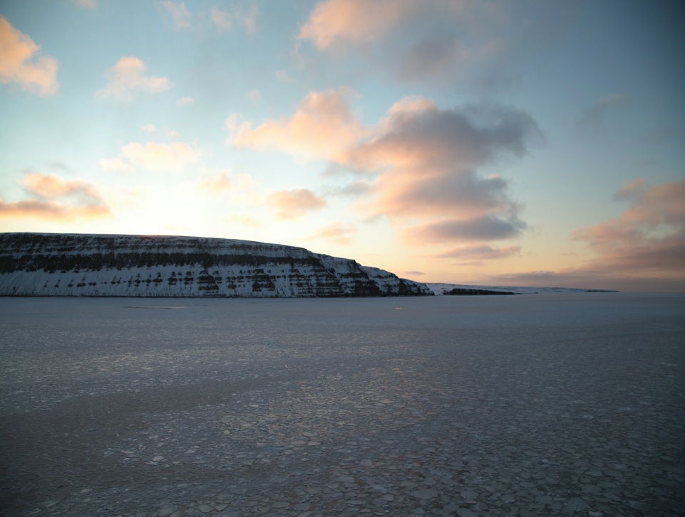
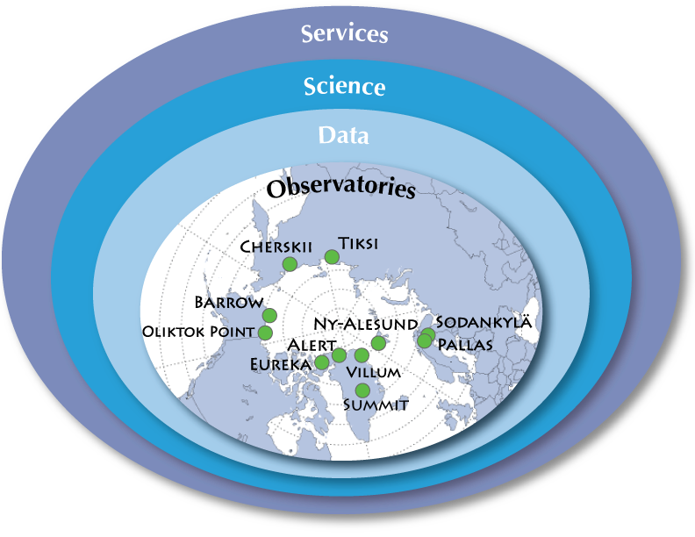
Arctic Research Program LOE 3
International Arctic Systems for Observing the Atmosphere
(IASOA)

Slide 13
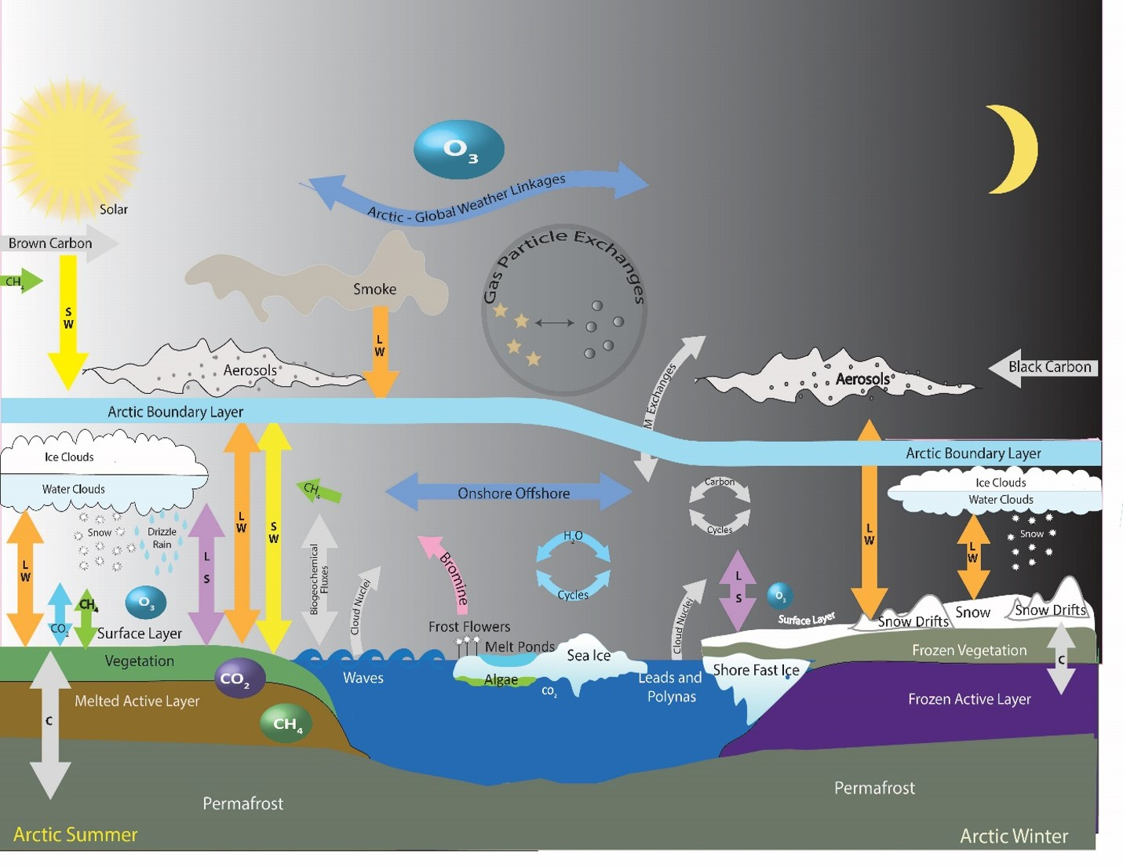
Arctic Research Program LOE 3
IASOA

Slide 14
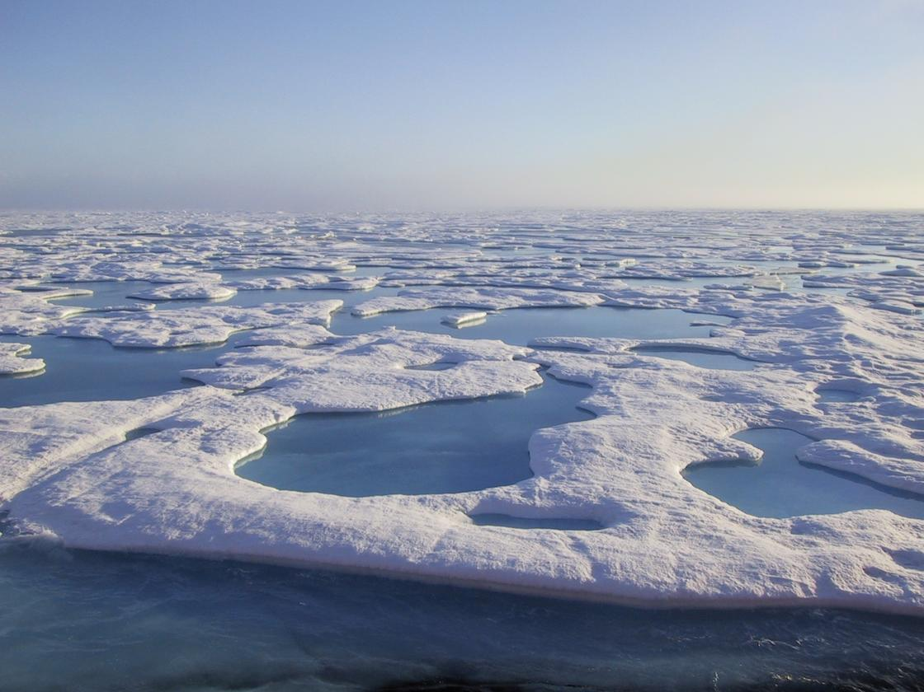
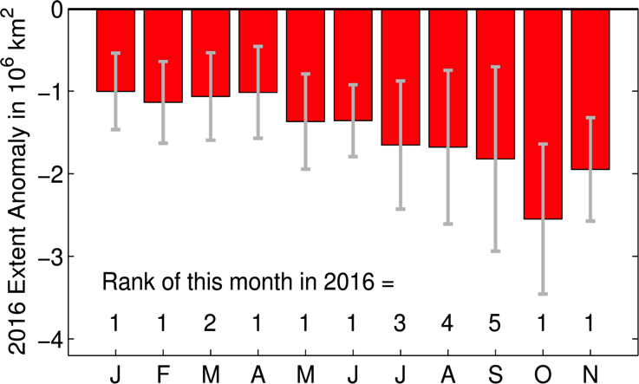
Arctic Research Program LOE 4
Support expanded modeling of climate, sea ice, and ecosystem response to changing environmental conditions in order to better inform observational needs.
2016 NOAA Arctic Report Card

Slide 15
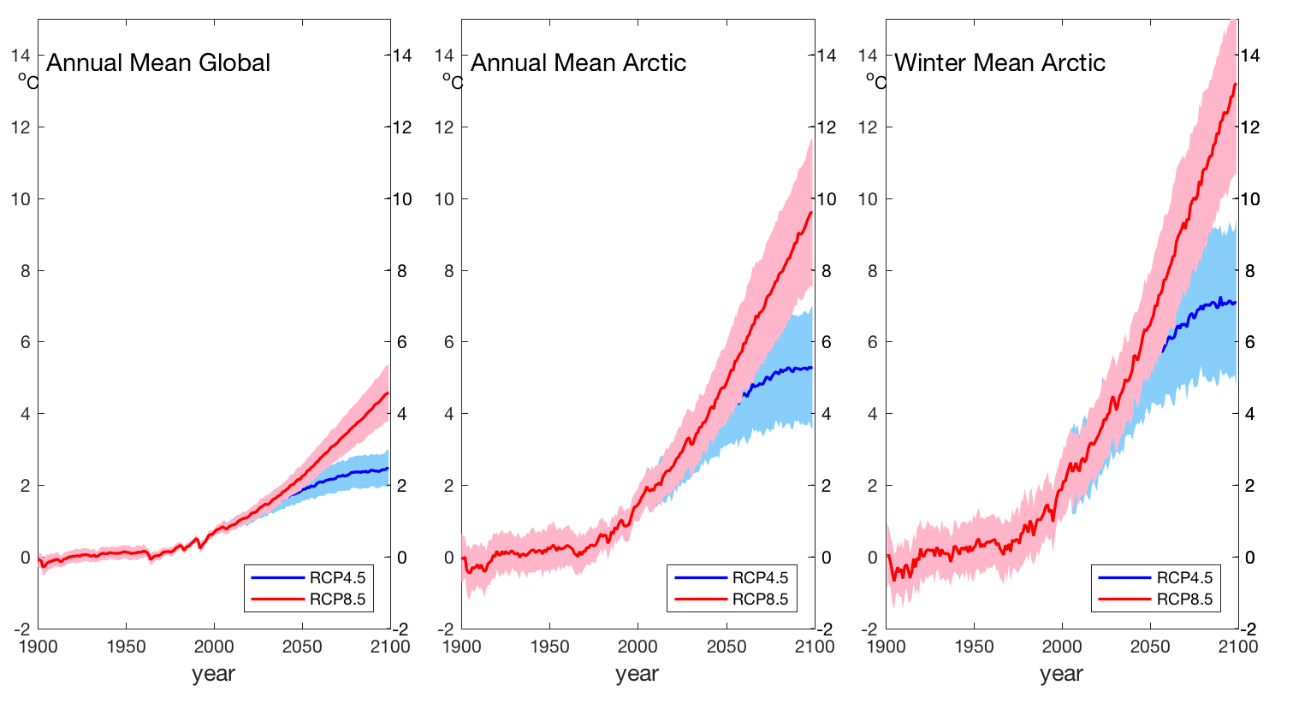
Arctic Research Program LOE 4
Support expanded modeling of climate, sea ice, and ecosystem response to changing environmental conditions in order to better inform observational needs.
Even if global temperatures stabilize at +2° C, the Arctic will hit +5° C
Courtesy of Jim Overland (NOAA-PMEL)

Slide 16
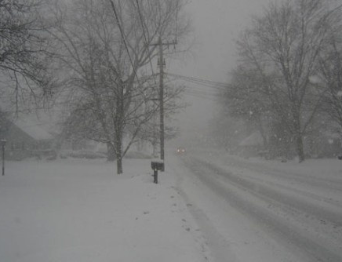
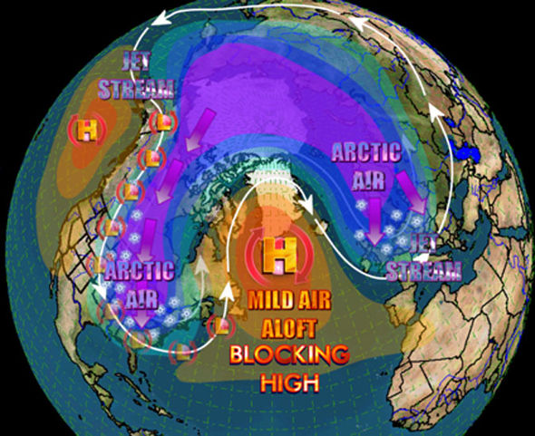
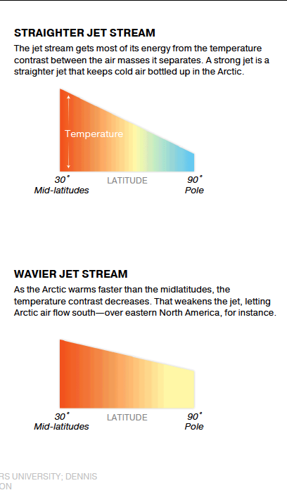
Arctic Research Program LOE 4
kcstormfront.wordpress.com
Notes:
Geopolitical, economic, commercial, ecosystem, and human factors.

Slide 17
Arctic Research Program LOE 5
U.S. Arctic Observing Network (AON)
Support the U.S. AON project office and its role in developing integrated products using existing Arctic observing assets.

Slide 18
Arctic Research Program LOE 5
U.S. Arctic Observing Network (AON)
Establish and support a task-driven US AON to mobilize U.S. contributions towards integrated and well-defined observing networks that enable access to high quality data, expertise and information in support of scientific understanding, local needs, and agency operations.
  Improve observing capacity for sea ice forecasting and navigation products;
  Improve cyberinfrastructure for synthesizing and applying ship tracking data (AIS) towards regional decision making;
  Improve observational products for terrestrial snow cover;
  Improve biogeochemistry products for fisheries management.

Slide 19
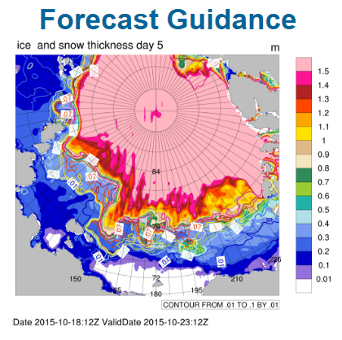
US AON Task: Operational, Multi-Sensor Sea Ice Thickness (SIT) Product
Arctic Research Program LOE 5
  An operational sea ice thickness product for forecast models has been identified as a critical advancement for sea ice forecasting.
  Challenge: There is currently no single observing technology that provides comprehensive, real-time sea ice thickness;
  US AON Task Approach: Assemble an interdisciplinary task team comprised of experts from each technology, model developers and operational ice centers to develop fit-for purpose, multi-sensor product(s).

Slide 20
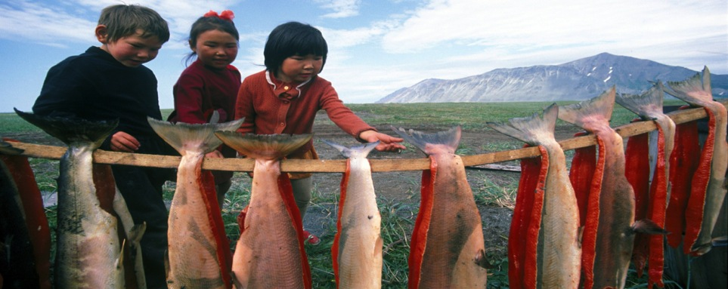
New IARPC Collaboration Team
Environmental Intelligence
Integrated environmental knowledge that is timely, reliable and suitable for the decisions at hand. Includes:
Observations, 2. Modeling, and 3. Data Integration

Slide 21
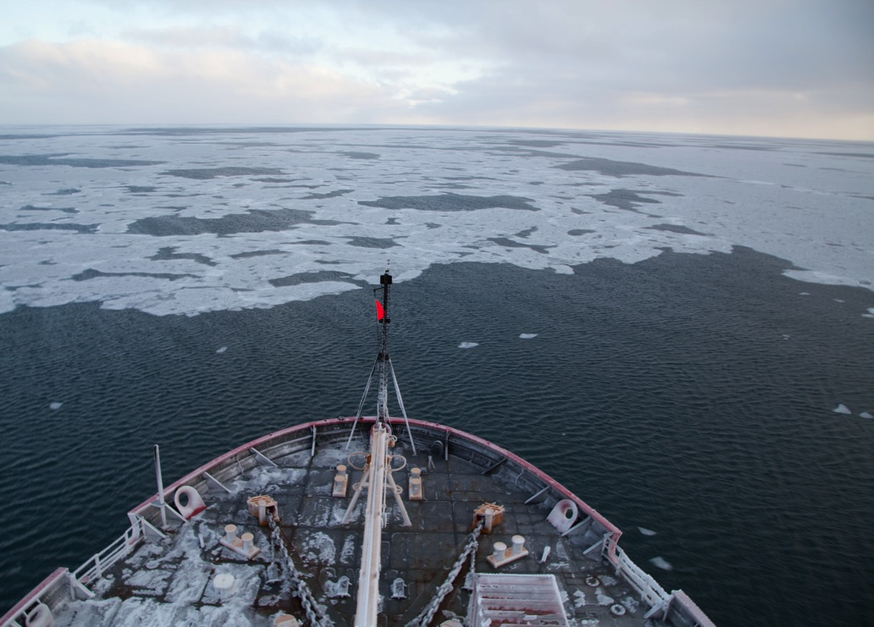
Why We Need Environmental Intelligence Gathering
2016 was an unprecedented year in the Arctic and trends in 2017 have shown a clearer, stronger and more pronounced signal of persistent warming than at any point in our observational record.
We need to expand and improve sustained information gathering in the Arctic to provide actionable intelligence and forecasting needed by residents and other stakeholders.
The issues at stake include food security, cultural survival, environmental and community health. There are also emerging opportunities in commerce, trade and issues of national security.

Slide 22
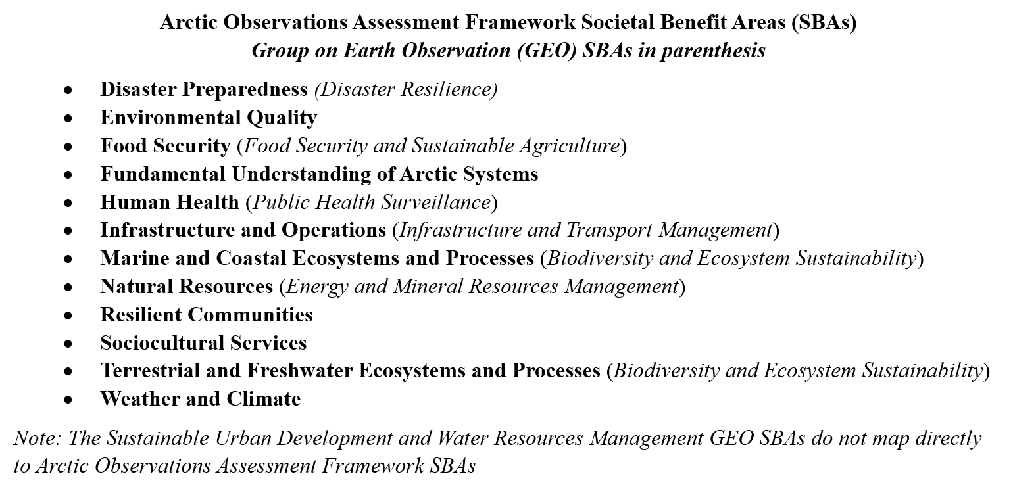

Environmental Intelligence Collaboration Team
By evaluating the connection between Earth-observing inputs and areas of societal benefit we identify the inputs most critical for a sustained portfolio of Arctic-observing systems.

Slide 23
Environmental Intelligence Collaboration Team
Environmental Intelligence Cycle

Slide 24
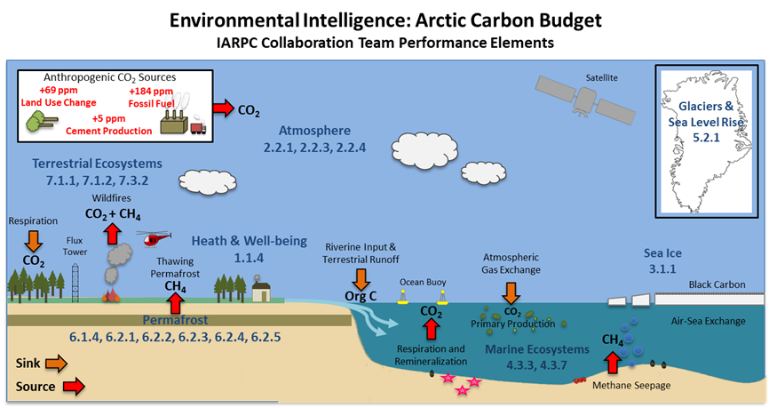
Environmental Intelligence Collaboration Team
The emergence of carbon-related issues such as ocean acidification, increased permafrost melt, and surges in wildfire frequency and severity highlight the need for a better understanding of the Arctic carbon system.
Courtesy of Emily Osborne

Slide 25

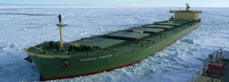
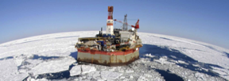
Supporting Development in the Arctic
We can use the Environmental Intelligence framework and U.S. AON capabilities to enhance food security, support tourism, facilitate increased ship traffic, and foster commercial development across the Arctic.
Notes:
Geopolitical, economic, commercial, ecosystem, and human factors.

Slide 26
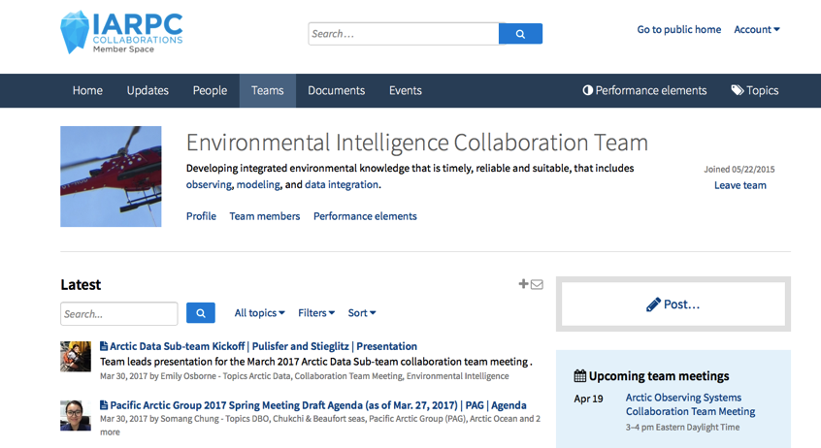
Environmental Intelligence Collaboration Team
http://www.iarpccollaborations.org/index.html

Slide 27
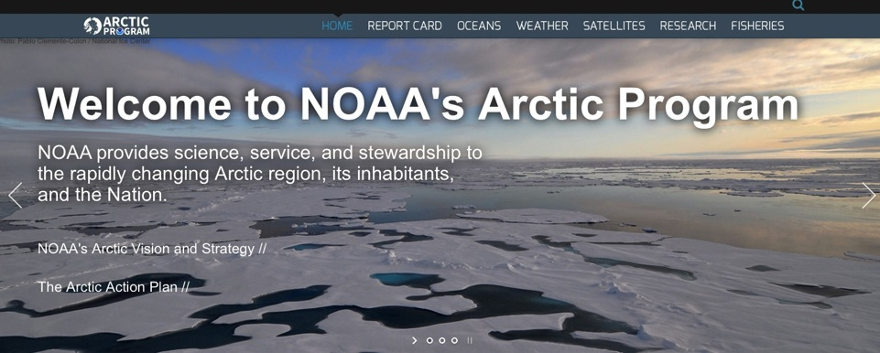
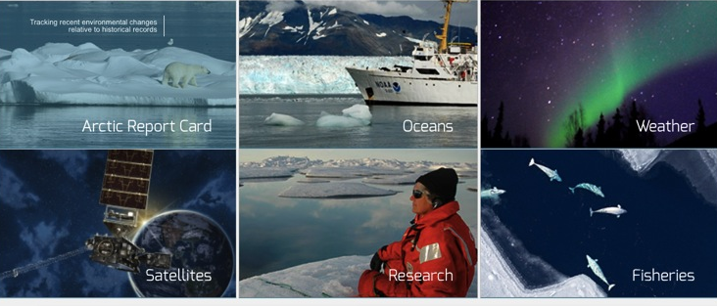
www.arctic.noaa.gov

