Slide 1
PREVENTING UNREGULATED
COMMERCIAL FISHING IN
THE CENTRAL ARCTIC OCEAN (CAO):
AN OVERVIEW
Dr. Peter Harrison
Professor Emeritus
School of Policy Studies, Queen’s University
Former Deputy Minister of Natural Resources Canada
and the Department of Fisheries and Oceans (DFO)
7th IDA Symposium, Washington DC
July 20th, 2017

Slide 2
THE DRIVER: CLIMATE CHANGE DIMINISHED SUMMER SEA ICE

Slide 3
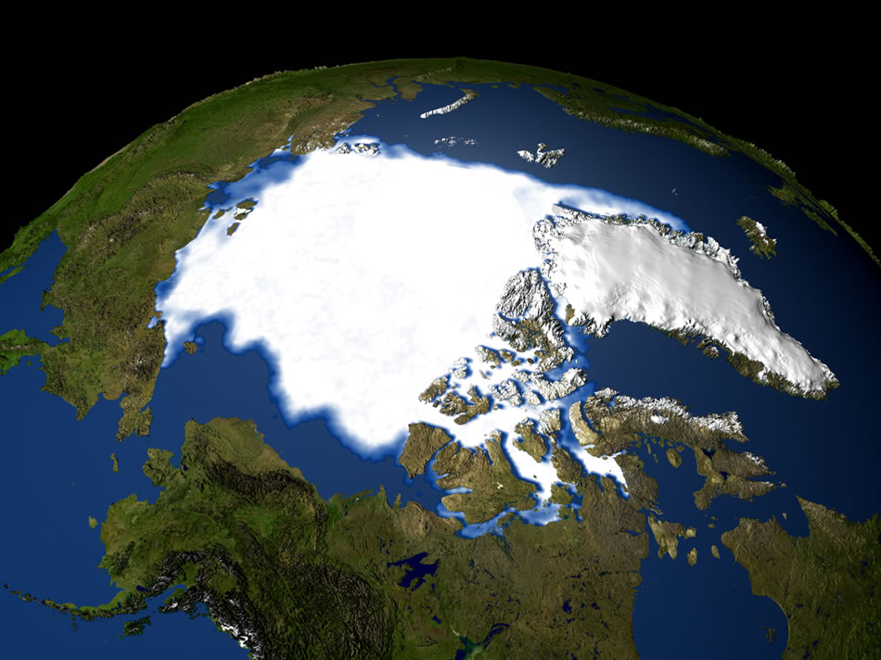
Summer Sea Ice Extent
1979
Source: Arctic Council ACIA

Slide 4
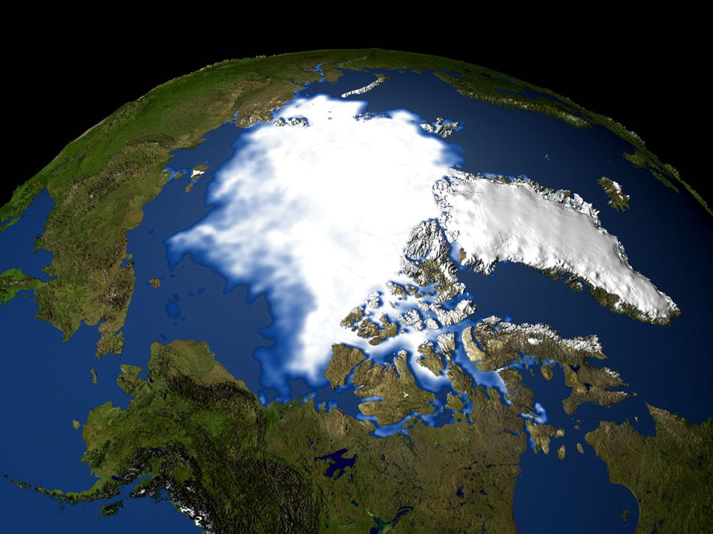
Summer Sea Ice Extent 2003
Source: Arctic Council ACIA

Slide 5
Summer Sea Ice Extent
CANADA

Slide 7
THE ISSUE

Slide 8
MARITIME ANOMALIES: HIGH SEAS “ENCLAVES” (HOLES) IN NORTHERN MARINE AREAS THAT ARE SURROUNDED BY EEZ’s (based on: zilanov)

Slide 9
Banana Hole
Central Arctic Ocean (CAO) High Seas
Loop Hole
Donut Hole
Polygon

Slide 10
POLLOCK
CATCH
1987: 1.7 million tons
1992; 10,000 tons
Agreement: 1993
Stock has
not come back

Slide 11
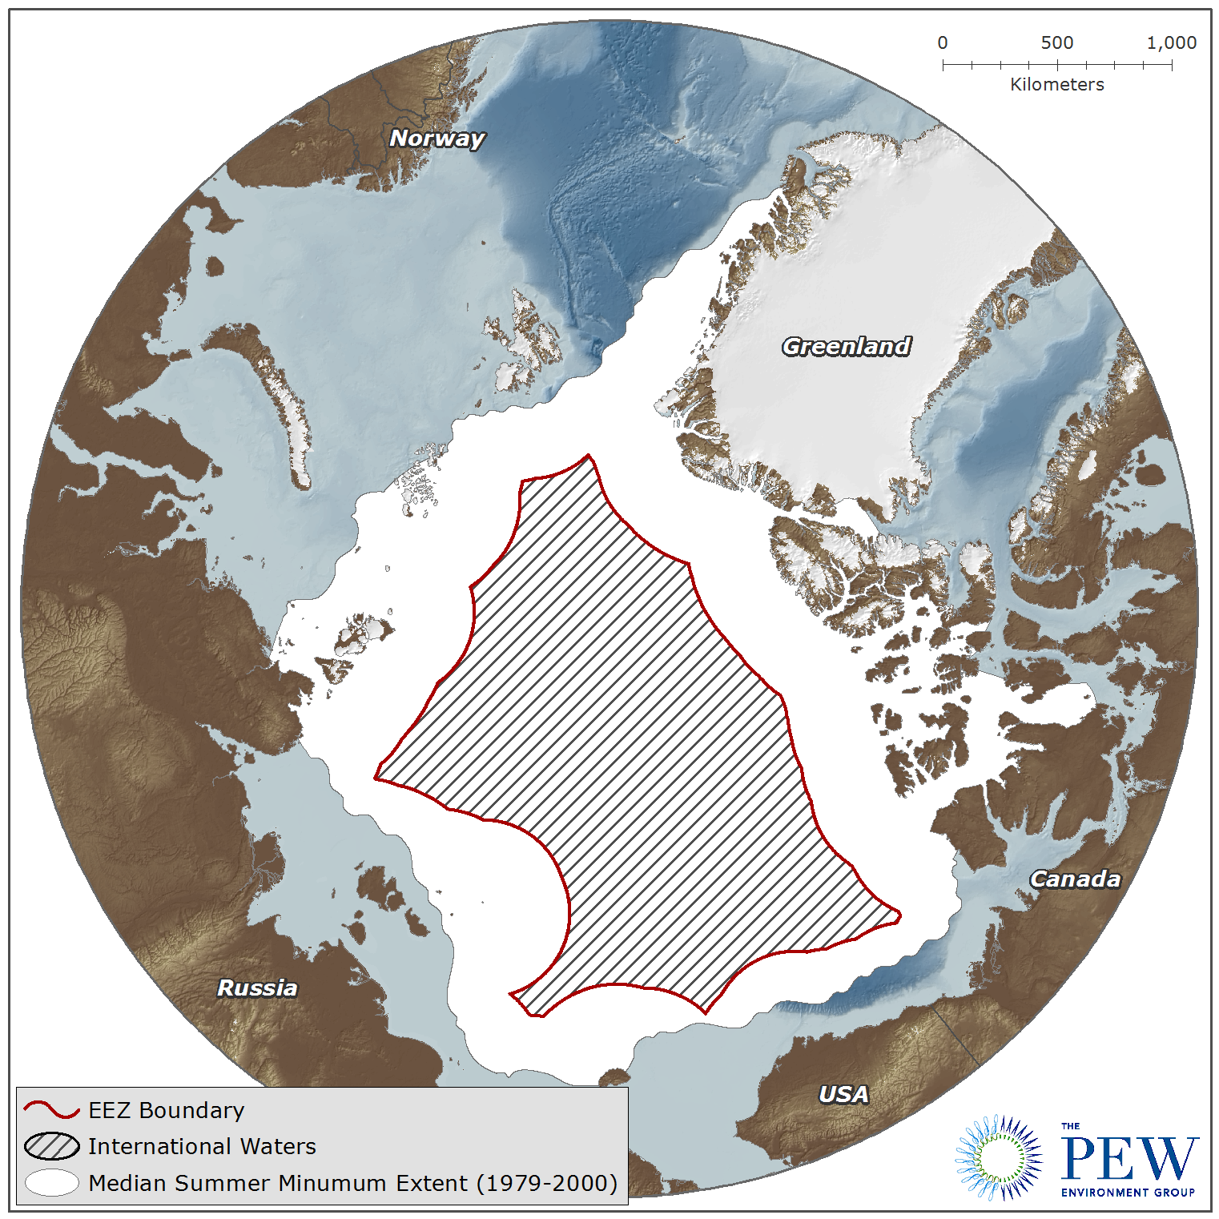
“Normal”
summer ice
conditions
200 NM Limit
The “High Seas”
Notes:
So international lines for things like fishing were really meaningless
This shows 200 mile limit beyond which is high seas – refer to it as CENTRAL ARCTIC OCEAN

Slide 12
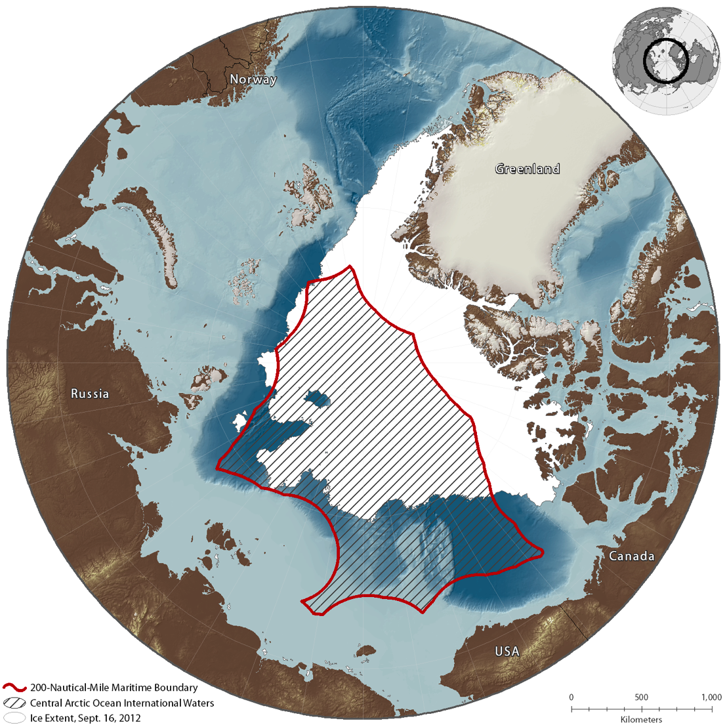
2012 summer ice
conditions
Notes:
So how does the accelerated melting of entire Arctic ice pack play out in the CAO?
Let’s take 2012 – one of the years of greatest melting
Note that the most dramatic melting is above the Bering Strait in the Chukchi Plateau near US, Russia, Canada
Ice persists above Svalbard and Greenland
Almost a third of the Canadian maritime boundary is ice free
More than ¾ of the Russian maritime boundary is ice free
All of US
Essentially we are seeing the birth of a new ocean

Slide 13
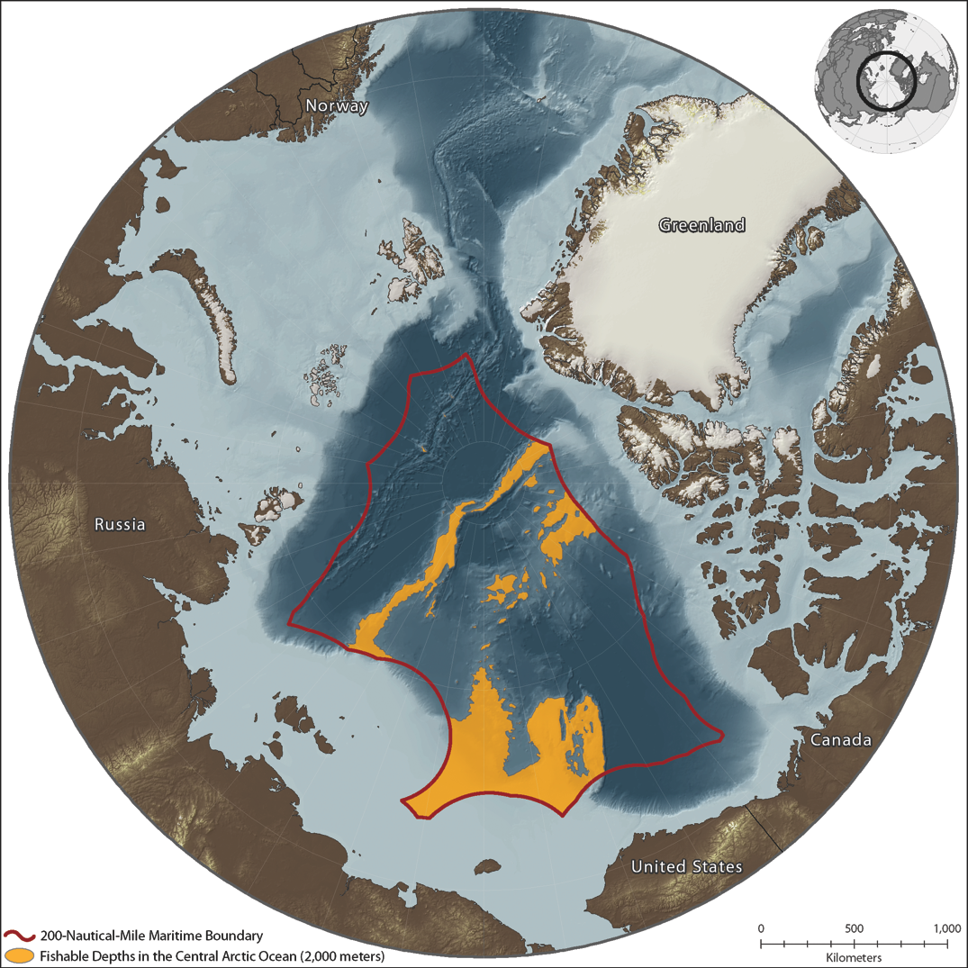

Slide 14
PUTTING
THIS ALL
TOGETHER
Notes:
What do we know about this area that is emerging?
For the open water portion of the CAO in 2012:
(1) We know much of it (roughly 37%, shown in ORANGE) is “fishable depths” (<2000 m)
Made up of continental shelf (Chukchi plateau) or ridges (Northwind, Mendeleev and Lomonosov Ridges) – Baltic Sea
- In 2007, roughly 40% of open water portion of the CAO fell into the fishable category
(2) We know there are straddling stocks of Arctic cod that marine mammals rely on
Right on the edge of areas that Arctic indigenous people in Alaska and Canada depend on for subsistence

Slide 15
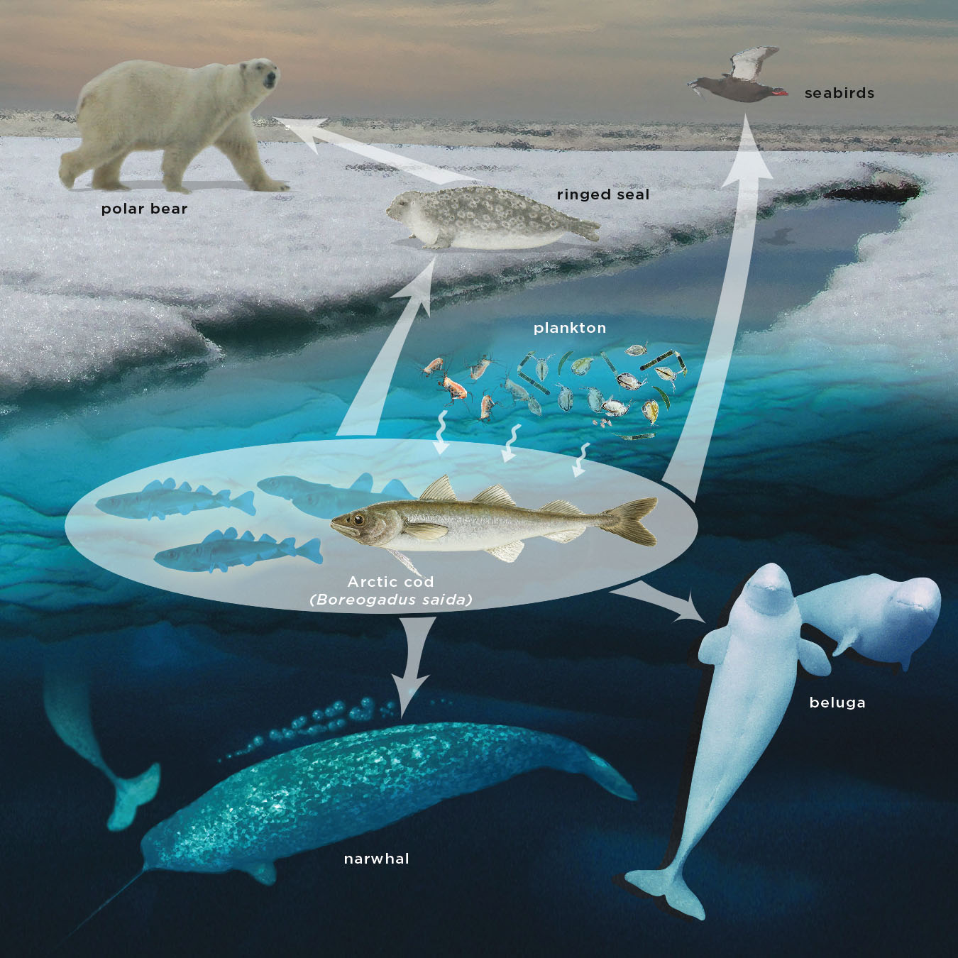
N
O
R
T
H
E
R
N
C
O
M
M
U
N
I
T
I
E
S

Slide 16
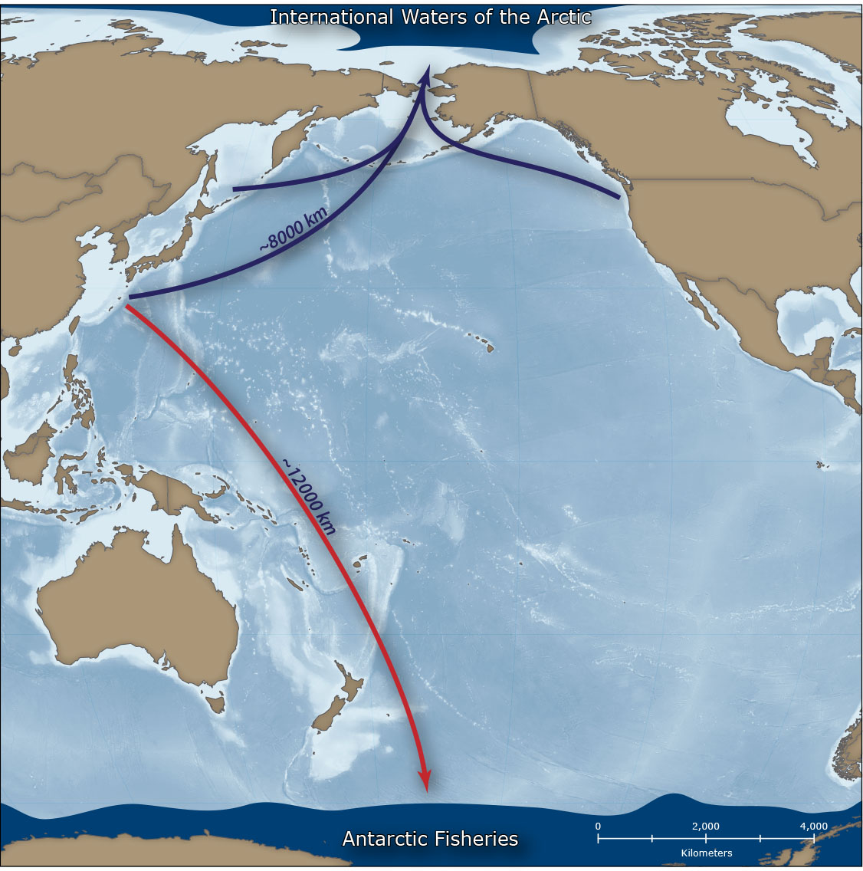
The Western Arctic
Ocean is one-third
closer to
Asia than the
Southern Ocean
Notes:
(3) And we know it is geographically ACCESSIBLE
To distant water fleets
Who regularly travel much greater distances for fishing krill in Antarctica, for example
The most likely scenario would be a reduction fishery for Arctic cod

Slide 17
PRESSURE FROM THE SCIENCE COMMUNITY

Slide 18
2010 CONCERNS RAISED ABOUT THE CAO AT THE INTERNATIONAL POLAR YEAR (IPY) “SCIENCE CONFERENCE” IN OSLO 2011 2,000 SCIENTISTS SIGNED AN “OPEN LETTER” ARGUING FOR GOVERNMENT ACTION AND BETTER CAO SCIENCE / KNOWLEDGE 2012 “OPEN LETTER” PROFILED AT THE IPY “FROM KNOWLEDGE TO ACTION” CONFERENCE IN MONTREAL

Slide 19
NORTH AMERICAN ACTIONS

Slide 20
2008 U.S. SENATE APPROVES PUBLIC LAW 243 CALLING FOR PREVENTION OF UNREGULATED COMMERCIAL FISHING IN THE CAO 2010 U.S. “PUTS A HOLD” ON COMMERCIAL FISHING IN THE “ARCTIC MANAGEMENT AREA” (EEZ) 2014 CANADA ANNOUNCES THE “BEAUFORT SEA MANAGEMENT FRAMEWORK”
Notes:
O A SENATE RESOLUTION

Slide 21
ACTIONS BY THE FIVE ARCTIC COASTAL STATES (CANADA; DENMARK/GREENLAND; NORWAY; RUSSIA; USA)

Slide 22
FEBRUARY 26, 2014 CONSENSUS ON THE NEED FOR ACTION “NUUK STATEMENT” JULY 16, 2015 THE “OSLO DECLARATION” SIGNED A COMMITMENT NOT TO ALLOW DOMESTIC FLEETS TO FISH IN THE CAO UNTIL THERE IS SUFFICIENT SCIENCE AND A MANAGEMENT REGIME IS IN PLACE

Slide 23
POLITICAL WILL

Slide 24
“ MARCH 10, 2016 PRESIDENT OBAMA AND PRIME MINISTER TRUDEAU CALL FOR A LEGALLY BINDING AGREEMENT IN THE CAO SEPTEMBER 3, 2016 PRESIDENT OBAMA AND PRESIDENT XI COMMIT TO “….WORK WITH OTHER RELEVANT GOVERNMENTS TOWARD REACHING AN INSTRUMENT TO PREVENT UNREGULATED COMMERCIAL FISHING IN THE HIGH SEAS OF THE CENTRAL ARCTIC OCEAN BY THE END OF 2016”

Slide 25
MULTI-LATERAL NEGOTIATIONS

Slide 26
THE “ARTIC FIVE” ARE NEGOTIATING AN AGREEMENT WITH THE E.U., ICELAND, CHINA, KOREA AND JAPAN WASHINGTON D.C.: 1-3 DECEMBER 2015 WASHINGTON D.C.: 19-21 APRIL 2016 IQALUIT (NUNAVUT): 6-8 JULY, 2016 TóRSHAVN (FAROE ISLANDS) 29 NOVEMBER – 01 DECEMBER, 2016 REYKJAVIK, ICELAND 15-18 MARCH, 2017 NEXT MEETING??

Slide 27
SCIENTISTS FROM THE TEN JURISDICTIONS HAVE BEEN MEETING TO DEFINE THE “SCIENCE QUESTIONS” AND MONITORING NEEDS FOURTH MEETING HELD IN TROMSø IN SEPTEMBER, 2016 NEXT MEETING: OTTAWA, OCTOBER 24-26, 2017

Slide 28
PARALLEL DIALOGUES (ASIA) WITH THE SUPPORT OF THE INTERNATIONAL ARCTIC PROGRAM OF THE PEW CHARITABLE TRUSTS

Slide 29
TONGJI UNIVERSITY (SHANGHAI) ROUNDTABLE OF NON-GOVERNMENT EXPERTS January, 2015 KOREAN POLAR RESEARCH INSTITUTE (KOPRI) (INCHEON) ROUNDTABLE OF NON-GOVERNMENT EXPERTS March, 2016 “WORKING SESSION” AT THE ARCTIC RESEARCH CENTRE HOKKAIDO UNIVERSITY (SAPPORO) December, 2016

Slide 30
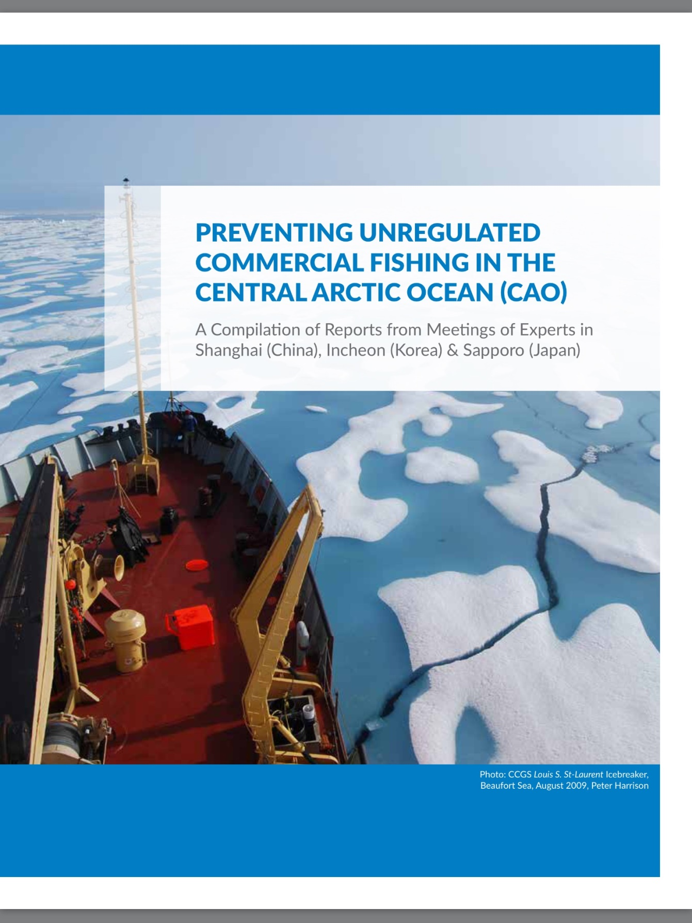

Slide 31
KEY OUTCOME OF THE THREE EVENTS: PRINCIPLES FOR THE CREATION OF A “STAND-ALONE” SCIENCE COORDINATING ORGANIZATION FOR THE CAO INCLUDING: INDIGENOUS INVOLVEMENT FROM DAY 1 EQUAL INVOLVEMENT OF ALL SIGNATORIES IN ANY INSTITUTIONAL ARRANGEMENT FOCUS ON THE ECOSYSTEM, NOT JUST FISH

Slide 32
MANDATE OF AN ORGANIZATION: CREATE A PLATFORM FOR EQUAL PARTICIPATION OF ALL SIGNATORIES; FOCUS ON THE CAO AND APPLY AN ECOSYSTEMS APPROACH DETERMINE PRIORITIES FOR RESEACH AND MONITORING IN THE CAO FACILITATE PLANNING AND IMPLEMENTATION AND INTEGRATION WITH EXISTING RESEARCH EFFORTS SHARE, ANALYZE, AND INTERPRET AVAILABLE DATA ON THE STATE OF CAO FISHSTOCKS AND THE SUPPORTING ECOSYSTEM

Slide 33
CONCLUSION: IT IS POSSIBLE THAT AN AGREEMENT ABOUT THE CAO WILL BE IN PLACE SOON…… THIS WOULD BE A MAJOR GLOBAL ACHIEVEMENT FOR ONCE, THE “PRECAUTIONARY PRINCIPLE” WOULD BE APPLIED BEFORE PROBLEMS OCCUR…….

Slide 34
THANK YOU!

